Slide 1
Reporting and Interpreting
Shareholders’ Equity
Chapter 10
Notes:
Chapter 11: Reporting and Interpreting Shareholders’ Equity.
1

Slide 2
Learning Objectives
LO10-1 Explain the role of share capital in the capital structure of a corporation.
LO10-2 Compute and analyze the earnings per share ratio.
LO10-3 Describe the characteristics of common shares, and analyze transactions affecting common shares.
LO10-4 Discuss dividends, and analyze related transactions.
LO10-5 Compute and analyze the dividend yield ratio.
LO10-6 Discuss the purpose of stock dividends and stock splits, and report transactions.

Slide 3
Learning Objectives Continued
LO10-7 Describe the characteristics of preferred shares, and analyze transactions affecting preferred shares.
LO10-8 Describe the changes in shareholders’ equity.
LO10-9 Discuss the impact of share capital transactions on cash flows.
SUPPLEMENTARY MATERIAL
LO10-S1 Report owners’ equity for sole proprietorships and partnerships.

Slide 4
Understanding The Business Part 1
A critical advantage that corporations have over sole proprietorships and partnerships is that they can raise large amounts of capital because both large and small investors can easily participate, not in management but in their ownership.
This ease is related to three important factors:
  Shares can be purchased in small amounts.
  Ownership interest can easily be transferred through the sale of shares on established markets, such as the Toronto Stock Exchange (TSX).
  Stock ownership provides investors with limited liability.

Slide 5
Understanding The Business Part 2
Many Canadians own shares, either directly or indirectly through a mutual fund or pension program.
Owning shares offers the opportunity to earn higher returns than those possible on deposits to bank accounts or investments in corporate bonds.
Share ownership also involves a higher risk of loss of the investment in shares because the company has no obligation either to repay investors the purchase price of the shares or pay dividends on common shares.
The proper balance between risk and the expected return on an investment depends on individual investors’ preferences.

Slide 6
Shareholders’ Equity
For most corporations, shareholders’ equity includes two primary sources of equity capital:
  Contributed capital states the amount invested by shareholders, and two distinct components:
    Amounts initially received from the sale of shares and
    Contributed surplus that reflects contributions made by shareholders in excess of the amounts credited to share capital accounts.
  Retained earnings are generated by the profit-making activities of the company. This is the cumulative amount of net earnings since the corporation’s inception, less the cumulative amount of dividends declared by the corporation since its formation as a corporation.

Slide 7
Ownership of a Corporation
The corporation is the only business form that the law recognizes as a separate entity.
The entity itself may own assets, incur liabilities, expand and contract in size, sue others, be sued, and managers may enter into contracts on behalf of the corporation, independent of the equity owners.
The law establishes the corporation as a distinct entity, existing separately from its equity owners and its managers.

Slide 8
Benefits of Share Ownership
Owners of common shares receive the following benefits:
  A voice in management. They may vote at the shareholders’ meeting (or by proxy) on major issues concerning management of the corporation.
  Dividends. They receive a proportionate share of the distribution of the corporation’s net earnings.
  Residual claim. They may receive a proportionate share of the distribution of remaining assets upon the liquidation of the company.

Slide 9
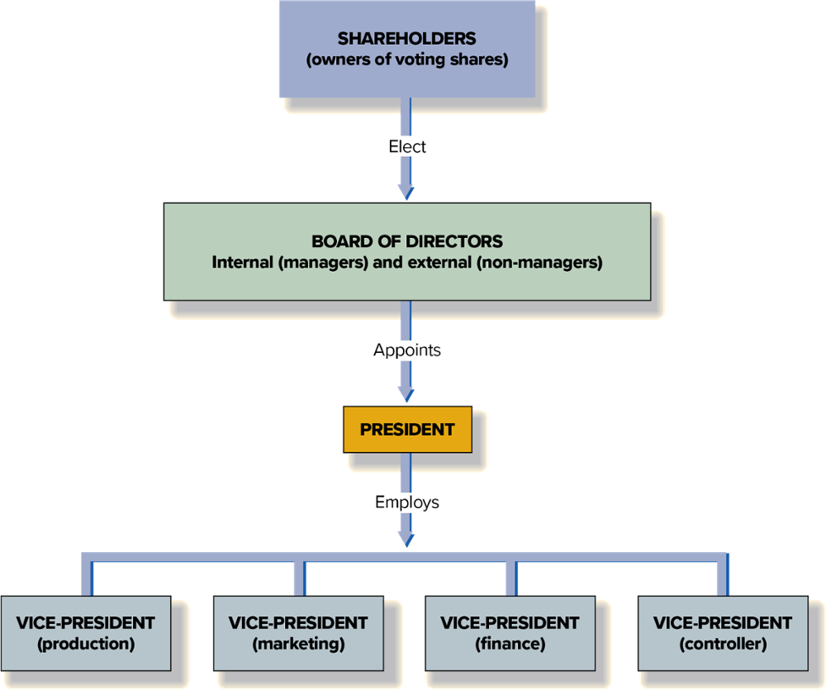
Typical Organizational Structure of a Corporation

Slide 10
Authorized, Issued, and Outstanding Shares
Definitions |  | Illustrations
Authorized shares: The maximum number of shares that can be issued, as specified in the charter of the corporation. |  | The charter specifies “an unlimited number of common shares.”
Issued shares: The total number of shares that the corporation has issued to date. |  | To date, XYZ Corporation has sold and issued 30,000 common shares.
Un-issued shares: The number of authorized shares that have never been issued to date. |  | Authorized shares Issued shares Un-issued shares | 100,000 (30,000) 70,000
Treasury shares: Shares that have been issued to investors and then reacquired by the issuing corporation. |  | To date, XYZ Corporation has repurchased 1,000 previously issued shares.
Outstanding number of shares: The number of shares currently owned by shareholders—that is, the number of shares authorized, minus the total number of un-issued shares, minus the number of treasury shares. |  | Authorized shares Treasury shares Un-issued shares Outstanding shares | 100,000 (1,000) (70,000) 29,000

Slide 11
Key Ratio Analysis – Earnings per Share Ratio
ANALYTICAL QUESTION → How profitable is a company?
RATIO AND COMPARISONS → The earnings per share (EPS) is a measure of the return on investment that is based on the number of shares outstanding instead of the dollar amounts reported on the statement of financial position. In simple situations, it is computed as follows:
Earnings per share is probably the single most widely watched financial ratio.
Net earnings available to common shareholders
Earnings per share
=
Average number of common shares outstanding

Slide 12
Common Share Transactions
Corporations issue two types of shares: common shares and preferred shares.
All corporations issue common shares, while only some issue preferred shares, which grant preferences that the common shares do not have.
Common shares are the basic voting shares issued by a corporation. They are often called the residual equity because they rank after the preferred shares for dividend and asset distribution upon liquidation of the corporation.

Slide 13
No Par Value and Par Value Shares
Par value is the nominal value per share established in the charter of a corporation. It has no relationship to the price at which shares are actually sold to investors.
The Canada Business Corporations Act and most provincial corporation acts prohibit the issuance of par value shares. The few Canadian companies that still have par value shares outstanding issued them before the CBCA was amended in 1985.
The remainder of this chapter focuses on no par value shares, which do not have an amount per share specified in the corporate charter. In contrast, most U.S. corporations issue par value shares.

Slide 14
Initial Sale of Shares
Two names are applied to transactions involving the initial sale of a company’s shares to the public. An initial public offering, or IPO, involves the very first sale of a company’s shares to the public (i.e., when the company first “goes public”).
Most sales of shares to the public are cash transactions.
For example; assume that BCE sold 100,000 common shares for $60 per share, as an initial sale of shares. The company records the following journal entry:
Cash (A) (100,000 × $60) |  |  |  |  |  | 6,000,000
Common shares (SE) |  |  |  |  |  |  | 6,000,000
Assets |  | = | Liabilities |  | + | Shareholders’ Equity
Cash | +6,000,000 |  |  |  |  | Common shares |  | +6,000,000

Slide 15
Sale of Shares in Secondary Markets
Subsequent to the initial sale, investors can sell shares to other investors without directly affecting the corporation.
For example, if investor Eric Mortisson sold 1,000 of BCE’s common shares to Jennifer Hussein, BCE does not record a journal entry on its books.
Eric received cash for the shares he sold, and Jennifer received shares for the cash she paid.
BCE itself did not receive or pay anything because of this transaction.

Slide 16
Shares Issued for Non-cash Assets or Services
Many start-up companies have a shortage of cash. These companies often cannot afford to pay cash for needed assets and services, they sometimes issue shares to people who can supply these assets and services.
Many executives, for instance, will join start-up companies for very low salaries because they also earn compensation in the form of common shares.
When a company issues shares to acquire assets or services, the acquired items are recorded at the fair value of the assets or services received.
If the company cannot reliably estimate the fair value of the assets or services received, then the fair value of the shares would be used.

Slide 17
Shares Issued for Employee Compensation
Stock options allow employees to purchase shares from the corporation at a predetermined, fixed price, which is generally at a fraction of the share price in the secondary market.
Executive and employee stock option plans have become an increasingly common form of non-cash compensation that should provide an incentive for executives and employees to act in the best interests of the corporation.
Canadian companies must estimate and report compensation expense associated with stock options on the statement of earnings.

Slide 18
Repurchase of Shares Part 1
Most Canadian companies cancel their shares when they buy them back from shareholders.
When shares are cancelled, the appropriate share capital account is reduced by an amount that reflects the average issuance price per share.
If the purchase price is less than the average issuance price, the difference is credited to contributed surplus.
For example, if BCE purchases 50,000 common shares in the open market at $50 per share and the average price of the previously issued common shares is $54, the journal entry and the transaction effects will be as follows:

Slide 19
Repurchase of Shares Part 2
Repurchases of shares at prices lower than the average issue price do not result in profit for the issuing company because they are capital transactions, not operating transactions.
Companies profit from buying and selling shares issued by other companies, but not their own shares.
Common shares (SE) (50,000 × $54) |  |  |  |  |  | 2,700,000
Cash (A) |  |  |  |  |  |  | 2,500,000
Contributed surplus (SE) |  |  |  |  |  |  | 200,000
Assets |  | = | Liabilities |  | + | Shareholders’ Equity
Cash | −2,500,000 |  |  |  |  | Common shares | −2,700,000
 |  |  |  |  |  | Contributed surplus | +200,000

Slide 20
Repurchase of Shares Part 3
Assume, that BCE subsequently purchased 40,000 of its own common shares when the price per share was $60.
In this case, the excess of the purchase price over the average issuance price is $6 per share for a total of $240,000. This difference is debited first to contributed surplus to the extent of $200,000 (the account balance), and the remaining amount of $40,000 is debited to retained earnings.
The retained earnings account is reduced, because the excess of the purchase price over the contribution made previously by shareholders reflects the company’s profitable operations, which resulted in net earnings and caused an increase in share price.

Slide 21
Repurchase of Shares Part 4
Therefor, the $40,000 is viewed as a distribution of accumulated net earnings, or retained earnings, to shareholders who sold their shares to the company. The journal entry and the transaction effects follow:
Common shares (SE) (40,000 × $54) | 2,160,000
Contributed surplus (SE) | 200,000
Retained earnings (SE) | 40,000
Cash (A) |  | 2,400,000
Assets |  | = | Liabilities |  | + | Shareholders’ Equity
Cash | −2,400,000 |  |  |  |  | Common shares | −2,160,000
 |  |  |  |  |  | Contributed surplus | −200,000
 |  |  |  |  |  | Retained earnings | −40,000

Slide 22
Dividends on Common Shares Part 1
The declaration and payment of dividends involves three key dates:
The declaration date: is the date on which the board of directors officially approved the dividend. As soon as it makes the declaration, it creates a dividend liability.
The date of record: is the date on which the corporation prepares the list of current shareholders, based on its shareholder records. The dividend is payable only to those names listed on the record date. No journal entry is made on this date.
The payment date: is the date on which the cash is disbursed to pay the dividend liability.

Slide 23
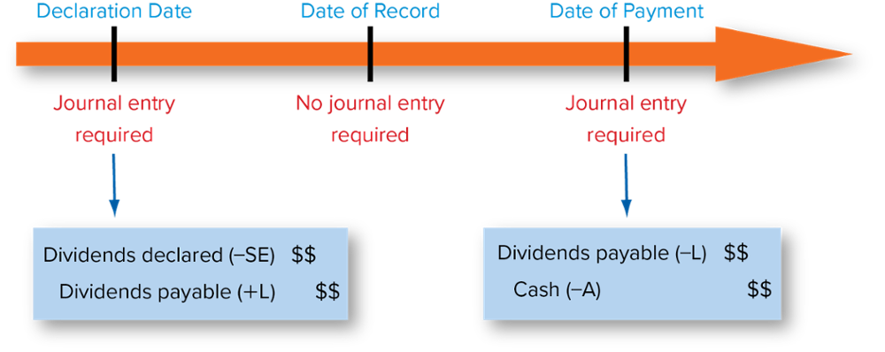
Dividends on Common Shares Part 2

Slide 24
Dividends on Common Shares Part 3
There are two fundamental requirements for the payment of a cash dividend:
Sufficient retained earnings.
Sufficient cash.

Slide 25
Dividends on Common Shares Part 4
In Canada, regardless of how profitable a company is, there is no legal obligation for companies to declare dividends.
While Canadian companies are not legally obligated to declare dividends, once the board of directors declares a dividend (i.e., creates a dividend payable), there is a legal obligation to pay that dividend.

Slide 26
Key Ratio Analysis – Dividend Yield Ratio
ANALYTICAL QUESTION → Investors in common shares expect to earn a return on their investment. A portion of this return comes in the form of dividends. How much do investors earn on their investment based on dividends?
RATIO AND COMPARISONS → The dividend yield ratio is a measure of the percentage return that shareholders earn from the dividends they receive. Potential investors often use this ratio to help select among alternative investment opportunities.
The
Dividend Yield Ratio
Dividends per share
=
Market price per share

Slide 27
Stock Dividends Part 1
A stock dividend is a distribution of additional shares of a corporation’s own share capital to its shareholders on a pro rata basis, at no cost to the shareholder.
The term “pro rata basis” means that each shareholder receives additional shares equal to the percentage of shares already held.
Stock dividends usually consist of additional common shares issued to the holders of common shares.
An investor owning 10 percent of the outstanding shares receives 10 percent of any additional shares issued as a stock dividend.

Slide 28
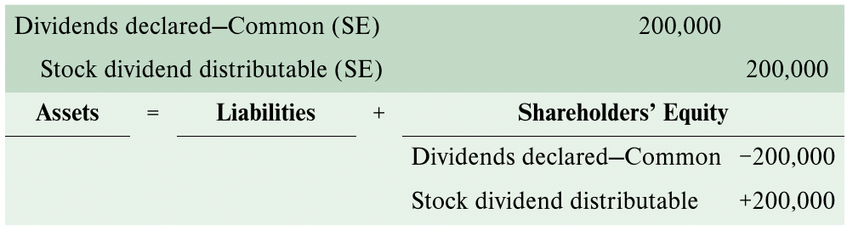
Stock Dividends Part 2
If a company declared on July 25, 2023 a 10 percent stock dividend on common shares to be issued on August 25, 2023 to shareholders of record on August 10, 2023. The company had 100,000 shares outstanding, and the market price per share was $20 on the date of declaration.
The value of the stock dividend is $200,000 (100,000 x 10% x $20) and the declaration of the stock dividend requires the following journal entry on July 25, 2023:

Slide 29
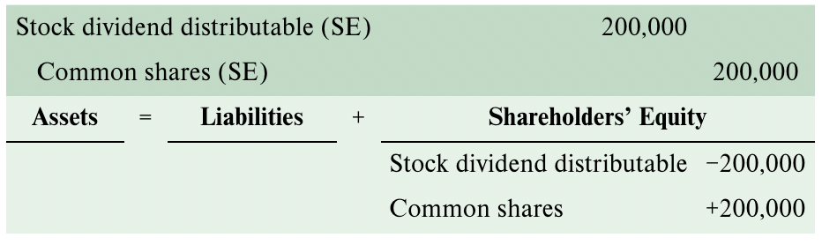
Stock Dividends Part 3
The equity account “Stock dividend to be issued” is credited, instead of the “Common shares” account, until the shares are issued. The issuance and distribution of the additional shares on August 25, 2023, is recorded as follows:

Slide 30
Stock Splits Part 1
Stock splits are not dividends. They are similar to a stock dividend but are quite different in terms of their impact on the shareholders’ equity accounts.
In a stock split, the total number of authorized, issued, and outstanding shares is increased by a specified number, such as a two-for-one split.
In both a stock dividend and a stock split, the shareholder receives more shares but does not pay to acquire the additional shares.
A stock dividend requires a journal entry; a stock split does not require one but is disclosed in the notes to the financial statements.

Slide 31
Stock Splits Part 2
The effects of a 2-for-1 stock split may be summarized as follows:
Shareholders’ Equity | Before the Stock Split | After the Stock Split
Contributed capital
Number of shares outstanding | 30,000 | 60,000
Average issue price per share | $10 | $5
Common shares | 300,000 | 300,000
Retained earnings | 650,000 | 650,000
Total shareholders’ equity | $950,000 | $950,000

Slide 32
Preferred Shares
In addition to common shares, some corporations issue preferred shares.
Preferred shares differ from common shares in a number of ways. The most significant differences are:
  Preferred shares typically do not grant voting rights.
  Preferred shares typically have a fixed dividend rate.
  Preferred shares are less risky than common shares.

Slide 33
Special Features of Preferred Shares
Convertible preferred shares may be exchanged for a different series of preferred shares or for common shares of the corporation.
Redeemable or Callable preferred shares may be repurchased by the corporation at a predetermined price.
Retractable preferred shares may be redeemed at the option of the shareholder for the redemption price.

Slide 34
Dividends on Preferred Shares
Generally, preferred shareholders do not have the right to vote, nor do they share in increased earnings if the company becomes more profitable.
To compensate these investors, preferred shares offer a dividend preference. The two most common dividend preferences are:
  Current Dividend Preference: The current preferred dividends must be paid before paying any dividends to common shares.
  Cumulative Dividend Preference: Any unpaid dividends from previous years (dividends in arrears) must be paid before common dividends are paid.
If the preferred shares are non-cumulative, any dividends not declared in previous years are lost permanently.

Slide 35
Dividends on Preferred Shares: Current Dividend Preference Only
Preferred shares outstanding, $1.20; 2,000 shares.
Common shares outstanding; 5,000 shares.
Allocation of dividends between preferred and common shares assuming current dividend preference only:
Assumptions | Total Dividends Paid | $1.20 Preferred Shares (2,000 shares) | Common Shares (5,000 shares)
No. 1 | $ 2,400 | $2,400 | 0
No. 2 | 3,000 | 2,400 | $ 600
No. 3 | 18,000 | 2,400 | 15,600

Slide 36
Dividends on Preferred Shares: Cumulative Dividend Preference
Preferred shares outstanding, $1.20; 2,000 shares.
Common shares outstanding; 5,000 shares.
Dividends are in arrears for the two preceding years.
Allocation of dividends between preferred and common shares, assuming cumulative preference:
Assumptions (dividends in arrears, 2 years) | Total Dividends Paid | $1.20 Preferred Shares (2,000 shares) | Common Shares (5,000 shares)
No. 1 | $ 2,400 | $ 2,400 | 0
No. 2 | 7,200 | 7,200 | 0
No. 3 | 8,000 | 7,200 | $ 800
No. 4 | 30,000 | 7,200 | 22,800

Slide 37
Measuring and Reporting Changes in Shareholders’ Equity
Two additional components of shareholders’ equity are:
Retained Earnings
Accumulated Other Comprehensive Income (Loss) (AOCI)

Slide 38
Retained Earnings
Retained earnings represent net earnings that has been earned less dividends that have been declared since the first day of the company’s operations.
Under rare circumstances, an adjustment to the beginning balance of retained earnings may result from either (1) a correction of a material accounting error that occurred in a prior period, or (2) a change in accounting policy.

Slide 39
Accumulated Other Comprehensive Income (Loss) Part 1
IFRS require Canadian publicly accountable enterprises to report accumulated other comprehensive income (loss).
This equity item reflects the financial effect of events that cause changes in shareholders’ equity, other than investments by shareholders or distributions to shareholders.
Such changes in equity result from unrealized gains or losses related to the valuation of specific assets and liabilities at fair value.

Slide 40
Accumulated Other Comprehensive Income (Loss) Part 2
The unrealized gains and losses resulting from these changes are not reported on the statement of earnings because they have not been realized yet.
Measurement of the unrealized gains and losses related to these and similar items is fairly complex and is covered in intermediate and advanced accounting courses.

Slide 41
Accounting and Reporting for Unincorporated Businesses Part 1
There are three forms of business organizations: corporations, sole proprietorships, and partnerships.
A corporation is a legal entity, separate and distinct from its owners. It can enter into contracts in its own name, it can be sued, and it is taxed as a separate entity.
A sole proprietorship is an unincorporated business owned by one individual. It is not necessary to file any legal papers to create a proprietorship.
A partnership is an unincorporated business owned by two or more people. Again, it is not necessary to file legal papers to create a partnership, but it is certainly a good idea to have a lawyer draw up a contract among all the partners.

Slide 42
Accounting and Reporting for Unincorporated Businesses Part 2
Neither partnerships nor proprietorships are separate legal entities. As a result, owners may be directly sued and are individually taxed on the earnings of the business.
The fundamentals of accounting and reporting for unincorporated businesses are the same as for a corporation, except for shareholders’ equity.
Typical account structures for the three forms of business organizations are outlined in the following slide.

Slide 43
Comparative Account Structure among Types of Business Entities
Typical Account Structure
Corporation (Shareholders’ Equity) |  | Sole Proprietorship (Owner’s Equity) |  | Partnership (Partners’ Equity)
Share capital, contributed surplus |  | Doe, capital |  | Able, capital; Baker, capital
Retained earnings |  | Not used |  | Not used
Dividends paid |  | Doe, drawings |  | Able, drawings; Baker, drawings
Revenues, expenses, gains, and losses |  | Same |  | Same
Assets and liabilities |  | Same |  | Same

Slide 44
Appendix 10A: Accounting for Owners’ Equity for Sole Proprietorships and Partnerships Part 1
Proprietorships and partnerships are private enterprises that do not issue shares for sale to the public.
They normally report their financial information in accordance with the accounting standards for private enterprises.
These standards are less complicated than the IFRS that publicly accountable enterprises must use.
The use of accounting standards for private enterprises does not mean, however, that the standards are less rigorous than those used by publicly accountable enterprises.

Slide 45
Appendix 10A: Accounting for Owners’ Equity for Sole Proprietorships and Partnerships Part 2
This simplified set of standards makes the preparation and audit of financial statements affordable for smaller business entities.
All of the principles, such as economic substance over form and the excess of benefit over cost, guided the production of these standards.

Slide 46
Appendix 10A: Owners’ Equity for Sole Proprietorships Part 1
A sole proprietorship is an unincorporated business owned by one person.
Only two owner’s equity accounts are needed: a capital account for the proprietor (J. Doe, capital) and a drawings (or withdrawal) account for the proprietor (J. Doe, drawings).
The capital account of a sole proprietorship serves two purposes: to record investments by the owner and to accumulate periodic net earnings or loss.

Slide 47
Appendix 10A: Owners’ Equity for Sole Proprietorships Part 2
The drawings account is used to record the owner’s withdrawals of cash or other assets from the business.
The drawings account is closed to the capital account at the end of each accounting period.
The capital account reflects the cumulative total of all investments by the owner, plus all earnings of the entity, less all withdrawals of resources from the entity by the owner.

Slide 48
Appendix 10A: Owners’ Equity for a Partnerships Part 1
A partnership is formed by two or more persons reaching mutual agreement about the terms of the partnership.
The law does not require an application for a charter as it does in the case of a corporation. Instead, the agreement between the partners constitutes a legally enforceable partnership contract.
The agreement should specify matters such as division of net earnings, management responsibilities, transfer or sale of partnership interests, disposition of assets upon liquidation, and procedures to be followed in case of the death of a partner.

Slide 49
Appendix 10A: Owners’ Equity for a Partnerships Part 2
The primary advantages of a partnership are:
  Ease of formation,
  Complete control by the partners, and
  Lack of income taxes on the business itself.
The primary disadvantage is the unlimited liability of each partner for the partnership’s liabilities.
If the partnership does not have sufficient assets to satisfy outstanding debt, its creditors can seize the partners’ personal assets.

Slide 50
Appendix 10A: Owners’ Equity for a Partnerships Part 3
Accounting for partners’ equity follows the same pattern as illustrated earlier for a sole proprietorship, except that separate partner capital and drawings accounts must be established for each partner.
Investments by each partner are credited to the partner’s capital account, and withdrawals from the partnership by each partner are debited to the respective drawings accounts.
The net earnings for a partnership are divided between the partners in the profit ratio specified in the partnership agreement, and credited to each partner’s account.

Slide 51
Appendix 10A: Owners’ Equity for a Partnerships Part 4
The respective drawings accounts are closed to the partner capital accounts.
After the closing process, each partner’s capital account reflects the cumulative total of all investments of that individual partner, plus the partner’s share of all partnership earnings, less all the partner’s withdrawals.

Slide 52
Appendix 10A: Owners’ Equity for a Partnerships Part 5
The financial statements of a partnership follow the same format as those for a corporation, except that:
  The statement of earnings includes an additional section titled distribution of net earnings,
  The partners’ equity section of the statement of financial position is detailed for each partner,
  A partnership has no income tax expense because partnerships do not pay income tax (each partner must report their share of the partnership net earnings on their individual tax return), and
  Salaries paid to partners are not recorded as expense but treated as a distribution of net earnings (withdrawals).

Slide 53
End of Chapter Summary Part 1
A common share is the basic voting share issued by a corporation. Usually, it has no par value, but par value shares can also be issued.
Preferred shares are issued by some corporations. These shares contain some special rights and may appeal to certain investors.
A number of key transactions involve share capital: (1) initial sale of shares, (2) cash dividends, (3) stock dividends and stock splits, and (4) repurchase of shares.
The return associated with an investment in shares comes from two sources: appreciation of share price and dividends.

Slide 54
End of Chapter Summary Part 2
Stock dividends are distributions of a company’s shares to existing shareholders on a pro rata basis. The transaction involves transferring an additional amount into the common shares account from the retained earnings account.
A stock split also involves the distribution of additional shares to shareholders, but no additional amount is transferred into the common shares account from the retained earnings account.
Preferred shares provide investors certain advantages, including dividend preferences and a preference on asset distributions in the event the corporation is liquidated.

Slide 55
End of Chapter Summary Part 3
The shareholders’ equity section of the statement of financial position is affected by many changes that occur over time. These changes are reported in a separate statement of changes in equity that discloses a summary of the effects of transactions and events that affected the various components of equity, including share capital, contributed surplus, retained earnings, and accumulated other comprehensive income (loss).
Both inflows (e.g., issuance of share capital) and outflows (e.g., repurchase of shares) are reported in the financing activities section of the statement of cash flows. The payment of dividends is reported as an outflow in this section.

