Slide 1
Statement of Cash Flows
Chapter 11
Notes:
Chapter 5: Reporting and Interpreting Cash Flows

Slide 2
Learning Objectives
LO11-1 Classify cash flow items into cash flows from operating, investing, and financing activities.
LO11-2 Report and interpret cash flows from operating activities, using the indirect method.
LO11-3 Analyze and interpret the quality of earnings ratio.
LO11-4 Report and interpret cash flows from investing activities.
LO11-5 Analyze and interpret the capital expenditures ratio.
LO11-6 Report and interpret cash flows from financing activities.

Slide 3
Learning Objectives Continued
LO11-7 Explain the format of the statement of cash flows and additional cash flow disclosures.
SUPPLEMENTARY MATERIAL
LO11-S1 Report cash flows related to disposal of long-lived assets, using the indirect method.
LO11-S2 Report and interpret cash flows from operating activities, using the direct method.
LO11-S3 Use the T-account approach to prepare the statement of cash flows under the indirect method.
LO11-S4 Report the statement of cash flows using the spreadsheet approach. (Online)

Slide 4
Classifications of Cash Flows Part 1
The statement of cash flows explains how the cash balance at the beginning of the period changed to another cash balance at the end of the period.
The definition of cash for the purpose of the cash flow statement includes cash and cash equivalents.
Cash equivalents are short-term, highly liquid investments that are both:
  Readily convertible to known amounts of cash, and
  Three months or less to their maturity and subject to an insignificant risk of changes in value.

Slide 5
Classifications of Cash Flows Part 2
The statement of cash flows reports cash inflows and outflows based on three broad categories: (1) operating activities, (2) investing activities, and (3) financing activities.
Together, these three cash flow categories explain the change in cash from the beginning balance to the ending balance on the statement of financial position.

Slide 6
Cash flows from Operating Activities
Cash flows from operating activities are the cash inflows and cash outflows that directly relate to revenues and expenses reported on the statement of earnings.
There are two alternative approaches for presenting the operating activities section of the statement: the direct method and the indirect method.
It is important to remember that the direct and indirect methods are simply alternative ways to calculate the same amount. The net cash provided by (used in) operating activities is always the same, whether it is calculated by using the direct or the indirect method.

Slide 7
The Direct Method
The direct method reports the components of cash flows from operating activities listed as gross receipts and gross payments:
The difference between the inflows and outflows is called the net cash provided by (used in) operating activities.
Inflows | Outflows
Cash received from | Cash paid for
Customers | Purchase of services (electricity, etc.) and goods for resale
Dividends and interest on investments | Salaries and wages Income taxes Interest on borrowings

Slide 8
The Indirect Method
The indirect method starts with net earnings for the period and then eliminates non-cash items to arrive at net cash inflow (outflow) from operating activities:
Net earnings
+/− Adjustments for non-cash items
Net cash provided by (used in) operating activities

Slide 9
Cash Flows from Investing Activities
Cash flows from investing activities are cash inflows and outflows related to the purchase and sale of long-lived productive assets and investments in the securities of other companies. Typical cash flows from investing activities include the following:
The difference between these cash inflows and outflows is called net cash provided by (used in) investing activities.
Inflows | Outflows
Cash received from | Cash paid for
Sale or disposal of property, plant, and equipment | Purchase of property, plant, and equipment
Sale or maturity of investments in securities | Purchase of investments in securities

Slide 10
Cash Flows from Financing Activities
Cash flows from financing activities are cash inflows and outflows related to external sources (owners and creditors) to finance the enterprise and its operations. Usual cash flows from financing activities include:
The difference between these cash inflows and outflows is called net cash provided by (used in) financing activities.
Inflows | Outflows
Cash received from | Cash paid for
Borrowing on notes, mortgages, bonds, etc. from creditors | Repayment of principal to creditors
Issuing shares to shareholders | Interest on borrowings if it is classified as a financing activity
 | Repurchasing shares from shareholders
 | Dividends to shareholders

Slide 11
Net Increase (Decrease) in Cash
The combination of the net cash flows provided by (used in) operating, investing, and financing activities must equal the net increase (decrease) in cash for the reporting period.

Slide 12
Relationships to the Statement of Financial Position and the Statement of Earnings Part 1
To prepare the statement of cash flows, the following data is needed:
Comparative statements of financial position, which are used to compute the cash flows from all activities (operating, investing, and financing).
A complete statement of earnings, which is used primarily to identify cash flows from operating activities.
Additional details concerning selected accounts because often the net change in an account balance during the year does not reveal the underlying nature of the cash flows.

Slide 13
Relationships to the Statement of Financial Position and the Statement of Earnings Part 2
The approach to preparing and understanding the statement of cash flows focuses on the changes in the accounts that are reported on the statement of financial position.
It relies on a simple algebraic manipulation of the accounting equation as follows:
Assets = Liabilities + Shareholders’ equity
Cash + Non-cash assets = Liabilities + Shareholders’ equity
Cash = Liabilities + Shareholders’ equity – Non-cash assets
Therefore...

Slide 14
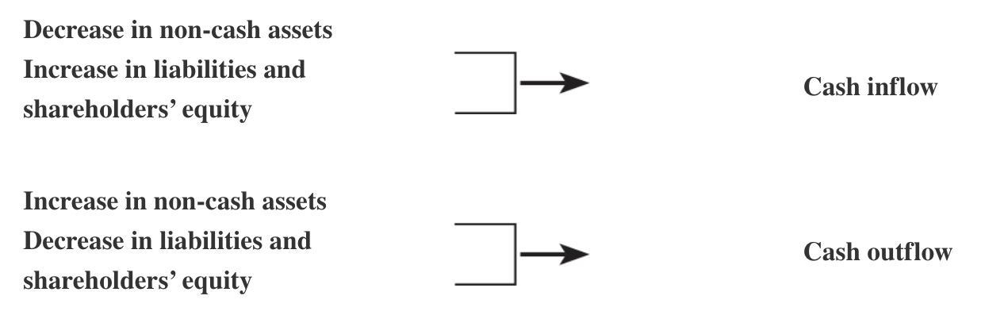
Relationships to the Statement of Financial Position and the Statement of Earnings Part 3
In general, increases in cash are associated with decreases in non-cash asset accounts or increases in liability and shareholders’ equity accounts.
In contrast, cash decreases when non-cash assets increase, and when liabilities or shareholders’ equity decrease:

Slide 15
Cash Transactions and Their Effects on Other Statement of Financial Position Accounts
Category | Transaction | Effect on Cash | Other Account Affected
Operating | Collect accounts receivable | +Cash | −Accounts receivable (A)
 | Pay accounts payable | −Cash | −Accounts payable (L)
 | Pay rent in advance | −Cash | +Prepaid rent (A)
 | Pay interest | −Cash | −Retained earnings (SE)
 | Sell goods and services for cash | +Cash | +Retained earnings (SE)
Investing | Purchase equipment for cash | −Cash | +Equipment (A)
 | Sell investment securities for cash | +Cash | −Investments
Financing | Pay back debt to bank | −Cash | −Notes payable—Bank (L)
 | Issue shares for cash | +Cash | +Share capital (SE)

Slide 16
Preliminary Steps in Preparing the Statement of Cash Flows
We use the following preliminary steps to prepare the statement of cash flows:
  Determine the change in each account on the statement of financial position by subtracting this year’s ending balance from this year’s beginning balance (which is last year’s ending balance).
  Classify each change as relating to operating (O), investing (I), or financing (F) activities.

Slide 17
Reporting Cash Flows from Operating Activities – Indirect Method Part 1
The indirect method of reporting cash flows from operating activities starts with net earnings and adjusts for the non-cash components of revenues and expenses.
Operating Activities
Net earnings
Add/subtract items not affecting cash:
+ Depreciation and amortization expense
− Gain on sale of investing activities
+ Loss on sale of investing activities
+ Decreases in operating assets
− Increases in operating assets
+ Increases in operating liabilities
− Decreases in operating liabilities
Net Cash Flows from Operating Activities

Slide 18
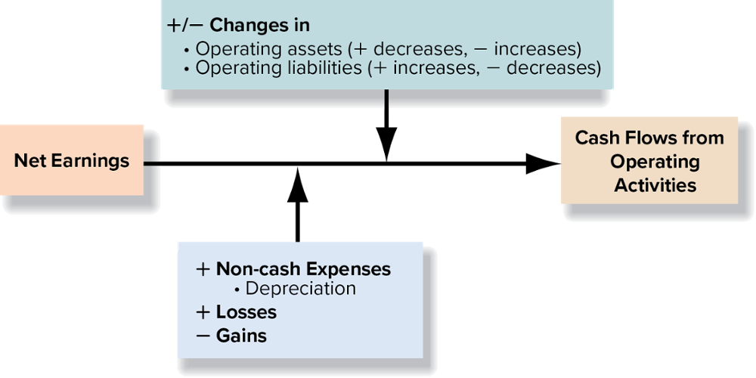
Reporting Cash Flows from Operating Activities – Indirect Method Part 2

Slide 19
Reporting Cash Flows from Operating Activities – Indirect Method Part 3
Completing the operating section by using the indirect method involves two steps:
Step 1: Adjust net earnings for the effect of depreciation and amortization expenses and gains and losses on sale of investing assets such as property, plant, and equipment, and investments.
Step 2: Adjust net earnings for changes in assets and liabilities marked as operating (O).

Slide 20
Reporting Cash Flows from Operating Activities – Indirect Method Part 4
When converting net earnings to cash flows from operating activities, apply the following general rules:
  Add the change when an operating asset decreases or an operating liability increases.
  Subtract the change when an operating asset increases or an operating liability decreases.
Understanding what makes these assets and liabilities increase and decrease is the key to understanding the logic of these additions and subtractions.

Slide 21
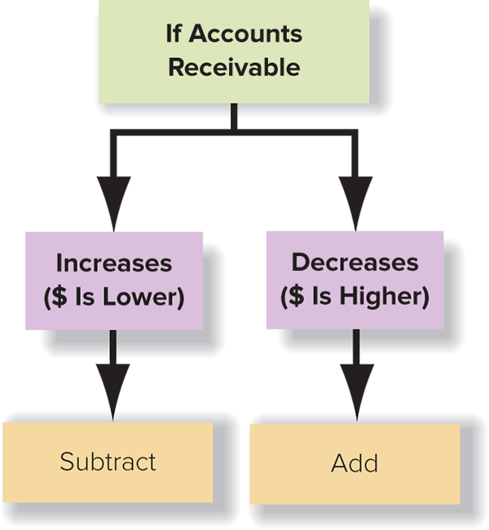
Change in Accounts Receivable

Slide 22
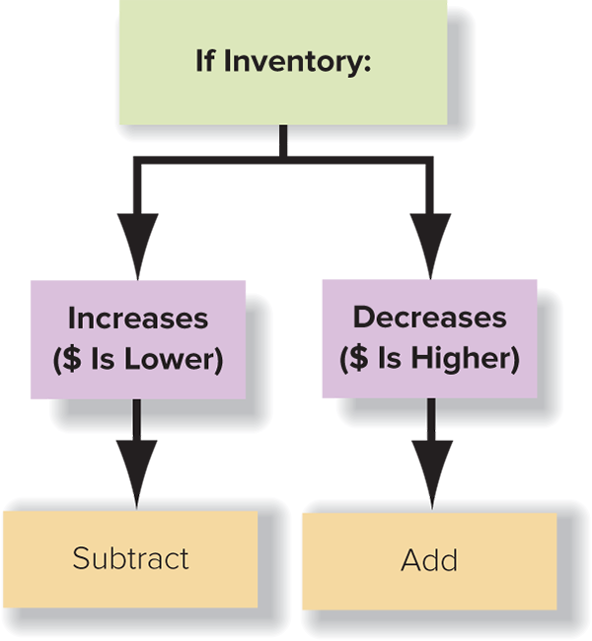
Change in Inventory

Slide 23

Change in Prepaid Expenses

Slide 24

Change in Accounts Payable

Slide 25

Change in Accrued Liabilities

Slide 26
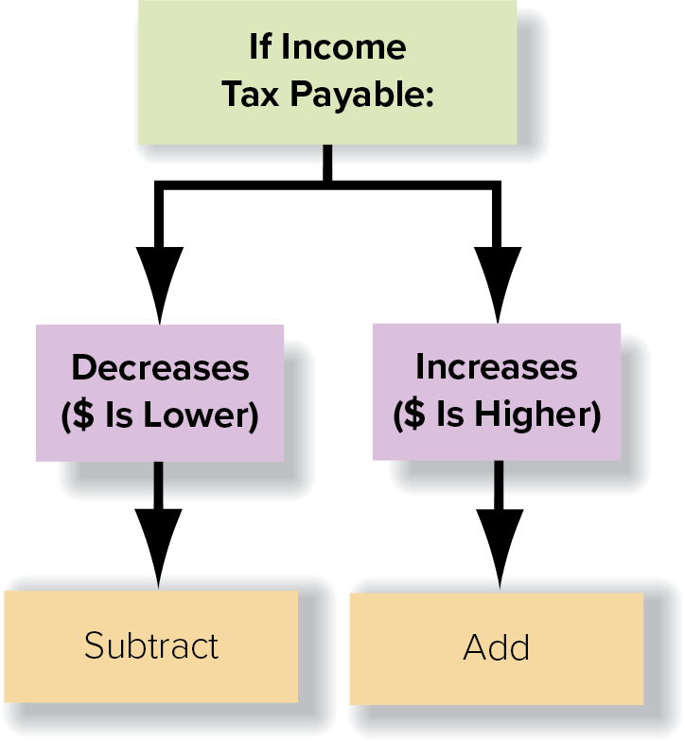
Change in Income Tax Payable

Slide 27
Summary of Additions and Subtractions
 | Additions and Subtractions to Reconcile Net Earnings to Cash Flows from Operating Activities
Item | When Item Increases | When Item Decreases
Depreciation and amortization | + | NA
Accounts receivable | − | +
Inventories | − | +
Prepaid expenses | − | +
Accounts payable | + | −
Accrued liabilities | + | −
Income tax payable | + | −

Slide 28
Interpreting Cash Flows from Operating Activities
Investors will not invest in a company if they do not believe that cash generated from operations will be available to pay them dividends or expand the company.
Creditors will not lend money if they do not believe that cash generated from operations will be available to pay back the loan.
A common guideline followed by financial and credit analysts is to avoid firms with rising net earnings but falling cash flow from operations.

Slide 29
Key Ratio Analysis → Quality of Earnings Ratio
ANALYTICAL QUESTION → How much cash does each dollar of net earnings generate?
RATIO AND COMPARISONS → The quality of earnings ratio is useful in answering this question. It is computed as follows:
In general, this ratio measures the portion of net earnings that was generated in cash. All other things equal, a higher quality of earnings ratio indicates greater ability to finance operating and other cash needs from operating cash inflows.
Quality of Earnings Ratio
Cash Flow from Operating Activities
Net Earnings
=

Slide 30
Reporting Cash Flows from Investing Activities Part 1
Preparing this section of the statement of cash flows requires analyzing the accounts related to property, plant, and equipment; intangible assets; and investments in the securities of other companies.
Normally, the relevant statement of financial position accounts include short-term investments and long-lived asset accounts, such as long-term investments and property, plant, and equipment.

Slide 31
Reporting Cash Flows from Investing Activities Part 2
The following relationships are the ones that you will encounter most frequently:
Related Statement of Financial Position Account(s) | Investing Activity | Cash Flow Effect
Property, plant, and equipment and intangible assets (e.g., patents) | Purchase of property, plant, and equipment or intangible assets for cash | Outflow
 | Sale of property, plant, and equipment or intangible assets for cash | Inflow
Short- or long-term investments in shares and bonds issued by other companies | Purchase of investment securities for cash | Outflow
 | Sale (maturity) of investment securities for cash | Inflow

Slide 32
Reporting Cash Flows from Investing Activities Part 3
Typical investing activities include the following:
  Cash expenditures that include the acquisition of tangible productive assets, such as buildings and equipment; intangible assets, such as trademarks and patents; and short- or long-term investments, such as shares or bonds issued by other companies, guaranteed investment certificates, or government securities with maturities of more than three months. Only purchases paid for with cash or cash equivalents are included.
  Cash proceeds from the sale of productive assets; intangible assets; and maturity of sale of short- or long-term investments. This is the amount of cash that was received from the sale of assets, regardless of whether the assets were sold at a gain or a loss.

Slide 33
Key Ratio Analysis → Capital Expenditures Ratio
ANALYTICAL QUESTION → To what degree was the company able to finance purchases of property, plant, and equipment with cash provided by operating activities?
RATIO AND COMPARISONS → This ratio is calculated as:
In general, this ratio reflects the portion of purchases of property, plant, and equipment financed from operating activities without the need for outside debt or equity financing or the sale of long-lived assets or other investments. A high ratio indicates less need for outside financing for current and future expansion.
Capital Expenditures Ratio
Cash Flow from Operating Activities
Cash Paid for Capital Expenditures
=

Slide 34
Free Cash Flow
Managers and analysts also often calculate free cash flow as a measure of the firm’s ability to pursue long-term investment opportunities. It is normally calculated as follows:
Free
Cash Flow
Cash Flow from Operating Activities
– Dividends – Capital Expenditures
=

Slide 35
Reporting Cash Flows from Financing Activities
Financing activities are associated with generating capital from creditors and owners.
This section reflects changes in two current liabilities, notes payable to financial institutions (often called short-term debt) and current portion of long-term debt, as well as changes in non-current liabilities and shareholders’ equity accounts.
These statement of financial position accounts relate to the issuance and retirement of debt, repurchase of shares, and payment of dividends.

Slide 36
Preparing, Reporting, and Explaining Cash Flows from Financing Activities Part 1
The following relationships are the ones that you will encounter most frequently:
Related Statement of Financial Position Account(s) | Financing Activity | Cash Flow Effect
Short-term debt | Borrowing cash from bank or other financial institution | Inflow
 | Repayment of loan principal | Outflow
Long-term debt | Long-term borrowings for cash | Inflow
 | Repayment of principal on long-term borrowings | Outflow
Share capital | Issuance of shares for cash | Inflow
 | Repurchase (retirement) of shares for cash | Outflow
Retained earnings | Payment of cash dividends | Outflow

Slide 37
Preparing, Reporting, and Explaining Cash Flows from Financing Activities Part 2
Typical financing activities include the following:
Proceeds from issuance of short- and long-term debt.
Principal payments on short- and long-term debt.
Proceeds from the issuance of shares.
Purchase of shares for retirement.
Interest and dividends.

Slide 38
Structure of the Statement of Cash Flows (Indirect Method) – Part 1
Statement of Cash Flows (Indirect Method)
Operating Activities:
Net earnings
+ Depreciation and amortization expense
− Gain on sale of long-lived asset
+ Loss on sale of long-lived asset
+ Decreases in operating assets
+ Increases in operating liabilities
− Increases in operating assets
− Decreases in operating liabilities
Net Cash Flow from Operating Activities

Slide 39
Structure of the Statement of Cash Flows (Indirect Method) – Part 2
Investing Activities:
− Purchase of property, plant, and equipment or intangible assets
+ Sale of property, plant, and equipment or intangible assets
− Purchase of investment securities
+ Sale (maturity) of investment securities
Net Cash Flow from Investing Activities
Financing Activities:
+ Borrowing from bank or other financial institution
− Repayment of loan principal
+ Issuance of long-term debt for cash
− Repayment of principal on long-term debt
+ Issuance of shares
− Repurchase (retirement) of shares
− Payment of (cash) dividends
Net Cash Flow from Financing Activities
Net Increase or Decrease in Cash and Cash Equivalents
Cash and cash equivalents at beginning of period
Cash and cash equivalents at end of period

Slide 40
Non-cash Investing and Financing Activities
Certain transactions are important investing and financing activities but have no cash flow effects.
These are called non-cash investing and financing activities; they are reported as a supplement to the statement of cash flows in narrative or schedule form.

Slide 41
Supplemental Cash Flow Information
Companies that use the indirect method of presenting cash flows from operations must also disclose the amounts of interest and dividends received and paid during the period, as well as cash paid for income taxes.
These are normally listed in the operating activities section of the statement or in the notes.

Slide 42
Appendix 11A: Adjustment for Gains and Losses on the Sale of Long-Lived Assets — Indirect Method
Transactions that cause gains and losses should be classified on the statement of cash flows as operating, investing, or financing activities, depending on their dominant characteristics. For example, if the sale of equipment produced a gain, it would be classified as an investing activity.
Gains → Gains must be subtracted from profit to avoid double counting the gain.
Losses → Losses must be added to profit to avoid double counting the loss.

Slide 43
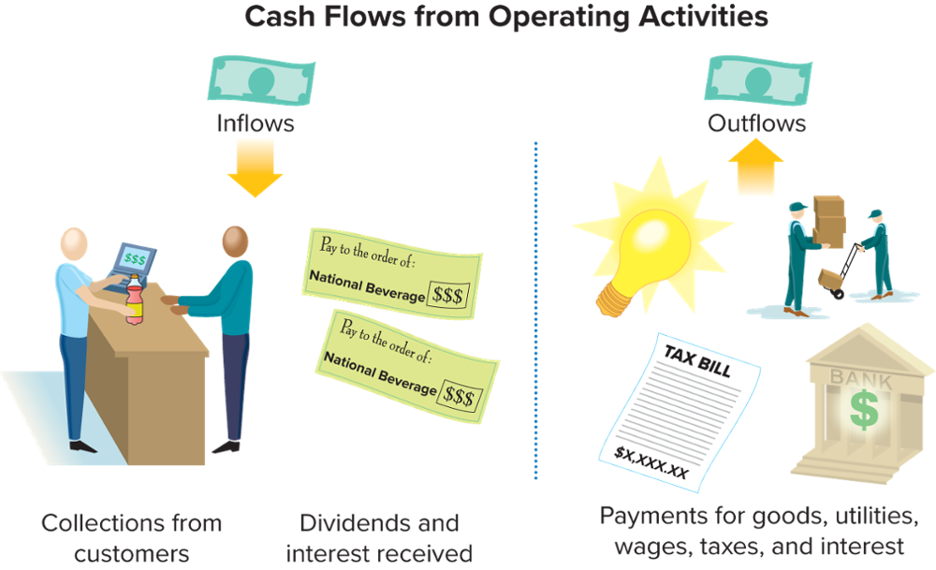
Appendix 11B: Reporting Cash Flows from Operating Activities – Direct Method

Slide 44
Converting Revenue and Expense Items from an Accrual Basis to a Cash Basis
Statement of Earnings Account | +/− Change in Statement of Financial Position Account(s) | = Operating Cash Flow
Sales revenue | + Beginning accounts receivable − Ending accounts receivable | = Collections from customers
Cost of sales | − Beginning inventory + Ending inventory + Beginning accounts payable − Ending accounts payable | = Payments to suppliers of inventory
Selling, general, and administrative expenses | − Beginning prepaid expenses + Ending prepaid expenses + Beginning accrued liabilities − Ending accrued liabilities | = Payments to suppliers of services (e.g., rent, utilities, wages)
Interest expense | + Beginning interest payable − Ending interest payable | = Payments for interest
Income tax expense | + Beginning income taxes payable − Ending income taxes payable | = Payments for income taxes

Slide 45
Appendix 5C: T-Account Approach – Indirect Method
The following three steps are used to prepare the statement of cash flows:
Determine the change in each statement of financial position account. From this year’s ending balance, subtract this year’s beginning balance
Identify the cash flow category or categories to which each account relates. Remember that changes in the balances of some accounts result from two types of activities.
Create schedules that summarize cash flows from operating, investing, and financing activities.
Instead of creating separate schedules for each section of the statement, many accountants prefer to prepare a single large T-account to represent the changes that have taken place in cash, subdivided into the three sections of the statement of cash flows.

Slide 46
Appendix 5D: Spreadsheet Approach – Statement of Cash Flows, Indirect Method
The spreadsheet approach offers a systematic way to keep track of data. A spreadsheet is organized as follows:
Four columns to record dollar amounts are established (beginning balance, debit changes, credit changes, and ending balance).
On the left of the top half of the spreadsheet, each account name from the statement of financial position is entered.
On the left of the bottom half of the spreadsheet, the name of each item that will be reported on the statement of cash flows is entered.
Changes in the various statement of financial position accounts are analyzed in terms of debits and credits in the top half of the spreadsheet, with the offsetting debits and credits being recorded in the bottom half of the spreadsheet in terms of their impact on cash flows. Each change in the non-cash statement of financial position accounts explains part of the change in the cash account.

Slide 47
End of Chapter Summary
The statement has three main sections: cash flows from operating activities, which are related to earning revenue from normal operations and incurring related expenses; cash flows from investing activities, which are related to the acquisition and sale of productive assets; and cash flows from financing activities, which are related to external financing of the enterprise.
The indirect method for reporting cash flows from operating activities presents a conversion of net earnings (loss) to net cash flows from operating activities.

Slide 48
End of Chapter Summary Continued
Investing activities reported on the statement of cash flows include cash payments to acquire property, plant, and equipment; intangibles; and short- and long-term investments. They also include cash proceeds from the sale of these assets.
Cash inflows from financing activities include cash proceeds from issuance of short- and long-term debt and contributed capital. Cash outflows include principal payments on short- and long-term debt, cash paid for the repurchase of the company’s shares, and dividend payments. Cash payments associated with interest relate to either operating activities or financing activities.

