Slide 1
Communicating Accounting Information
and Analyzing Financial Statements
Chapter 12
Notes:
Chapter 12: Communicating Accounting Information and Analyzing Financial Statements.
1

Slide 2
Learning Objectives
LO12-1 Recognize the roles of people involved in the accounting communication process (regulators, managers, board of directors, auditors, information intermediaries, and users), and the guidance they receive from legal and professional standards.
LO12-2 Identify the steps in the accounting communication process, including the issuance of press releases, annual reports, quarterly reports, and documents filed with securities commissions.
LO12-3 Explain how a company’s business strategy affects financial statement analysis.
LO12-4 Discuss how analysts use financial statements.

Slide 3
Learning Objectives Continued
LO12-5 Compute and interpret component percentages (vertical analysis).
LO12-6 Compute and interpret percentage changes over time (horizontal analysis).
LO12-7 Compute and interpret profitability ratios.
LO12-8 Compute and interpret asset turnover ratios.
LO12-9 Compute and interpret liquidity ratios.
LO12-10 Compute and interpret solvency ratios.
LO12-11 Compute and interpret market ratios.
SUPPLEMENTARY MATERIAL
LO12-S1 Evaluate a company’s performance using the expanded DuPont model.

Slide 4
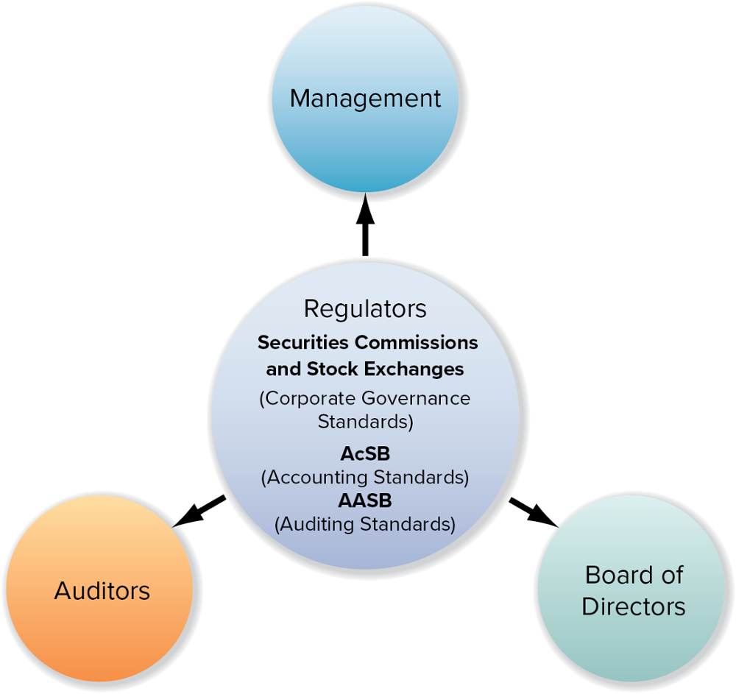
Ensuring the Integrity of Financial Information

Slide 5
Regulators Part 1
The financial information reported by Canadian companies is subject to strict regulations and standards issued by government regulators and private standard-setting organizations.
Canadian publicly traded corporations must comply with provincial securities regulations that are coordinated by the Canadian Securities Administrators (CSA).
The CSA is a forum for the 13 securities regulators of Canada’s provinces and territories that was established to harmonize regulation of the Canadian capital markets where financial securities are offered and traded.

Slide 6
Regulators Part 2
Securities regulators work closely with the Accounting Standards Board (AcSB), which is responsible for establishing standards of accounting and reporting by Canadian companies.
External auditors ensure that companies prepare their financial reports in accordance with these standards, and their audit work is guided by International Standards on Auditing, which have been adopted by the Canadian Auditing and Assurance Standards Board (AASB) as Canadian Auditing Standards.

Slide 7
Regulators Part 3
Stock exchanges also provide an essential quality assurance service to listed companies by undertaking ongoing surveillance of their reporting and trading activities.
When they suspect non-compliance with accounting standards, the stock exchanges undertake independent investigations and share information with law enforcement agencies such as securities commissions, the Canada Revenue Agency (CRA), which collects income taxes from corporations, and the Royal Canadian Mounted Police (RCMP).

Slide 8
Managers Part 1
The primary responsibility is for the information in the financial statements and disclosures lies with both:
  Chief Executive Officer (CEO): highest officer of the company.
  Chief Financial Officer (CFO): highest officer associated with the financial and accounting side of the business.
Accounting Staff: prepare the details of the reports and bear professional responsibility for the accuracy of the information.

Slide 9
Managers Part 2
All Canadian publicly accountable enterprises, the CEO and CFO must personally certify the following:
  Each report filed with the regulatory authorities does not contain any untrue statement of a material fact or omit stating a material fact, and fairly presents, in all material respects, the financial condition, financial performance, and cash flows of the company.
  There are no significant deficiencies and material weaknesses in the design or operation of internal controls over financial reporting that are reasonably likely to adversely affect the company’s ability to record, process, summarize, and report financial information.
  They have disclosed to the auditors and the audit committee of the board any weaknesses in internal controls or any fraud involving management or other employees who have a significant role in financial reporting.

Slide 10
Board of Directors (Audit Committee) Part 1
The board of directors, elected by the shareholders to represent their interests, is responsible for maintaining the integrity of the company’s strategy, internal control system, and presentation of financial reports.
The audit committee of the board, which must be composed of independent, financially literate directors, oversees management in carrying out its responsibilities for financial reporting systems and internal control.
The audit committee reports its findings to the board of directors for them to consider and approve the annual financial statements to be issued to shareholders.

Slide 11
Board of Directors (Audit Committee) Part 2
Recent changes to securities regulations have increased the burden of management’s responsibility for accurate financial disclosure.
It is the responsibility of management and those charged with governance, including the board of directors, to develop and oversee systems to prevent and detect fraud.
If any company listed on a stock exchange is found guilty of knowingly violating any disclosure regulation, not only the company but also individual senior officers, such as the CEO and CFO, and members of its board of directors can be sued.

Slide 12
Board of Directors (Audit Committee) Part 3
If experts, such as accountants or financial analysts, who relied on the company’s financial reports also issued disclosure that misrepresented the company, they too may be individually sued by users who seek to recover some or all of their financial losses, which may have resulted from reliance on misleading information.

Slide 13
Auditors Part 1
The provincial securities commissions require that publicly traded companies have their statements and their control systems over the financial reporting process audited by professional independent accountants in accordance with International Standards on Auditing (ISA).
In Canada, the Canadian Auditing Standards (CAS) converge with the ISA. Many privately owned companies also have their statements audited.

Slide 14
Auditors Part 2
An unqualified (clean) audit opinion is the auditors’ declaration that the financial statements are fair presentations in all material respects in conformity with IFRS.
By signing an unqualified audit opinion, the audit firm assumes full responsibility for conducting the audit in compliance with all authoritative accounting standards and guidance, as well as the jurisdiction’s laws and regulations.
This opinion, which adds credibility to the statements, is also often required by agreements with lenders and private investors.

Slide 15
How Data Analytics is Affecting What Auditors Do Part 1
Modern data analytics is changing the world of auditing.
The availability of more data from clients’ enterprise-wide accounting systems, has allowed access now to entire populations of transactions instead of smaller statistical samples as in the past.
This eases identification of trends, patterns, and outliers, which become the focus for further investigation.
Even for a large multinational client, auditors can now examine the whole population of manual entries to determine particular locations and types of transactions generating unexpected numbers of entries, which the auditor then examines further.

Slide 16
How Data Analytics is Affecting What Auditors Do Part 2
Data analytics also makes it easier to correlate information from various parts of the client’s accounting systems such as sales invoices, shipping records, and cash receipts to identify areas where undetected material misstatements may exist (audit risks).
The ability to understand client accounting systems and to apply predictive models and data visualization tools to data extracted from client systems is fast becoming a key part of the auditor’s skill set.
The availability of data analytics also decreases the amount of repetitive manual work in the audit and increases the value of audit services to clients and securities markets.

Slide 17
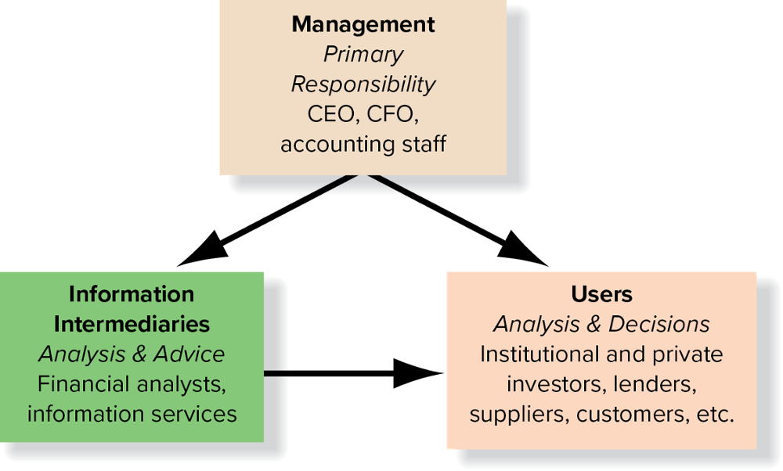
Information Intermediaries: Analysts and Information Services

Slide 18
Financial Analysts Part 1
Financial analysts receive accounting reports and other information about the company from electronic information services. They also gather information through conversations with company executives and visits to company facilities and competitors. The results of their analyses are combined into analysts’ reports.
Analysts’ reports normally include forecasts of share price and future quarterly and annual earnings per share; a buy, sell, or hold recommendation for the company shares; and explanations for these judgments.

Slide 19
Financial Analysts Part 2
In making these earnings forecasts or predictions of earnings for future accounting periods, the analysts rely heavily on their knowledge of how the accounting system translates business events into the numbers on a company’s financial statements.
Individual analysts often specialize in particular industries (such as sporting goods or energy companies). Analysts are regularly evaluated based on the accuracy of their forecasts, as well as the profitability of their stock picks.

Slide 20
Information Services
Canadian companies file financial statements and other securities-related forms electronically with SEDAR (System for Electronic Document Analysis and Retrieval), which is the official site for the filing of documents by public companies as required by securities laws in Canada.
SEDAR is currently a free service available on the Internet at www.sedar.com.
Many companies also provide access to their financial statements and other information over the Internet.

Slide 21
Users: Institutional and Private Investors, Creditors, and Other
Institutional Investors:
  Includes private pension funds, public pension funds, mutual funds, endowments and trust funds, and charitable foundations.
Private Investors:
  Individuals who purchase shares in companies.
Lenders (creditors):
  Suppliers, banks, commercial credit companies, and other financial institutions that lend money to companies.

Slide 22
ESG – Investor Demand for Relevant Information
In 2021, the CPA profession responded to intensifying demand by global institutional investors for relevant, faithfully representative, standardized, and publicly available ESG measures.
The IASB established the International Sustainability Standards Board (ISSB).
IFRS published drafts of general ESG and specific environmental standards, with the expectation that final standards will follow in due course.
CPA Canada can choose to adopt the standards as they are or adapt them to better reflect unique factors in Canada’s business and economic contexts.

Slide 23
The Disclosure Process – Press Releases
To provide timely information to external users and to limit the possibility of selective leakage of information, most public companies announce quarterly and annual earnings through a press release: a written public news announcement normally distributed to major news services as soon as the verified figures (audited for annual and reviewed for quarterly earnings) are available.
The announcements are sent electronically to the major print and electronic news services, which make them immediately available to subscribers.

Slide 24
Annual Reports Part 1
For privately held companies, annual reports are relatively simple documents.
They normally include the following:
Basic financial statements: statement of earnings, statement of financial position, statement of changes in equity, and statement of cash flows.
Related notes.
Report of independent accountants (auditor’s opinion) if the statements are audited.

Slide 25
Annual Reports Part 2
The annual reports of public companies are significantly more elaborate, both because of additional reporting requirements imposed on these companies by securities commissions and because many companies use their annual reports as public relations tools to communicate non-accounting information to shareholders, customers, the press, and others.

Slide 26
Annual Reports Part 3
The annual reports of public companies are normally split into two sections.
  Non-financial:
    Includes a letter to shareholders from the chairperson and CEO, along with descriptions of the company’s management philosophy, products, successes (and occasionally failures), and exciting prospects and challenges for the future.
  Financial:
    Includes the core of the report. Securities regulators set minimum disclosure standards for the financial section of the annual reports of public companies.

Slide 27
Annual Reports Part 4
The principal components of the financial section follow:
Summarized financial data.
Management’s discussion and analysis (MD&A) of the company's financial condition and results of operations.
Report of the independent accountants (Auditor’s Opinion) and the management report.
The basic financial statements.
Notes to the financial statements.
The order of these components varies.

Slide 28
Quarterly Reports
Quarterly reports normally begin with a short letter to shareholders.
A condensed statement of earnings for the quarter, which often shows less detail than the annual statement of earnings, and a condensed statement of financial position dated at the end of the quarter. These condensed financial statements are not audited and so are marked “unaudited.”
Often, the statement of cash flows, the statement of changes in equity, and some notes to the financial statements are omitted.

Slide 29
Reports to Securities Commissions
Public companies must also file periodic reports with the OSC and other provincial securities commissions.
These reports include the annual report, quarterly reports, an annual information form, and an information circular.
The annual information form provides a more detailed description of the business.
The information circular is a legal document that is forwarded to the company’s shareholders prior to the annual general or special meeting of shareholders. The circular also provides compensation details for the CEO, CFO, and other key executives as well as information about the company’s corporate governance practices.

Slide 30
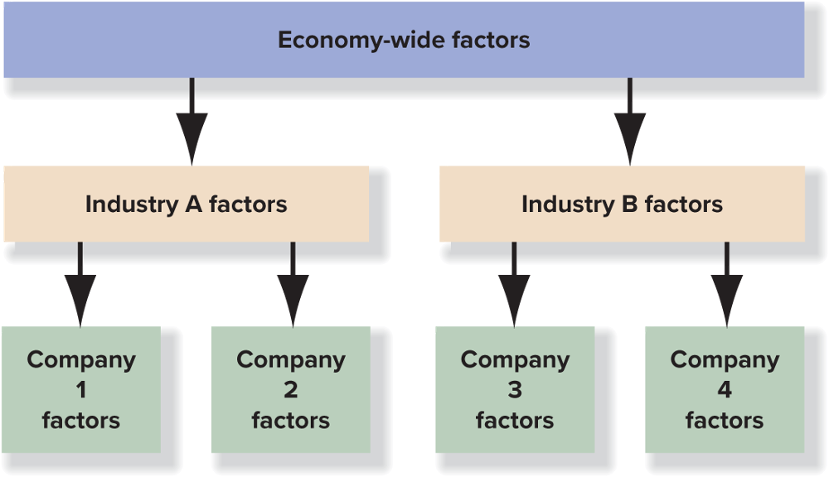
The Investment Decision Part 1
When considering an investment in shares, the investor should evaluate the future net earnings and growth potential of the business on the basis of three factors:

Slide 31
The Investment Decision Part 2
Economy-wide factors: The overall health of the economy has a direct impact on the performance of an individual business. Prudent investors must consider data such as the unemployment rate, the general inflation rate, and changes in interest rates.
Industry factors: Certain events have a major impact on each company within an industry but have only a minor impact on other companies outside the industry.
Individual company factors: To properly analyze a company, you should learn as much as you can about it. Good analysts do not rely solely on the information contained in the financial statements. They visit the company, buy its products, and read about it in the business press.

Slide 32

Understanding A Company’s Strategy Part 1
Financial statement analysis involves more than just “crunching numbers.”
Before you start looking at numbers, you should know what you are looking for.
While financial statements report on transactions, each of these transactions is the result of a company’s operating decisions as it implements its business strategy.

Slide 33
Understanding A Company’s Strategy Part 2
Businesses can earn a high rate of return by following different strategies. There are two fundamental strategies:
Product differentiation (or high-value): Under this strategy, companies offer products with unique benefits, such as high quality or unusual features or style.
Cost differentiation: Under this strategy, companies selling similar products attempt to operate more efficiently than their competitors, allowing them to offer lower prices to attract customers.

Slide 34
Financial Statement Analysis Part 1
Financial results cannot be evaluated in isolation.
To properly analyze the information reported in financial statements, you must develop appropriate comparisons.
The task of finding appropriate benchmarks requires judgment, and it is not always an easy task.
For this reason, financial analysis is a sophisticated skill, not a mechanical process.

Slide 35
Financial Statement Analysis Part 2
There are two types of benchmarks for making financial comparisons: time series and comparisons with other companies.
Comparing across time. In this type of analysis, which often is referred to as “time-series analysis,” information on a single company is compared over time.
Comparing across companies. In this type of analysis, which often is referred to as “cross-sectional analysis,” information for multiple companies is compared at a point in time or across time. By comparing a company with another one in the same line of business, an analyst can obtain better insight into its performance.

Slide 36
Component Percentages, Trend Analysis, and Ratio Analysis
All financial analysts use various tools to analyze a company’s financial statements.
These tools include:
Component percentages,
Trend analysis, and
Ratio analysis

Slide 37
Component Percentages
A component percentage expresses each item on a financial statement as a percentage of a single base amount, the denominator of the ratio. The base amount on the statement of earnings is net sales.
To calculate component percentages on the statement of earnings, each amount reported is divided by net sales. The base amount on the statement of financial position is total assets.
To calculate component percentages on the statement of financial position, each amount is divided by total assets. This is also known as vertical analysis or creating a common-size financial statement.

Slide 38
Trend Analysis and Ratio Analysis
Trend analysis (or horizontal analysis) examines the dollar amounts or changes in the reported values of specific financial statement items over multiple periods to identify patterns that may be useful in predicting future values.
Ratios may be computed by using amounts in one statement, such as the statement of earnings, or in two different statements, such as the statement of earnings and the statement of financial position.

Slide 39
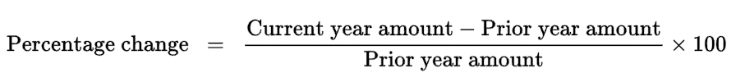
Trend Analysis
Another type of analysis tracks the changes to specific line items in financial statements over time for the purpose of identifying significant changes that may be used in predicting future values.
Trend analysis helps in identifying significant changes over time and in raising questions about the underlying reasons for such changes. It is important to remember, however, that changes that appear to be significant in percentage terms may not be significant in dollar amount.

Slide 40
Ratio Analysis Part 1
Component percentages are a type of ratio.
Ratios simply express one number relative to another number.
With component percentages, both the numerator and the denominator of the ratio come from the same financial statement. This does not have to be the case.
Ratio analysis helps decision makers identify significant relationships and make meaningful comparisons.

Slide 41
Ratio Analysis Part 2
A basic fact about financial statements: The statement of financial position amounts are as at a specific point in time while statement of earnings amounts relate to a period of time.
To adjust for this difference, analysts often use the average statement of financial position amount when comparing a statement of financial position amount to a statement of earnings amount.
Making this adjustment allows you to compare the average statement of financial position amount that corresponds to the period for which the statement of earnings amount was generated.

Slide 42
Widely Used Accounting Ratios Part 1
Profitability Ratios |  | BASIC COMPUTATION
1. Return on equity (ROE) | Chapter 4 | Net earnings
 |  | Net earnings Average shareholders ’ equity
2. Return on assets (ROA) | Chapter 3 | Net earnings
 |  | Average total assets
3. Gross profit margin ratio | Chapter 5 | Gross profit
 |  | Net sales
4. Net profit margin ratio | Chapter 4 | Net earnings
 |  | Net sales
5. Earnings per share (EPS) ratio | Chapter 10 | Net earnings available to common shareholders
 |  | Average number of common shares outstanding
6. Quality of earnings ratio | Chapter 11 | Cash flows from operating activities
 |  | Net earnings

Slide 43
Widely Used Accounting Ratios Part 2
Asset Turnover Ratios |  | BASIC COMPUTATION
7. Total asset turnover ratio | Chapter 3 | Net sales
 |  | Average total assets
8. Fixed asset turnover ratio | Chapter 7 | Net sales
 |  | Average net fixed assets
9. Receivables turnover ratio | Chapter 5 | Net credit sales
 |  | Average net accounts receivable
10. Inventory turnover ratio | Chapter 6 | Cost of sales
 |  | Average inventory

Slide 44
Widely Used Accounting Ratios Part 3
Liquidity Ratios |  | BASIC COMPUTATION
11. Current ratio | Chapter 2 | Current assets
 |  | Current liabilities
12. Quick ratio | Chapter 8 | Quick assets
 |  | Current liabilities
13. Cash ratio | Chapter 12 | Cash + Cash equivalents
 |  | Current liabilities
Solvency Ratios |  | BASIC COMPUTATION
14. Times interest earned ratio | Chapter 9 | Net earnings + Interest expense + Income tax expense
 |  | Interest expense
15. Cash coverage ratio | Chapter 12 | Cash flows from operating activities (before interest and taxes)
 |  | Interest paid
16. Debt-to-equity ratio | Chapter 9 | Total liabilities
 |  | Shareholders ’ equity

Slide 45
Widely Used Accounting Ratios Part 4
Market Ratios |  | BASIC COMPUTATION
17. Price/earnings ratio | Chapter 12 | Current market price per share
 |  | Earnings per share
18. Dividend yield ratio | Chapter 10 | Dividends per share
 |  | Market price per share

Slide 46
Profitability Ratios
Profitability is a primary measure of the overall success of a company. It is necessary for a company’s survival.
Investors and creditors prefer a single measure of profitability that is meaningful in all situations. However, there is no single measure that can meet this need.
Several profitability ratios focus on measuring the adequacy of net earnings by comparing it to other items reported on the financial statements.

Slide 47
1. Return on Equity (ROE)
Return on equity (also called return on owners’ investment) relates net earnings to the investment made by the owners.
It reflects the simple fact that investors expect to earn a return on the money they invest in a company.
Net Earnings
Average Shareholders’ Equity
Return on Equity
=

Slide 48
2. Return on Assets (ROA)
Another test of profitability compares net earnings to the total assets (i.e., total investment) used to generate the net earnings. The ROA is computed as follows:
Return on Assets
Net Earnings
Average Total Assets
=

Slide 49
3. Gross Profit Margin Ratio
The gross profit margin ratio (also referred to as the gross profit percentage) reflects gross profit as a percent of sales.
If not shown separately on a company’s statement of earnings, gross profit is computed by subtracting cost of sales from net sales.
The gross profit margin ratio is computed as follows:
Gross Profit
Net Sales
Gross Profit Margin Ratio
=

Slide 50
4. Net Profit Margin Ratio
The net profit margin ratio measures the percentage of each sales dollar, on average, that represents net earnings. It is computed as follows:
Net Earnings
Net Sales
Net Profit Margin Ratio
=

Slide 51
5. Earnings per Share (EPS)
Earnings per share (EPS) is a measure of the return on investment that is based on the number of shares outstanding instead of the dollar amounts reported on the statement of financial position. In simple situations, EPS is computed as follows:
This calculation of EPS is based on information reported on the statement of earnings. The additional complexities in the calculation of EPS are discussed in advanced accounting courses.
Net earnings available to common shareholders
Average number of common shares outstanding
EPS =

Slide 52
6. Quality of Earnings Ratio
Most financial analysts are concerned about the quality of a company’s earnings because the use of some accounting procedures can result in higher earnings numbers. A ratio higher than 1 indicates high-quality earnings.
Quality of earnings
ratio
Net earnings
=
Cash flows from operating activities

Slide 53
Asset Turnover Ratios
Asset turnover ratios focus on capturing how efficiently a company uses its assets.
For example, acquiring and selling inventory is a key activity for many companies. The inventory turnover ratio helps analysts evaluate a company’s ability to sell its inventory.
Another example is the receivables turnover ratio, which helps analysts evaluate a company’s ability to collect its receivables.
These and other asset turnover ratios are discussed below.

Slide 54
7. Total Asset Turnover Ratio
The total asset turnover ratio captures how well a company uses its assets to generate revenue. The ratio is computed as follows:
Total Asset
Turnover
Net Sales
Average Total Assets
=

Slide 55
8. Fixed Asset Turnover Ratio
The fixed asset turnover ratio focuses more narrowly on how well a company uses its fixed assets to generate revenues.
The term fixed assets is synonymous with property, plant, and equipment.
The ratio is computed as follows:
Fixed Asset
Turnover Ratio
Net Sales
Average Net Fixed Assets
=

Slide 56
9. Receivables Turnover Ratio
This ratio measures how quickly a company collects its trade receivables.
The receivables turnover ratio is often converted to a time basis known as the average days to collect receivables or average collection period.
Receivables Turnover Ratio
Net Credit Sales
Average Net Accounts Receivable
=
Average days to collect Receivables
Days in a year
Receivables turnover ratio
=

Slide 57
10. Inventory Turnover Ratio
The inventory turnover ratio is a measure of operating efficiency.
It reflects the relationship of inventory to the amount of sales during the period.
It is computed as follows:
Inventory Turnover Ratio
Cost of Sales
Average Inventory
=

Slide 58
Using Ratios to Analyze the Operating Cycle Part 1
The operating cycle is the time it takes for a company to pay cash to its suppliers, sell goods to its customers, and collect cash from its customers.
Analysts are interested in the operating cycle because it helps them evaluate a company’s cash needs and is a good indicator of operating efficiency.
The operating cycle for most companies involves four distinct phases: acquisition of inventory, payment of cash to suppliers, sale of inventory, and collection of cash from customers.

Slide 59
Using Ratios to Analyze the Operating Cycle Part 2
We have discussed three ratios that are helpful in evaluating a company’s operating cycle. They are the accounts payable turnover ratio, the inventory turnover ratio, and the receivables turnover ratio.
Ratio | Operating Activity
Accounts payable turnover ratio | Purchase of inventory
Inventory turnover ratio | Sale of inventory
Receivables turnover ratio | Collection of cash from customers

Slide 60
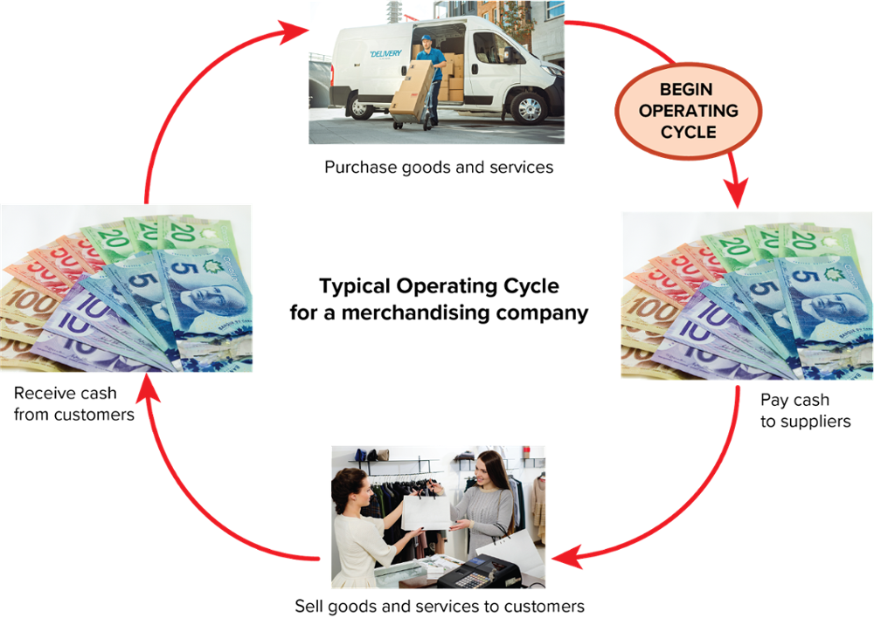
Using Ratios to Analyze the Operating Cycle Part 3

Slide 61
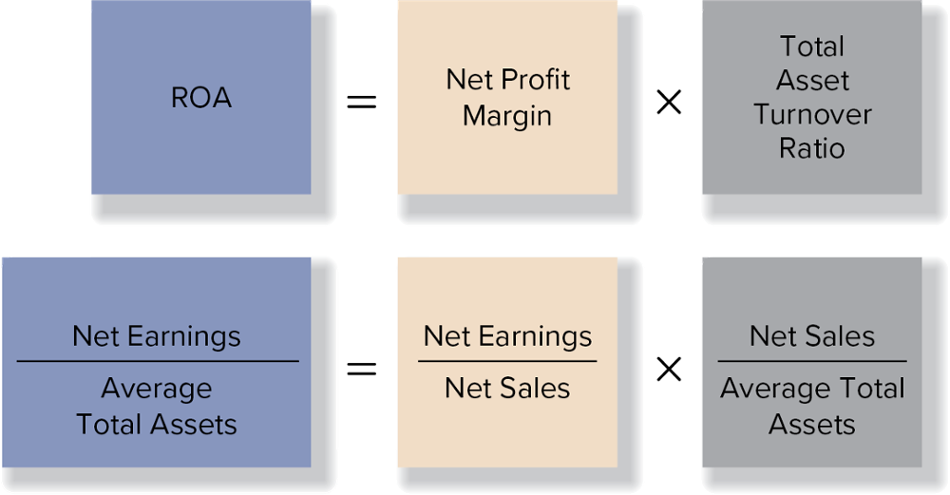
ROA Profit Driver Analysis and the Dupont Model Part 1
The ROA profit driver analysis is a useful framework for evaluating a company’s profit drivers.
Breaking down ROA into its two components provides a better understanding of what underlies a company’s performance. With this knowledge, one can better assess whether a company is effectively implementing its business strategy.

Slide 62
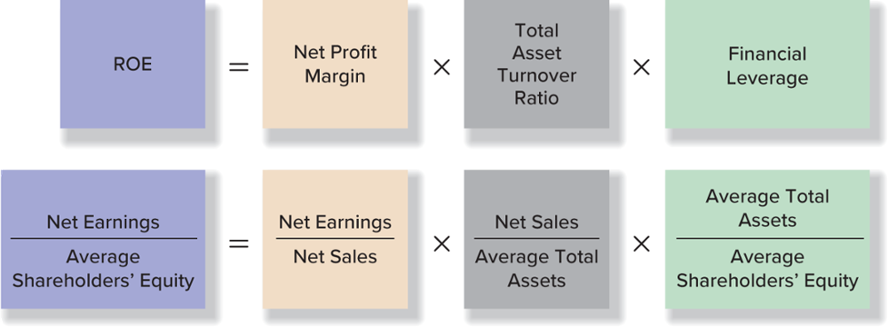
ROA Profit Driver Analysis and the Dupont Model Part 2
Some analysts include a third component in their analysis: financial leverage.
When financial leverage is added to the model, it is commonly referred to as the DuPont model.

Slide 63
ROA Profit Driver Analysis and the Dupont Model Part 3
A key insight provided by the DuPont model is that companies can be profitable by achieving high profit margins; by achieving a rapid turnover of assets; by increasing reliance on debt relative to equity in their capital structure; or by some combination of these strategies.

Slide 64
Liquidity Ratios
Liquidity refers to a company’s ability to meet its short-term obligations.
Because most short-term obligations are paid with current assets, liquidity ratios focus on the relationship between current assets and current liabilities.
A company’s ability to pay its current liabilities is an important factor in evaluating its short-term financial strength.
Three ratios are used to measure liquidity:
  The current ratio
  The quick ratio
  The cash ratio

Slide 65
11. Current Ratio
The current ratio measures the relationship between current assets and current liabilities at a specific date.
It measures the ability of the company to pay current debts as they become due.
Current
Ratio
Current Assets
Current Liabilities
=

Slide 66
12. Quick Ratio
The quick ratio, sometimes referred to as the acid test, is a more stringent test of short-term liquidity than the current ratio.
The quick ratio compares quick assets, defined as cash and near-cash assets, to current liabilities.
Quick
Ratio
Quick Assets
Current Liabilities
=

Slide 67
13. Cash Ratio
This ratio measures the adequacy of available cash.
Cash + Cash Equivalents
Current Liabilities
Cash Ratio
=

Slide 68
Solvency Ratios
Solvency refers to a company’s ability to meet its long-term obligations.
Solvency ratios measure this ability; examples are:
  Times interest earned
  Cash coverage
  Debt-to-equity ratios

Slide 69
14. Times Interest Earned
This ratio indicates a margin of protection for creditors.
Times Interest Earned Ratio
Net Earnings Interest Income Tax
Expense Expense
Interest Expense
+
+
=

Slide 70
15. Cash Coverage Ratio
This ratio compares the cash generated with the cash obligations of the period.
Cash
Coverage
Ratio
Cash Flow from Operating Activities
Before Interest and Taxes
Interest Paid (from statement of cash flows)
=

Slide 71
16. Debt-to-Equity Ratio
This ratio expresses a company’s debt as a proportion of its shareholders’ equity.
It is computed as follows:
Debt-to-Equity Ratio
Total Liabilities
Shareholders’ Equity
=

Slide 72
Market Ratios
Some ratios, often called market ratios, relate the current market price per share to the return that accrues to shareholders.
Many analysts prefer these ratios because they are based on the current value of an owner’s investment in a company.

Slide 73
17. Price/Earnings (P/E) Ratio
This ratio measures the relationship between the current market price of the share and its earnings per share.
Price/Earnings
Ratio
Current Market Price Per Share
Earnings Per Share
=

Slide 74
18. Dividend Yield Ratio
When investors buy shares, they expect returns from two sources: dividend income and price appreciation.
The dividend yield ratio measures the relationship between the dividend per share paid to shareholders and the current market price per share.
Dividend
Yield Ratio
Dividends Per Share
Market Price Per Share
=

Slide 75
Interpreting Ratios and Other Analytical Considerations
Ratios may be interpreted by comparison with ratios of other companies or with industry average ratios.
Ratios may vary because of the company’s industry characteristics, nature of operations, size, and accounting policies.

Slide 76
Other Financial Information
In addition to financial ratios, special factors might affect company analysis:
  Rapid growth.
  Uneconomical expansion.
  Non-financial information.
No single approach can be used to analyze all companies.
An effective analyst will look beyond the information contained in an annual report.

Slide 77
End of Chapter Summary Part 1
Management of the reporting company must decide on the appropriate format (categories) and level of detail to present in its financial reports.
Independent audits increase the credibility of the information.
Earnings are first made public in press releases.
Analysts use financial statements to understand present conditions and past performance, as well as to predict future performance.
To calculate component percentages for the statement of earnings, the base amount is net sales. Each expense is expressed as a percentage of net sales.

Slide 78
End of Chapter Summary Part 2
On the statement of financial position, the base amount is total assets; the balance of each account is divided by total assets.
Component percentages are evaluated by comparing them over time for a single company or by comparing them with percentages for similar companies.
Several profitability ratios focus on measuring the adequacy of net earnings by comparing it to other items reported on the financial statements.
Asset turnover ratios focus on capturing how effectively a company uses its assets.

Slide 79
End of Chapter Summary Part 3
Liquidity ratios measure a company’s ability to meet its short-term obligations.
Solvency ratios measure a company’s ability to meet its long-term obligations.
Market ratios relate the current price per share to the return that accrues to investors.

