Slide 1
Adjustments, Financial Statements,
and the Closing Process
Chapter 4

Slide 2
Learning Objectives
LO4-1 Explain the purpose of adjusting entries and analyze the adjustments necessary at the end of the period to update revenues and expenses and related statement of financial position accounts.
LO4-2 Prepare a statement of earnings with earnings per share, a statement of changes in equity, and a statement of financial position.
LO4-3 Compute and interpret the net profit margin ratio and the return on equity.
LO4-4 Explain the closing process at the end of the period.

Slide 3
The Accounting Cycle Part 1
The accounting cycle is the process used by entities to analyze and record transactions, adjust the records to provide reliable account balances at the end of the period, prepare financial statements, and prepare the records for the next cycle.
During the accounting period, transactions that result in exchanges of benefits and obligations between the company and other external parties are analyzed and recorded in the general journal in chronological order (journal entries), and the related accounts are updated in the general ledger (T-accounts).
The end-of-period steps focus primarily on adjustments to record revenues and expenses in the proper period and to update the statement of financial position accounts for reporting purposes.

Slide 4
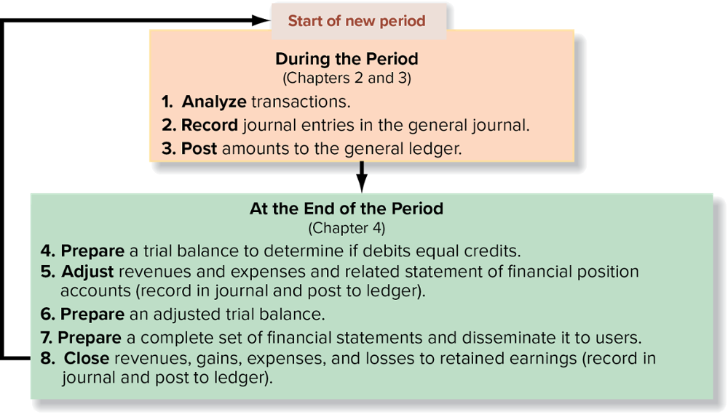
The Accounting Cycle Part 2

Slide 5
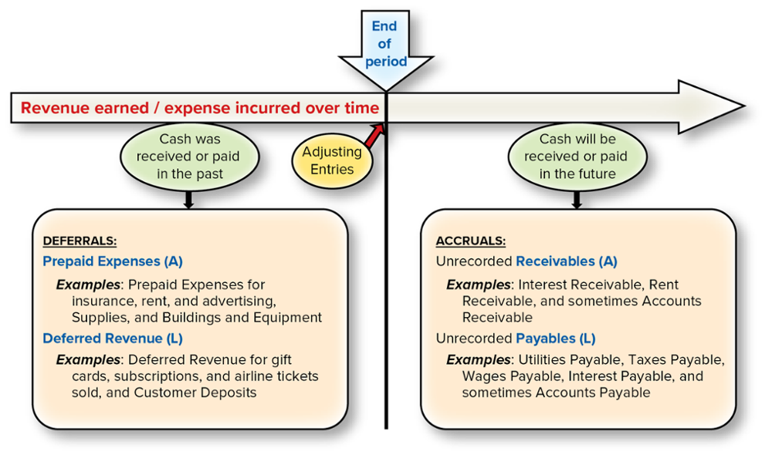
Four Types of Adjustments

Slide 6
Purpose of Adjustments Part 1
Adjusting entries are recorded at the end of every accounting period, so that
  Revenues are recorded when earned (the revenue recognition principle).
  Expenses are recorded when incurred to generate revenue during the same period (the expense recognition principle).
  Assets are reported at amounts that represent the probable future benefits remaining at the end of the period.
  Liabilities are reported at amounts that represent the probable future sacrifices of assets or services owed at the end of the period.

Slide 7
Purpose of Adjustments Part 2
Companies wait until the end of the accounting period to adjust their accounts, because adjusting the records daily would be very costly and time-consuming.
Adjusting entries are required every time a company wants to prepare financial statements for external users.

Slide 8
Adjustment Process Part 1
Step 1: Ask: Was revenue earned that is not yet recorded?
If the answer is YES, increase the revenue account —credit the revenue account in the adjusting entry.
Step 2: Ask: Was the related cash received in the past or will it be received in the future?
If cash was received in the past, a deferred revenue (liability) account was recorded in the past ⟶ now, reduce (debit) the liability account (usually deferred revenue) that was recorded when cash was received, because the company has fulfilled its obligations to the customer and decreased all or part of its liability.
If cash will be received in the future ⟶ increase (debit) the receivable account (such as interest receivable or rent receivable) to record what is owed by others to the company (creates accrued revenue).
Step 3: Compute the amount of revenue earned and record the adjusting entry.
Sometimes the amount is given or known. At other times it must be computed, or sometimes estimated.

Slide 9
Adjustment Process Part 2
Step 1: Ask: Was an expense incurred that is not yet recorded?
If the answer is YES, increase the expense account—debit the expense account in the adjusting entry.
Step 2: Ask: Was the related cash paid in the past or will it be paid in the future?
If cash was paid in the past, a deferred expense account (asset) was recorded in the past ⟶ now, reduce (credit) the asset account (such as supplies or prepaid expenses) that was recorded in the past because the entire asset or part of it has been used since then. (A variation of this concept will be illustrated for the use of buildings, equipment, and some intangible assets.)
If cash will be paid in the future ⟶ increase (credit) the payable account (such as interest payable or wages payable) to record what is owed by the company to others (creates an accrued expense).
Step 3: Compute the amount of expense incurred and record the adjusting entry.
Sometimes the amount is given or known. At other times it must be computed, or sometimes estimated.

Slide 10
Adjusting Entries Summary
When revenue is earned |  |  |  | When expense is incurred
DEFERRED REVENUE |  |  |  | DEFERRED EXPENSE
If cash was received and previously recorded |  |  |  | If cash was paid and previously recorded
Cash (+A) | xx |  |  | Prepaid expense (+A) | xx
Deferred revenue (+L) |  | xx |  | Cash (–A) |  | xx
the adjusting entry is |  |  |  | the adjusting entry is
Deferred revenue (–L) | xx |  |  | Expense (+E, –SE) | xx
Revenue (+R, +SE) |  | xx |  | Prepaid expense (–A) |  | xx
OR |  |  |  | OR
ACCRUED REVENUE |  |  |  | ACCRUED EXPENSE
If cash will be received, the adjusting entry is |  |  |  | If cash will be paid, the adjusting entry is
Accounts receivable (+A) | xx |  |  | Expense (+E, –SE) | xx
Revenue (+R, +SE) |  | xx |  | Payable (+L) |  | xx

Slide 11
Deferred Revenues
When a customer pays for goods or services before the company delivers them, the company records the amount of cash received in a deferred revenue account.
Deferred revenue is a liability representing the company’s promise to perform or deliver the goods or services in the future.
Recognition of (recording) the revenue is deferred (postponed) until the company meets its obligation.
Examples include rent received in advance, magazine subscriptions, season tickets to sporting events, plays, and concerts, and airline tickets sold in advance.
Adjusting Entry: Decrease Liability and Increase Revenue

Slide 12
Accrued Revenues
Sometimes, companies perform services or provide goods (i.e., earn revenue) before customers pay.
Because the cash that is owed for these goods has not yet been received, the revenue that was earned has not been recorded.
Revenues that have been recognized (earned) but have not yet been realized in cash and recorded at the end of the accounting period are called accrued revenues.
Examples include interest on notes receivable and rent of facilities that have not been received in cash by the end of the accounting period.
Adjusting Entry: Increase Asset and Increase Revenue

Slide 13
Deferred Expenses
Assets represent resources with probable future benefits to the company. Many assets are used over time to generate revenues, including supplies, prepaid rent, prepaid insurance, buildings, equipment, and intangible assets, such as patents and copyrights. These assets are deferred expenses.
At the end of every period, an adjustment must be made to record the amount of the asset that was used during the period.
Examples include supplies, prepaid expenses (e.g., rent, insurance) and buildings and equipment.
Adjusting Entry: Increase Expense and Decrease Asset

Slide 14
Property, Plant, and Equipment Part 1
Property, plant, and equipment increases when assets are acquired and decreases when they are sold or disposed of.
However, these assets are also used over time to generate revenue. Thus, a part of their cost should be expensed in the same period (following the expense recognition principle).
These assets depreciate over time as they are used. In accounting, depreciation is an allocation of an asset’s cost over its estimated useful life to the organization.

Slide 15
Property, Plant, and Equipment Part 2
To keep track of the asset’s historical cost, the amount that has been used is not subtracted directly from the asset account. Instead, it is accumulated in a new kind of account called a contra account.
A contra account is an account that is an offset to, or reduction of, the primary account. It is directly related to another account, but has a balance on the opposite side of the T-account.
As a contra account increases, the net amount (the account balance less the contra-account balance) decreases. For property, plant, and equipment, the contra account is called accumulated depreciation.

Slide 16
Property, Plant, and Equipment Part 3
Since assets have debit balances, accumulated depreciation has a credit balance.
On the statement of financial position, the amount that is reported for property, plant, and equipment is its carrying amount (book value or net book value), which equals the ending balance in the property, plant, and equipment account minus the ending balance in the accumulated depreciation account.

Slide 17
Accrued Expenses
Numerous expenses are incurred in the current period without being paid for until the next period.
Common examples include interest expense incurred on debt, wages expense for the wages owed to employees, and utilities expense for water, gas, and electricity used during the period for which the company has not yet received a bill.
These accrued expenses accumulate (accrue) over time but are not recognized until the end of the period in an adjusting entry.
Examples include interest payable, wages payable, and property taxes payable.
Adjusting Entry: Increase Expense and Increase Liability

Slide 18
Materiality and Adjusting Entries
The term “materiality” describes the relative significance of financial statement information in influencing economic decisions made by financial statement users.
Materiality suggests that minor items that would not influence the decisions of financial statement users are to be treated in the most cost-beneficial way in compliance with the accounting standards.
Materiality is a qualitative factor in the conceptual framework providing scope for accountants to apply the pervasive constraint that benefit to users must outweigh the cost of reporting accounting information when they record the effects of transactions and prepare financial disclosure.

Slide 19
Preparing Financial Statements
Financial statements are interrelated; that is, the numbers from one statement flow into the next statement.
The adjusted balances in the trial balance is what is used to prepare the statement of earnings, the statement of changes in equity (which includes a column for retained earnings), and then the statement of financial position.
Exhibit 4.4 highlights the interconnections among the statements using the fundamental accounting equation, followed by a summary structure of each statement highlighting relationships. This is shown on the next slide.

Slide 20
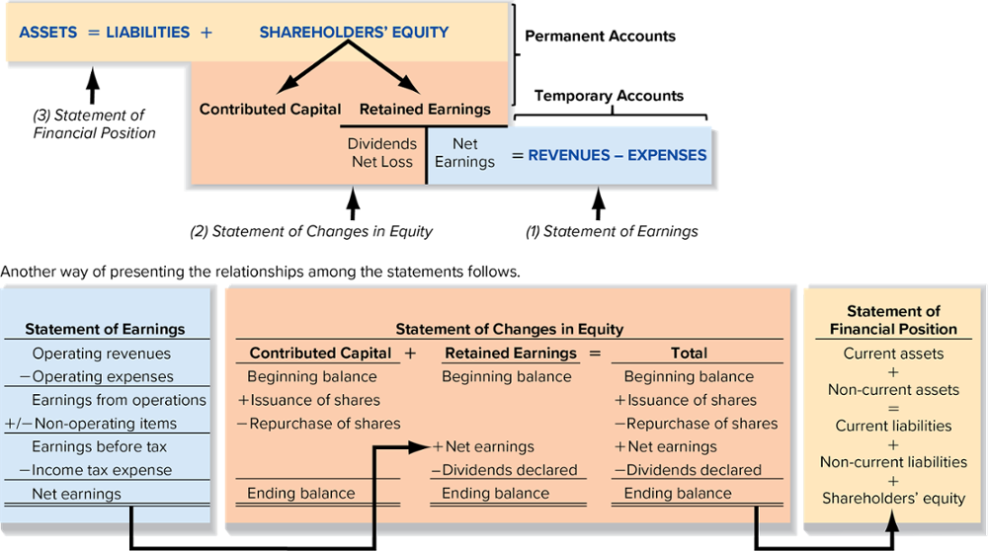
Interrelationships of Financial Statements

Slide 21
Statement of Earnings
The statement of earnings is prepared first, because net earnings is a component of retained earnings, which is reported on the statement of changes in equity.
The earnings per share (EPS) ratio is reported on the statement of earnings. It is widely used in evaluating the operating performance and profitability of a company and is the only ratio required to be disclosed on the statement or in the notes to the financial statements.

Slide 22
Earnings Per Share (EPS)
The actual calculation for EPS is quite complex and appropriate for intermediate accounting courses; however, in this text we simplify the earnings per share calculation to be:
Earnings per share =
Net earnings
Average number of common shares
Outstanding during the period

Slide 23
Statement of Changes in Equity
The final amount from the statement of earnings, net earnings, is carried forward to the retained earnings column of the statement of changes in equity.
Net earnings is an increase in Retained Earnings.
Dividends declared during the period are deducted to arrive at the ending balance. The issuance of additional shares is added to the beginning balance of contributed capital.

Slide 24
Statement of Financial Position
The ending balances under the headings contributed capital, retained earnings, and other components on the statement of changes in equity are included on the statement of financial position.
Assets are listed in order of liquidity, while liabilities are listed in order of time to maturity.
Current assets are those used or turned into cash within one year. Current liabilities are obligations to be settled within one year.

Slide 25
Net Profit Margin Ratio
The net profit margin ratio compares net earnings to the revenues generated during the period.
ANALYTICAL QUESTION → How effective is management at controlling revenues and expenses to generate more earnings?
RATIO AND COMPARISONS → The net profit margin ratio is useful in answering this question. It is computed as follows:
*Net sales is sales revenue less any returns from customers, and other reductions. For companies in the service industry, total operating revenues equals net sales.
Net Profit
Margin Ratio
Net Earnings
Net Sales (or Operating revenues)*
=

Slide 26
Net Profit Margin Ratio Interpretations
The net profit ratio margin measures how much profit is earned as a percentage of revenues generated during the period.
A rising net profit margin ratio signals more efficient management of sales and expenses.
Financial analysts expect well-run businesses to maintain or improve their net profit margin ratio over time.

Slide 27
Return on Equity (ROE)
The return on equity relates net earnings to shareholders’ investment in the business.
ANALYTICAL QUESTION → How well has management used shareholder investment to generate net earnings during the period?
RATIO AND COMPARISONS → The return on equity (ROE) helps in answering this question. It is computed as follows:
​​
*Average shareholders’ equity = (Beginning shareholders’ equity + Ending shareholders’ equity) ÷ 2
Return on
Equity
Net Earnings
=
Average Shareholders’ Equity*

Slide 28
Return on Equity Interpretations
ROE measures how much the firm earned, on average, for every dollar invested by shareholders.
In the long run, firms with higher ROE are expected to have higher share prices than firms with lower ROE, all other things being equal.
Managers, analysts, and creditors use this ratio to assess the effectiveness of the company’s overall business strategy (its operating, investing, and financing strategies).

Slide 29
How Transactions Affect Ratios
Investors and creditors follow companies key financial ratios closely, therefore, company managers closely follow the effects of their own actual and planned transactions on these same key financial ratios.
The following three-step process helps compute the effects of transactions on ratios:
  Journalize the transaction to determine its effects on various accounts.
  Determine which accounts belong to the financial statement subtotals or totals in the numerator (top) and denominator (bottom) of the ratio and the direction of their effects.
  Evaluate the combined effects from step 2 on the ratio.

Slide 30
Closing the Books
All adjusting entries are recorded and posted to update the accounts and then the financial statements are prepared.
A closing process is needed as the last step in the accounting cycle to mark the end of the current period and the beginning of the next.

Slide 31
End of the Accounting Cycle
Statement of financial position accounts are permanent (real) accounts and are not reduced to zero at the end of the accounting period. The ending balance for the current accounting period becomes the beginning account balance for the next accounting period.
However, revenue, expense, gain, loss, and dividend accounts are used to accumulate transaction effects for the current accounting period only; they are called temporary (nominal) accounts.
At the end of each period, the balances in the temporary accounts are transferred, or closed, to the retained earnings account by recording closing entries.

Slide 32
Closing Entries
The closing entries have two purposes:
To transfer the balances in the temporary accounts to retained earnings.
To establish a zero balance in each of the temporary accounts to start the accumulation in the next accounting period.

Slide 33
Steps for Closing Entries Part 1
The closing process requires three journal entries:
  one entry to close the revenue and gain accounts,
  another entry to close the expense and loss accounts, and
  a final entry to close the dividends declared account.
Income Summary, is a temporary account used only during the closing process to facilitate closing temporary accounts.

Slide 34
Steps for Closing Entries Part 2
Revenue and gain accounts, which have credit balances, are closed by debiting each account for the account balance and crediting the total amount to income summary.
Expense and loss accounts, which have debit balances, are closed by crediting each account for the account balance and debiting the total amount to income summary.

Slide 35
Steps for Closing Entries Part 3
The balance of the income summary account reflects the net earnings (loss) and is then closed to the retained earnings account.
The statement of earnings accounts are again ready for their temporary accumulation function for the next period.
Closing entries are dated the last day of the accounting period, entered in the usual format in the journal, and immediately posted to the ledger (or T-accounts).

Slide 36
Post-Closing Trial Balance
After the closing process is complete, all of the statement of earnings accounts have a zero balance. These accounts are ready for recording the effects of transactions that generate revenues and incur expenses in the new accounting period.
The ending balance in retained earnings is now up to date and is carried forward as the beginning balance for the next period.
A post-closing trial balance should be prepared as the last step of the accounting cycle to check that debits equal credits and that all temporary accounts have been closed.

Slide 37
End of Chapter Summary Part 1
Adjusting entries are necessary at the end of the accounting period to measure earnings properly, correct errors, and provide for adequate valuation of financial statement accounts.
There are four types of adjustments:
  Deferred revenues
  Accrued revenues
  Deferred expenses
  Accrued expenses

Slide 38
End of Chapter Summary Part 2
A rising net profit margin ratio signals more efficient management of revenues and expenses.
Managers, analysts, and creditors use the ROE ratio to assess the effectiveness of the company’s overall business strategy.
Temporary accounts (revenues, expenses, gains, and losses) are closed to a zero balance at the end of the accounting period to allow for the accumulation of these items in the following period and to update retained earnings for the period’s net earnings.

