Slide 1
Reporting and Interpreting Sales Revenue, Receivables, and Cash
Chapter 5
Notes:
Chapter 6: Reporting and Interpreting Sales Revenue, Receivables, and Cash.
1

Slide 2
Learning Objectives
LO5-1 Analyze and interpret the impact of credit card sales, sales discounts, sales returns, and sales of bundled items on the amounts reported as net sales.
LO5-2 Analyze and interpret the gross profit percentage.
LO5-3 Estimate, record, report, and evaluate the effects of uncollectible accounts receivable (bad debts) on financial statements.
LO5-4 Analyze and interpret the receivables turnover ratio and the effects of accounts receivable on cash flows.
LO5-5 Report, control, and safeguard cash.

Slide 3
Learning Objectives Continued
SUPPLEMENTARY MATERIAL
LO5-S1 Record and interpret the effects of credit card discounts, sales discounts, and sales returns on net sales.

Slide 4
Accounting for Net Sales Revenue Part 1
The core principle of revenue recognition requires that revenues be recorded when the company transfers goods and services to customers, in the amount it expects to be entitled to receive.
There are straightforward ways to identify when the core principle is fulfilled and the risks and benefits of ownership have transferred from the seller to the customer.
A contract, written, oral, or based on conventions and norms, will specify when the risks and benefits of ownership are transferred.

Slide 5
Accounting for Net Sales Revenue Part 2
It is customary to use the shipping terms in a sales contract to determine the point at which title (ownership) changes hands:
  When goods are shipped FOB (free on board) shipping point, title changes hands at shipment, and the buyer normally pays for shipping.
  When they are shipped FOB destination point, title changes hands on delivery, and the seller normally pays for shipping.
Revenues from goods sold FOB shipping point are normally recognized at shipment. Revenues from goods sold FOB destination point are normally recognized at delivery.

Slide 6
Accounting for Net Sales Revenue Part 3
Service companies most often record sales revenue when they have fulfilled their obligations to the buyer under the contract to which both have agreed.
Companies disclose the specific revenue recognition policies they use in the note to their financial statements titled “Significant Accounting Policies.”

Slide 7
Motivating Sales and Collections
There are a variety of methods that can be used to motivate its customers, both business and consumers, to buy products and make payments for their purchases.
The principal methods are:
  (1) allowing all customers to use credit cards to pay for purchases
  (2) providing business customers direct credit and discounts for early payment and
  (3) allowing returns from all customers under specific circumstances.
These methods, in turn, affect the way we compute net sales revenue.

Slide 8
Credit Card Sales to Customers
Companies accept credit cards for several reasons:
To increase sales.
To avoid providing credit directly to customers.
To avoid losses due to bad cheques.
To avoid losses due to fraudulent credit card sales.
To receive payment quicker.
The credit card company charges a fee for the service it provides.
The fee charged by the credit card company for its services is the credit card discount.

Slide 9
Credit Card Sales to Customers - Example
If daily credit card sales were $3,000, and the credit card company charges a 3% service fee, the following would be reported:
Journal Entry
Cash 2,910
Credit card discount 90
    Sales (or Revenue) 3,000
Gross sales |  | $3,000
Less: Credit card discount (0.03 × $3,000) |  | 90
Net sales (reported on the statement of earnings) |  | $2,910

Slide 10
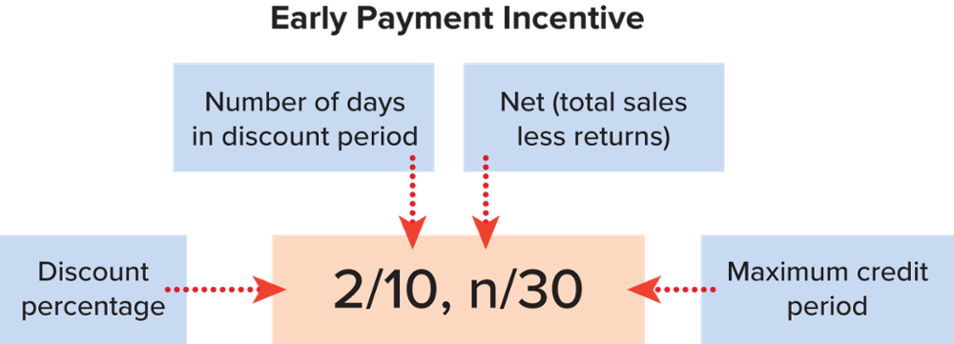
Sales Discounts to Businesses
A sales (or cash) discount is offered to the business customer to encourage prompt payment of a trade account receivable.

Slide 11
Sales Discounts to Businesses - Example
If credit sales are recorded with terms 2/10, n/30 and payment of $980 (= $1,000 × 0.98) is made within the discount period, net sales of the following amount would be reported:
At time of sale
Accounts receivable 980
Revenue 980
Collection
Cash 980
Accounts receivable 980
Gross sales |  | $1,000
Less: Sales discounts (0.02 × $1,000) |  | 20
Net sales (reported on the statement of earnings) |  | $ 980

Slide 12
Sales Returns
The amount of expected product returns can be estimated based on past experience, subsequent to the sale transaction.
The estimated amount of sales returns is then subtracted from the gross sales to determine the net sales revenue.
For example, a customer bought 40 dozen T-shirts from Gildan for $2,000 on account. If the company expects 5% of the T-shirts to be returned for credit, then Gildan would compute net sales as follows:
Gross sales |  | $2,000
Less: Estimated sales returns (0.05 × $2,000) |  | 100
Net sales (reported on the statement of earnings) |  | $1,900

Slide 13
Reporting Net Sales
The amount of sales revenue to record is the amount the company expects to be entitled to receive.
Consequently, credit card fees, sales discounts, and estimated sales returns must be subtracted to compute net sales.
Gross sales
Less: Credit card discounts
Sales discounts
Estimated sales returns
Net sales (reported on the first line of the statement of earnings)

Slide 14
Revenue Recognition for Bundled Goods & Services Part 1
As customers, we make frequent purchases and we know that some purchases are paid for completely at the point of sale, some have warranties, and return opportunities, and others have benefits attached to the purchase that are provided over time.
Accountants refer to this type of sale as a bundle of goods and services in a sales contract, which is an agreement between two or more parties that creates enforceable rights and obligations.

Slide 15
Revenue Recognition for Bundled Goods & Services Part 2
Bundling of goods and services within one sales contract is common in a variety of industries.
When a seller promises to provide more than one good or service in a single sales contract, International Financial Reporting Standards specify a five-step process to determine the amount to be recognized as revenue.
Step 1: Identify the contract between the company and customer.
Step 2: Identify the performance obligations (promised goods and services).
Step 3: Determine the transaction price.
Step 4: Allocate the transaction price to the performance obligations.
Step 5: Recognize revenue when each performance obligation is satisfied (or over time if a service is provided over time).

Slide 16
Key Ratio Analysis – Gross Profit Percentage
ANALYTICAL QUESTION → How effective is management at selling goods and services for more than the costs to purchase or produce them?
RATIO AND COMPARISONS → The gross profit percentage is helpful in answering this question. It is computed as follows:
Interpretation in General → The gross profit percentage measures how much gross profit is generated from every sales dollar. It reflects the ability to charge premium prices and produce goods and services at low cost. All other things being equal, a higher gross profit results in higher net earnings.
Gross Profit
Percentage
Gross Profit
Net Sales
=

Slide 17
Measuring and Reporting Receivables Part 1
Receivables may be classified in three common ways:
  First, in a statement of financial position, receivables are classified as either current or non-current assets (short-term or long-term), depending on whether the cash is expected to be collected within one year of the date of the statement.
  Second, a receivable may be either an account receivable or a note receivable.
  Third, receivables may be classified as trade or non-trade receivables.

Slide 18
Measuring and Reporting Receivables Part 2
Accounts receivable are created when companies have sales to customers on open accounts.
Notes receivable are written promises from another party to pay with specified terms.
Trade receivables are open accounts owed to the business by trade customers and are created in the normal course of business when there is a sale of merchandise or services on credit.
Non-trade receivables are amounts owed to the business for other than normal business transactions.

Slide 19
Accounting for Bad Debts
Bad debts result from credit customers who will not pay the amount they owe, regardless of collection efforts.
The expense recognition principle requires the recording of bad debt expense in the same accounting period as the one in which the related sales are made.
This presents an important accounting problem, companies may not know which particular customers will not pay until the next accounting period, therefore not knowing which customers’ accounts receivable are bad debts.

Slide 20
Allowance Method Part 1
The allowance method is used to measure bad debt expense.
The allowance method is based on an estimate of the expected amount of uncollectible accounts.
There are two primary steps in applying the allowance method:
  Estimating bad debt expense and recording the end-of-period adjusting entry
  Writing off specific accounts determined to be uncollectible during the period

Slide 21
Allowance Method Part 2
The estimation of bad debts is an example of prudence, whereby the company deducts the estimated amount of bad debts from the ending balance of accounts receivable and reports the net realizable value of accounts receivable on the statement of financial position.

Slide 22
Recording Bad Debt Expense Estimates Part 1
Bad debt expense (doubtful accounts expense) is the expense associated with estimated uncollectible accounts receivable.
Bad debt expense is recorded through an adjusting entry at the end of the accounting period.
Bad debt expense decreases net earnings and shareholders’ equity.
Accounts receivable is not credited in the journal entry, because there is no way to know which customers’ accounts receivable are involved.

Slide 23
Recording Bad Debt Expense Estimates Part 2
The credit is made, instead, to the account called allowance for doubtful accounts (allowance for doubtful receivables, allowance for bad debts), a contra-asset account containing the estimated uncollectible accounts receivable.
As a contra asset, the balance in allowance for doubtful accounts is always subtracted from the balance of the asset accounts receivable.
Thus, the entry decreases the net realizable value of accounts receivable and total assets.

Slide 24
Writing Off Specific Doubtful Accounts
When it is determined that a customer will not pay its debt (e.g., due to bankruptcy), the write-off of that individual receivable is recorded through a journal entry.
When a specific accounts receivable has been identified as uncollectible, it must be removed from the appropriate accounts receivable account.
At the same time, the previously established allowance for such a doubtful receivable is no longer needed and should be removed from the allowance for doubtful accounts.

Slide 25
Recovery of Bad Debts
When a customer makes a payment on an account previously written off, the initial journal entry to write off the account is reversed for the amount that is collected, and another journal entry is made to record the collection of cash.
The net effect of the recovered amount on accounts receivable is zero.
The recovered amount is first recorded in accounts receivable to reinstate the amount in the customers’ accounts and show that the customers have honoured their previous commitments.

Slide 26
Summary of the Accounting Process
Accounting for bad debts is a three-step process:
Financial
Statement Effects
Step
Timing
Accounts Affected
1. Record
estimated
bad debts
adjustment
2. Identify and
write off
actual bad
debts
3. Record recovery
of bad debts that
were written off
previously
End of period in which sales are made
Throughout
period as bad
debts become
known
Throughout period as bad debts are recovered
Bad Debt Expense (E)
Allowance for Doubtful Accounts (XA)
Accounts Receivable (A)
Allowance for Doubtful Accounts (XA)
Accounts Receivable (A)
Allowance for doubtful accounts (XA)
Cash (A)
Net Earnings
Assets (Accounts
Receivable, Net)
Net Earnings
Assets (Accounts
Receivable, Net)
Net earnings
Assets (A/R, Net)
Cash
No
effect
No
effect

Slide 27
Estimating Bad Debts
The bad debt expense recorded in the end-of-period adjusting entry is often estimated based on either:
  A percentage of total credit sales for the period or
  An aging of accounts receivable.
Both methods are acceptable under IFRS.
The percentage of credit sales method is simpler to apply, but the aging method is generally more accurate.

Slide 28
Percentage of Credit Sales Method
The percentage of credit sales method bases bad debt expense on the historical percentage of credit sales that result in bad debts.
The average percentage of credit sales that result in bad debts can be computed by dividing total bad debts by total credit sales.
A company that has been operating for some years has sufficient experience to estimate probable future bad debts.

Slide 29
Aging of Accounts Receivable Method
The aging of accounts receivable method estimates uncollectible accounts based on the age of each account receivable.
As accounts receivable become older and overdue they are usually less likely to be collectible.
For example, a receivable that is due in 30 days but has not been paid after 60 days is more likely to be collected, on average, than a similar receivable that still remains unpaid after 120 days.

Slide 30
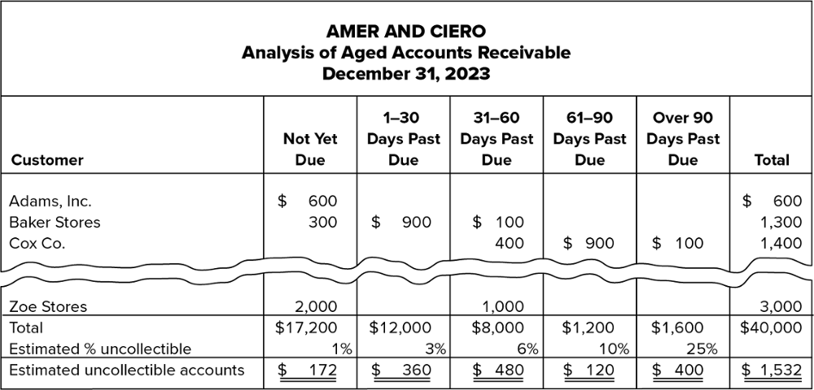
Aging of Accounts Receivable Method - Example
This illustration of the aging schedule results in an estimate of total uncollectible amounts of $1,532, the estimated ending balance that should be in the allowance for doubtful accounts.
From this, the adjustment to record bad debt expense (and an increase in the allowance for doubtful accounts) for 2023 would be calculated.

Slide 31
Comparison of the Two Methods
It is important to recognize that the approach to recording bad debt expense using the percentage of credit sales method is different from that for the aging of accounts receivable method:
Percentage of credit sales. Directly compute the amount to be recorded in the adjusting entry as bad debt expense for the period.
Aging of accounts receivable. Compute the estimated ending balance of the allowance for doubtful accounts. The difference between the current balance in the account and the estimated balance is recorded as the adjusting entry for bad debt expense for the period.

Slide 32
Actual Write-offs Compared with Estimates
The amount of uncollectible accounts actually written off seldom equals the estimated amount previously recorded.
This error in estimating bad debts is taken into consideration in determining the bad debt expense at the end of the next accounting period.
When estimates are found to be incorrect, financial statement values for prior annual accounting periods are not corrected.

Slide 33
Prudence in the Valuation of Accounts Receivable Part 1
Prudence is the exercise of caution when making judgments under conditions of uncertainty.
Potential investors, creditors, and other stakeholders prefer that managers avoid overstating both revenue and assets such as receivables, and understating both liabilities and expenses such as bad debts.
Managers fulfill their duty of care when they choose prudent credit policies, which align with the preferences of stakeholders.

Slide 34
Prudence in the Valuation of Accounts Receivable Part 2
Accountants are also required to exercise a professional duty of care, professional skepticism, and judgment to fulfill the requirements of the Professional Code of Conduct.
They too must be prudent and are held to a higher level of responsibility because their professional education and experience combine to provide accountants with exceptional skills to assess how well managers have safeguarded assets.

Slide 35
Key Ratio Analysis – Receivables Turnover Ratio
ANALYTICAL QUESTION → How effective are credit granting and collection activities?
RATIO AND COMPARISONS → An answer to this question is provided by the receivables turnover ratio, which is computed as follows:
Interpretations in General → The receivables turnover ratio reflects how many times average accounts receivable are recorded and collected during the period.
The higher the ratio, the faster the collection of receivables.
Receivables Turnover Ratio
Net Credit Sales
Average Net Accounts Receivable
=

Slide 36
Internal Control and Management Responsibility
The term internal control refers to the process by which a company’s board of directors, audit committee, management, and other personnel provide reasonable assurance that the accounting system minimizes the risk of both types of fraud, either misappropriation of assets or material misstatement of reported financial information.
The internal control system must assure both the effectiveness and efficiency of the company’s operations, and its compliance with all laws and regulations.
Accountants assess how well managers have developed a company’s system of internal control, which prevents and detects both fraud and inadvertent material misstatement of the company’s financial position.

Slide 37
Control over Accounts Receivable
To guard against the extending of credit to non-worthy customers, the following practices can help minimize bad debts:
Require approval of customers’ credit history by a person independent of the sales and collection functions
Monitor the age of accounts receivable periodically, and contact customers with overdue payments
Reward both sales and collection personnel for speedy collections so that they work as a team.

Slide 38
Cash and Cash Equivalents Part 1
Cash is defined as money or any instrument that banks will accept for deposit and immediate credit to the company’s account, such as a cheque, money order, or bank draft.
Cash is usually divided into three categories: cash on hand, cash deposited in banks, and other instruments that meet the definition of cash.

Slide 39
Cash and Cash Equivalents Part 2
Cash equivalents are as short-term, highly liquid investments that are readily convertible to known amounts of cash and that are subject to an insignificant risk of changes in value.
Typical instruments included as cash equivalents are bank certificates of deposit, and Treasury bills issued by the government to finance its activities.

Slide 40
Cash Management
Cash Management Procedures include:
Accurate accounting so that reports of cash flows and balances may be prepared.
Controls to ensure that enough cash is on hand to meet (a) current operating needs, (b) maturing liabilities, and (c) unexpected emergencies.
Prevention of the accumulation of excess amounts of idle cash. Idle cash earns no revenue; therefore, it is often invested in securities to earn revenue (return) until it is needed for operations.

Slide 41
Internal Control of Cash
Because cash is the asset most vulnerable to theft and fraud, a significant number of internal control procedures should focus on cash.
Effective internal control of cash should include the following:
Separation of duties related to cash handling and recordkeeping.
Prescribed policies and procedures.

Slide 42
Separation of Duties
Separation of duties related to cash handling and recordkeeping:
Complete separation of the tasks of receiving cash and disbursing cash ensures that the individual responsible for depositing cash has no authority to sign cheques.
Complete separation of the procedures of accounting for cash receipts and cash disbursements ensures, for example, that those handling sales returns do not create fictitious returns to conceal cash shortages.
Complete separation of the physical handling of cash and all phases of the accounting function ensures that those either receiving or paying cash have no authority to make accounting entries.

Slide 43
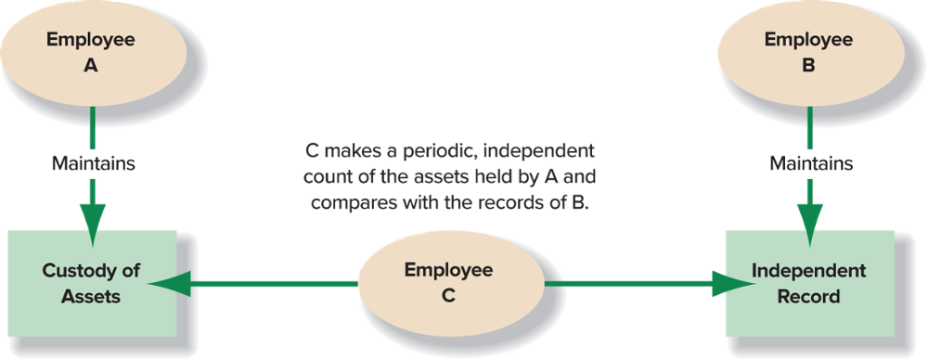
Separation of Duties Contributes to Strong Internal Control

Slide 44
Typical Internal Controls for Cash
Internal Control Component |  | Prescribed Policies or Procedures
Cash budget |  | Prepare a monthly forecast of cash receipts, disbursements, and balances for the year, and require that managers document and justify any deviations from the budget each month. This is important in order to detect differences quickly and remedy them as soon as possible.
Cash receipts |  | Prepare a listing of cash receipts on a daily basis. In practice, this often takes the form of cash register receipts or a descriptive list of incoming cheques. Require that all cash receipts be deposited in a bank daily. Keep any cash on hand under strict control. In so doing, the amount of actual cash accessible is kept to a minimum each day and the loss from theft is minimized.
Cash payments |  | Require separate approval of the purchases and other expenditures and separate approval of the actual cash payments. Assign the cash-payment approval and the actual cheque-signing responsibilities to different individuals. Use pre-numbered cheques and pay special attention to payments by electronic funds transfers, since the bank does not process controlled documents (cheques). Once in place, this procedure will require at least four employees to collude to misappropriate funds (steal cash) from the company.
Independent internal verification |  | Require comparison, by an independent supervisor, of cash receipts to bank deposits and of cheques issued to invoices. Require monthly reconciliation of bank accounts with the cash accounts on the company’s books (discussed in detail in the next section). This is important in order to detect differences quickly and remedy them as soon as possible.
Rotation of duties |  | Require that employees take vacations, and rotate their duties. Any economic crime already under way will be interrupted by an extended absence of a perpetrator; this provides an opportunity for others to detect the crime.

Slide 45
Reconciliation of the Cash Accounts and the Bank Statements
Proper use of the bank accounts of a business can be an important internal control procedure for cash.
Every month, the bank provides the company (the depositor) with a bank statement.
The bank statement and the online banking site list:
Each paper or electronic deposit recorded by the bank during the period,
Each paper or electronic cheque cleared by the bank during the period,
The bank charges or deductions (such as service charges) made directly to the company’s account by the bank, and
The balance in the company’s account.

Slide 46
Need for Reconciliation
A bank reconciliation is a schedule that explains the difference between the ending cash balance in the company’s records and the ending cash balance reported by the bank on the monthly bank statement (or on the online banking site).
A bank reconciliation should be completed for each separate chequing account at the end of each month.
Usually, the ending cash balance as shown on the bank statement does not agree with the ending cash balance shown by the related cash ledger account on the books of the company.

Slide 47

Bank Reconciliation Part 1
The flow of documents that have not reached either the company or the bank by the end of the accounting period is illustrated below:

Slide 48
Bank Reconciliation Part 2
Most common causes of differences between the ending bank balance and the ending book balance of cash are as follows:
  Outstanding cheques
  Deposits in transit
  NSF cheques
  Bank service charges
  Interest
  Errors

Slide 49
Bank Reconciliation Illustrated
The general format for the bank reconciliation is:
Ending cash balance per books |  | $xxx |  | Ending cash balance per bank statement |  | $xxx
+ Interest paid by bank |  | xx |  | + Deposits in transit |  | xx
− NSF cheques/Service charges |  | xx |  | − Outstanding cheques |  | xx
± Company errors |  | xx |  | ± Bank errors |  | xx
Ending correct cash balance |  | $xxx |  | Ending correct cash balance |  | $xxx

Slide 50
Bank Reconciliation Part 3
Steps to follow in preparing the bank reconciliation:
Identify the outstanding cheques
Identify the deposits in transit.
Identify bank charges and credits not recorded on the company’s books.
Determine the impact of errors.
Note: all of the additions and deductions on the company’s-books side of the reconciliation need journal entries to update the cash account. The additions and deductions on the bank-statement side do not need journal entries because they will work out automatically when they clear the bank.

Slide 51
Appendix 5A: Recording Discounts and Returns Part 1
The five-step model of revenue recognition illustrated in the chapter consists of five steps:
  Identify the contract between the company and customer.
  Identify the performance obligations (promised goods and services).
  Determine the transaction price.
  Allocate the transaction price to the performance obligations.
  Recognize revenue when each performance obligation is satisfied (or over time if a service is provided over time).
All five steps must be satisfied before revenue can be recognized.

Slide 52
Appendix 5A: Recording Discounts and Returns Part 2
This appendix considers three separate sales transactions involving:
  Credit card sales to customers
  Credit sales to businesses
  Sales returns
The appendix goes through these three separate sales transactions and shows the journal entries to record them.

Slide 53
End of Chapter Summary
Credit card discounts, sales or cash discounts, and sales returns reduce net sales. Sales of bundled items must be accounted for using the five-step process to allocate the sales price to performance obligations.
The gross profit percentage measures the ability to charge premium prices and produce goods and services at lower cost.
Managers, analysts, and creditors use this ratio to assess the effectiveness of the company’s product development, marketing, and production strategy.

Slide 54
End of Chapter Summary Continued
When receivables are material, companies must employ the allowance method to account for uncollectibles. The steps in the process are as follows:
Write off specific accounts determined to be uncollectible during the period.
Recover amounts previously written off.
Prepare the end-of-period adjusting entry to record an estimate of bad debt expense.
The adjusting entry reduces net earnings as well as net accounts receivable. The related expense must be recorded as an operating expense. The write-off of accounts receivable affects neither net earnings nor net accounts receivable.

