Slide 1
Reporting and Interpreting Cost of Sales
and Inventory
Chapter 6
Notes:
Chapter 7: Reporting and Interpreting Cost of Sales and Inventory.
1

Slide 2
Learning Objectives
LO6-1 Apply the cost principle to identify the amounts that should be included in inventory, and apply the expense recognition principle to determine the cost of sales for typical retailers, wholesalers, and manufacturers.
LO6-2 Record inventory and cost of sales by using three inventory costing methods.
LO6-3 Select the inventory costing method that reports the most faithful representation and relevant information to users of financial statements.
LO6-4 Report inventory at the lower of cost and net realizable value (LC&NRV).

Slide 3
Learning Objectives Continued
LO6-5 Describe methods for controlling inventory, and analyze the effects of inventory reporting errors on financial statements.
LO6-6 Evaluate inventory management by using the inventory turnover ratio, and analyze the effects of inventory on cash flows.
SUPPLEMENTARY MATERIAL
LO6-S1 Report inventory and cost of sales in a periodic inventory system.
LO6-S2 Compare and contrast the recording of inventory transactions in periodic and perpetual inventory systems.

Slide 4
Understanding the Business
Primary Goals of Inventory Management:
  Provides sufficient quantities of high-quality inventory.
  Minimizes the costs of carrying inventory.
Roles of the Accounting System:
  Provides accurate information
  Provides up-to-date information
  Provides information to help protect and control assets

Slide 5
Inventory
Inventory is a tangible asset that is either:
  Held for sale in the ordinary course of business or
  Used in the process to produce goods for sale or render services.
Inventory is reported on the statement of financial position as a current asset, because it is normally used or converted into cash within one year or within the next operating cycle of the business, whichever is longer.
The types of inventory normally held depend on the characteristics of the business.

Slide 6
Items Included in Inventory
Merchandisers hold Merchandise inventory.
  These are finished goods (or merchandise) held for resale in the ordinary course of business. The goods are usually acquired by the merchandiser in a finished condition and are ready for sale without further processing.
Manufacturing businesses hold three types of inventory:
Raw materials inventory
Work-in-process inventory
Finished goods inventory

Slide 7
Manufacturing Types of Inventory
Raw materials inventory: This consists of items acquired by purchase, growth (such as food products), or extraction (natural resources) for processing into finished goods. Such items are included in raw materials inventory until used, at which point they become part of work-in-process inventory.
Work-in-process inventory: This includes goods in the process of being manufactured but not yet complete. When complete, work-in-process inventory becomes finished goods inventory.
Finished goods inventory: This consists of manufactured goods that are complete and available for sale.

Slide 8
Environmental, Social, and Governance Reporting
IFRS detail the type of depiction of sustainability-related information as a neutral and faithful representation of its sustainability-related financial information.
The information must be a sufficient basis on which users can assess the implications of sustainability-related risks and opportunities on the entity’s enterprise value.

Slide 9
Costs Included in Inventory Purchases
Goods in inventory are initially recorded at cost.
The primary basis of accounting for inventory is cash-equivalent cost, which is either the price paid or consideration given to acquire an asset.
Inventory cost includes the sum of the costs incurred in bringing an article to a usable or saleable condition and location.
Any purchase returns and allowances or purchase discounts taken are subtracted.

Slide 10
Flow of Inventory Costs
Direct labour cost represents the earnings of employees who work directly on the products being manufactured.
Factory overhead costs include all other manufacturing costs that are not raw material or direct labour costs.
There are three stages to inventory cost flows for both merchandisers and manufacturers.
  The first involves purchasing and/or production activities.
  The second stage, these activities result in additions to inventory accounts on the statement of financial position.
  The third stage, the inventory items are sold and the amounts become cost of sales on the statement of earnings.

Slide 11
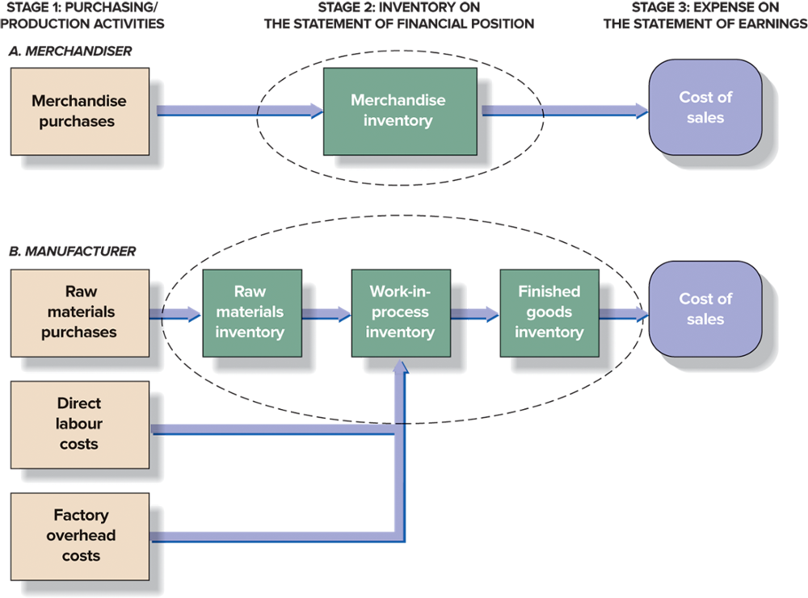
Flow of Inventory Costs – Exhibit 6.2

Slide 12
Cost of Sales Equation Part 1
Cost of sales (COS) is directly related to sales revenue.
Sales revenue during an accounting period is the number of units sold multiplied by the sales price.
Cost of sales is the same number of units, multiplied by their unit costs.
It includes all costs of the merchandise or the finished goods sold during the period.

Slide 13
Cost of Sales Equation Part 2
Each accounting period is started with a stock of merchandise inventory called beginning inventory (BI).
During the accounting period, new purchases (P) are added to inventory.
The sum of the cost of beginning inventory and the cost of purchases (or additions to its merchandise inventory) is the cost of goods available for sale during that period.
What remains unsold at the end of the period becomes ending inventory (EI) on the statement of financial position.

Slide 14
Cost of Sales Equation Part 3
The portion of the cost of goods available for sale that are actually sold becomes cost of sales on the statement of earnings.
The ending inventory for one accounting period then becomes the beginning inventory for the next period.
The relationships between these various amounts are brought together in the cost of sales equation:
BI + P − EI = COS

Slide 15
Cost of Sales Equation Part 4
Beginning inventory
+ Purchases of merchandise during the year
Cost of goods available for sale
- Ending inventory
Cost of sales

Slide 16
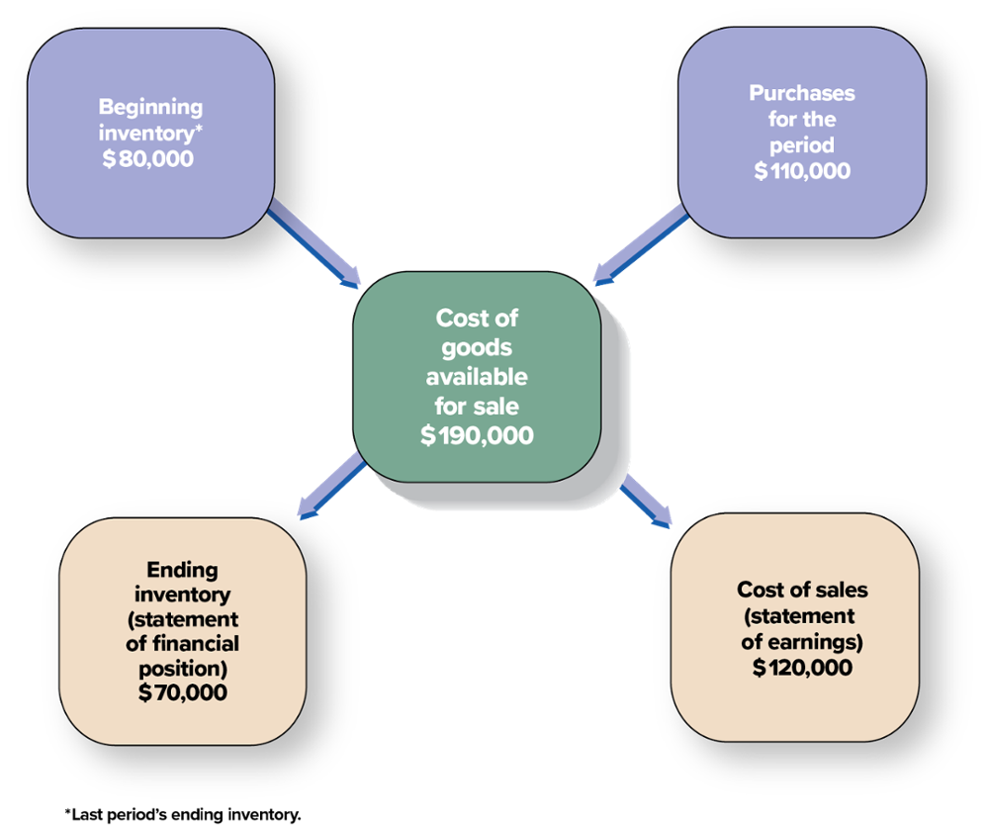
Nature of Cost of Sales for Merchandise Inventory

Slide 17
Perpetual and Periodic Inventory Systems
To calculate cost of sales, three amounts must be known:
  Beginning inventory;
  Purchases of merchandise, or additions to finished goods, during the period; and
  Ending inventory.
The amount of purchases for the period is always accumulated in the accounting system.
The cost of sales and cost of ending inventory can be determined by using one of two different inventory systems: perpetual and periodic.

Slide 18
Perpetual Inventory System Part 1
In a perpetual inventory system, purchase transactions are directly recorded in an inventory account.
Simultaneously, when each sale is recorded, a companion cost of sales entry is made, decreasing inventory and recording cost of sales.
As a result, information on cost of sales and ending inventory is available on a continuous (perpetual) basis.

Slide 19
Perpetual Inventory System Part 2
A detailed record is maintained for each type of merchandise stocked, showing:
  Units and cost of the beginning inventory,
  Units and cost of each purchase,
  Units and cost of the goods for each sale, and
  Units and cost of the goods on hand at any point in time.
This up-to-date record is maintained on a transaction-by-transaction basis and is usually necessary for purchasing, manufacturing, and distribution decisions.

Slide 20
Periodic Inventory System Part 1
Under the periodic inventory system, companies do not maintain an ongoing record of inventory during the year; rather, an actual physical count of the goods remaining on hand is required at the end of each period.
The number of units of each type of merchandise on hand is multiplied by their unit cost to compute the total cost of the ending inventory.
Cost of sales is calculated by using the cost of sales equation.

Slide 21
Periodic Inventory System Part 2
Because the amount of inventory is not known until the end of the period when the physical inventory count is taken, the cost of sales cannot be determined reliably until the inventory count is completed.
Inventory purchases are debited to a temporary account called purchases.
Revenues are recorded at the time of each sale.
However, the cost of sales is not recorded until after the inventory count is completed.
At all other times, companies using a periodic system must estimate the value of inventory on hand.

Slide 22
Recording Inventory Transactions in a Perpetual System Part 1
Sellers of merchandise or raw materials use a variety of methods to motivate their customers to buy the products they offer.
The principal methods include:
  (1) allowing customers to make purchases on account and pay later,
  (2) offering business customers discounts for early payment, and
  (3) allowing returns from all customers under specific circumstances.

Slide 23
Recording Inventory Transactions in a Perpetual System Part 2
The amount recorded for inventory purchases should include the invoice price to be paid plus other expenditures related to the purchase, such as import duties, transportation charges (freight-in), as well as inspection and preparation costs.
Any purchase returns and allowances or purchase discounts taken are subtracted.

Slide 24
Inventory Purchases
The point at which title (ownership) changes hands is determined by the shipping terms in the purchase contract, as explained in Chapter 5.
When goods are shipped FOB (free on board) destination point, title changes hands on delivery at the buyer’s location, and the seller pays the shipping costs.
When they are shipped FOB shipping point, title changes hands on delivery at the seller’s location, and the buyer pays for shipping.

Slide 25
Purchase Returns and Allowances
Goods purchased may be returned to the supplier if they do not meet specifications, arrive in damaged condition, or are otherwise unsatisfactory.
Alternatively, the buyer may keep the unsatisfactory goods and benefit from a cost reduction or allowance.
The effect of purchases returns or allowances on the cost of purchases must be measured.
The buyer normally receives a cash refund or a reduction in the liability owed to the supplier.
Purchase returns and allowances are treated as a reduction in the cost of inventory purchases associated with unsatisfactory goods.

Slide 26
Purchase Discounts
Cash discounts must be accounted for by both the buyer and the seller (seller was discussed in Chapter 5).
When inventory is purchased on credit, terms such as 2/10, n/30 are sometimes specified. These terms mean that if payment is made within 10 days from the date of purchase, the buyer can deduct a 2 percent purchase discount for prompt payment.
If payment is not made within the discount period, the amount owed (net of purchases returns and allowances) is due 30 days after the date of purchase.

Slide 27
Inventory Costing Methods
There are three generally accepted inventory costing methods available to determine the cost of sales:
  Specific identification
  First-in, first-out (FIFO)
  Weighted average
These methods are alternative ways to assign the total cost of goods available for sale between (1) ending inventory and (2) cost of sales.
International Accounting Standard 2 requires only that the inventory costing method used be rational and systematic; it should be the one that provides a faithful representation of expenses to correspond to the revenues earned during the period.

Slide 28
Specific Identification Method Part 1
The specific identification method requires that the cost of each item sold be individually identified and recorded as cost of sales.
It cannot be used when units are identical because the method may be manipulated without electronic tracking of the units sold.
It is easy to affect the cost of sales and the ending inventory accounts by picking and choosing from among the several available unit costs. For this reason, IFRS prohibit the use of specific identification when there are large numbers of inventory items that are interchangeable, such as leather jackets of the same size and style.

Slide 29
Specific Identification Method Part 2
The specific identification method is impractical when large quantities of similar items are kept in stock.
It is appropriate, however, when dealing with very expensive items, such as broadband telecommunications systems, aircraft, yachts, fine art objects, buildings, luxury cars, and fine jewellery, because each item tends to differ from the other items.
Technology assists in keeping track of the purchase cost of each item. This is done by either (1) coding the purchase cost on each unit before placing it in stock or (2) keeping a separate record of the unit and identifying it with a serial number.

Slide 30
Cost Flow Assumptions
Most inventory items are accounted for by using one of two cost flow assumptions.
The choice of an inventory costing method is not based on the physical flow of goods on and off the shelves.
The first-in, first-out (FIFO) method assumes that the earliest goods purchased (the first ones in) are the first ones sold (the first ones out) and the last ones purchased remain in ending inventory.
FIFO allocates the oldest unit costs to cost of sales and the newest unit costs to ending inventory.

Slide 31
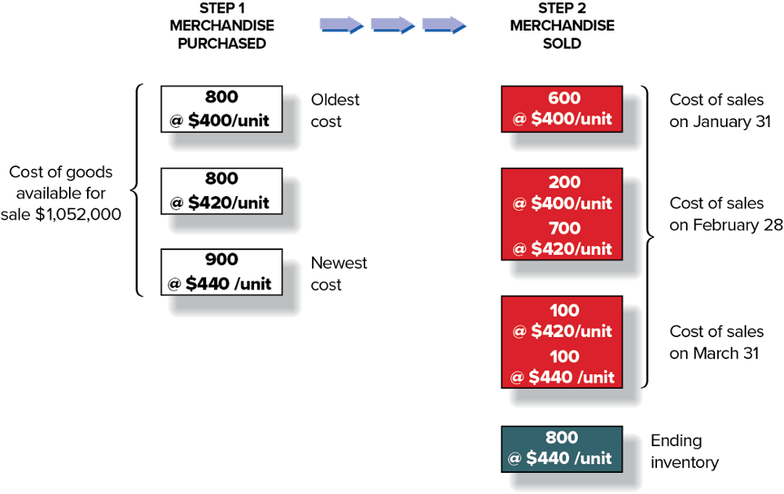
FIFO Inventory Flows – Perpetual Inventory System; Exhibit 6.5 Part 1

Slide 32
FIFO Inventory Flows – Perpetual Inventory System; Exhibit 6.5 Part 2
Cost of Sales Calculation (FIFO Perpetual)
Cost of Jackets Purchased and Sold
Date |  |  | Units |  | Cost |  | Total
January 1 | Beginning inventory | Oldest cost | 800 | × | $400 | = | $320,000
January 31 | Cost of sales |  | (600) | × | $400 | = | (240,000)
 | Cost of remaining inventory |  | 200 | × | $400 | = | 80,000
February 5 | Purchase |  | 800 | × | $420 | = | 336,000
 | Cost of goods available for sale |  | 1,000 |  |  |  | 416,000
February 28 | Cost of sales (900 units) |  | (200) | × | $400 | = | (80,000)
 |  |  | (700) | × | $420 | = | (294,000)
 | Cost of remaining inventory |  | 100 | × | $420 | = | 42,000
March 10 | Purchase | Newest cost | 900 | × | $440 | = | 396,000
 | Cost of goods available for sale |  | 1,000 |  |  |  | 438,000
March 31 | Cost of sales (200 units) |  | (100) | × | $420 | = | (42,000)
 |  |  | (100) | × | $440 | = | (44,000)
 | Ending inventory |  | 800 | × | $440 | = | 352,000
 | Cost of sales* |  |  |  |  |  | $700,000
*Cost of sales = $240,000 + $80,000 + $294,000 + $42,000 + $44,000 = $700,000

Slide 33
Weighted-Average Cost Method
The weighted-average cost method requires calculating the weighted-average unit cost of the goods available for sale.
When a unit is sold, the average cost of each unit in inventory is assigned to cost of sales.
Ending Inventory
Units in Ending Inventory × Average Cost per Unit
Cost of Sales
Units Sold × Average Cost per Unit
Cost of Goods Available for Sale
Number of Units Available for Sale
÷

Slide 34
Average Cost Inventory Flows – Perpetual Inventory System;
Cost of Sales Calculation (Avg Cost Perpetual)
Cost of jackets purchased and sold
Date |  |  | Units |  | Cost |  | Total
January 1 | Beginning inventory |  | 800 | × | $400 | = | $320,000
January 31 | Cost of sales |  | (600) | × | $400 | = | (240,000)
 | Cost of remaining inventory |  | 200 | × | $400 | = | 80,000
February 5 | Purchase |  | 800 | × | $420 | = | 336,000
 | Cost of goods available for sale |  | 1,000 |  | 416 |  | 416,000
February 28 | Cost of sales (900 units) |  | (900) | × | $416 | = | (374400)
 | Cost of remaining inventory |  | 100 | × | $416 | = | 41,600
March 10 | Purchase |  | 900 | × | $440 | = | 396,000
 | Cost of goods available for sale |  | 1,000 |  | 437.600 |  | 437,600
March 31 | Cost of sales (200 units)
 |  |  | (200) | × | $437.60 | = | (87,520)
 | Ending inventory |  | 800 | × | $218.80 | = | 350,080
 | Cost of sales* |  |  |  |  |  | $701,920

Slide 35
Financial Statement Effects of Inventory Costing Methods
Advantages of Methods:
  First-In, First-Out → Ending inventory approximates current replacement cost.
  Weighted Average → Smooths out price changes.
 | Normal Financial Statement Effects of:
 | Rising Costs |  | Declining Costs
 | FIFO | Weighted Average | FIFO | Weighted Average
Cost of sales | Lower | Higher | Higher | Lower
Gross profit | Higher | Lower | Lower | Higher
Net earnings | Higher | Lower | Lower | Higher
Ending inventory | Higher | Lower | Lower | Higher

Slide 36
Consistency in Use of Inventory Costing Methods Part 1
Regardless of the physical flow of goods, a company can use either the weighted-average or the FIFO inventory costing method.
Companies are expected to select the most representationally faithful inventory costing method.
The cost of inventory is supposed to reflect most accurately the anticipated benefit that will eventually be realized from either the use or the sale of the inventory.
Therefore, a company is not required to use the same inventory costing method for all inventory items. The justification arises from the pervasive principle of economic substance over form.

Slide 37
Consistency in Use of Inventory Costing Methods Part 2
To enhance comparability, accounting rules require companies to apply their accounting methods on a consistent basis.
A company is not permitted to use FIFO one period, weighted average the next, and then FIFO the next.
A change in method is allowed only if the change will improve the measurement of financial results and financial position.
Changing from one inventory costing method to another is a significant event. Such a change requires full disclosure of the reason for the change and the accounting effects.

Slide 38
Managers’ Choice of Inventory Costing Methods Part 1
In principle, managers should choose the method that best reflects the company’s economic circumstances for financial reporting purposes.
In practice, most managers choose generally accepted accounting methods based on two factors:
  Effect on net earnings (managers prefer to report higher earnings for their companies).
  Effect on income taxes (managers prefer to pay the least amount of taxes allowed by law, as late as possible: the least–latest rule).

Slide 39
Managers’ Choice of Inventory Costing Methods Part 2
Because accounting standards and tax laws differ, management must also choose an inventory costing method to use on the company’s tax return (for tax purposes).
In general, most companies choose to use the same inventory costing method for both financial reporting and tax reporting purposes.

Slide 40
Valuation at Lower of Cost and Net Realizable Value Part 1
Ending inventory is reported at the lower of cost or net realizable value (LC&NRV).
Net Realizable Value (NRV) is the expected sales price less estimated selling costs (e.g., repair and disposal costs).
This valuation rule is a departure from the cost principle and is particularly important for two types of companies:
  (1) high-technology companies, such as Apple, that manufacture goods for which the cost of production and the selling price are declining and
  (2) companies like Canada Goose that sell seasonal goods, the value of which drops dramatically at the end of each selling season.

Slide 41
Valuation at Lower of Cost and Net Realizable Value Part 2
Under LC&NRV, companies recognize a loss in the period in which the net realizable value of an item drops rather than in the period in which the item is sold.
The loss is the difference between the purchase cost and the net realizable value and is added to the cost of sales of the period.

Slide 42
Valuation at Lower of Cost and Net Realizable Value Part 3
If the NRV of the inventory items that were written down increases in a subsequent accounting period because of changed economic circumstances, then the amount of the write-down is reversed up to the original cost, so that the new carrying amount of the inventory is the lower of the cost and the revised net realizable value.
Normally, a reversal of a previous write-down occurs when an inventory item that is carried at NRV is still on hand in a subsequent period when its selling price has increased.
Under IFRS, the LC&NRV rule must be applied to all inventories, item by item, regardless of the inventory costing methods that a company uses.

Slide 43
Internal Control of Inventory
The following are the most important control features:
Separation of responsibilities for inventory accounting and physical handling of inventory.
Storage of inventory in a manner that protects it from theft and damage.
Limiting access to inventory to authorized employees.
Maintaining modern and comprehensive accounting information systems that provide timely reports of sales and perpetual inventory records.
Comparing perpetual records to periodic physical counts of inventory.
The first three features protect inventory while the last two ensure the accuracy of reporting inventory costs.

Slide 44
Errors in Measuring Ending Inventory Part 1
As the cost of sales equation indicates, a direct relationship exists between the cost of ending inventory and the cost of sales, because items not in the ending inventory are assumed to have been sold.
The measurement of ending inventory quantities and costs affects both the statement of financial position (assets) and the statement of earnings (cost of sales, gross profit, and net earnings).
The measurement of ending inventory affects not only the net earnings for that period but also the net earnings for the next accounting period.

Slide 45
Errors in Measuring Ending Inventory Part 2
This two-period effect occurs because the ending inventory for one accounting period is the beginning inventory for the next.
Exhibit 6.8 shows how an error that understates the cost of ending inventory affects other elements of financial statements during the year of the error and the following year.
An error that overstates ending inventory would have exactly the opposite effects on the financial statement items shown in Exhibit 6.8 on the next slide.

Slide 46
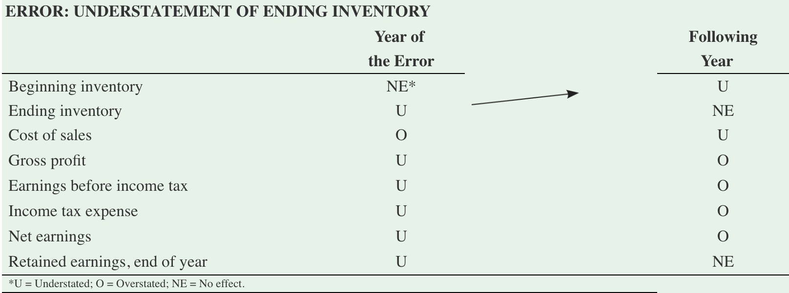
Errors in Measuring Ending Inventory – Exhibit 6.8
Effect of Understatement in Ending Inventory on Selected Financial Statement Items

Slide 47
Key Ratio Analysis – Inventory Turnover Ratio
ANALYTICAL QUESTION → How efficient are inventory management activities?
RATIO AND COMPARISONS → The answer to this question is facilitated by the computation of the inventory turnover ratio as follows:
This ratio reflects how many times average inventory was produced and sold during the period.
A higher ratio indicates that inventory moves more quickly thus reducing storage and obsolescence costs.
Cost of Sales
=
Average Inventory
Inventory Turnover Ratio

Slide 48
Key Ratio Analysis – Average Days to Sell Inventory
This ratio reflects the average time in days it takes a company to produce and deliver inventory to its customers.
Average Days to Sell Inventory
365
Inventory Turnover
=

Slide 49
Inventory and Cash Flows
When companies expand production to meet increases in demand, this increases the amount of inventory reported on the statement of financial position.
However, when companies overestimate demand for a product, they usually produce too many units of the slow-moving item.
This increases storage costs as well as the interest costs on short-term borrowings that finance the inventory. It may even lead to losses if the excess inventory cannot be sold at normal prices.
The statement of cash flows often provides the first sign of such problems.

Slide 50
Accounting Standards for Private Enterprises
The accounting standards related to measuring and reporting of inventories by Canadian private enterprises are very similar to those included in IAS 2—Inventories, which Canadian publicly accountable enterprises must use.
Accounting Standards for Private Enterprises (ASPE) do not allow, however, the reversal of a write-down to inventory.

Slide 51
Appendix 6A: Cost Flow Assumptions – Periodic Inventory System
When a periodic inventory system is used, the cost of merchandise sold is not recorded every time a sale is made.
Instead, the cost of all the goods sold during the period is recorded at year-end.
The cost of ending inventory is first determined based on an actual physical count of the number of units of each type of merchandise on hand, multiplied by their unit cost.
The cost of sales equation is then used to calculate the cost of sales.

Slide 52
Appendix 6A: Comparison of Perpetual and Periodic Inventory Systems: Exhibit 6A.3
Perpetual |  | Periodic
 | Beginning inventory (carried over from prior period) |  | Beginning inventory (carried over from prior period)
+ | Purchases for the period (accumulated in an inventory account) | + | Purchases for the period (accumulated in a purchases account)
= | Cost of goods available for sale | = | Cost of goods available for sale
− | Cost of sales (measured at every sale, based on perpetual record) | − | Ending inventory (measured at end of period, based on physical inventory count)
= | Ending inventory (perpetual record updated at every sale) | = | Cost of sales (computed as a residual amount)
 | EI = BI + PUR − COS |  | COS = BI + PUR − EI

Slide 53
End of Chapter Summary
Inventory should include all of the items owned that are held for resale. Costs flow into inventory when goods are purchased or manufactured.
A company can keep track of the ending inventory and cost of sales for the period using (1) the perpetual inventory system, which is based on the maintenance of detailed and continuous inventory records, and (2) the periodic inventory system, which is based on a physical count of ending inventory and uses of the cost of sales equation to determine cost of sales.
The three inventory costing methods are specific identification, FIFO, and weighted-average cost.

Slide 54
End of Chapter Summary Continued
Ending inventory should be measured based on the lower of actual cost and net realizable value (LC&NRV basis).
Various control procedures can limit inventory theft or mismanagement.
An error in the measurement of ending inventory affects the cost of sales on the current period’s statement of earnings and ending inventory on the statement of financial position. It also affects the cost of sales in the following period by the same amount, but in the opposite direction, because this year’s ending inventory becomes next year’s beginning inventory.
These relationships can be seen through the cost of sales equation, BI + P − EI = COS.

