Slide 1
Reporting and Interpreting Long-Lived Assets
Chapter 7
Notes:
Chapter 8: Reporting and Interpreting Long-Lived Assets
1

Slide 2
Learning Objectives
LO7-1 Define, classify, and explain the nature of long-lived assets, and interpret the fixed asset turnover ratio.
LO7-2 Apply the cost principle to measure the acquisition and maintenance of property, plant, and equipment.
LO7-3 Apply various depreciation methods as assets are held and used over time.
LO7-4 Explain the effect of asset impairment on the financial statements.
LO7-5 Analyze the disposal of property, plant, and equipment.

Slide 3
Learning Objectives Continued
LO7-6 Apply measurement and reporting concepts for natural resources, intangible assets, and goodwill.
LO7-7 Explain the impact on cash flows of the acquisition, use, and disposal of long-lived assets.

Slide 4
Classification of Long-Lived Assets Part 1
The term long-lived assets is used to identify property, plant, equipment, intangible assets, and goodwill held for production, rental to others, or administrative purposes, as well as the development, construction, maintenance, or repair of other assets.
Long-lived assets are listed as non-current assets on the statement of financial position.
Long-lived assets include tangible assets, intangible assets, and goodwill.

Slide 5
Classification of Long-Lived Assets Part 2
Tangible assets (or fixed assets) can be touched because they have physical substance. This classification is most often called property, plant, and equipment.
The three kinds of tangible assets held for use in operations are as follows:
  Land
  Buildings, fixtures, and equipment
  Natural resources

Slide 6
Classification of Long-Lived Assets Part 3
Intangible assets have no physical substance and frequently arise from intellectual effort and are known as intellectual property. Examples include copyrights, patents, licences, trademarks, software, and subscription lists.
Goodwill has no physical substance. It reflects the favourable reputation that a company has with its customers.
Goodwill arises from factors such as customer confidence, reputation for good service and quality products, and financial standing. It is reported as an asset only when one business purchases another business.

Slide 7
Key Ratio Analysis – Fixed Asset Turnover Ratio
ANALYTICAL QUESTION → How effectively is management utilizing its property, plant, and equipment to generate revenues?
RATIO AND COMPARISONS → The fixed asset turnover ratio is useful in answering this question:
The fixed asset turnover ratio measures the sales dollars generated by each dollar of fixed assets used.
A high ratio normally suggests effective management. An increasing ratio over time signals more-efficient use of fixed assets.
Fixed Asset
Turnover Ratio
Net Sales Revenue
Average Net Fixed Assets
=

Slide 8
Measuring and Recording Acquisition Cost Part 1
The cost principle requires that all reasonable and necessary costs incurred in acquiring a long-lived asset, placing it in its operational setting, and preparing it for use should be recorded in a designated asset account.
These costs, including non-refundable taxes, legal fees, transportation costs, and installation costs, are added to the purchase price of the asset.
These expenditures are capitalized (recorded as part of the total cost of the asset), not recorded as expenses in the current period.
Any interest charges associated with the purchase are recorded as expenses when incurred.

Slide 9
Measuring and Recording Acquisition Cost Part 2
When a company purchases land, all of the incidental costs of the purchase, such as title fees, sales commissions, legal fees, title insurance, delinquent taxes, and surveying fees—should be included in its cost.
Because land is not subject to depreciation, it must be recorded as a separate asset.
The amount recorded for the purchase is called the acquisition cost. It is the net cash amount paid for the asset, or when noncash assets are used as payment, the fair value of the asset given or asset received, whichever can be more clearly determined (called the cash equivalent price).

Slide 10
Acquisition by Construction Part 1
A company may construct an asset for use instead of buying it from a manufacturer.
The acquisition cost of this self-constructed asset will include all direct and indirect costs of construction, including interest on any loans obtained to construct the asset.
As soon as the asset is available for use, the accumulated construction costs will be depreciated over its productive life.
The amount of interest that is included in the cost of the construction is called capitalized interest, which reduces the company’s total interest expense every year until the facility is ready for use.

Slide 11
Acquisition by Construction Part 2
Once the construction of the facility is completed, any interest costs on construction loans, however, must be expensed.
The complex computation of interest capitalization is discussed in other accounting courses.
Capitalizing labour, materials, and a portion of interest expense increases assets, decreases expenses, and increases net earnings.

Slide 12
Acquisitions as a Basket Purchase of Assets
When several long-lived assets, such as land, building, and equipment, are acquired in a single transaction and for a single lump sum, known as a basket purchase, the cost of each asset must be measured and recorded separately.
This is because land is not depreciated but buildings and equipment are, although at different rates.
The purchase price must be apportioned among the land, the building, and the equipment, on a rational basis.

Slide 13
Repairs, Maintenance, and Improvements Part 1
Most assets require substantial expenditures during their useful lives to maintain or enhance their productive capacity.
These expenditures include cash outlays for ordinary repairs and maintenance, major repairs, replacements, and additions.
The terms expenditure and expense are not synonymous.
An expenditure is the payment of money to acquire goods or services. These goods and services may be recorded as either assets or expenses, depending on whether they benefit future periods or only the current period.

Slide 14
Repairs, Maintenance, and Improvements Part 2
Expenditures that are made after an asset is acquired are classified as follows:
  Ordinary repairs and maintenance or
  Improvements

Slide 15
Ordinary Repairs and Maintenance
Ordinary repairs and maintenance are expenditures for the normal maintenance and upkeep of long-lived assets.
These expenditures maintain the productive capacity of the asset during the current accounting period only.
These cash outlays are recorded as expenses in the current period.
These expenditures are recurring in nature, involve relatively small amounts at each occurrence, and do not directly lengthen the useful life of the asset.

Slide 16
Improvements Part 1
Improvements are expenditures that increase the productive life, operating efficiency, or capacity of the asset.
These capital expenditures, which provide benefits to the company over a number of accounting periods, are added to the appropriate asset accounts (i.e., they are capitalized).
They occur infrequently, involve large amounts of money, and increase an asset’s economic usefulness in the future through either increased efficiency or longer life.
Examples include additions, complete reconditioning, and major overhauls and replacements, such as the complete replacement of an engine on an aircraft.

Slide 17
Improvements Part 2
In many cases, no clear line distinguishes improvements (assets) from ordinary repairs and maintenance (expenses).
Accountants must exercise professional judgment and make subjective decisions.
Because the decision to capitalize or expense is subjective, auditors closely review the items reported as capital expenditures and ordinary repairs and maintenance.
To avoid spending too much time on classifying capital expenditures and repair expenses, some companies develop simple policies that govern the accounting for these expenditures.

Slide 18
Depreciation Concepts Part 1
All long-lived assets have limited useful lives, except land.
Long-lived assets represent the prepaid cost of a bundle of future services or benefits.
A portion of an asset’s acquisition cost must be allocated as an expense to the periods in which revenue is earned as a result of its use.
The term used to identify and allocate the acquisition cost of using buildings and equipment that generate revenue over time is depreciation.
Depreciation is the process of allocating the acquisition cost of buildings and equipment over their productive lives by using a systematic and rational method.

Slide 19
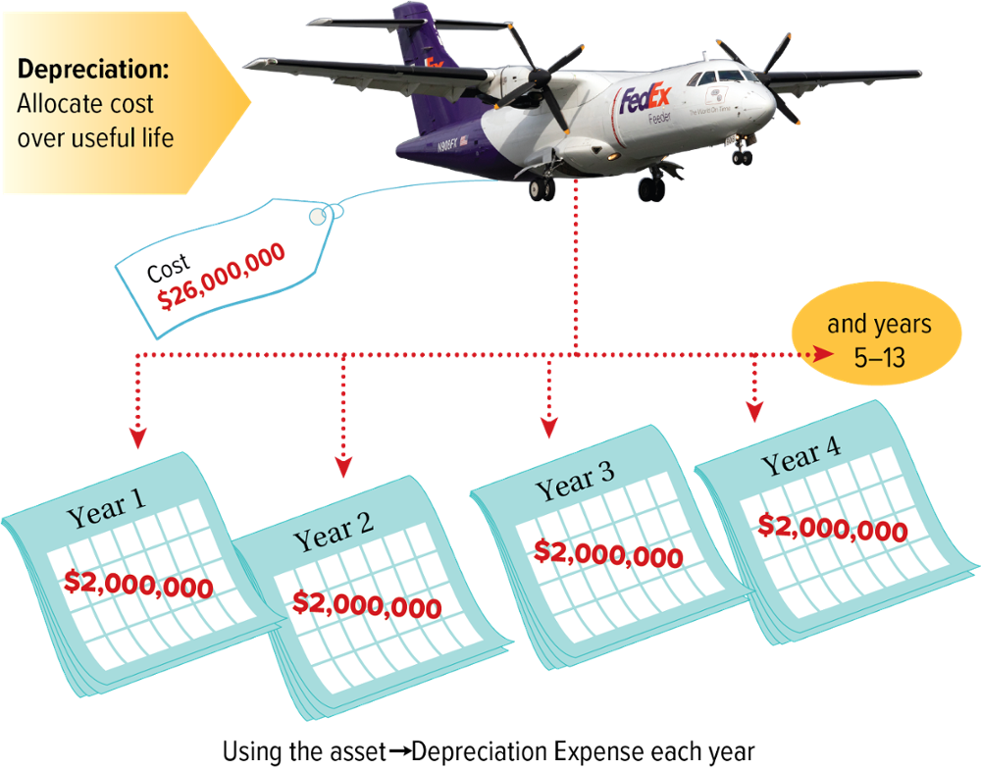
Depreciation Concepts - Example

Slide 20
Depreciation Concepts Part 2
The amount of depreciation recorded during each period is reported on the statement of earnings as Depreciation Expense.
The amount of depreciation expense accumulated since the acquisition date is a contra-account, Accumulated Depreciation, and deducted from the related asset’s cost.
The acquisition cost minus accumulated depreciation and any write-downs in asset value is called the carrying amount (carrying value or net book value) and is reported on the statement of financial position.
Companies disclose information about the long-lived assets they own or control, and the related accumulated depreciation, in a note to the financial statements.

Slide 21
Calculation of Depreciation Expense Part 1
The calculation of depreciation expense requires three amounts for each depreciable asset:
  Acquisition cost
  Estimated useful life to the company
  Estimated residual (or salvage) value at the end of the asset’s useful life to the company
Two of these three amounts are estimates.
Therefore, depreciation expense is an estimate.

Slide 22
Calculation of Depreciation Expense Part 2
Estimated useful life represents management’s estimate of the asset’s useful economic life to the company, rather than of its total economic life to all potential users.
The asset’s expected physical life is often longer than the company intends to use the asset.
Estimated residual (or salvage) value represents management’s estimate of the amount the company expects to recover upon disposal of the asset at the end of its estimated useful life, less any estimated costs of dismantling, disposal, and sale.
The residual value may be the estimated value of the asset as salvage or scrap, or its expected value if sold to another user.

Slide 23
Alternative Depreciation Methods
The three most common depreciation methods are:
  Straight line
  Units of production
  Declining (or diminishing) balance
The depreciation method used should reflect the anticipated reduction in future cash flow as a result of the wear and tear from using the asset over time.
Once a method is selected, the depreciation method should be applied consistently over time to enhance comparability of financial information to users.

Slide 24
Straight-Line Method Part 1
More companies, use straight-line depreciation in their financial statements.
Under straight-line depreciation, an equal portion of an asset’s depreciable cost is allocated to each accounting period over its estimated useful life.
The formula to estimate annual depreciation expense follows:
Depreciation
Expense per Year
Cost – Residual Value
Useful Life in Years
=

Slide 25
Straight-Line Method Part 2
Under the Straight-Line Method:
  Depreciation expense is a constant amount for each year.
  Accumulated depreciation increases by an equal amount each year.
  Carrying amount decreases by the same amount each year until it equals the estimated residual value.

Slide 26
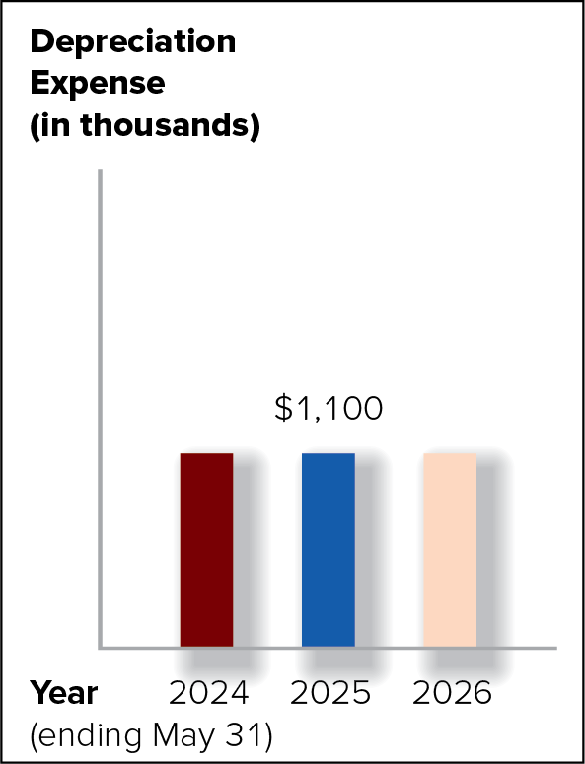
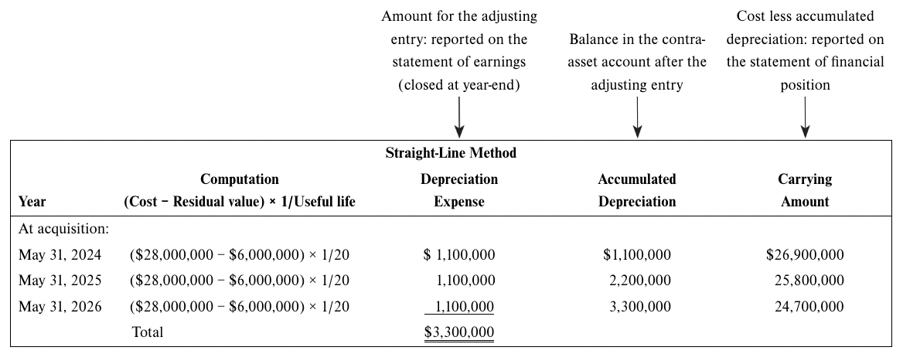
Straight-Line Method - Example

Slide 27
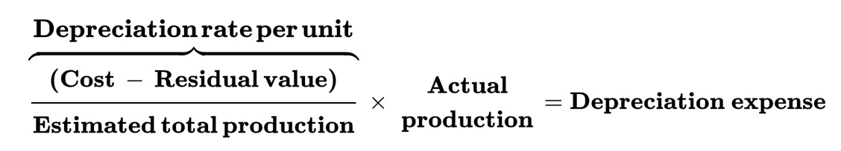
Units-of-Production (Activity) Method Part 1
Units-of-production depreciation method allocates the cost of an asset over its useful life based on the relation of its periodic output to its total estimated output.
The formula to estimate annual depreciation expense under this method follows:
Dividing the depreciable amount by the estimated total production yields the depreciation rate per unit of production (or activity), which is then multiplied by the actual annual production (or activity) to determine depreciation expense.

Slide 28
Units-of-Production (Activity) Method Part 2
When the units-of-production method is used, depreciation expense is said to be a variable expense because it varies directly with production, or use.
The carrying amount and the amount of accumulated depreciation will also fluctuate from year to year.
If any difference occurs at the end of the asset’s life, the final adjusting entry to depreciation expense should be for the amount needed to cause the asset’s carrying amount to equal the asset’s estimated residual value.
The units-of-production method is based on an estimate of an asset’s total productive capacity or output that is difficult to determine.

Slide 29
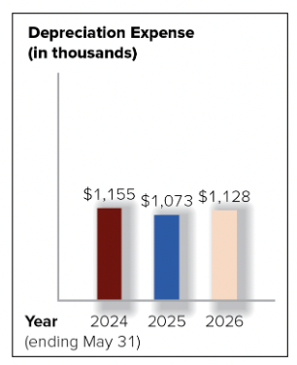
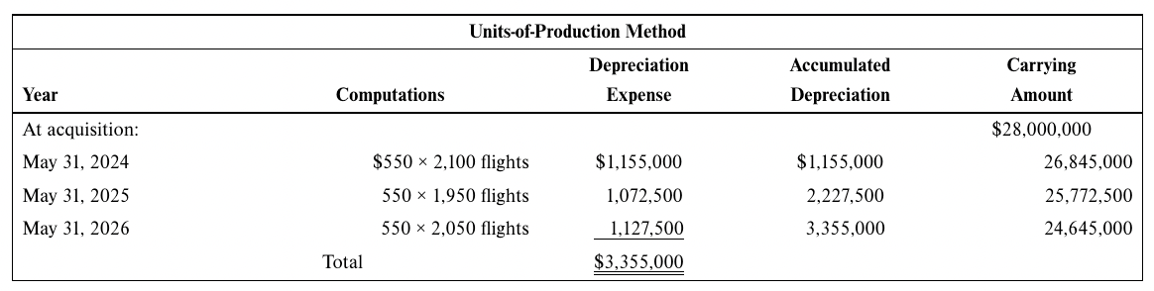
Units-of-Production (Activity) Method - Example

Slide 30
Accelerated Depreciation
If an asset is considered to be more efficient or productive in its earliest years, with a levelling off in later years, managers might choose the declining-balance depreciation method to reflect a sharper reduction in the economic benefits (cash flow) expected to be derived from the asset in the earlier rather than later years.
This is called accelerated depreciation.
A declining-balance method is used to better reflect the decline of economic benefits over time.

Slide 31
Declining-Balance Method
Declining-balance depreciation is based on multiplying the asset’s carrying amount by a fixed rate that exceeds the straight-line (SL) rate.
The rate is often double (two times) the SL rate and is called the double declining-balance rate.
For example, if the estimated useful life of an asset is 10 years and the SL rate is 10 percent (1 ÷ 10), then the declining-balance rate is 20 percent (2 × the SL rate of 10 percent).
The double declining-balance (DDB) rate is adopted most frequently by companies utilizing the accelerated method.

Slide 32
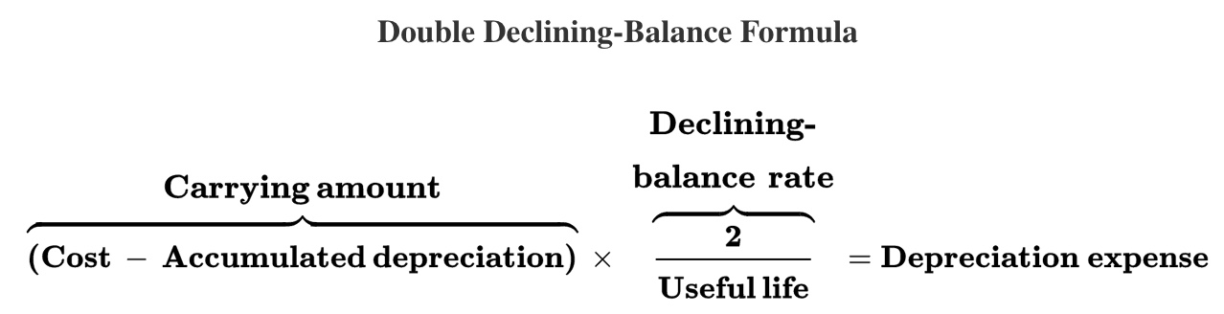
Double Declining-Balance Formula
To calculate depreciation expense under the double declining-balance method the following formula is used:

Slide 33
Double Declining-Balance Part 1
There are two important differences between the double declining-balance method and the others described previously:
Accumulated depreciation, not residual value, is included in the formula. Since accumulated depreciation increases each year, the carrying amount (cost − accumulated depreciation) decreases. The DDB rate is applied to a lower carrying amount each year, resulting in a decline in depreciation expense over time.

Slide 34
Double Declining-Balance Part 2
There are two important differences between the double declining-balance method and the others described previously:
The carrying amount should not be depreciated below the residual value:
    Before the end of the estimated useful life, if the annual computation reduces the carrying amount below residual value, only the amount of depreciation expense needed to make the carrying amount equal to residual value is recorded, and no additional depreciation expense is computed in subsequent years.
    In the last year of the asset’s estimated useful life, whatever amount is needed to bring the carrying amount to residual value is recorded, regardless of the amount of the computation.

Slide 35
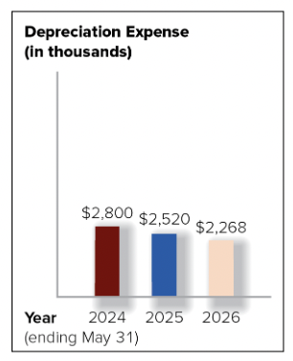
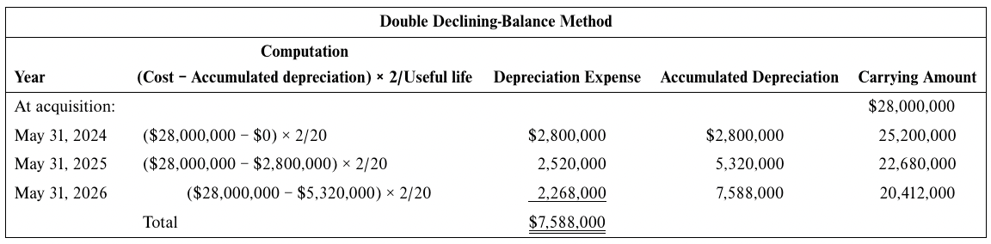
Double Declining-Balance Part 3

Slide 36
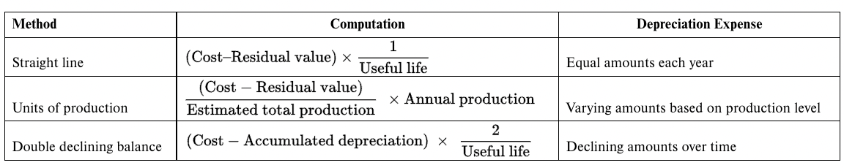
Depreciation Expense – Summary

Slide 37
Changes in Depreciation Estimates Part 1
Depreciation is based on two estimates—useful life and residual value.
These estimates are made at the time a depreciable asset is acquired.
One or both of these initial estimates may have to be revised. As well, any improvements may be added to the original acquisition cost at some time during the asset’s use.
When it is clear that either estimate should be revised to a material degree or the asset’s cost has been changed, the undepreciated asset balance (less any residual value at that date) should be apportioned over the remaining estimated life from the current year into the future.

Slide 38
Changes in Depreciation Estimates Part 2
To calculate the new depreciation expense resulting from a change in estimate for any of the depreciation methods described in this chapter you would substitute:
  The carrying amount for the original acquisition cost.
  The new residual value for the original amount.
  The estimated remaining useful life for the original estimated useful life.
Companies may change depreciation methods; requiring more disclosure because comparability is compromised.
Changes in accounting estimates and depreciation methods should be made only when the new estimate or accounting method “better measures” the periodic net earnings of the business.

Slide 39
Managers’ Selection among Accounting Alternatives
Financial Reporting (IFRS) |  | Tax Reporting
The objective of financial reporting is to provide financial information about the reporting entity that is useful to existing and potential investors, lenders, and other creditors in making decisions about providing resources to the entity. |  | The objective of the Income Tax Act is to raise sufficient revenues to pay for the expenditures of the federal government, with many provisions designed to encourage certain behaviours that are thought to benefit society (e.g., contributions to charities are tax-deductible to encourage people to support worthy programs).

Slide 40
Depreciation and CCA Part 1
Corporations that are subject to taxation in Canada must apply capital cost allowance (CCA) to tangible assets, as determined by the schedules provided by the tax authorities.
The CCA schedules must be used to calculate the maximum annual expense used in computing taxable income according to the tax rules and regulations.
These schedules classify capital assets into different classes and stipulate the maximum CCA rate (a declining-balance rate) for each class.

Slide 41
Depreciation and CCA Part 2
CCA does not attempt to match the cost of an asset with the revenue it produces over its useful life.
Instead, CCA provides for accelerated depreciation of an asset over a period that is usually much shorter than the asset’s estimated useful life.
Because CCA is based on an accelerated method, the expense reported under CCA reduces a corporation’s taxable income more in the early years of a long-lived asset than in later years.

Slide 42
Measuring Asset Impairment Part 1
Canadian corporations are required to review the carrying amount of their tangible and intangible assets for possible impairment.
Assets can have different values that are used for different purposes.
Historical acquisition costs are essential for the verifiability of past transactions. These costs are then adjusted for systematic depreciation over their useful lives.
However, adjusted historical costs are not relevant for investment decisions that rely on expectations of future cash flows.
Notes:
42

Slide 43
Measuring Asset Impairment Part 2
Consequently, investors and creditors may be interested in the asset’s fair value, which reflects the amount at which an asset can be bought or sold between two knowledgeable, willing parties in an arm’s-length transaction.
Companies usually acquire long-lived assets for use in their production processes, and not for resale to others.
Therefore, a long-lived asset has value in use, which is measured as the present value (or current cash equivalent) of future cash flows expected to be derived from use of the asset over time.
Notes:
43

Slide 44
Measuring Asset Impairment Part 3
Subsequent to the acquisition, the economic benefits or future cash flows associated with assets do change for a variety of reasons.
Adverse changes to future benefits may be triggered, for example, by a pandemic, a war, contraction in an economy and decreased disposable income, the reduced market price for the asset, ongoing evidence of operating cash flow losses, and technological obsolescence.
Consequently, assets should then be assessed for possible impairment.
Notes:
44

Slide 45
Measuring Asset Impairment – Two Steps
Step 1: Test for impairment
  Impairment occurs when events or changed circumstances cause the carrying amount of these assets to exceed their recoverable amount, which is the higher of its value in use and its fair value less costs to sell.
  If Carrying amount > Recoverable amount, then the asset is impaired
Step 2: Computation of impairment loss
  For any asset considered to be impaired, companies recognize a loss for the difference between the asset’s carrying amount and its recoverable amount.
  Impairment loss = Carrying amount − Recoverable amount

Slide 46
Disposal of Property, Plant, and Equipment
A business may voluntarily decide not to hold a long-lived asset for its entire life.
These disposals include sale, trade-in, and retirement.
A business may also dispose of an asset involuntarily as a result of a casualty, such as a storm, fire, or accident.
Depreciation must be updated to the date of disposal. The disposal of a depreciable asset usually requires two journal entries:
1. An adjusting entry to update the depreciation expense and accumulated depreciation accounts.
2. An entry to record the disposal.

Slide 47
Entry to Record the Disposal
2. An entry to record the disposal:
  The cost of the asset and any accumulated depreciation at the date of disposal must be removed from the accounts.
  The difference between any resources received on disposal of an asset and its carrying amount at the date of disposal is a gain or loss on disposal of the asset.
  This gain (or loss) is reported in operations on the statement of earnings.

Slide 48
Acquisition and Depletion of Natural Resources Part 1
Some large companies develop raw materials and products from natural resources—assets that occur in nature, such as oil, diamonds, gold, and iron ore.
These resources are often called wasting assets because they are depleted (i.e., physically used up).
In Canada, natural resource companies do not own the land from which they extract oil or minerals. They acquire mineral rights from the government to explore, develop, and extract minerals from the land, but they do not own the land itself.

Slide 49
Acquisition and Depletion of Natural Resources Part 2
When the rights to explore and develop natural resources are acquired, they are recorded in conformity with the cost principle.
Through exploration, the company estimates the value of the resources extracted and sold throughout the productive life of the natural resource reserves.
The quantity of resources in the reserve is surveyed by using sophisticated geological engineering methods to establish its potential value over its productive life.

Slide 50
Acquisition and Depletion of Natural Resources Part 3
As a natural resource is used up, its acquisition cost must be apportioned among the periods in which revenues are earned in conformity with the expense recognition principle.
The term depletion describes the process of allocating a natural resource’s cost over the period of its exploitation.
The units-of-production method often is applied to compute depletion.

Slide 51
Acquisition and Depletion of Natural Resources Part 4
Often these companies keep the reserve value separate from other property, plant, and equipment values incurred, because the companies may have to construct special roads and erect housing, buildings, and facilities in remote locations to extract the resources.
When the site is put into production, these accumulated costs will be depreciated over the productive life of the site.
Therefore, natural resource companies amortize the acquisition costs of intangible mineral rights, deplete their reserve values, and depreciate exploration and development costs as well as self-constructed extraction facilities.

Slide 52
Acquisition and Depletion of Natural Resources Part 5
A depletion rate is calculated by dividing the total acquisition and development cost (less any estimated residual value, which is rare) by the estimated units that can be withdrawn, economically, from the resource.
The depletion rate is multiplied each period by the actual number of units withdrawn during the accounting period.
This procedure is the same as the units-of-production method of calculating depreciation.

Slide 53
Acquisition and Depletion of Natural Resources Part 6
When buildings and similar improvements are acquired for the development and exploitation of a natural resource, they should be recorded in separate asset accounts and depreciated—not depleted.
Their estimated useful lives cannot be longer than the time needed to exploit the natural resource, unless they have a significant use after the source is depleted.

Slide 54
Acquisition and Amortization of Intangible Assets Part 1
An intangible asset has value because of certain rights and privileges conferred by law on its owner.
An intangible asset has no material or physical substance.
Examples include mineral rights to explore and develop land, landing rights for time slots at airports, copyrights, customer lists, patents, trademarks, and licences.
Legal documents usually confirm the nature and existence of intangible assets.

Slide 55
Acquisition and Amortization of Intangible Assets Part 2
Intangible assets are recorded at historical cost only if they are purchased.
If an intangible asset is developed internally, the cost of development is normally recorded as an expense.
Upon acquisition of intangible assets, managers determine whether the separate intangibles have definite or indefinite lives.

Slide 56
Acquisition and Amortization of Intangible Assets – Definite Life
The cost of an intangible with a definite life is allocated on a straight-line basis each period over its useful life in a process called amortization that is similar to depreciation and depletion.
However, most companies do not estimate a residual value for their intangible assets.

Slide 57
Acquisition and Amortization of Intangible Assets – Indefinite Life Part 1
Intangible assets with indefinite lives are not amortized.
These assets must be reviewed at least annually for possible impairment.
If the fair value of the asset less costs to sell is more than its carrying amount, the asset is not impaired.
If not, the asset’s value in use should be determined.
An impairment loss must be recognized if the value in use is less than the carrying amount.

Slide 58
Acquisition and Amortization of Intangible Assets – Indefinite Life Part 2
If both the asset’s value in use and its fair value less costs to sell are lower than the carrying amount, then the asset’s recoverable amount (the higher of value in use and fair value less costs to sell) is compared to the carrying amount to determine the impairment loss.
This process is similar to that used for other long-lived assets, including intangibles with definite lives.

Slide 59
Acquisition and Amortization of Intangible Assets – Patents
A patent is an exclusive right granted by the Canadian Intellectual Property Office of Industry Canada for a period of 20 years.
A patent that is purchased is recorded at cost.
An internally developed patent is recorded at only its registration and legal costs.
Should acquirers of patent rights incur costs to significantly change the product or process which has been patented, these costs may be capitalized under conditions specified in IAS 38—Intangible Assets. Given its limited life, a patent is typically amortized over the shorter of its economic life and its remaining legal life.

Slide 60
Acquisition and Amortization of Intangible Assets – Copyrights
Copyright protection is also granted by the Canadian Intellectual Property Office.
A copyright that is purchased is recorded at cost. It gives the owner the exclusive right to publish, use, and sell a literary, musical, or artistic piece of work for a period not exceeding 50 years after the author’s death.
The same principles, guidelines, and procedures used in accounting for the cost of patents are also used for copyrights.

Slide 61
Acquisition and Amortization of Intangible Assets – Technology
Website development costs related to acquiring a domain name and developing graphics are capitalized as an intangible asset.
Computer software costs incurred during a preliminary concept phase of a project should be expensed.
Once technological feasibility is reached for the project (the point at which there is a detailed program design or completion of a working model), the direct costs of the actual development, such as coding and testing the software, should be capitalized as an intangible asset.

Slide 62
Acquisition and Amortization of Intangible Assets – Research and Development Costs
If an intangible asset is developed internally, the cost of research is recorded as an expense.
When a company can demonstrate that technical and commercial feasibility of the resulting product or service has been established, development costs can be deferred and amortized over the lifetime of the commercialized product.

Slide 63
Acquisition and Amortization of Intangible Assets – Trademarks Part 1
A trademark is an exclusive legal right to use a name, image, or slogan identified with a product or a company.
Trademarks are protected by law when they are registered at the Canadian Intellectual Property Office of Industry Canada.
The protection of a trademark provides the registered holder with exclusive rights to the trademark and can be renewed every 15 years throughout its life.

Slide 64
Acquisition and Amortization of Intangible Assets – Trademarks Part 2
Most companies do not amortize their trademarks as their useful lives can be extended indefinitely.
Trademarks are often some of the most valuable assets that a company can own, but they are rarely seen on statements of financial position.
The reason is simple—intangible assets are not recorded unless they are purchased.
Companies often spend millions of dollars developing trademarks, but these expenditures are recorded as expenses and not capitalized.

Slide 65
Acquisition and Amortization of Intangible Assets – Franchises
A franchise is a contractual right to sell certain products or services, use certain trademarks, or perform activities in a geographical region.
Franchises may be granted by either the government or other businesses for a specified period and purpose.
Franchise agreements are contracts that can have a variety of provisions.
They usually require an investment by the franchisee; therefore, they should be accounted for as intangible assets.
The life of the franchise agreement depends on the contract. It may be for a single year or an indefinite period.

Slide 66
Acquisition and Amortization of Intangible Assets – Licences and Operating Rights
Licences and operating rights are typically obtained through agreements with governmental units or agencies, and permit the holders to use public property in performing their services.

Slide 67
Goodwill Part 1
The most frequently reported asset lacking physical substance is goodwill.
The term goodwill, means the favourable reputation that a company has with its customers.
Goodwill arises from factors such as customer confidence, reputation for good service and quality products, and financial standing.
From its first day of operations, a successful business continuously builds its own goodwill through a combination of factors that cannot be sold separately.

Slide 68
Goodwill Part 2
Goodwill is said to be internally generated and is not reported as an asset.
The only way to report goodwill as an asset is to purchase another business.
Often, the purchase price of a business exceeds the fair value of all of the identifiable assets owned by the business minus all of the identifiable liabilities owed to others; this is because of goodwill.
Unlike intangible assets, goodwill is not identifiable and can only be identified with the business as a whole.
Goodwill is therefore reported as a separate item in the statement of financial position.

Slide 69
Goodwill Part 3
For accounting purposes, goodwill is defined as the difference between the purchase price of a company as a whole and the fair value of its net assets.
According to IFRS, goodwill has an indefinite life and any subsequent impairment in its value should be written down.
This leads to the recognition of a loss, which must be reported as a separate item on the statement of earnings in the year the impairment occurs.

Slide 70
Financial Analysis - A Misinterpretation
Cash from operations can only be provided by selling goods and services.
Depreciation expense does not require a cash outflow. Although depreciation is added in the operating section of the statement of cash flows, depreciation is not a source of cash, when using the indirect method.
Because tax depreciation (CCA) is tax deductible, it reduces the cash outflow related to taxes (often called a tax shield). CCA can affect cash flows by affecting the amount of taxes that a company pays.

Slide 71
End of Chapter Summary
Non-current assets are those that a business retains for long periods of time, for use in the course of normal operations rather than for sale. They may be divided into tangible assets (land, buildings, equipment, natural resources), intangible assets (patents, franchises), and goodwill.
The acquisition cost of property, plant, and equipment is the cash-equivalent purchase price plus all reasonable and necessary expenditures made to acquire and prepare the asset for its intended use.
Common depreciation methods include straight line, units of production, and double declining balance.

Slide 72
End of Chapter Summary Continued
When events or changes in circumstances reduce the estimated future cash flows of long-lived assets below their carrying amounts, the carrying amounts should be written down (by recording a loss) to the recoverable amounts of the assets.
When assets are disposed of through sale or abandonment:
  Record additional depreciation since the last adjustment was made.
  Remove the cost of the old asset and its related accumulated depreciation or depletion.
  Recognize the cash proceeds.
  Recognize any gains or losses when the asset’s carrying amount is not equal to the cash received.

