Slide 1
Reporting and Interpreting
Current Liabilities
Chapter 8
Notes:
Chapter 9: Reporting and Interpreting Current Liabilities.
1

Slide 2
Learning Objectives
LO8-1 Define, measure, and report current liabilities.
LO8-2 Compute and interpret the accounts payable turnover ratio.
LO8-3 Report notes payable, and explain the time value of money.
LO8-4 Report contingent liabilities.
LO8-5 Explain the importance of working capital and its impact on cash flows.
LO8-6 Compute and interpret the quick ratio.

Slide 3
Learning Objectives Continued
SUPPLEMENTARY MATERIAL
LO8-S1 Compute and report deferred income taxes.
LO8-S2 Compute and report present values of future cash flows.
LO8-S3 Compute and report future value of a single amount. (Online)
LO8-S4 Compute and report future value of an annuity. (Online)

Slide 4
Understanding the Business
The acquisition of assets is financed from two sources:
Debt → Funds from creditors.
Equity → Funds from shareholders.
The mix of debt and equity for a company is called the capital structure.
Debt is considered riskier than equity.
Debt payments are legal obligations.
Creditors can force bankruptcy.
Creditors can require sale of assets.

Slide 5
Liabilities Defined and Classified Part 1
Liabilities are defined as present debts or obligations of the entity that result from past transactions, which will be paid with assets or services.
Current liabilities are short-term obligations that will be settled within the coming year by providing cash, goods, other current assets, or services.
Non-current liabilities include all other liabilities.
Most liabilities are recorded as they occur during the accounting period.

Slide 6
Liabilities Defined and Classified Part 2
However, specific liabilities that can be determined with accuracy, such as salaries payable and interest payable, require accrual through adjusting entries at the end of the accounting period, prior to the preparation of financial statements.
For other types of liabilities, the exact amounts will not be known with certainty until a future event, but they must be estimated and recorded if they relate to transactions that occurred during the accounting period.
Such liabilities are referred to as provisions on the statement of financial position.

Slide 7
Liabilities Defined and Classified Part 3
In particular cases, it may not be possible to provide a reasonable estimate of a potential future liability that is contingent on a future event.
Relevant information about contingent liabilities must, therefore, be disclosed in notes to the financial statements.

Slide 8
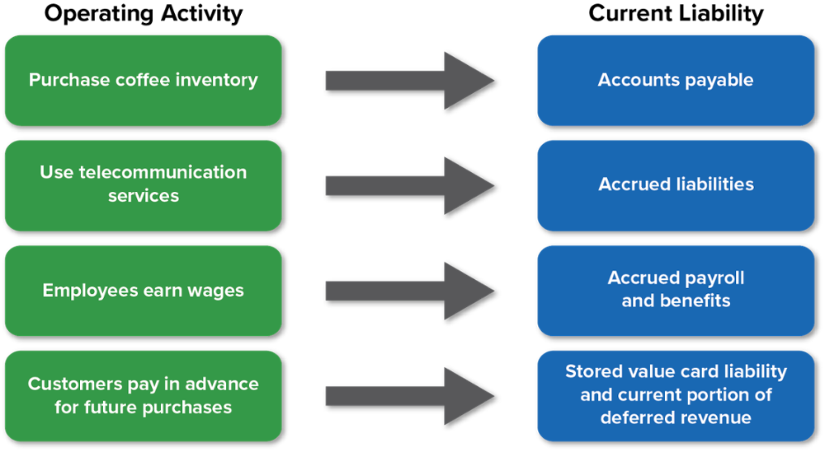
Current Liabilities

Slide 9
Accounts Payable
Most companies purchase goods and services from other businesses in the course of running their day-to-day operations.
Typically, these supplies and services are purchased on credit with cash payments made after the goods and services have been received.
Most companies list such obligations on their statement of financial position as accounts payable, also called trade accounts payable.

Slide 10
Key Ratio Analysis – A/P Turnover Ratio
ANALYTICAL QUESTION → How efficient is management at meeting its obligations to suppliers?
RATIO AND COMPARISONS → The accounts payable turnover ratio is a measure of how quickly management is paying trade suppliers. Analysts use this ratio as a measure of liquidity. It is computed as follows:
A high turnover ratio normally suggests that a company is paying its suppliers in a timely manner.
A/P Turnover
ratio
Cost of Sales
Average Accounts Payable
=

Slide 11
Accrued Liabilities
Accrued liabilities are expenses that have been incurred before the end of an accounting period but have not yet been paid.
Income taxes payable → corporations must pay taxes on income from active business operations, property income and capital gains arising from the sale of assets.
Sales Taxes → companies are often required to collect and pay other types of taxes and fees, depending on the specific industry and geographical location in which they operate. These taxes add to the cost of producing and selling goods and services and are eventually passed on to customers through higher sales prices.

Slide 12
Payroll Liabilities
At the end of each accounting period, employees will usually have earned salaries that have not been paid.
Unpaid salaries may be reported as part of a general accrued liability account on the statement of financial position or as a separate item.
In addition to reporting salaries that have been earned but are unpaid, companies must also report the cost of unpaid benefits, which include retirement programs, vacation time, employment insurance, and health insurance that employees have earned during the reporting period but have not taken or been paid.
Employers must also remit income tax and other social benefit contributions on behalf of their employees to the appropriate government agencies.

Slide 13
Employee Deductions Part 1
Federal and provincial laws require the employer to deduct an appropriate amount of income tax each period from the gross earnings of each employee.
Employee income tax is usually the largest amount withheld from wages and salaries by the employer.
The amount of income tax withheld from the employee’s salary is recorded by the employer as a current liability between the date of deduction and the date on which the amount held is remitted to the government.

Slide 14
Employee Deductions Part 2
Additional amounts are deducted from the gross earnings for Employment Insurance (EI); for contributions to the Canada Pension Plan (CPP), or Quebec Pension Plan (QPP) in the province of Quebec; for future retirement benefits; for health insurance; and for other contributions that you and your employer must remit to the appropriate agencies.

Slide 15
Deferred Revenue
Typically, cash is paid when a product or service is delivered, or soon thereafter. In some cases, however, cash is paid in advance of delivery.
When a company collects cash before the related revenue has been earned, the cash is called deferred revenue.
Deferred revenues are reported as a liability because cash has been collected but the related revenue has not been earned by the end of the accounting period.

Slide 16
Notes Payable Part 1
When a company borrows money, it normally signs a formal written contract with a bank and reports the amount borrowed as a note payable.
The contract specifies the amount borrowed, the date by which it must be repaid, and the interest rate associated with the debt.
Notes payable can vary in amount borrowed, the interest charged, and length of time of the contract.

Slide 17
Notes Payable Part 2
The time value of money is interest that is associated with the use of money over time.
To the borrower, interest reflects the cost of using someone else’s money and is therefore an expense.
To creditors, interest reflects the benefit of allowing someone else to use their money and is therefore revenue.

Slide 18
Notes Payable Part 3
You need three pieces of information to calculate interest:
  (1) the principal (i.e., the cash that was borrowed),
  (2) the annual interest rate, and
  (3) the time period for the loan.
Interest for the period =
Principal x Annual interest rate x Number of months
12 months

Slide 19
Current Portion of Long-Term Debt
Long-term debt is split between the current portion and the non-current portion.
The current portion of long-term debt is any portion of a note payable that is due within one year, or the operating cycle, whichever is longer.

Slide 20
Provisions Part 1
When either the amount or the timing of the liability is uncertain, it is referred to as provision.
A provision must be recognized when the following conditions are met:
  An entity has a present obligation as a result of a past event,
  It is probable that cash or other assets will be required to settle the obligation, and
  A reliable estimate can be made of the amount of the obligation.

Slide 21
Provisions Part 2
Examples of provisions include:
  Estimated liabilities for warranties,
  Product returns and allowances,
  Legal and tax disputes that arise in the ordinary course of business,
  Closing of stores or specific operations, and
  Restructuring of the production, sales, or administrative structures.

Slide 22
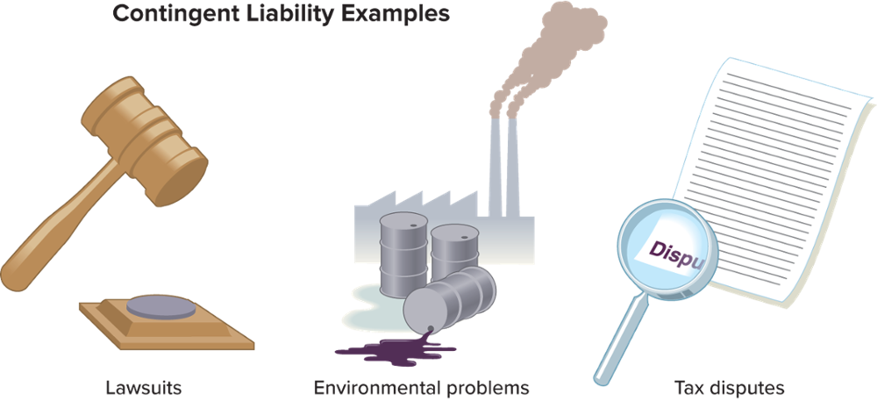
Contingent Liabilities Part 1
A contingent liability is a possible liability that is created as a result of a past event, and which may or may not become a recorded liability, depending on future events.

Slide 23
Contingent Liabilities Part 2
Level of Certainty of the Present or Possible Obligation | Should a Liability Be Recognized? | Disclosure Requirements
There is a present obligation that probably requires an outflow of resources.
The amount of the liability can be estimated reliably. | A provision must be recognized. | Disclosure of the provision is required.
The amount of the liability cannot be estimated reliably. | No provision shall be recognized. | Disclosure is required for the contingency.
There is either a present or a possible obligation that may, but probably will not, require an outflow of resources. | No provision shall be recognized. | Disclosure is required for the contingency.
There is either a present or a possible obligation where the likelihood of an outflow of resources is remote. | No provision shall be recognized. | Disclosure is not required.

Slide 24
International Perspective – It is a Matter of Degree of Certainty Part 1
The assessment of future probabilities is inherently subjective, but both IFRS and U.S. GAAP provide some guidance.
Under IFRS, “probable” is defined as more likely than not to occur, which implies more than a 50 percent chance of occurring.
Under U.S. GAAP, “probable” has been defined as likely to occur, which is commonly interpreted to mean having a greater than 70 percent chance of occurring.

Slide 25
International Perspective – It is a Matter of Degree of Certainty Part 2
This difference means that for some contingent liabilities, IFRS would require the reporting of a liability on the statement of financial position whereas U.S. GAAP would simply require note disclosure.
The more stringent requirement under IFRS reflects a more prudent way of providing relevant information to investors, creditors, and other users, primarily because it advances the timing of recording liabilities.

Slide 26
ESG Reporting Part 1
The Canada Energy Regulator (CER) states the aspiration of regulation is to assure the health of people by keeping the environment (soil, air, water) uncontaminated as resource extraction and harvesting proceeds.
The laws and regulations apply not to the depletion of resources but to the remediation of land altered by extraction of resources.
While remediation is not restoration, related costs are significant and can give rise to significant contingent liabilities.
It is illegal in Canada for companies to abandon sites without decontaminating them.

Slide 27
ESG Reporting Part 2
Canada has enacted 21 sets of laws to protect the environment against contamination.
The government expects companies to put measures in place to anticipate, prevent, and mitigate contamination, and if it occurs, to manage, contain, and remediate contamination.
Remediation, management, and mitigation must be reported immediately to CER and other regulators as well as all other parties affected.
Non-compliance with environmental laws and regulations can result in significant financial penalties and expenses that must be reported on financial statements according to accounting standards.

Slide 28
Working Capital Management
Working Capital = Current Assets – Current Liabilities
Changes in working capital accounts are important to managers and analysts because they have a direct impact on cash flows from operating activities reported on the statement of cash flows.
Liquidity is the ability to pay current obligations.

Slide 29
Key Ratio Analysis – Quick Ratio
ANALYTICAL QUESTION → Does the company currently have the resources to pay its short-term debt?
RATIO AND COMPARISONS → Analysts use the quick ratio as an indicator of the amount of quick assets (cash, short-term investments, and net receivables) available to satisfy current liabilities. It is computed as follows:
Quick Ratio = Quick Assets / Current Liabilities
A high ratio normally suggests good liquidity, but too high a ratio suggests inefficient use of resources. Many strong companies use sophisticated management techniques to minimize funds invested in current assets, and as a result, have quick ratios that are very low.

Slide 30
Appendix 8A: Deferred Income Tax Assets and Liabilities Part 1
Permanent differences → arise from specific differences between rules that govern the preparation of financial statements (IFRS) and tax returns (Income Tax Act). Specifically, some types of revenue are exempt from tax while other types of expenses are not deductible in computing taxable income.
Temporary Differences → are timing differences that cause deferred income taxes and will reverse, or turn around, in the future.

Slide 31
Appendix 8A: Deferred Income Tax Assets and Liabilities Part 2
Temporary differences of the following types result in complex accounting:
  Product warranty costs that are recognized as a liability and an expense for financial reporting purposes when the related products are sold, but they are deductible for tax purposes only when payments under the warranty are made.
  Long-lived assets, including development costs, which are usually depreciated by using the straight-line method for financial reporting purposes, are depreciated on an accelerated basis (capital cost allowance) for tax purposes.

Slide 32
Appendix 8A: Deferred Income Tax Assets and Liabilities Part 3
IFRS is the set of rules for preparing financial statements, which results in income tax expense.
The Income Tax Act is the set of rules for preparing tax returns, which results in income taxes payable.
Usually, income tax expense does not equal income tax payable.
The difference between income tax expense and income tax payable is recorded in an account called a Deferred Income Tax.

Slide 33
Appendix 8B: Present Value Concepts Part 1
The concept of present value (PV) is based on the time value of money that we introduced earlier in this chapter.
It provides a foundation for measuring and reporting long-term notes and bonds.
Present value is the current cash equivalent of an amount to be received in the future, or a future amount discounted for compound interest.
Money received today is worth more than money to be received one year from today (or at any other future date) because it can be used to earn interest.

Slide 34
Appendix 8B: Present Value Concepts Part 2
With a present value problem, you know the dollar amount of a cash flow that will occur in the future and need to determine its value now.
The opposite situation occurs when you know the dollar amount of a cash flow that occurs today and need to determine its value at some point in the future.
These problems are called future value problems.
Future value is the sum to which an amount will increase as a result of compound interest.

Slide 35
Appendix 8B: Present Value Concepts Part 3
Present and future value problems may involve two types of cash flow: a single payment or an annuity (a series of cash payments).
Therefore, four different situations are related to the time value of money:
  Present value of a single payment
  Future value of a single payment
  Present value of an annuity
  Future value of an annuity

Slide 36
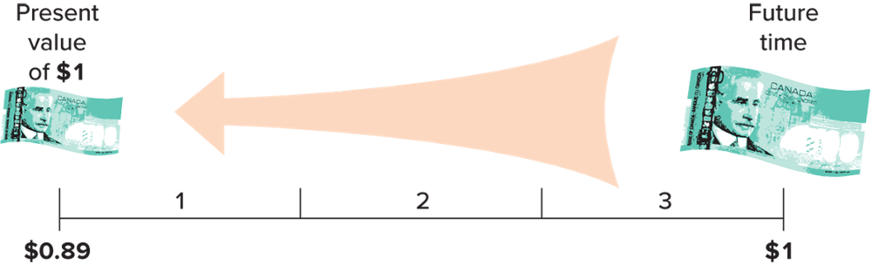
Appendix 8B: Present Value of a Single Amount Part 1
The present value of a single amount is the amount of cash you are willing to accept today in lieu of a cash receipt at some date in the future.

Slide 37
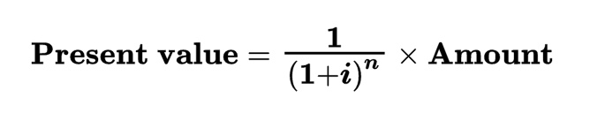
Appendix 8B: Present Value of a Single Amount Part 2
To calculate the present value of an amount to be received in the future, we subtract interest that is earned over time from the amount to be received in the future.
You discount the amount to be received in the future at interest rate i for n periods.
The formula to calculate the present value of a single amount is:

Slide 38
Appendix 8B: Present Value of an Annuity Part 1
An annuity is a series of consecutive payments characterized by:
  An equal dollar amount each interest period
  Interest periods of equal length (year, half-year, quarter, or month)
  An equal interest rate each interest period
Examples of annuities are monthly payments on an automobile or a home loan, annual contributions to a savings account, and monthly retirement benefits.

Slide 39
Appendix 8B: Present Value of an Annuity Part 2
The present value of an annuity is the value now of a series of equal amounts to be received (or paid) each period for some specified number of periods in the future.
It is calculated by discounting each of the equal periodic amounts.
A good example of this type of problem is a retirement program that offers the retiree a monthly income after retirement.

Slide 40
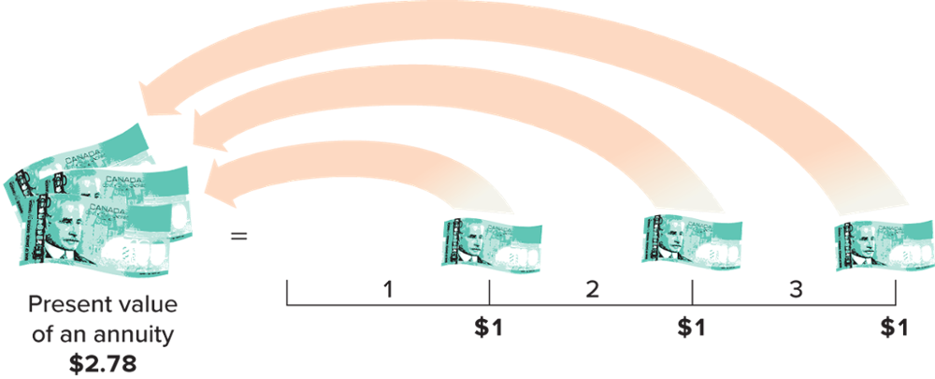
Appendix 8B: Present Value of an Annuity Part 3
The present value of an annuity of $1 for three periods at 4 percent may be represented graphically, as follows:

Slide 41
Appendix 8E: Future Value of a Single Amount Part 1
The future value of a single amount → calculating how much money you will have in the future as a result of investing a certain amount at the present time.
To solve a future value problem, you need to know three items:
  The amount to be invested.
  The interest rate (i) that the amount will earn.
  The number of periods (n) in which the amount will earn interest.

Slide 42
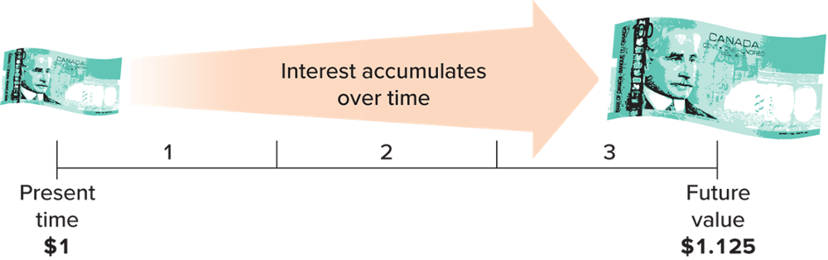
Appendix 8E: Future Value of a Single Amount Part 2
Since the future value concept is based on compound interest, the amount of interest for each period is calculated by multiplying the interest rate by the principal plus any interest not paid out in prior periods.
Graphically, the calculation of the future value of $1 for three periods and an interest rate of 4 percent may be represented as follows:

Slide 43
Appendix 8E: Future Value of an Annuity Part 1
The future value of an annuity calculation will tell you how much money you will have in the future, if you save a fixed amount of money each month.
The future value of an annuity includes compound interest on each payment from the date of payment to the end of the term of the annuity.
Each new payment accumulates less interest than prior payments only because the number of periods remaining to accumulate interest decreases.

Slide 44
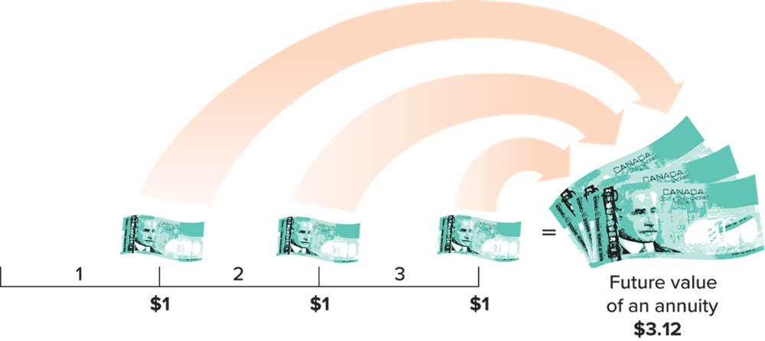
Appendix 8E: Future Value of an Annuity Part 2
The future value of an annuity of $1 for three periods at 4 percent may be represented graphically as follows:

Slide 45
End of Chapter Summary
Accountants define liabilities as obligations arising from past transactions that will be settled in the future by some transfer or use of assets or provision of services.
They are classified on the statement of financial position as either current or non-current.
A note payable specifies the amount borrowed, when it must be repaid, and the interest rate associated with the debt. Accountants must report the debt and the interest as it accrues.
The time value of money refers to the fact that interest accrues on borrowed money with the passage of time.

Slide 46
End of Chapter Summary Continued
A contingency is a possible liability that has arisen as a result of a past event.
Contingencies are disclosed in a note if it is not probable that cash or other assets will be required to settle the obligation, or if the amount of the obligation cannot be measured with sufficient reliability.
Working capital is defined as current assets minus current liabilities.
The quick ratio is a comparison of the most liquid or quick assets (cash, short-term investments, and net receivables) to current liabilities.

