Slide 1
Reporting and Interpreting
Non-current Liabilities
Chapter 9
Notes:
Chapter 10: Reporting and Interpreting Non-current Liabilities.
1

Slide 2
Learning Objectives
LO9-1 Describe the characteristics of long-term notes and bonds payable.
LO9-2 Report notes payable and related interest expense.
LO9-3 Report bonds payable and interest expense for bonds sold at par, at a discount, or at a premium.
LO9-4 Compute and interpret the times interest earned ratio.
LO9-5 Report the early retirement of bonds.
LO9-6 Describe other non-current liabilities.

Slide 3
Learning Objectives Continued
LO9-7 Compute and interpret the debt-to-equity ratio.
LO9-8 Explain how financing activities are reported on the statement of cash flows.

Slide 4
Understanding the Business
Non-current liabilities include all of the entity’s obligations that are not classified as current liabilities, such as long-term notes and bonds payable.
Typically, a non-current liability will require payment more than one year in the future. These obligations may be created by borrowing money, or they may result from other activities.
The mixture of debt and equity used to finance a company’s growth is called the capital structure:
  Debt – Funds from creditors
  Equity – Funds from shareholders

Slide 5
Reasons Why Companies Issue Debt
Use of long-term debt offers significant advantages:
Shareholders maintain control. Issuing bonds allows shareholders to maintain their current level of control. Debtholders do not participate in management decisions, including decisions to distribute dividends to shareholders.
Interest expense is tax deductible. The deductibility of interest for tax purposes reduces the net cost of borrowing. In contrast, dividends are not tax deductible.
Issuing bonds can increase the return to shareholders. If a company can borrow at a low interest rate and invest in projects that earn a high rate of return, it can increase the return to shareholders.

Slide 6
Disadvantages to Using Long-Term Debt
There are two potential disadvantages to using long-term debt:
Risk of bankruptcy. Interest payments to the debtholders must be made each period whether the corporation generates net earnings or incurs a loss.
Negative impact on cash flows. Debt must be repaid at a specific time in the future. Management must be able to generate sufficient cash to repay the debt or have the ability to refinance it.

Slide 7
Types of Long-Term Debt
Long-term debt is available to companies in various forms:
  Bank loans
  Notes
  Mortgages
  Bonds and Debentures

Slide 8
Bond Terminology Part 1
A bond usually requires the payment of interest over its life, with the repayment of principal on the maturity date.
The bond principal is:
  The amount payable at the maturity date and
  The basis for computing periodic cash interest payments.
The principal also is called the par value, face value, or maturity value.
All bonds have a par value, which is the amount that will be paid when the bond matures. For most individual bonds, the par value is $1,000, but it can be any amount.

Slide 9
Bond Terminology Part 2
A bond always specifies a coupon rate (also called the stated rate, contract rate, or nominal rate) and the frequency of periodic cash interest payments.
These interest payments are sometimes called coupon payments.
A bond’s coupon rate is always stated in annual terms.

Slide 10
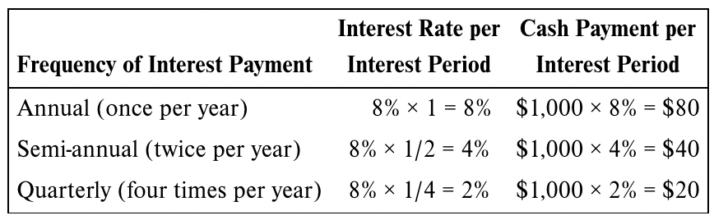
Bond Terminology Part 3
The following table reflects how a bond’s cash interest payment is calculated when interest is paid annually, semi-annually, and quarterly. The face value of the bond is $1,000 and the coupon rate is 8 percent.
If the bond pays interest annually, bondholders will receive one interest payment of $80 during the year. If the bond pays interest semi-annually, bondholders will receive a $40 interest payment every six months, for a total of $80 a year. If the bond pays interest quarterly, bondholders will receive a $20 interest payment every three months, for a total of $80 a year. Note that in all cases, $80 in interest is paid per year.

Slide 11
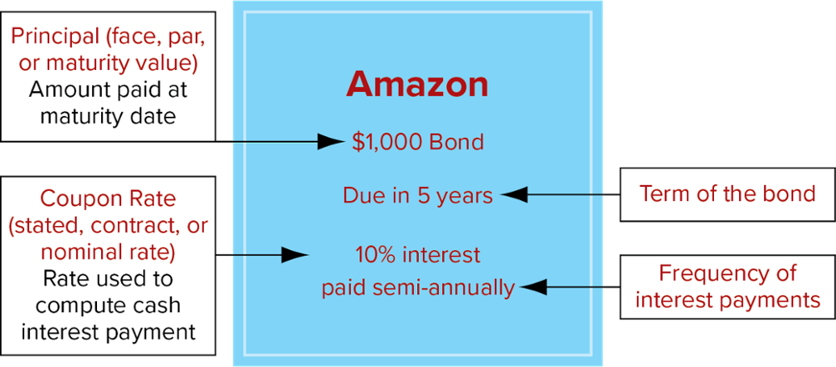
Bond Terminology - Example

Slide 12
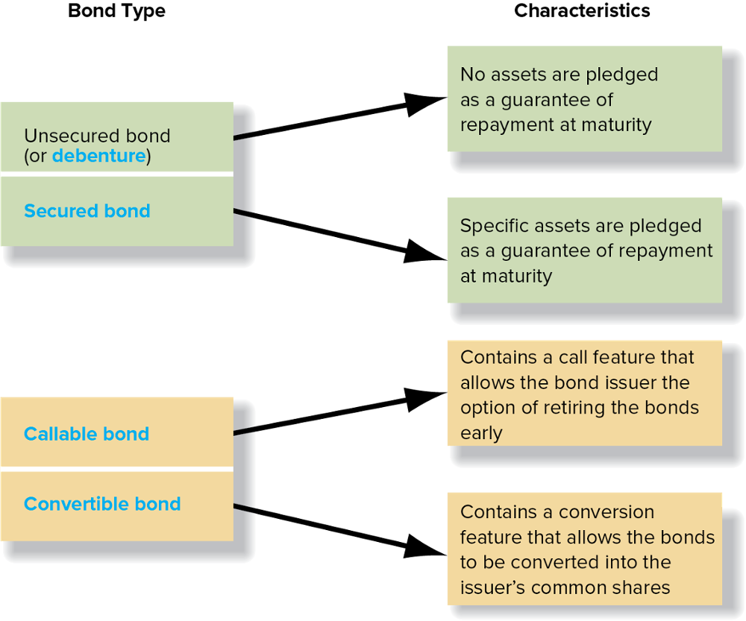
Bond Characteristics

Slide 13
Bond Issuance Process Part 1
An indenture is a bond contract that specifies the legal provisions of a bond issue.
The bond indenture contains covenants designed to protect the creditors.
The bond issuer also prepares a prospectus, which describes the company, the bonds, and how the proceeds of the bonds will be used.
When a bond is issued, the investor receives a bond certificate.

Slide 14
Bond Issuance Process Part 2
All of the bond certificates for the same bond issuance, whether an actual paper certificate or an electronic certificate, contain the same information.
The certificates show the same maturity date, interest rate, interest dates, and other provisions.
An independent party, called the trustee, is usually appointed to represent the bondholders.
A trustee’s duties are to ascertain whether the issuing company fulfills all of the provisions of the bond contract.

Slide 15
Reporting Note Transactions
The terms of a debt agreement are negotiated between the lender and the borrower.
The debt contract specifies the interest rate on the debt and the dates of payment of both interest and principal.
Notes payable → the lender and the borrower may agree that the principal will be paid at a specific date in the future (the maturity date), plus annual or semi-annual interest payments.
Alternatively, they may agree that equal portions of the principal are payable annually with interest on the debt, or that equal payments covering both principal and interest known as blended payments, will be made periodically until the principal is fully paid at maturity.

Slide 16
Reporting Bond Transactions Part 1
When bonds (or notes) are issued, two types of cash payments need to be specified in the bond contract:
Principal. This is usually a single payment made when the bond matures. It is also called the par value, face value, or maturity value.
Cash interest payments. These payments are computed by multiplying the principal amount times the coupon rate. The bond contract specifies whether these payments are made quarterly, semi-annually, or annually.

Slide 17
Reporting Bond Transactions Part 2
The issue price of the bond is determined by the market, based on the time value of money.
The interest rate used to compute the present value is the market interest rate (also known as the yield, or the effective interest rate).
As market interest rates rise the price of a bond falls and vice versa.
This is because of the important role the market interest rate plays in determining the present value of a bond.

Slide 18
Reporting Bond Transactions Part 3
When a company issues a bond, the market interest rate will be either the same as the coupon rate, greater than the coupon rate, or less than the coupon rate.
The relationship between the market interest rate and the bond’s coupon rate determines whether the bond is issued at par, at a premium, or at a discount.

Slide 19
Reporting Bond Transactions Part 4
If the coupon rate and the market interest rate are the same, a bond sells at par.
If a bond pays a coupon rate that is lower than the market rate that creditors demand, they will not buy it unless its price is reduced (i.e., a discount must be provided).
If a bond pays a coupon rate that is higher than the market rate, then creditors will pay a premium to buy it.

Slide 20
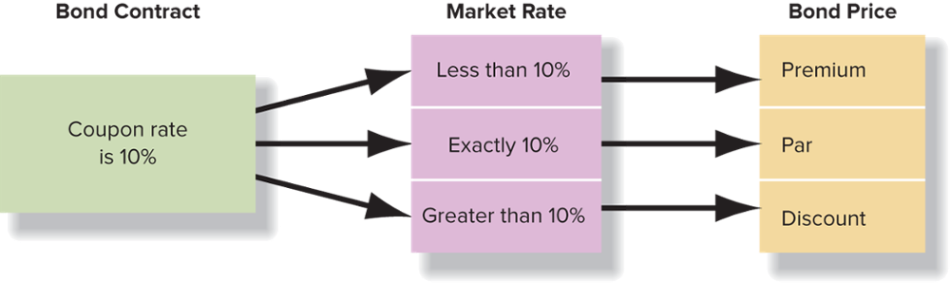
Reporting Bond Transactions Part 5

Slide 21
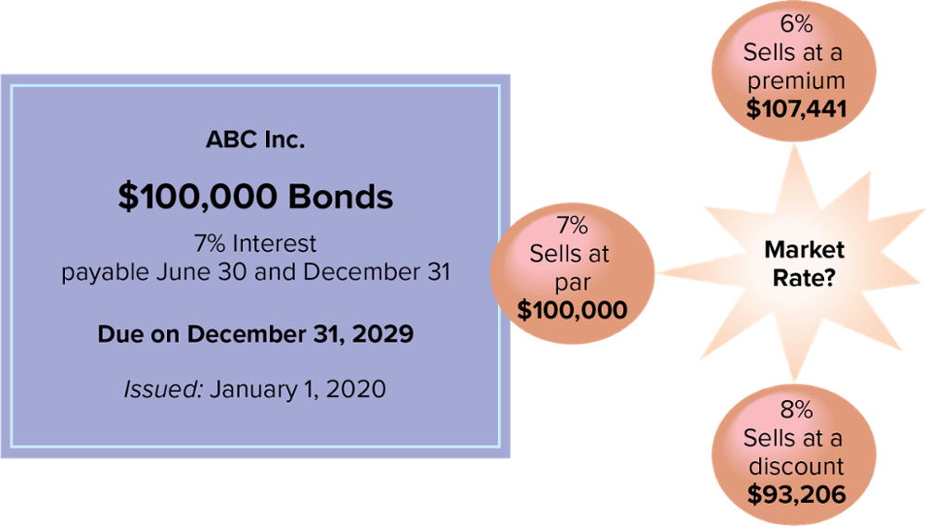
Reporting Bond Transactions Part 6
Corporations and creditors are indifferent to whether a bond is issued at par, at a discount, or at a premium, because bonds are always priced to provide the market rate of interest.

Slide 22
Reporting Bond Transactions – Data Analytics
Using Artificial Intelligence (AI) to Invest in Bonds
  Individuals who invest in bonds often spend considerable time and effort gathering and assessing vast amounts of market information as well as company-specific information.
  Using technology to expand and expedite this process would allow investors to make more informed, quicker decisions.
  AllianceBernstein, a global investment-management and research firm, has created Abbie, a virtual assistant based on artificial intelligence that helps investors make bond investing decisions.
  You can read more about Abbie’s abilities here: alliancebernstein.com/fixed-income/bonds/abbie.htm

Slide 23
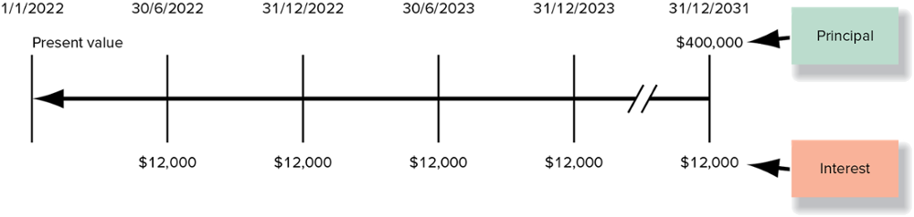
Bonds Issued at Par Part 1
On January 1, 2022, Mobile Services Corporation (MSC) issued 6% bonds with a par value of $400,000 and received $400,000 in cash. The bonds mature in 10 years and interest is paid semi-annually.
When MSC issued its bonds, it agreed to make two types of payments in the future: a single payment of $400,000 when the bond matures in 10 years and an annuity of $12,000 payable twice each year for 10 years. The bond payments can be shown graphically, as follows:

Slide 24
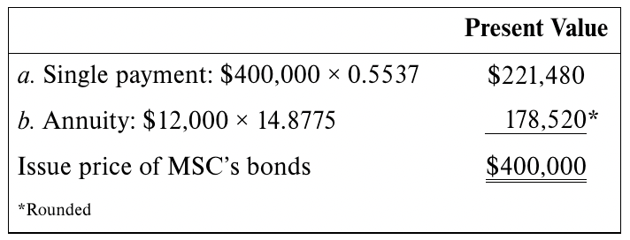
Bonds Issued at Par Part 2
The present value of the bond payments can be calculated with the PV tables by using the factor for 20 periods and an interest rate of 3 percent (6 percent ÷ 2):
When the effective rate of interest equals the stated rate of interest, the present value of the future cash flows associated with a bond always equals the bond’s par value.

Slide 25
Bonds Issued at Par Part 3
A bond’s selling price is determined by the present value of its future cash flows, not the par value.
On the date of issue, bond liabilities are recorded at the amount creditors are willing to pay for the bonds:
Cash (A) |  |  |  |  |  | 400,000
Bonds payable (L) |  |  |  |  |  |  | 400,000
Assets |  | = | Liabilities |  | + | Shareholders’ Equity
Cash | + 400,000 |  | Bonds payable | + 400,000

Slide 26
Reporting Interest Expense on Bonds Issued at Par
MSC will pay interest at 3 percent (i.e., 6 percent per year) on the par value of the bonds each June 30 and December 31 until the bond’s maturity date.
The amount of interest each period will be $12,000 (3% × $400,000). The entry to record the interest payments follows:
Bond interest expense (E) |  |  |  |  |  | 12,000
Cash (A) |  |  |  |  |  |  | 12,000
Assets |  | = | Liabilities |  | + | Shareholders’ Equity
Cash | −12,000 |  |  |  |  | Bond interest expense | −12,000 | −12,000

Slide 27
Bonds Issued at a Discount Part 1
On January 1, 2022, MSC issued 6% bonds with a par value of $400,000. The bonds mature in 10 years and interest is paid semi-annually. The market rate is 8% annually. Therefore, since the stated rate is less than the market rate, this bond is issued at a discount.
To calculate the issue price of the bonds, we need to calculate the present value of the future cash flows specified on the bond.
The number of periods is 20, but we use an interest rate of 4 percent (8 percent ÷ 2), which is the market rate of interest.

Slide 28
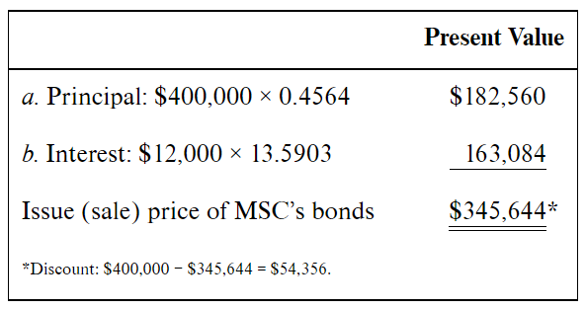
Bonds Issued at a Discount Part 2
The issue price of MSC’s bonds is calculated as follows:
The cash price of the bonds issued by MSC is $345,644.
Some people refer to this price as 86.4, which means that the bonds were sold at 86.4 percent of their par value ($345,644 ÷ $400,000).

Slide 29
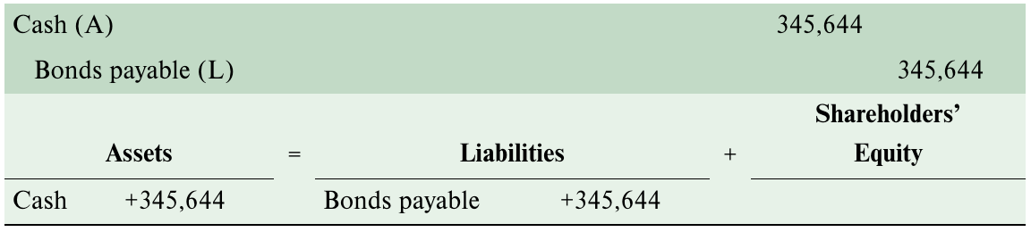
Bonds Issued at a Discount Part 4
On the date of issue, MSC records a bond liability equal to the amount creditors are willing to pay for the bonds:
While MSC received only $345,644 when it sold the bonds, it must repay $400,000 when the bonds mature.

Slide 30
Bonds Issued at a Discount Part 4
The $54,356 of additional cash that MSC must pay at maturity is incrementally reflected in interest expense and added to the carrying amount of the liability each period over the life of the bond.
This causes interest expense to reflect the market interest rate while the cash being paid to bondholders each period reflects the coupon rate.
The accounting method used to record interest expense is referred to as the effective-interest method.
Canadian publicly accountable enterprises are required to use the effective-interest method to amortize bond discount or premium.

Slide 31
Reporting Interest Expense on Bonds Issued at a Discount using Effective-Interest Amortization - 1
Step 1: Compute the interest expense:
  Interest expense = Unpaid balance x Market interest rate x n/12
  n = number of months in each interest period
Step 2: Compute the interest to be paid:
  Bond face value x Coupon rate per period
Step 3: Compute the amortization amount:
  Amortization of bond discount = Interest expense
  – Interest paid (or accrued)

Slide 32
Reporting Interest Expense on Bonds Issued at a Discount using Effective-Interest Amortization - 2
The first interest payment on MSC’s bonds is on June 30, 2022. Interest expense and the amount of the bond discount amortized are:
Step 1: Interest expense:
$345,644 × (0.08 × 6/12) = $13,826
Step 2: Interest to be paid:
$400,000 × (0.06 × 6/12) = $12,000
Step 3: Amortized discount:
$13,826 − $12,000 = $1,826

Slide 33
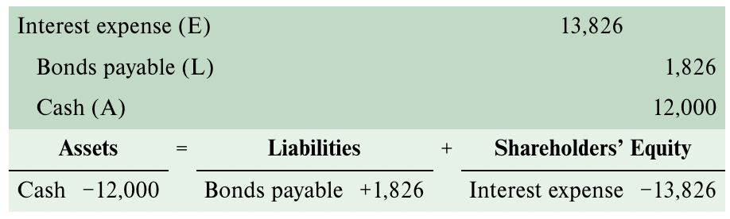
Reporting Interest Expense on Bonds Issued at a Discount using Effective-Interest Amortization - 3
The journal entry to record the periodic interest expense is as follows:

Slide 34
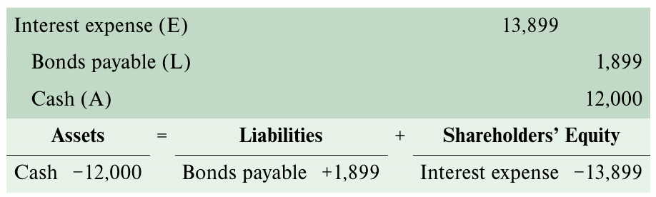
Reporting Interest Expense on Bonds Issued at a Discount using Effective-Interest Amortization - 4
Interest expense for the second half of 2022 is calculated by multiplying the carrying amount on June 30, 2022 (which is $345,644 plus $1,826, or $347,470) by the market interest rate for six months ($347,470 × (0.08 × 6/12) = $13,899).
The amortization of the bond discount in the second period is $1,899.

Slide 35
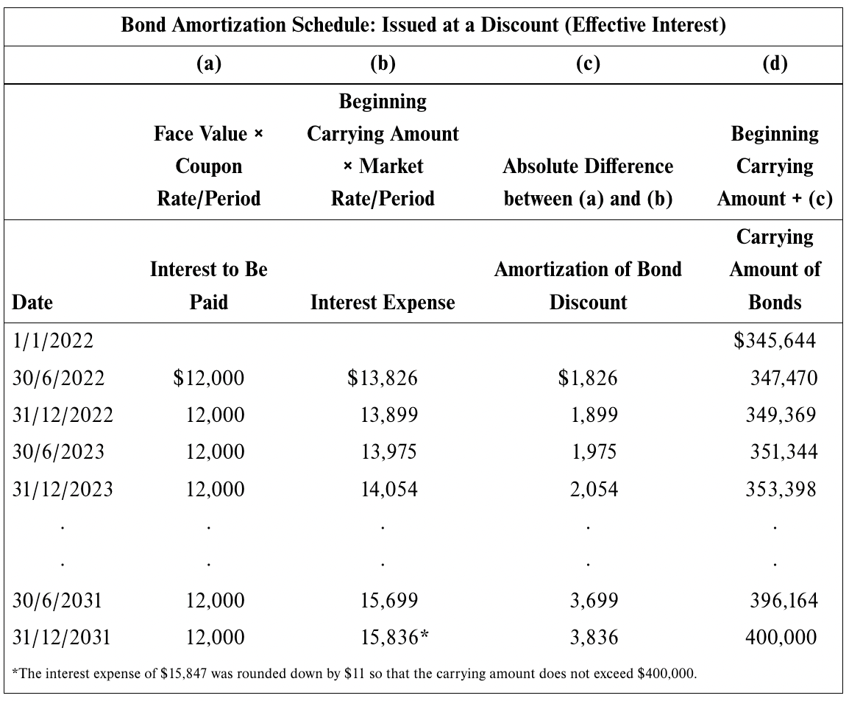
Reporting Interest Expense on Bonds Issued at a Discount using Effective-Interest Amortization - 5

Slide 36
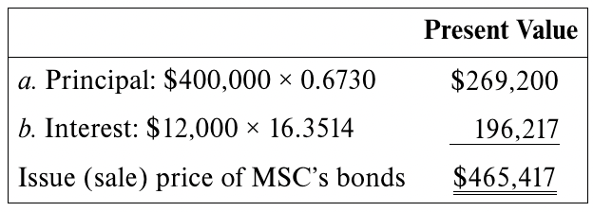
Bonds Issued at a Premium Part 1
When the market interest rate is less than the bond’s coupon rate, the bonds sell at a premium.
We use the same MSC example as before but assume that the market interest rate is 4 percent while the coupon rate remains the same, at 6 percent. The bonds are issued on January 1, 2022; pay interest semi-annually; and mature in 10 years.
The present value of the bonds can be calculated from the tables using the factor for 20 periods and an interest rate of 2 percent per period (4% × ½ year):

Slide 37
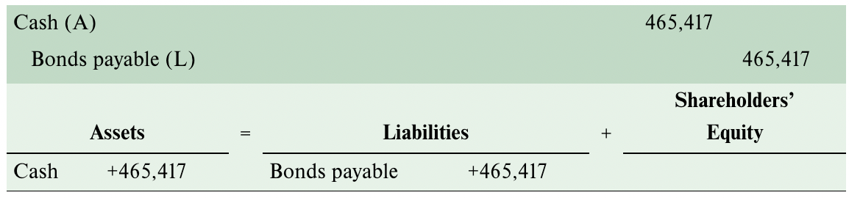
Bonds Issued at a Premium Part 2
Accounting for bonds issued at a premium is similar to accounting for bonds issued at a discount.
The January 1, 2022, issuance of MSC’s bonds at a premium would be recorded as follows:

Slide 38
Bonds Issued at a Premium Part 3
While MSC received $465,417 when it sold the bonds, it must repay only $400,000 when the bonds mature.
The $65,417 of additional cash that MSC received is repaid gradually over time as part of the periodic interest payments that exceed the amount of interest that the bondholders demanded for their investment in these bonds.
The difference between the interest payment and the interest expense reduces the carrying amount of the liability each period over the life of the bond.
The interest expense reflects the market interest rate while the cash being paid to bondholders each period reflects the coupon rate.

Slide 39
Reporting Interest Expense on Bonds Issued at a Premium using Effective-Interest Amortization - 1
Step 1: Compute the interest expense:
  Interest expense = Unpaid balance x Effective interest rate x n/12
  n = number of months in each interest period
Step 2: Compute the interest to be paid:
  Bond face value x Coupon rate per period
Step 3: Compute the amortization amount:
  Amortization of bond premium = Interest paid (or accrued)
  – Interest expense

Slide 40
Reporting Interest Expense on Bonds Issued at a Premium using Effective-Interest Amortization - 2
Step 1: Interest expense:
$465,417 × (0.04 × 6/12) = $9,308
Step 2: Interest to be paid:
$400,000 × (0.06 × 6/12) = $12,000
Step 3: Amortized premium:
$12,000 − $9,308 = $2,692

Slide 41
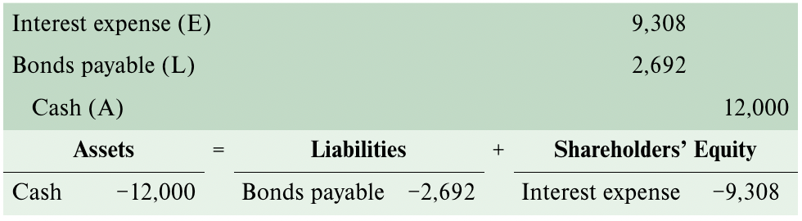
Reporting Interest Expense on Bonds Issued at a Premium using Effective-Interest Amortization - 3
The first payment of interest on the bonds is recorded, as follows:

Slide 42
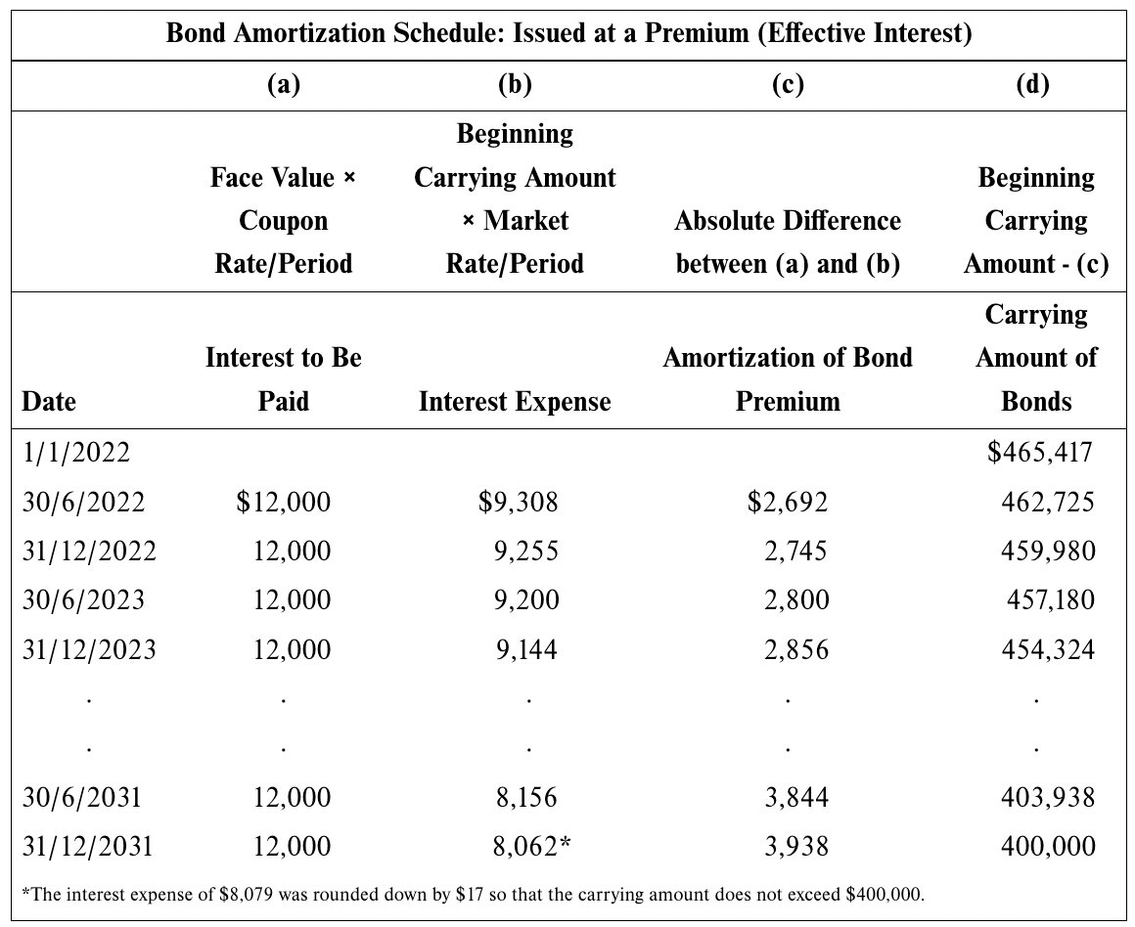
Reporting Interest Expense on Bonds Issued at a Premium using Effective-Interest Amortization - 4

Slide 43
Reporting Interest Expense on Bonds Issued at a Premium using Effective-Interest Amortization - 5
The basic difference between effective-interest amortization of a bond discount and a bond premium is that the amortization of a discount increases the carrying amount of the liability and the amortization of a premium reduces it.
Both serve the same purpose: to bring the liability to the bond’s face value at the maturity date.
This is illustrated on the next slide, which shows how the carrying amount of a bond changes over its life when the bond is issued at par, at a discount, or at a premium.

Slide 44
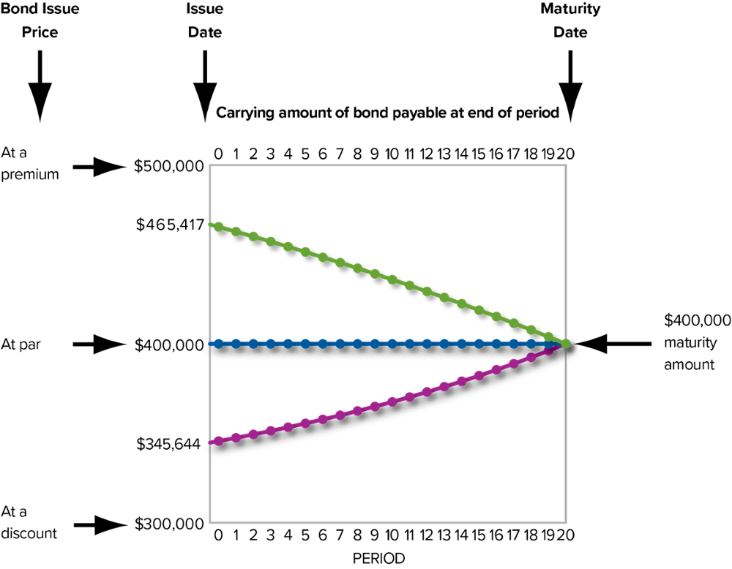
The Change in the Carrying Amount of a Bond over Time, Exhibit 9.6

Slide 45
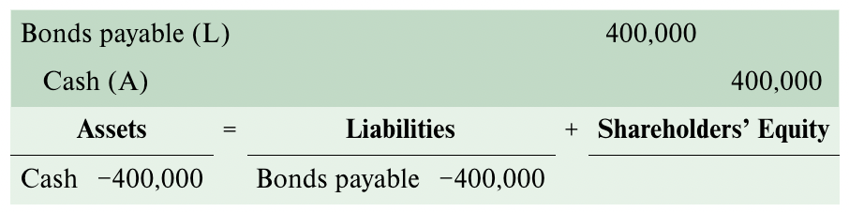
Reporting Interest Expense on Bonds Issued at a Premium using Effective-Interest Amortization - 6
Regardless of whether a company issues bonds at par, at a discount, or at a premium, the company will record the same journal entry when it retires the bonds at maturity.
For our MSC example, the journal entry would be:

Slide 46
Accounting for Issuance Costs
When companies issue bonds, they almost always hire underwriters to help them with the offering for a fee.
The amount of the fee is deducted from the proceeds of the bond issuance.
If after deducting fees the total amount received is less than the face value of the bonds, the bonds are issued at a discount.
If after deducting fees the amount received is greater than the face value of the bonds, the bonds are issued at a premium.
The examples in this chapter assume that the company issuing bonds does not incur any issuance costs.

Slide 47
Reporting Interest Expense Using Straight-Line Amortization
While the effective-interest method is the preferred method to amortize bond discount or premium, Canadian private enterprises may use straight-line amortization, which allocates an equal amount to each interest period, because it is relatively easy to compute the required numbers.
Private enterprises are permitted to use the straight-line method because the amortized discount or premium that result from the two methods are normally not materially different.

Slide 48
Key Ratio Analysis – Times Interest Earned Ratio
ANALYTICAL QUESTION → Is the company generating sufficient resources (added value) from its profit-making activities to meet its current obligations associated with debt?
RATIO AND COMPARISONS → The times interest earned ratio is helpful in answering this question. It is calculated as follows:
The ratio shows the amount of resources generated for each dollar of interest expense. In general, a high ratio is viewed more favourable than a low ratio.
Net earnings + Interest expense + Income tax expense
Times Interest
Earned Ratio
=
Interest expense

Slide 49
Early Retirement of Debt Part 1
Bonds are normally issued for long periods, such as 20 or 30 years.
Bondholders who need cash prior to the maturity date can simply sell the bonds to another investor. This transaction does not affect the accounts of the company that issued the bonds.
Each bond issue has characteristics specified in the bond indenture.
The issuing company often adds special characteristics to a bond to make it more attractive to investors that normally have a large number of investment alternatives from which to select.

Slide 50
Early Retirement of Debt Part 2
Some bonds have a call feature that allows the issuing company to call (retire) the bonds early.
A call feature most often requires the issuing company to pay investors an amount greater than the bond’s face value to retire the bonds before their maturity date.
The amount often is stated as a percentage of the bond’s face value and is described in the bond indenture or bond prospectus.
A company may elect to retire debt early by purchasing it on the open market, just as an investor would.
This approach is necessary when the bonds do not have a call feature.

Slide 51
International Perspective – Borrowing in Foreign Currencies
Companies may elect to borrow in foreign markets
  To reduce exchange rate risk.
  Because interest rates often are low in other countries.
For reporting purposes, accountants must convert, or translate, foreign debt into Canadian dollars.
Assume that Amazon borrowed 1 million euros. For Amazon’s annual report, the accountant must use the conversion rate as of the statement of financial position date, which we assume was €1.00 to US$1.1371.
€1,000,000 × US$1.1371 = US$1,137,100
The debt will be reported at $1,137,100 on Amazon’s financial statements.

Slide 52
Lease Liabilities Part 1
Companies often lease rather than purchase assets.
When a company leases an asset, it enters into a contractual agreement with the owner of the asset.
The party that owns the asset is referred to as the lessor.
The party that pays for the right to use the asset is referred to as the lessee.
This textbook focuses on accounting for leases from the lessee’s perspective.

Slide 53
Lease Liabilities Part 2
For accounting purposes, a lessee can lease an asset by signing either a short-term lease (12 months or less) or a long-term lease.
The lease contract for a short-term lease does not transfer control of the asset to the lessee.
For long-term leases, which are more common, International Financial Reporting Standard (IFRS) 16 requires the lessee to recognize a right-of-use asset and a lease liability, measured at the present value of future lease payments.

Slide 54
Key Ratio Analysis – Debt-To-Equity Ratio
ANALYTICAL QUESTION → As an investor who must decide whether or not to buy shares, it is important to know how much of the company’s assets is financed by creditors and how much is financed by owners. The debt-to-equity ratio is used to assess the debt capacity of a business. It is computed as follows:
The ratio shows the relationship between the amount of capital provided by owners and the amount provided by creditors. In general, a high ratio suggest that a company relies heavily on funds provided by creditors.
Debt-to-equity
Ratio
Total Liabilities
=
Shareholders’ equity

Slide 55
Focus on Cash Flows
The cash received when a company issues long-term debt is reported as a cash inflow from financing activities.
The repayment of principal is reported as an outflow from financing activities.
You will see in Chapter 11 that interest paid may be reported in either the operating or the financing section of the statement of cash flows.
Interest expense is reported on the statement of earnings and is a component of net earnings. As a result, most companies report interest payments as operating activities.

Slide 56
End of Chapter Summary
Long-term notes and bonds payable have a number of characteristics designed to meet the needs of the issuing corporation and the creditor.
Corporations use debt to raise long-term capital.
A note or mortgage payable requires periodic payment of interest and repayment of the principal amount.
Three types of events must be recorded over the life of a typical bond: (1) the receipt of cash when the bond is first sold, (2) the periodic payment of interest, and (3) the repayment of principal upon the maturity of the bond.
Bonds are sold at a discount when the coupon rate is less than the market interest rate.

Slide 57
End of Chapter Summary Continued
Bonds are sold at a premium when the coupon rate is greater than the market interest rate.
A corporation may retire bonds before their maturity date. The difference between the carrying amount and the amount paid to retire the bonds is reported as a gain or a loss, depending on the circumstances.
Typical non-current liabilities include lease obligations and deferred income taxes.
The debt-to-equity ratio measures the relationship between total liabilities and the shareholders’ capital that finances the assets. The higher the ratio, the more debt is used to finance assets. As the ratio increases, risk increases.

