Slide 1
PART 1 · MODEL MIGRATION & IN-HOUSE DEPLOYMENT
Gait Foundation Model,
running in-house — end to end
We migrated the co-authored movement model into Newton's own environment, verified it runs
correctly, and reproduced the study's published results as an end-to-end check.
BioPilot.ai · prepared for Newton-Tech
Doc BP-PO008-001 · v1.0 Draft · 2026-08-13 · Jointly-owned (IP §5.6) · Confidential

Slide 2
THE OBJECTIVE
What Part 1 set out to do
The goal
Take the gait foundation model, co-authored with the Weizmann research team and described in the recent paper, and make it run reliably inside Newton's own environment, then prove it works from start to finish.
The deliverable
A working in-house model, its source code, and integration notes so the team can run and build on it.
1
Migrate
Model + checkpoint into Newton's setup
2
Verify
Runs correctly, end to end
3
Reproduce
Matches the paper's published results

Slide 3
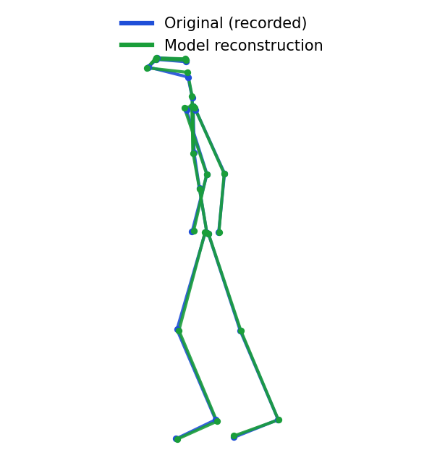
IN PLAIN TERMS
What the model actually does
A depth camera records a person doing simple movements (walking, standing, sit-to-stand)
Pre-processing video into a moving 3-D stick figure.
The model has learned what healthy human movement looks like to a point it can redraw a person's motion from a partial view, accurate to about 8 millimetres.
In doing so it produces a compact “movement fingerprint” for each recording (1,024 numbers) that capture how someone moves. Those fingerprints are what we predict health traits from.
Recorded movement (blue) vs. the model's reconstruction (green) — they overlap almost perfectly.

Slide 4
FIVE STEPS, END TO END
How we migrated it in-house
1
Set up the environment A clean, native install on Newton's Apple-Silicon Mac (cloud/GPU path documented too).
2
Load the model Loaded the co-authored checkpoint and rebuilt its architecture automatically from the saved weights.
3
Verify it runs Confirmed it reconstructs movement to ~8 mm, the same accuracy reported in the paper.
4
Connect to Newton's data Streamed recordings directly from Newton's cloud (S3) storage, without keeping any sensitive files on the machine.
5
Produce embeddings Turned each recording into its 1,024-number movement fingerprint, ready for analysis.

Slide 5
END-TO-END CHECK
Can movement alone predict health traits? Yes.
Using only the movement fingerprints, we predicted age, body-mass index (BMI) and sex for 3,643 people, the paper's headline result and matched the published numbers.
SEX
BMI
AGE
99.8%
0.87–0.90
± ~6 yrs
accuracy (AUC 0.998)
correlation with truth
from movement alone
Movement carries real physiological signal, the basis for Newton's downstream health analytics.

Slide 6
REPRODUCTION
Our in-house results match the paper
Trait | Our in-house model | Published paper
Sex (accuracy) | 0.998 | 0.99
BMI - men | 0.873 | 0.896
BMI - women | 0.900 | 0.915
Age - men | 0.686 | 0.691
Age - women | 0.671 | 0.689
How to read it
Numbers are correlation / accuracy (higher is better) 1.0 is perfect.
Every trait lands within a few hundredths of the published value.
Sex prediction slightly exceeds the paper.
Evaluated exactly as the paper does: separate models per sex, tested on people the model never trained on, averaged over 15 repeats.

Slide 7
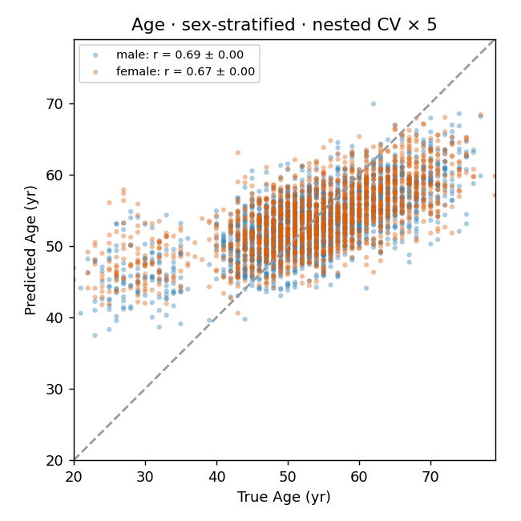
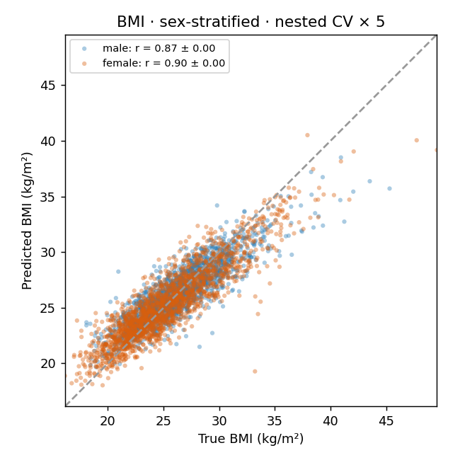
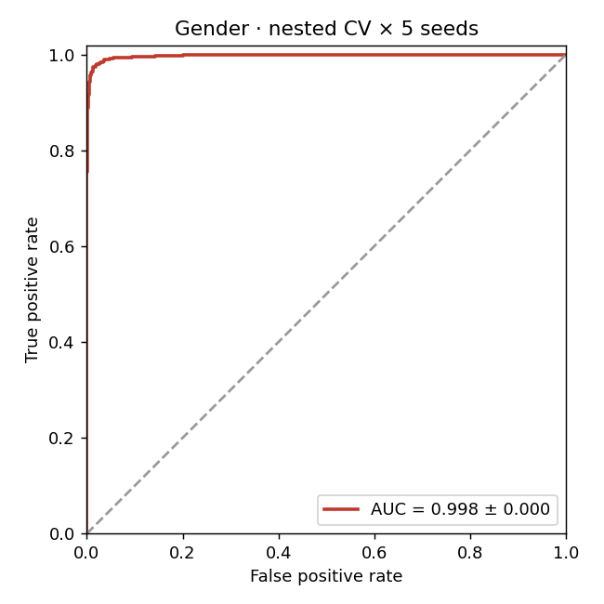
PREDICTED VS. ACTUAL
The results, at a glance
Each dot is a person: predictions (vertical) track their true values (horizontal). The sex panel shows near-perfect separation.

Slide 8
PART 1 OUTPUTS
What's delivered
1
Working in-house model
2
Source code
The co-authored model runs on Newton's hardware, loading the checkpoint and producing embeddings.
Two clean, reusable Python modules: a streaming extractor and the analysis/probe.
3
Reviewable notebook
4
Integration notes
A Jupyter notebook that shows each step live: the model running, the fingerprints, the results and plots.
Environment, data flow, how to run, and known limitations, this report plus the written notes.

Slide 9
HONEST SCOPE
Limitations & what comes next
Scope & limitations
Natural next steps
This validates the model on age, BMI and sex. The paper's broader 18-body-system phenotypes are future work.
Visceral-fat (VAT) prediction from the paper is excluded, as that label isn't in Newton's data.
A small residual gap (≈ 0.02) to the paper remains attributable to cohort and aggregation details, not the model.
Pretrain a naïve gait model
achieve similar prediction accuracies
IP & data note The model and training pipeline are jointly-owned (master agreement §5.6). Recordings are subject-level and stay within Newton's environment; nothing is stored on local machines.

Slide 10
PART 1 · COMPLETE
The model runs in-house, end to end
and reproduces the published science.
Working in-house model · source code · integration notes - delivered.
Traceability: repo GaitPredict · commits 6f021e7, 5e550e4 · code, results & notebook in-repo.
Doc BP-PO008-001 · v1.0 Draft for Newton review · reviewed / approved by Newton VP R&D.
BioPilot.ai for Newton-Tech

