Slide 1
Processor Data Path and Control
Diana Palsetia
UPenn

Slide 2
What Do We Know?
Already discovered:
  Gates (AND, OR..)
  Combinational logic circuits (decoders, mux)
  Memory (latches, flip-flops)
  Sequential logic circuits (state machines)
  Simple processors (programmable traffic sign)
What’s next?
  Apply all this to build a working processor

Slide 3
Von Neumann Model
MEMORY
MAR MDR
INPUT
Keyboard
Mouse
Scanner
Disk
OUTPUT
Monitor
Printer
LED
Disk
PROCESSING UNIT
ALU TEMP
CONTROL UNIT
PC IR

Slide 4
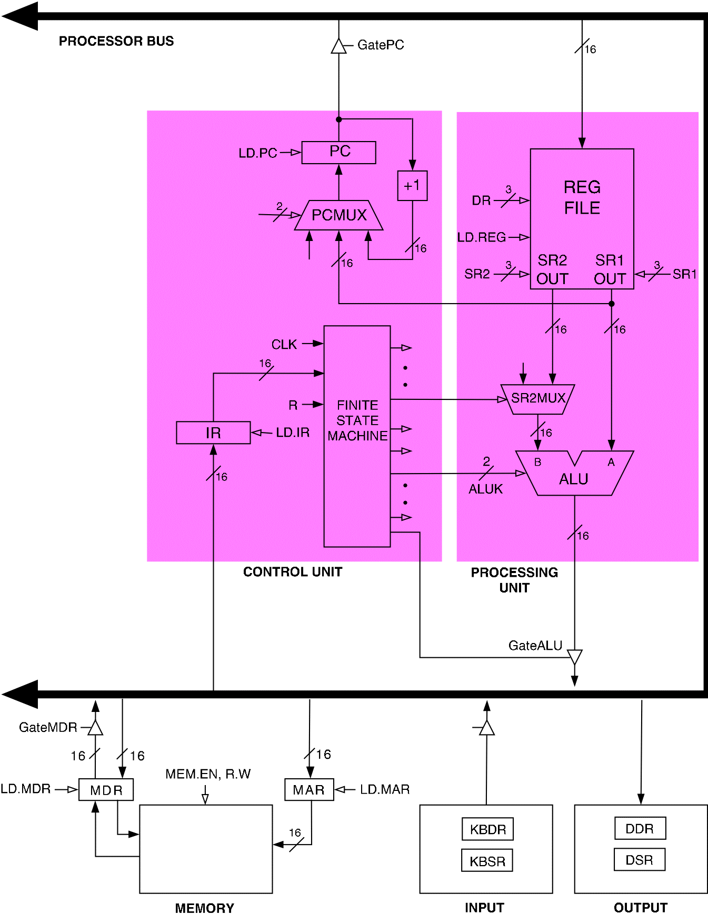
LC-3 Processor Von Nuemann Model
CONTROL
UNIT
Notes:
Notice all the “floating” control lines; they really come from FSM.

Slide 5
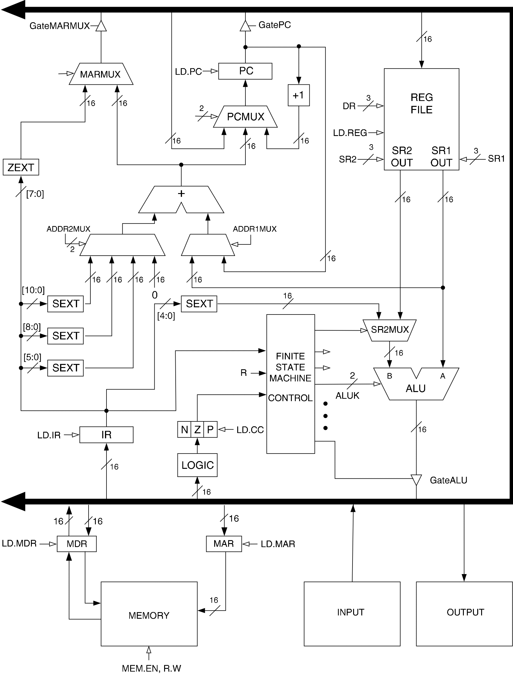
LC-3 Data Path
The data path of a computer is all the logic used to process information
Filled arrow
= info to be processed.
Unfilled arrow
= control signal.
CONTROL
UNIT

Slide 6
One More Device
Tri-state buffer
  NOT an inverter!
  Device with a special output that can take a third state (i.e. besides 0 and 1)
Allows wires to be “shared”
  Alternative to mux
  Only one source may drive at a time!
  Usually used to control data over a bus
D
Q
E | D | Q
1 | 0 | 0
1 | 1 | 1
0 | 0 | Z
0 | 1 | Z
E
Z = “high impedance” state

Slide 7
Data Path Components
Global bus
  Set of wires that carry 16-bit signals to many components
  Inputs to bus are controlled by triangle structure called tri-state devices
    Place signal on bus when enabled
    Only one (16-bit) signal should be enabled at a time
    Control unit decides which signal “drives” the bus
  Any number of components can read bus
    Register only captures bus data if write-enabled by the control unit
Memory and I/O
  Control signals and data registers for memory and I/O devices
  Memory: MAR, MDR (also control signal for read/write)
  Input (keyboard): KBSR, KBDR
  Output (text display): DSR, DDR

Slide 8
LC-3 Data Path
CONTROL
UNIT
Filled arrow = info to be processed. Unfilled arrow = control signal.

Slide 9
Data Path Components (cont.)
ALU
  Input: register file or sign-extended bits from IR (immediate field)
  Output: bus; used by…
    Condition code registers
    Register file
    Memory and I/O registers
Register File
  Two read addresses, one write address (3 bits each)
  Input: 16 bits from bus
    Result of ALU operation or memory (or I/O) read
  Outputs: two 16-bit
    Used by ALU, PC, memory address
    Data for store instructions passes through ALU

Slide 10
Data Path Components (contd..)
PC and PCMUX
  Three inputs to PC, controlled by PCMUX
    Current PC plus 1 (normal operation)
    Adder output (BR, JMP, …)
    Bus (TRAP)
MAR and MARMUX
  Some inputs to MAR, controlled by MARMUX
    Zero-extended IR[7:0] (used for TRAP; more later)
    Adder output (LD, ST, …)

Slide 11
Data Path Components (cont..)
Condition Code Logic
  Looks at value (from ALU) on bus and generates N, Z, P signals
  N,Z,P Registers are set only when control unit enables them
Control Unit
  For each stage in instruction processing decides:
    Who drives the bus?
    Which registers are write enabled?
    Which operation should ALU perform?
Lets Look at Instruction Processing next..

Slide 12
Instructions
Fundamental unit of work
Constituents
  Opcode: operation to be performed
  Operands: data/locations to be used for operation
Encoded as a sequence of bits (just like data!)
  Sometimes have a fixed length (e.g., 16 or 32 bits)
  Atomic: operation is either executed completely, or not at all

Slide 13
Instruction Processing
FETCH instruction from mem.
DECODE instruction
EVALUATE ADDRESS
FETCH OPERANDS
EXECUTE operation
STORE result

Slide 14
Instruction Processing: FETCH
Idea
  Put next instruction in IR & increment PC
Steps
  Load contents of PC into MAR
  Increment PC
  Send “read” signal to memory
  Read contents of MDR, store in IR
F
D
EA
OP
EX
S

Slide 15
FETCH in LC-3
Control
Load PC into MAR (inc PC)
Data
CONTROL
UNIT

Slide 16
FETCH in LC-3
Control
Load PC into MAR
Data
Read Memory
CONTROL
UNIT

Slide 17
FETCH in LC-3
Control
Load PC into MAR
Data
Read Memory
Copy MDR into IR
CONTROL
UNIT
Notes:
Q: What if we didn’t have MDR/MAR? A: Couldn’t have bus!

Slide 18
Instruction Processing: DECODE
Identify opcode
  In LC-3, always first four bits of instruction
  4-to-16 decoder asserts control line corresponding
  to desired opcode
Identify operands from the remaining bits
  Depends on opcode
  e.g., for LDR, last six bits give offset
  e.g., for ADD, last three bits name source operand #2
F
D
EA
OP
EX
S

Slide 19
DECODE in LC-3
Decoding usually a part of the Control Unit but can be seperate
CONTROL
UNIT

Slide 20
Instruction Processing: EVALUATE ADDRESS
Compute address
  For loads and stores
  For control-flow instructions
Examples
  Add offset to base register (as in LDR)
  Add offset to PC (as in LD and BR)
F
D
EA
OP
EX
S

Slide 21
EVALUATE ADDRESS in LC-3
Load/Store
CONTROL
UNIT

Slide 22
Instruction Processing: FETCH OPERANDS
Get source operands for operation
Examples
  Read data from register file (ADD)
  Load data from memory (LDR)
F
D
EA
OP
EX
S

Slide 23
FETCH OPERANDS in LC-3
ADD
CONTROL
UNIT

Slide 24
FETCH OPERANDS in LC-3
LDR
CONTROL
UNIT

Slide 25
Instruction Processing: EXECUTE
Actually perform operation
Examples
  Send operands to ALU and assert ADD signal
  Do nothing (e.g., for loads and stores)
F
D
EA
OP
EX
S

Slide 26
EXECUTE in LC-3
ADD
CONTROL
UNIT

Slide 27
Instruction Processing: STORE
Write results to destination
  Register or memory
Examples
  Result of ADD is placed in destination reg.
  Result of load instruction placed in destination reg.
  For store instruction, place data in memory
    Set MDR
    Assert WRITE signal to memory
F
D
EA
OP
EX
S

Slide 28
STORE in LC-3
ADD
CONTROL
UNIT
Notes:
This should probably be part of EXEC phase

Slide 29
STORE in LC-3
LDR
CONTROL
UNIT

Slide 30
STORE in LC-3
STORE
  Set MDR
CONTROL
UNIT

Slide 31
STORE in LC-3
STORE
  Set MDR
  Assert “write”
CONTROL
UNIT

Slide 32
Time to Complete One Instruction
It takes fixed number of clock ticks (repetition of rising or falling edge) to execute each instruction
  The time interval between ticks is known as clock cycle
  Thus instruction performance is measured in clock cycles
Hence the clock sequences each phase of an instruction by raising the right signals as the right time
So what determines the time between ticks i.e. the length of the clock cycle?

Slide 33
Clocking Methodology
Defines when signals can be read and when they can be written
It is important to specify the timing of reads and writes because, if a value is written at the same time it is read, the value of read could be old, new or mix of both
All values are stored on clock edge (edge-triggered) i.e. within a defined interval of time (length of the clock cycle)
In a processor, since only memory elements can store values this means that
  Any collection of combinational logic must have its inputs coming from a set of memory elements and its outputs written into a set of memory elements

Slide 34
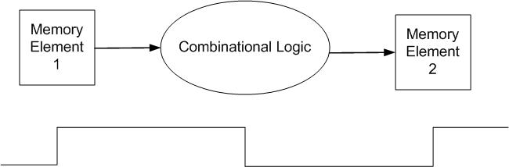
Clocking Methodology (contd..)
The length of the clock cycle is determined as follows:
The time necessary for the signals to reach memory element 2 defines the length of the clock cycle
  i.e. minimum clock cycle time must be at least as great as the maximum propagation delay of the circuit

