Slide 1
Chapter 5
The LC-3 Instruction Set Architecture
ISA Overview
Operate instructions
Data Movement instructions
Control Instructions
LC-3 data path

Slide 2
A specific ISA: The LC-3
We have:
Reviewed data encoding and simple digital concepts
Introduced a general model for computer organization
Discussed a general model for computer execution (the instruction cycle)
Now its time to focus on a specific example: The LC-3 ISA
The LC-3 uses a 16-bit word and is word-addressable
How large can the LC-3 memory be?
All instructions are represented as 16-bit words
All data is represented as 16-bit words
Native Data Type: only 2’s complement integer
The LC-3 uses eight 16-bit GPRs: R0-R7
The LC-3 maintains three 1-bit status codes: N, Z, P

Slide 3
LC-3 Instructions
Three types of instructions
Operate: Manipulate data directly
ADD, AND, NOT
Data Movement: Move data between memory and registers
LD, LDI, LDR, LEA, ST, STI, STR
Control: Change the sequence of instruction execution
BR, JMP/RET, JSR/JSSR, TRAP, RTI
Addressing Modes:
Immediate (non-memory addressing mode)
Register (non-memory addressing modes)
Direct (memory addressing mode)
Indirect (memory addressing mode)
Base+Offset (memory addressing modes)

Slide 4
LC33 Instruction word
LC-3 Instructions word: 16 bits
4-bit opcode => 16 instructions (RISC)
remaining 12 bits specify operand(s), according to the addressing mode proper to each instruction.
Opcode: Specifies what the instruction does
IR[15:12]: 4 bits allow 16 instructions
specifies the instruction to be executed
Operands: Specifies what the instruction acts on
IR[11:0]: contains specifications for:
Registers: 8 GPRs (i.e. require 3 bits for addressing)
Address Generation bits: Offset (11 or 9 or 6 bits) (more later)
Immediate value: 5 bits
Examples
ADD DR, SR1, SR2 ; DR ← (SR1) + (SR2)
[15:12] [11:9] [8:6] [2:0]
LDR DR, BaseR, Offset ; DR ← Mem[BaseR + Offset]
[15:12] [11:9] [8:6] [5:0]

Slide 5
Addressing Modes
The LC-3 supports five addressing modes:
the operand is located:
in the instruction itself (#1: immediate a.k.a literal)
in a register (#2)
in memory:
Note: the effective address (ea) is the memory location of the operand
the ea is encoded in the instruction (#3: direct, or PC-relative)
a pointer to the ea is encoded in the instruction (#4: indirect)
a pointer to the ea is stored in a register (#5: base+offset, a.k.a. relative)
LC-3 Operate instructions use only immediate and register modes
LC-3 Data movement instructions use all five modes

Slide 6
Operate Instructions - 1
Arithmetic and Logic
Arithmetic: add, subtract, multiply, divide (the LC-3 only has add)
Logic: and, or, not, xor (the LC-3 only has and, not)
LC-3: NOT, ADD, AND
AND (opcode = 0101) has the same structure as ADD
dest reg
src reg
1 0 0 1
0 1 1
0 1 0
1
1 1
1 1 1
NOT
R3
R2
dest reg
src reg
src reg
0 0 0 1
0 1 1
0 1 0
0
0 0
1 0 1
ADD
R3
R2
R5

Slide 7
Condition Codes
“Hiding” in the control unit, we find the Processor Status Register (PSR)
Many instructions set the condition codes according to their results
Z = result was zero
N = result was negative
P = result was positive
Note that one and only one of these conditions can be true
Priv Priority N Z P
15
10 – 8
2 1 0

Slide 8
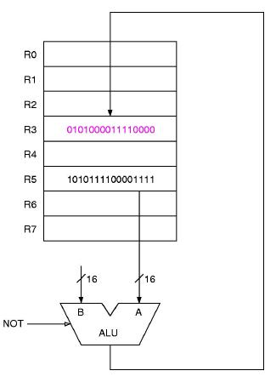
NOT: Bitwise Logical NOT
UNARY OPERATION
Assembler Inst.
NOT DR, SR ; DR = NOT SR
Encoding
1001 DR SR 111111
Example
NOT R3, R5
Note: Condition codes are set.

Slide 9
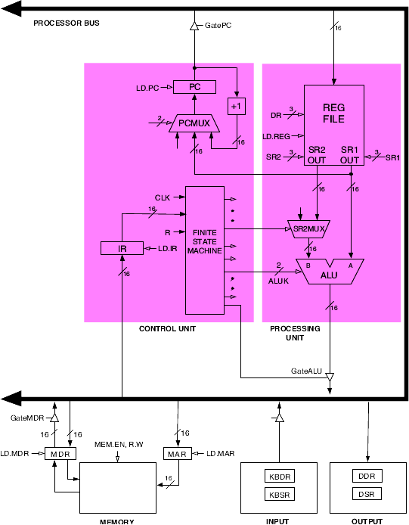
Control signals for NOT
NOT R3, R5
SR1 = 101; ALUK = NOT; GateALU = 1
Wait for signal propagation/sub-cycle tick
DR = 011; LD.REG = 1
Wait for signal propagation/sub-cycle tick
RELEASE ALL

Slide 10
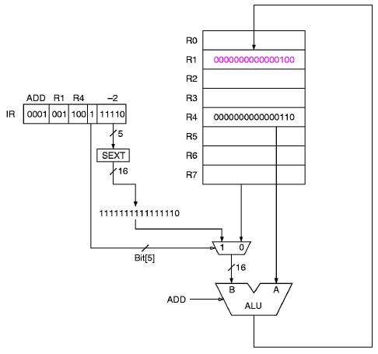
ADD: Two's complement 16-bit Addition
BINARY OPERATION
Assembler Instruction
(register addressing)
ADD DR, SR1, SR2 ; DR = SR1 + SR2
(immediate addressing)
ADD DR, SR1, imm5 ; DR = SR1 + Sext(imm5)
Encoding
0001 DR SR1 0 00 SR2
0001 DR SR1 1 imm5
Examples
ADD R1, R4, R5
ADD R1, R4, # -2
Note: Condition codes are set

Slide 11
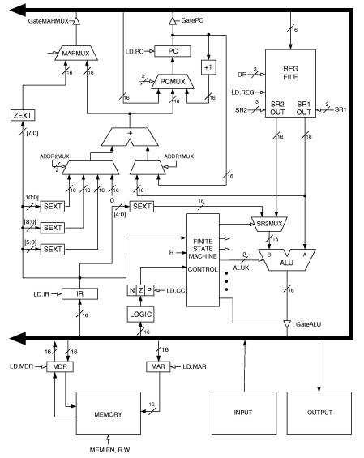
Control signals for ADD (immed5)
ADD R1,R4,-2
SR1 = 100; SR2MUX = IR; ALUK = ADD; GateALU = 1
Wait for signal propagation/sub-cycle tick
DR = 001; LD.REG = 1
Wait for signal propagation/sub-cycle tick
RELEASE ALL

Slide 12
Control signals for ADD (register)
ADD R1,R4,R5
SR1 = 100; SR2 = 101; SR2MUX = REGfile; ALUK = ADD; GateALU = 1
Wait for signal propagation/sub-cycle tick
DR = 001; LD.REG = 1
Wait for signal propagation/sub-cycle tick
RELEASE ALL

Slide 13
AND: Bitwise Logical AND
Assembler Instruction
AND DR, SR1, SR2 ; DR = SR1 AND SR2
AND DR, SR1, imm5 ; DR = SR1 AND Sext(imm5)
Encoding
0101 DR SR1 0 00 SR2
0101 DR SR1 1 imm5
Examples
AND R2, R3, R6
AND R2, R2, #0 ; Clear R2 to 0
Question: if the immediate value is only 6 bits, how can it mask the whole of R2?
Note: Condition codes are set.

Slide 14
The whole enchilada
So, we now understand the data path in great detail for register and immediate instructions.
For memory access instructions, we need to worry about the entire instruction cycle (all 6 steps), so let’s revisit a simple instruction:
ADD R1,R4,R5

Slide 15
The complete instruction cycle
ADD R1,R4,R5
GatePC = 1; LD.MAR = 1; MEM.EN, R.W = Read, LD.MDR = 1
Wait, then release all
GateMDR = 1; LD.IR = 1; PCMUX = +1; LD.PC
Now the control unit can see the IR, so it “knows” what to do next
Wait, then release all
SR1 = 100; SR2 = 101; SR2MUX = REGfile; ALUK = ADD; GateALU = 1
DR = 001; LD. REG = 1
Wait, then release all
Now, where is the PC pointing?

Slide 16
Data Movement Instructions - 1
Move Data
from register to memory => store
nominated register is Source
from memory to register => load
nominated register is Destination
The LC-3 cannot move data from memory to memory
also to/from I/O devices (later)
LC-3 Load/Store Instructions
LD, LDI, LDR, LEA, ST, STI, STR
Format:
15 14 13 12 11 10 9 8 7 6 5 4 3 2 1 0
opcode
DR or SR
Address generator bits

Slide 17
Data Movement Instructions - 2
What do you do with the 9 Addr Gen bits IR[8:0]?
LC-3 Load/Store Addressing modes:
direct or PC-Relative: LD & ST
The EA is the Sign Extended Addr. Generator added to the current value of the Program Counter - i.e.
EA = (PC) + SEXT( IR[8:0] )
DR <= Mem[ EA ]
indirect: LDI & SDI
EA = Mem[ (PC) + SEXT( IR[8:0] ) ]
DR <= Mem[ EA ]
base + offset (relative): LDR & STR (BaseReg is specified by IR[8:6])
EA = BaseReg + SEXT( IR[5:0] )
DR <= Mem[ EA ]
immediate: LEA
Does NOT access Memory! It “LOADS” an address for later use!; - i.e.
DR <= (PC) + SEXT( IR[8:0] )

Slide 18
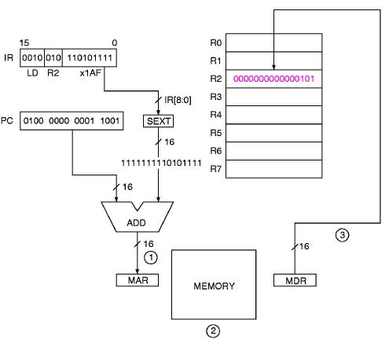
LD: Load Direct
LD R2, x1AF
Assembler Inst.
LD DR, LABEL ; DR <= Mem[LABEL]
Encoding
0010 DR PCoffset9
Examples
LD R2, param ; R2 <= Mem[param]
Notes:
The LABEL must be within +256/-255 lines of the instruction.
Condition codes are set.

Slide 19
ST: Store Direct
Assembler Inst.
ST SR, LABEL ; Mem[LABEL] <= SR
Encoding
0011 SR offset9
Examples
ST R2, VALUE ; Mem[VALUE] <= R2
Notes:
- The LABEL must within +/- 256 lines of the instruction.
- Condition codes are NOT set.

Slide 20
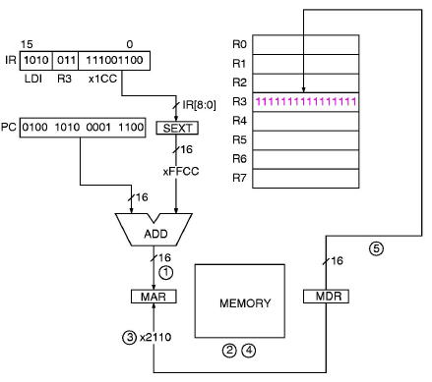
LDI: Load Indirect
Assembler Inst.
LDI DR, LABEL ; DR <= Mem[Mem[LABEL]]
Encoding
1010 DR PCoffset9
Examples
LDI R2, POINTER ; R2 <= Mem[Mem[POINTER]]
Notes:
- The LABEL must be within +256/-255 lines of the instruction.
- Condition codes are set.
LDI R3, x1CC

Slide 21
STI: Store Indirect
Assembler Inst.
STI SR, LABEL ; Mem[Mem[LABEL]] <= SR
Encoding
1011 SR offset9
Examples
STI R2, POINTER ; Mem[Mem[POINTER]] <= R2
Notes:
- The LABEL must be within +/- 256 lines of the instruction.
- Condition codes are NOT set.

Slide 22
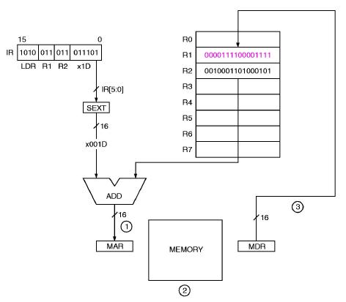
LDR: Load Base+Index
Assembler Inst.
LDR DR, BaseR, offset ; DR <= Mem[ BaseR+SEXT( IR[5:0] )]
Encoding
0110 DR BaseR offset6
Examples
LDR R2, R3, #15 ; R2 <= Mem[(R3)+15]
Notes:
The 6 bit offset is a 2’s complement number, so range is -32 to +31.
Condition codes are set.
LDR R1, R2, x1D

Slide 23
STR: Store Base+Index
Assembler Inst.
STR SR, BaseR, offset6 ; Mem[BaseR+SEXT(offset6)] <= (SR)
Encoding
0111 SR BaseR offset6
Examples
STR R2, R4, #15 ; Mem[R4+15] <= (R2)
Notes: The offset is sign-extended to 16 bits.
Condition codes are not set.

Slide 24
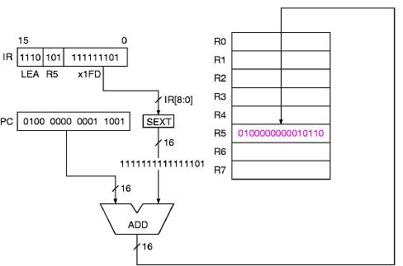
LEA: Load Effective Address
Assembler Inst.
LEA DR, LABEL ; DR <= LABEL
Encoding
1110 DR offset9
(i.e. address of LABEL = (PC) + SEXT(offset9)
Examples
LEA R2, DATA ; R2 gets the address of DATA
Notes:
- The LABEL must be within +/- 256 lines of the instruction.
- Condition codes are set.
LEA R5, # -3

Slide 25
Examples
What is the EA for the following instructions?
Given: PC = x2081, R6 = x2035, LOC = x2044, Mem[x2044] = x3456
0110 001 110 00 1100
LDR R1, R6, #12
Base+Offset addressing:
EA = (R6)+12 = x2035 + x000C
= x2041
1010 010 1 1100 0011
LDI R2, LOC
Indirect addressing:
EA = Mem[x2044] = x3456
ADD R1, R3, R2
Register addressing:
DR <= ?
ADD R5, R1, #15
Immediate addressing:
DR <= ?
LD R1, LOC
Direct addressing:
DR <= ?

Slide 26
Control Instructions
Change the Program Counter
Conditionally or unconditionally
Store the original PC (subroutine calls) or not (goto)
LC-3 Control Instructions
BRx, JMP/RET, JSR/JSRR, TRAP, RTI
JMP/RET & JSRR use base+offset addressing with zero offset
BRx uses PC-Relative addressing with 9-bit offset
JSR uses PC-Relative addressing with 11-bit offset

Slide 27
JMP: Jump or GoTo
Assembler Inst.
JMP BaseR
Take the next instruction from the address stored in BaseR
Encoding
1100 000 BaseR 00 0000
Example
JMP R5 ; if (R5) = x3500, the address x3500 is written to the PC

Slide 28
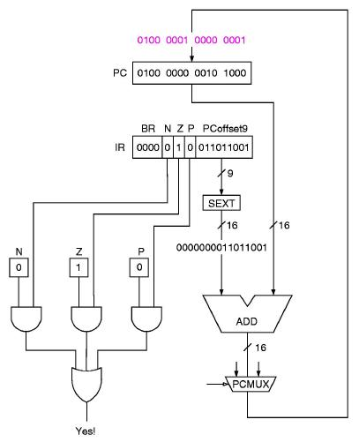
BR: Conditional Branch
Assembler Inst.
BRx LABEL
where x = n, z, p, nz, np, zp, or nzp
Branch to LABEL iff the selected condition code are set
Encoding
0000 n z p PCoffset9
Examples
BRzp LOOP ; branch to LOOP if previous op returned zero or positive.
BRz x0D9

Slide 29
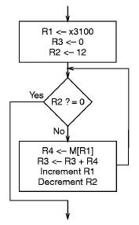
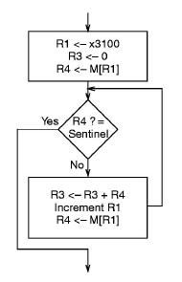
Building loops using BR
Counter control
Sentinel control
Add 12 integers in array @ 0x3100
There are two Branches: what are they?
Add integers in null terminated array @ 0x3100

Slide 30
TRAP Instruction (The basics)
Traps will be covered in detail later
Used to invoke an system routine.
Trap vector table: a list of locations of the service call routines.
TRAP has one operand, the trap vector:
PC is set to the value stored at that location of the vector table.
But we need some I/O services now:
* x20: R0 <- input ANSI character from stdin
* x23: R0 <- input ANSI character from stdin with prompt & echo
* x21: output ANSI character to stdout <- R0
* x25: halt the program
More details later
Assembler Inst.
TRAP trapvec
Encoding
1111 0000 trapvect8
Examples
TRAP x23
Notes:
R7 <= (PC) (for eventual return)
PC <= Mem[Zext(trapvect8)]

Slide 31
Immediate & Register Operands
Immediate
If bit 5 = 1, the value in IR[4:0] (“immediate”) is sign extended (SEXT) to
16 bits and added to the contents of the source register SR1 (IR[8:6]).
Register
if bit 5 = 0, the contents of source register SR2 (IR[2:0]) are added to the contents of source register SR1 (IR[8:6]).
In both cases, the result goes to the destination register DR (IR[11:9]).
opcode
operands
[15:12]
[11:9]
[8:6]
[5]
[4:0]
ADD
DR
SR1
1
imm
opcode
operands
[15:12]
[11:9]
[8:6]
[5]
[2:0]
ADD
DR
SR1
0
SR2

Slide 32
Memory Addressing Modes
Direct addressing (PC-Relative)
effective address = (PC) + SEXT( IR[8:0] )
operand location must be within approx. 256 locations
of the instruction
actually between +256 and -255 locations of the instruction
being executed (why?)
[15:12]
[11:9]
[8:0]
LD
DR
Addr. Gen. bits

Slide 33
Memory Addressing Modes - 2
Indirect addressing
Same initial mechanism as direct mode (i.e. PC-Relative), but the calculated memory location now contains the address of the operand, (i.e. the ea is indirect):
pointer address = (PC) + SEXT( IR[8:0] )
effective address = Mem[ (PC) + SEXT( IR[8:0] ) ]
Note that the memory has to be accessed twice to get the actual operand.
[15:12]
[11:9]
[8:0]
LDI
DR
Addr. Gen. bits

Slide 34
Memory Addressing Modes - 3
Relative (Base+Offset) addressing
effective address = (BaseRegister) + offset
sign extend (SEXT) the 6 bit offset ([5:0]) to 16 bits
add it to the contents of the Base Register ([8:6])
differences from Direct addressing (PC-Relative):
base+offset field is 6 bits, PC-Relative offset field is 9 bits
base+offset can address any location in memory, PC-Relative
offset only within +/- 256 locations of the instruction.
[15:12]
[11:9]
[8:6]
[5:0]
LDR
DR
BaseR
offset

Slide 35
Data Path - 1
Global Bus
16-bit, data & address
connects all components
is shared by all
Memory
Memory Address Register: MAR
address of location to be accessed
Memory Data Register: MDR
data loaded or to be stored

Slide 36
Data Path - 2
ALU & Registers
Two ALU sources
source 1: register
source 2: register or IR
Result: goes onto bus, then to DR
PC & PCMUX
PC sends address to MAR for instruction fetch
PCMUX: a 3:1 mux that selects the new PC
Incremented PC
offset PC (9 or 11 bits)
offset BaseR (6 bits or 0)
TRAP vector contents

Slide 37
Data Path - 3
MARMUX
A 2:1 mux that selects the source of MAR
PC-Relative addressing
BaseR + offset addressing
Trap vector

Slide 38
Data Path

