Slide 1
TCSS 372A
Computer Architecture

Slide 2
Getting Started
Get acquainted (take pictures)
Review Web Page (http://faculty.washington.edu/lcrum)
Review Syllabus and Textbook
Purpose, scope, and expectations of the course
Expectations & strategy for doing well
Discuss Homework Format

Slide 3
Review ? from TCSS 371
Simple machine Overview (LC-3)
Memory map
Architecture
Instructions
Addressing Modes
Traps
Subroutines (Functions)
Activation (Context) Records
I/O Interrupts
Logic
State machines
Buses

Slide 4
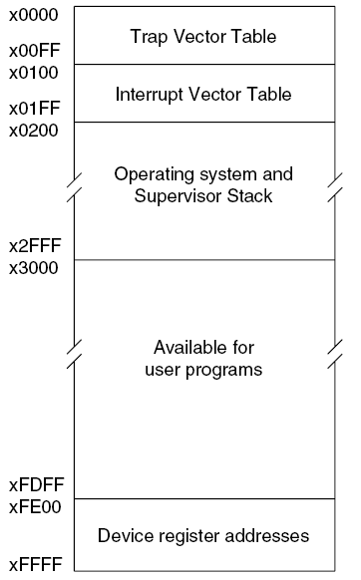
LC-3 Memory Map:

Slide 5
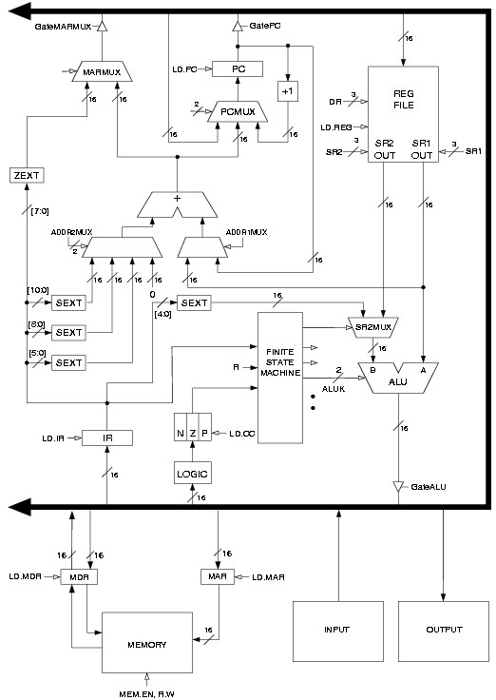
LC-3 Architecture & Data Paths:
Combinational
Logic
Storage
State Machine

Slide 6
LC-3 CPU Registers:
PC Program counter
IR Instruction Register
PSR (PSW) Program Status Register (Program Status Word)
PSR[15] – Privilege Bit (Supervisor or User State)
PSR[10:8] – Priority Bits
PSR[2:0] – Condition codes - N, Z, P
Register File:
R7 {Program Counter storage}
R6 {Stack Pointer}
R5 [Context Frame Pointer]
R4 [Beginning of Global Data & Heap]
R3
R2
R1
R0 {Often used for Pass Value}
Special Hidden Registers:
USP.Saved
SSP.Saved
Memory Read/Write Support Registers:
MDR Memory Data Register
MAR Memory Address Register
I/O Devices (Pair of Registers per Device):
DCR I/O Device Status/Control Register (e.g. Ready/Done, EnIntr, Priority)
DDR I/O Device Data Register (maybe byte or word)
State of Program (Context): PC, PSW, SP, +

Slide 7
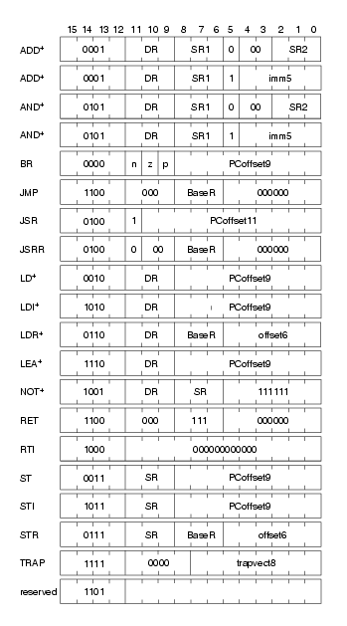
LC-3 Instructions:

Slide 8
LC-3 Instruction Addressing Modes
    Register (Operand is in one of the 8 registers)
    Immediate (Operand is in the instruction)
    PC-relative (Operand is “offset” from the (PC) )
    Indirect (The “Operand” actually points to the real address
    – rather than being the operand)
    Base + Offset (Base relative) (Operand is “offset” from the contents of a register)
    Note: no Direct Addressing defined in the LC-3

Slide 9
Traps & Subroutines
How are Subroutines different from Traps ?
  Traps are called using the TRAP instruction
  (Indirect call through the Trap Vector Table)
  Subroutines are called using JSR or JSRR instructions (JSR Direct call, JSRR Indirect call)
  Both end with a RET ( load the return address)
A Trap is an Subroutine call (Indirect) through a Vector Table (the Trap Vector Table [x0000-x00FF]).

Slide 10
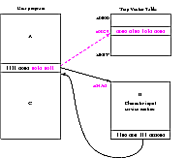
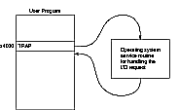
Traps:
Execute TRAP “vector” - Operating System Service Routines
2) Trap Vectors are at memory locations [0000:00FF]
Trap Vectors contain addresses of Trap Service Routines
[PC] is stored in R7
Address of Trap Service Routine loaded into PC
Service Routine Program executed
Trap service routine program ends with an RET
( [R7] loaded into PC)

Slide 11
Allocating Space for Variables
x0000
Vectors
Global data section
  All global variables stored here
  (actually all static variables)
  R4 points to beginning
Run-time stack
  Used for local variables
  R6 points to top of stack
  R5 points to top frame on stack
  New frame for each block
  (goes away when block exited)
Offset = distance from beginning of storage area
  Global: LDR R1, R4, #x
  Local: LDR R2, R5, #-y
x0200
Op Sys
x3000
R6
run-time
stack
R5
instructions
PC
R4
global data
xFE00
Device Registers
xFFFF

Slide 12
Activation Record or Context Frame Format
R6
Stack Ptr
Function stacked stuff
……..
……..
Local Variables
Caller’s Frame Pointer (R5)
Caller’s Return PC (R7)
Function Return Value
Function Pass Value n
……..
Function Pass Value 1
R5
Frame Ptr

Slide 13
Interrupts:
Programmer Action:
Enable Interrupts by setting “intr enable” bit in Device Status Reg
Enabling Mechanism for device:
When device wants service, and
its enable bit is set (The I/O device has the right to request service), and
its priority is higher than the priority of the presently running program, and
execution of an instruction is complete, then
The processor initiates the interrupt
Process to service the interrupt:
The Processor saves the “state” of the program (has to be able to return)
The Processor goes into Privileged Mode (PSR bit 15 cleared)
Priority level is set (established by the interrupting device)
The (USP), (R6) → USP.saved register (UserStackPointer.saved)
The (SSP.saved) → R6 (SupervisorStackPointer)
The (PC) and the (PSR) are PUSHED onto the Supervisor Stack
The contents of the other registers are not saved. Why?
The CC’s are cleared
The Processor Loads the PC from the Interrupt vector (vectors in 0100:01FF)
Interrupt Service Routine is executed
Ends with an RTI
Program returns from Service routine
The stored user PSR (POP into PSR), PC (POP into PC), (R6)→SSP.saved, (USP.saved→R6), and the next
instruction fetched

Slide 14
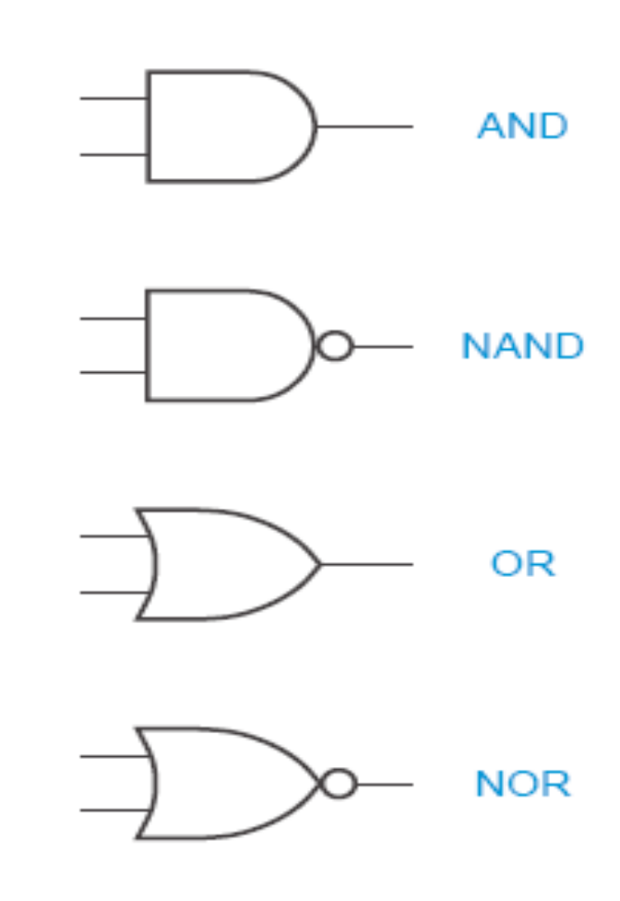
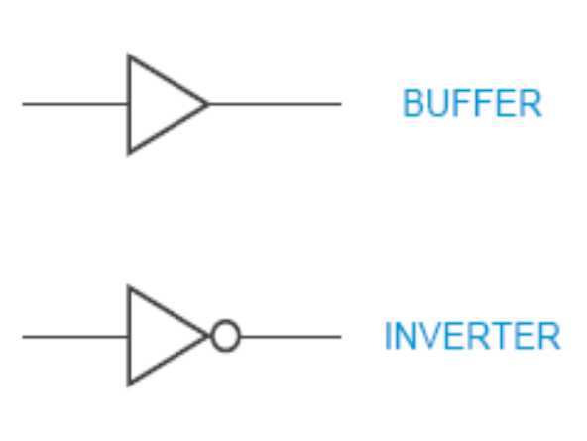
Basic Logic Gates

Slide 15
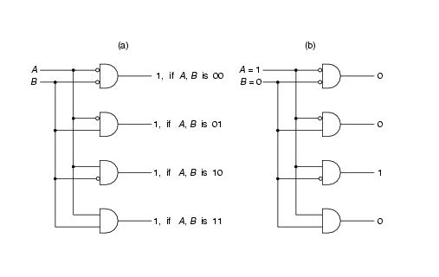
2 BIT Decoder
Why are we interested in decoders ?

Slide 16
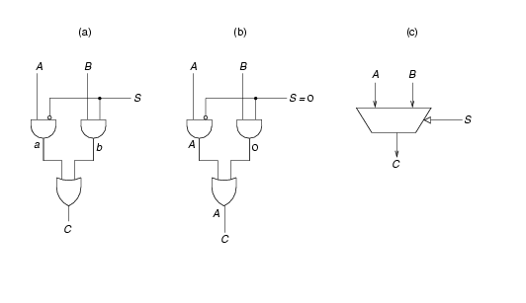
2-to-1 MUX
MUX Circuit Case: S=0 MUX Symbol
Why are we interested in MUX’s ?

Slide 17
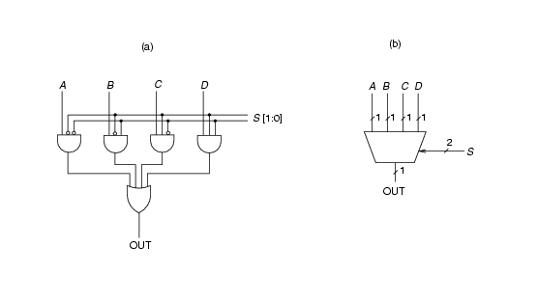
4-to-1 MUX
Symbol
Logic

Slide 18
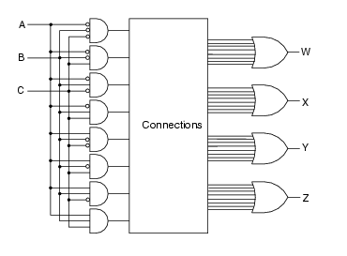
Programmmable Logic Arrays (PLAs)
Why are PLA’s cool ?

Slide 19
TCSS372A - HW1
Memory Map & Activation Records: Show the memory map during execution of the following program at point 1 , and the stack at points 1 through point 7.
int main ()
{
int a = 23;
int b = 14;
...
/* point 1 */
b = Watt(a);
/* point 5 */
b = Volta(a,b);
... /* point 7 */
}
int Watt(int c);
{
int w = 5;
... /* point 2 */
w = Volta(w,10);
/* point 4 */
...
return w;
}
int Volta(int q, int r)
{
int k = 3;
int m = 6;
... /* point 3 & point 6 */
return k+m;
}

