Slide 1
Major Design Project #32 Mems Microphone FEEDBACK CONTROLLER
Wesley Chiu, Adam Hess, Andrew Steinmann

Slide 2
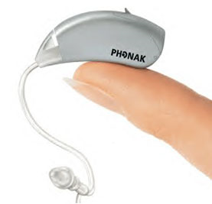
Introduction
Problems of current hearing-aids
Poor performance in noisy environments
Constant electronic static noise

Slide 3
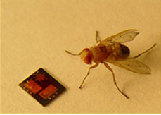
MEMS Microphone
Advantages:
Capable of directional hearing
Drastically reduced self noise to as low as 35dBA
Issues:
Introduces a resonant peak in the frequency response
Produces a whistling sound

Slide 4
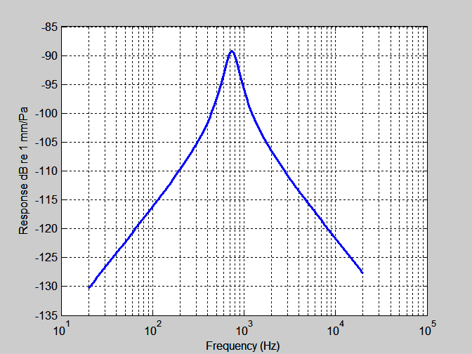
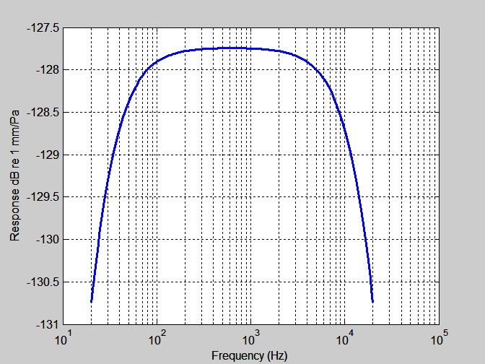
Project Goals
Reduce or remove the resonant peak

Slide 5
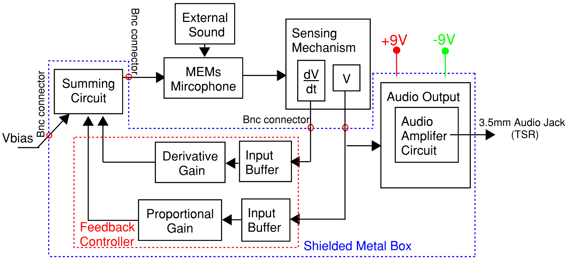
Device Overview

Slide 6
Current Frequency Response

Slide 7
Desired Closed Loop Frequency Response

Slide 8
Microphone Differential Equation
Must select operating point to linearize equation
Θ - diaphragm rotation
I – Mass moment of inertia
k_{t} – Torsional stiffness
c_{t} – Torsional dashpot
M – Moment due to sound field
V – Voltage
Θ
Notes:
Using the ideal microphone freq response and the current frequency response we can theoretically obtain the necessary feedback. The s term and constant term need to be altered so the closed loop freq response matches the ideal case. By adding a proportional term and derivative term in the feedback path the system poles can be altered to the desired closed loop poles. Using the open loop frequency response G(s) and equating it to the desired closed loop frequency response we are able to solve for the necessary constants needed for the PD controller. The only problem we are running into is we have yet to be given the constants associated with the microphone

Slide 9
Linearization of Differential Equation
If V_{f} << V_{b}
[1] R. N. Miles and Q. T. Su, “Differential MEMS Microphone with Active Q-Control”, ME Dept. Binghamton University, October 2009

Slide 10
Controller Design: S-Domain
I – Mass moment of inertia
k_{t} – Torsional stiffness
c_{t} – Torsional dashpot
Alpha – low cutoff frequency
Beta – high cutoff frequency
I_{A} - area moment of inertia
c_{p} – speed of sound

Slide 11
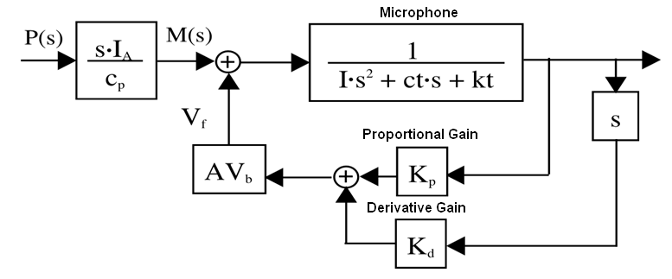
Control System Block Diagram
Linear Model – Assumes V_{b}>>V_{f}

Slide 12
Controller Gain Calculation
Solve for K_{d}
Solve for K_{p}

Slide 13
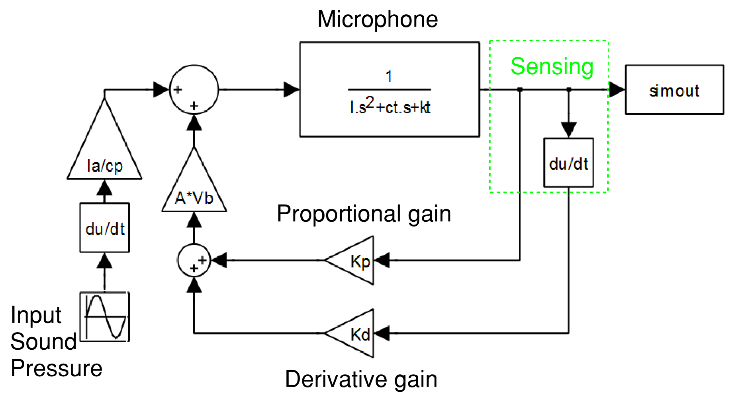
Linear Simulink Model

Slide 14
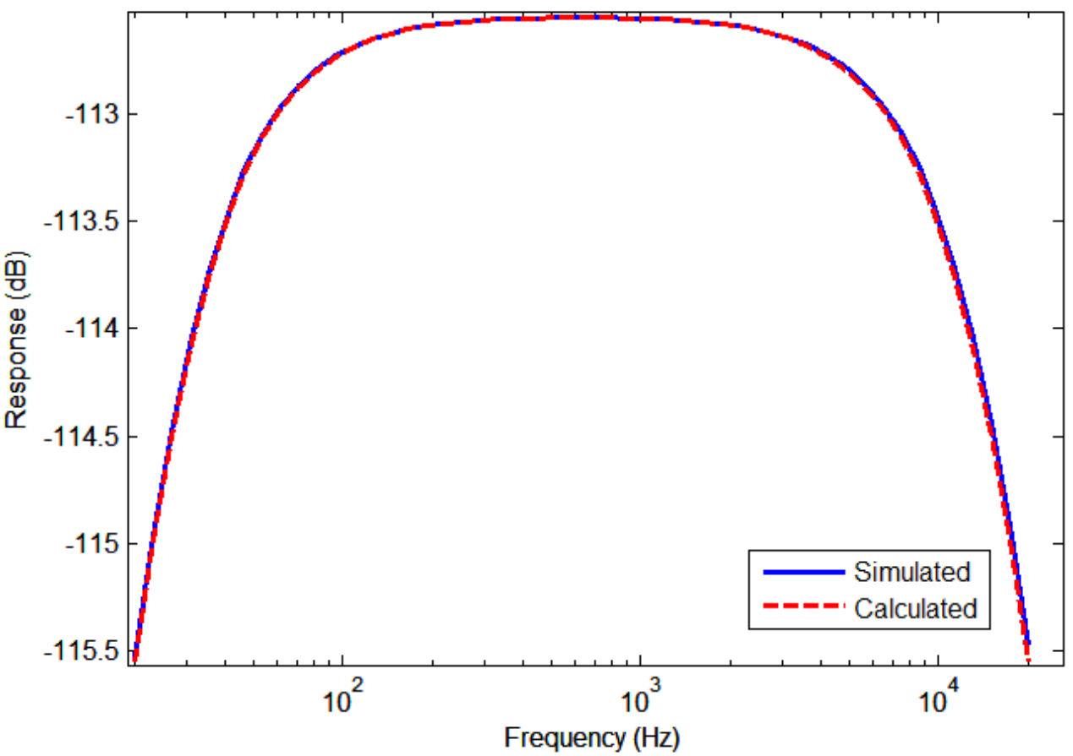
Confirmation of Gain Calculations

Slide 15
Parameter Variation
Varied k_{t}, I and c_{t} independently
Since varying I and kt will have largest effect

Slide 16
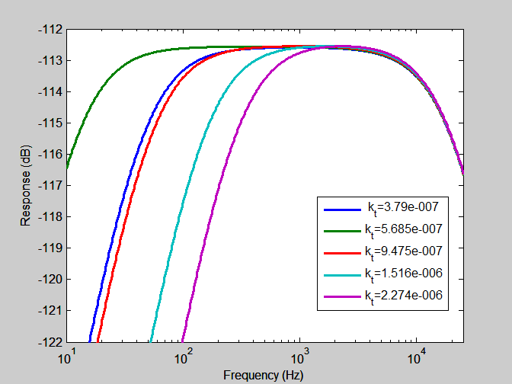
Variation of Torsional Stiffness
Variation in kt – given kt= 7.58e-7

Slide 17
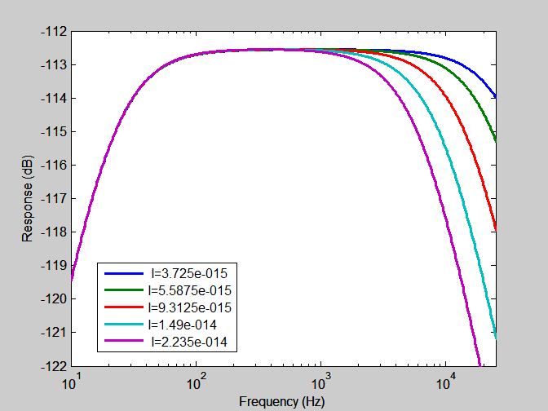
Variation of Mass Moment of Inertia
Variation in I – given I= 7.45e-15

Slide 18
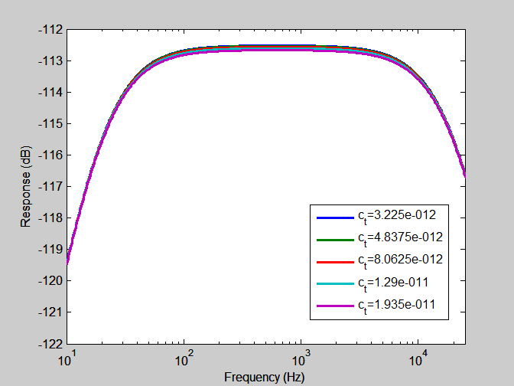
Variation of Torsional Dashpot
Variation in ct – given ct= 6.4500e-12

Slide 19
Laser Vibrometer
A bridge step before testing with optical sensor.
Used to measure the response of the microphone.
Outputs a displacement voltage - Proportional
Outputs a velocity voltage - Derivative

Slide 20
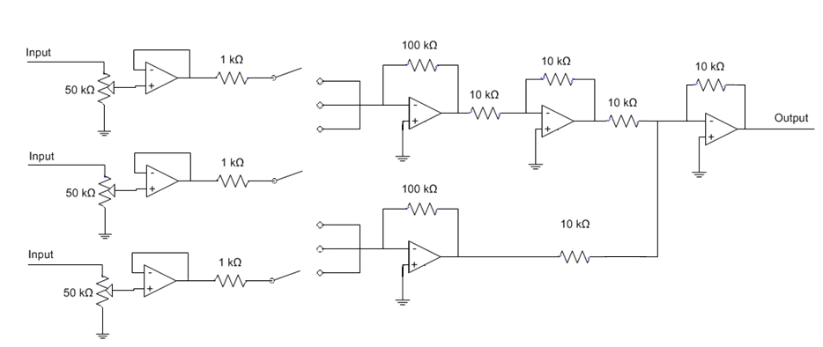
Summer Circuit I
Cost: TL074 (5pcs) $0.88
Resistors (300pcs) $8.00
Potentiometers (5pcs) $2.35
Total $11.23
-
Derivative
Proportional
+
Bias
Issues: Gain Band Width Product CONSTRAINT OF TL0748CN
Solutions: Two stage gain, or OP-AMP with higher GBP

Slide 21
Device Overview

Slide 22
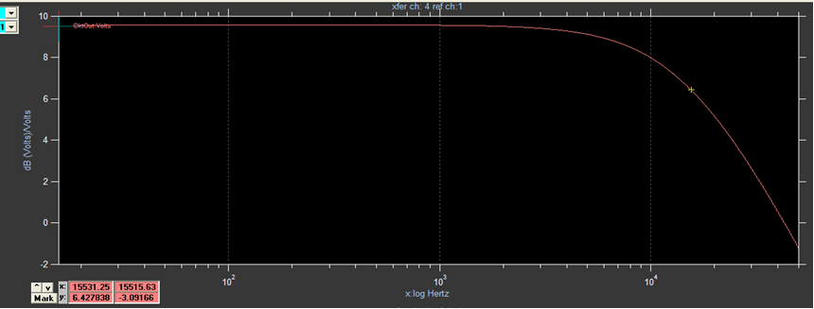
Summer I Frequency Response

Slide 23
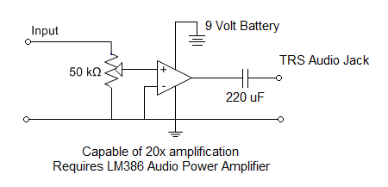
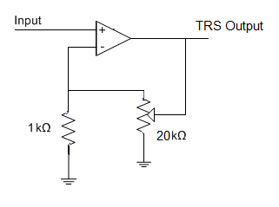
Audio Output Designs
Desired output is between .5V and 3V

Slide 24
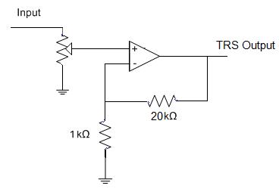
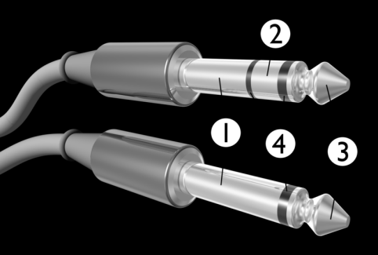
Final Output Design
Issues: Dependant on output voltage of microphone

Slide 25
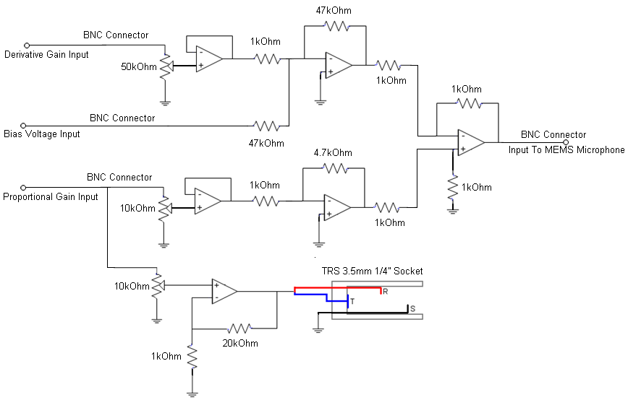
Summer Circuit II
Cost:
OP470 (10pcs) $15.00
Resistors (300 pcs) $8.00
TRS Jack $3.00
Potentiometers (5pcs) $2.35
Total $28.35
OP-Amps: OP470

Slide 26
Noise
Requirement
The feedback controller shall add no more than 5dB of noise
Noise Analysis
Models
Types
Thermal
Shot
Flicker

Slide 27
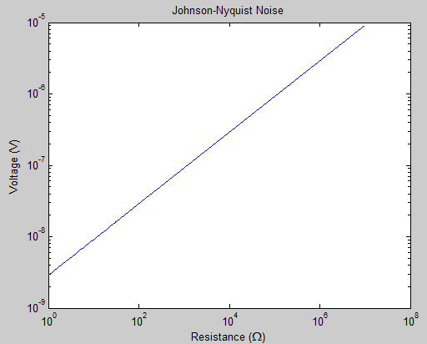

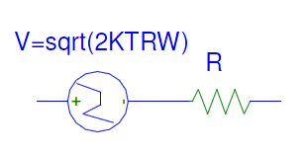
Thermal Noise
Johnson-Nyquist Noise
B = 1kHz
T = 300K

Slide 28
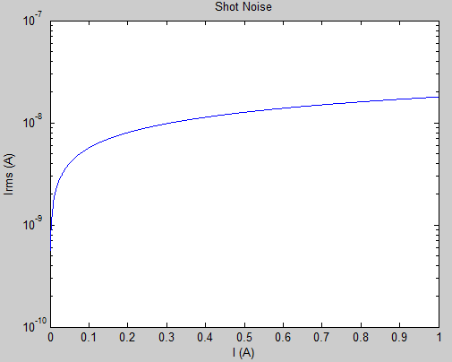

Shot Noise
Shot Noise
B= 1kHz
Bursts of current Pockets

Slide 29
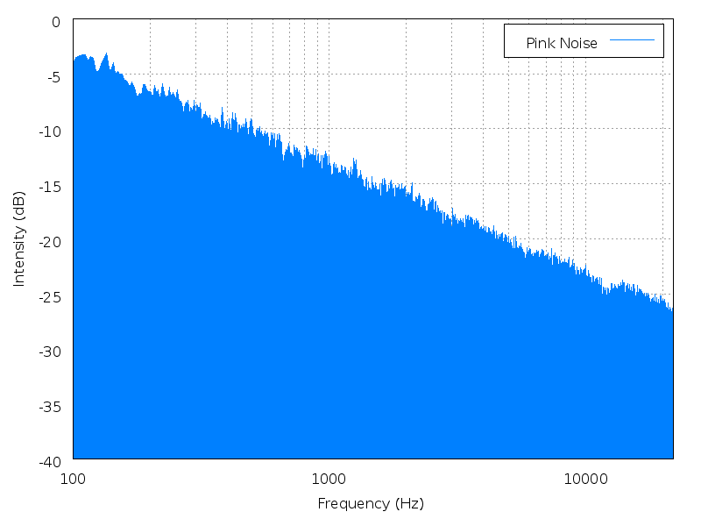
Flicker Noise
Flicker (Pink) Noise
Generally:

Slide 30
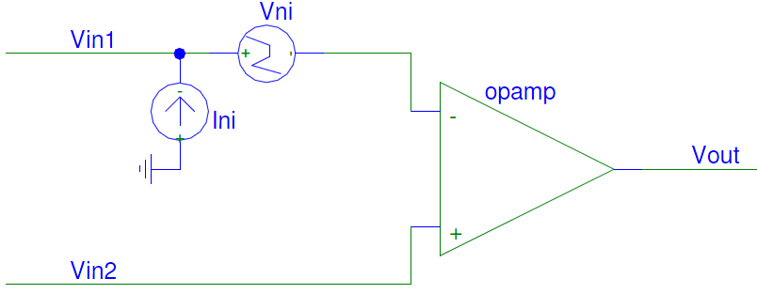
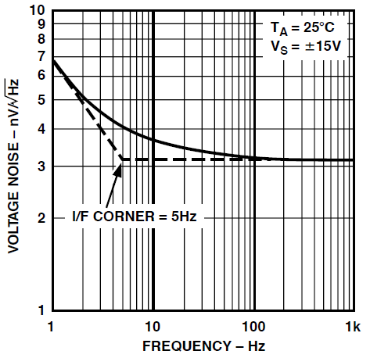
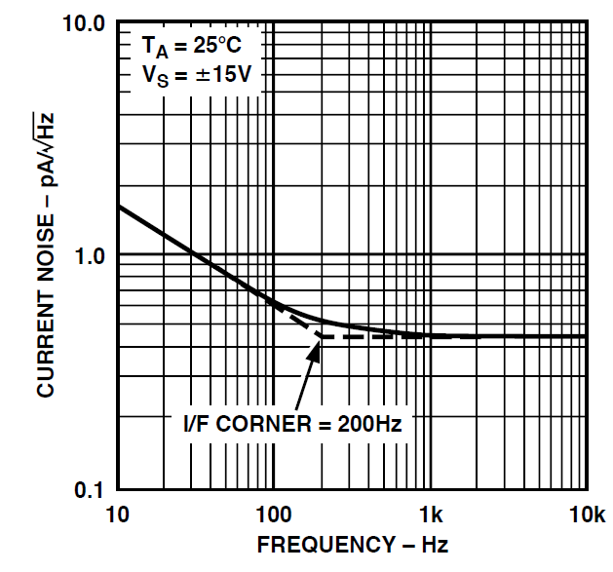
OpAmp Noise Model
Described by:
Input Voltage Noise
Input Current Noise

Slide 31
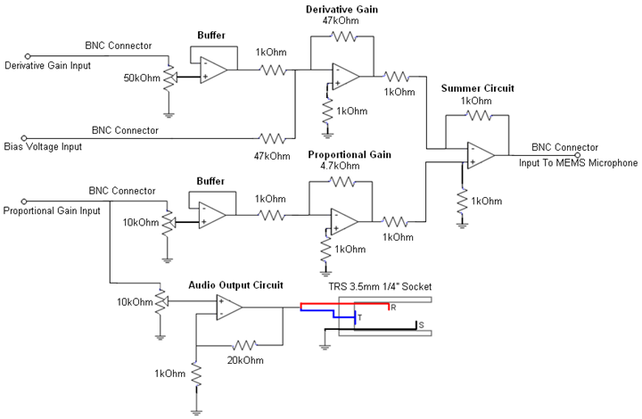
Prototype Circuit
OP-Amps: OP470

Slide 32
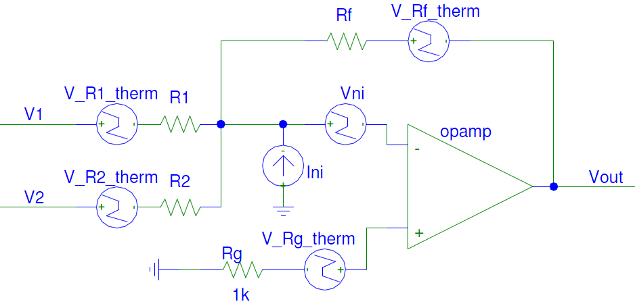
Summing/Inverting Amplifier Noise

Slide 33
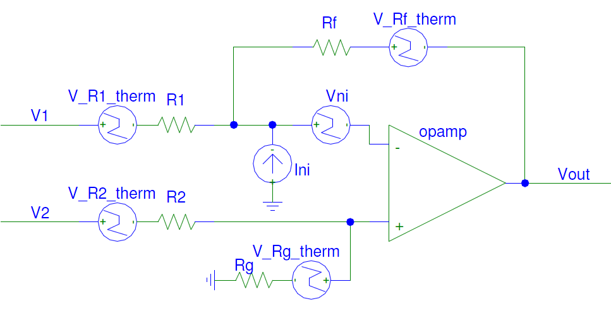
Difference Amplifier Noise

Slide 34
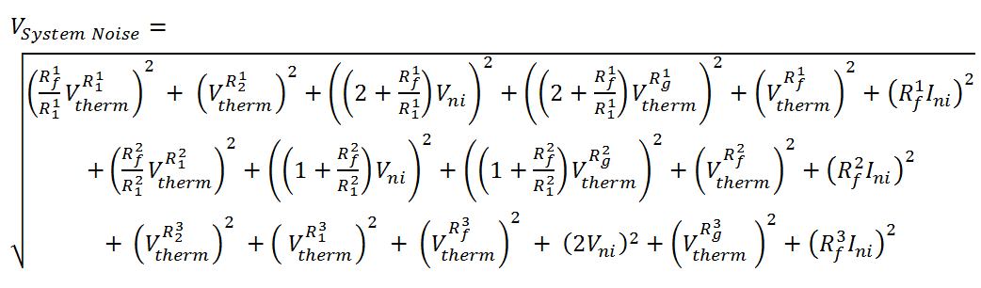
Results
Modest part selections of parts in the kOhm range, OpAmp input voltage noise less than 5nV/sqrt(Hz) and input current noise less than 2 pA/sqrt(Hz)
V system noise = 39.3nV
Six Sigma= +/- 117.9 nV
[2] C.D. Mochenbacher, Low-Noise Electonic System Design, New York, Wiley. P. 8, 27-28

Slide 35
Non-Idealities of Op Amp
Harmonic Distortion
Input Bias Current
Gain Bandwidth Product
Unity Gain Stability

Slide 36

Distortion
Total Harmonic Distortion (THD)
Ratio of the Sum of the power of the harmonic frequencies above the fundamental
The ratio is often expressed as a dB value

Slide 37
THD Example
THD Distortion:

Slide 38
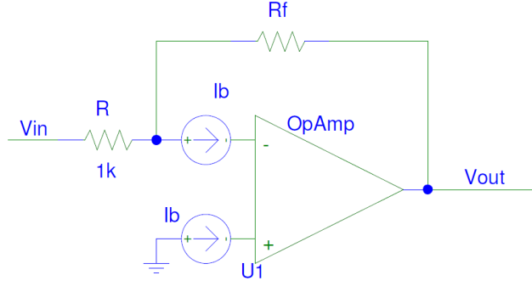
Input Bias Current
Vout = Rf *Ib

Slide 39
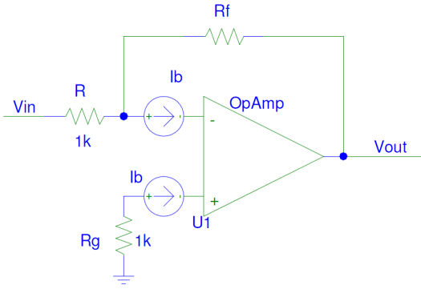
Input Bias Current

Slide 40
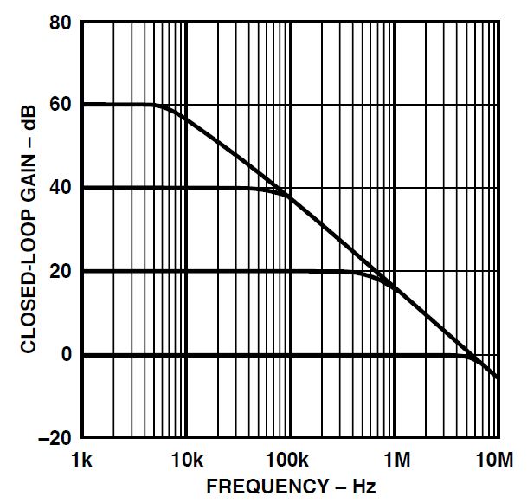
Gain Bandwidth Product
GBP = Gain * Bandwidth
GBP = constant
As gain increases, BW decreases.

Slide 41
Unity Gain Stability
AD797
Distorted Output
Minimum Required Gain
Unstable In breadboards

Slide 42
Op Amp Selection
Chip | Weight | AD797 | AD743 | OP470 | TL0748CN | AD548 | Units
Voltage Input Noise | 0.10 | 1.0 | 2.9 | 3.2 | 15 | 30 | nV/√Hz
Current Input Noise | 0.20 | 2000 | 6.9 | 1700 | 10 | 1.8 | fA/√Hz
THD | 0.05 | -120 0.0001 | -100 0.0003 | -80 0.001 | -100 0.0003 | -73 0.003 | dB %
Gain BW Product -3db | 0.20 | 8 | 4.5 | 6 | 3 | 1 | MHz
Unity Gain Stable | 0.30 | 0.25 | 1 | 1 | 1 | 1 | Yes = 1 No = 0
Packaging | 0.15 | 1 | 1 | 4 | 4 | 1 | Amps/Pack
Chip | Weight | AD797 | AD743 | OP470 | TL0748CN | AD548
Voltage Input Noise | 10% | 10 | 9 | 8 | 5 | 3
Current Input Noise | 20% | 10 | 16 | 10 | 14 | 18
THD | 5% | 5 | 4.75 | 4 | 4.75 | 3.5
Gain BW Product | 20% | 20 | 16 | 18 | 8 | 2
Unity Gain Stable | 30% | 7.5 | 30 | 30 | 30 | 30
Packaging | 15% | 7.5 | 7.5 | 15 | 15 | 7.5
Total | 100% | 60 | 83.25 | 85 | 76.75 | 64

Slide 43
Final Selection
Chip | AD743 | OP470 | Units
Input Noise | 2.9 | 3.2 | nV/√Hz
Input Noise | 6.9 | 1700 | fA/√Hz
THD | -100 0.0003 | -80 0.001 | dB %
Gain BW Product | 4.5 | 6 | MHz
Unity Gain Stable | 1 | 1 | Yes = 1 No = 0
Packaging | 1 | 4 | Amps/Pack

Slide 44
FINAL CIRCUIT
Cost:
OP470 (10pcs) $15.00
Resistors (300 pcs) $8.00
TRS Jack $3.00
Potentiometers (5pcs) $2.35
Total $28.35

Slide 45
Considerations for Next Semester
Non-Linear Simulink Model
Optical Sensor
Differentiator
Chassis and PCB
Closed Loop System Noise Model
Capacitive Microphone Sensing

Slide 46
Aknowedgements
Professor Ron Miles
Professor Eva Wu
Professor Quang Su
Professor Chris Twigg
Professor Vladimir Nikulin
Professor Kurt Rogers

