Slide 1
SAM Phase 2 eece 545
Adam Hess
Chuanke Lin
Guang Liu
Morenike Aina

Slide 2

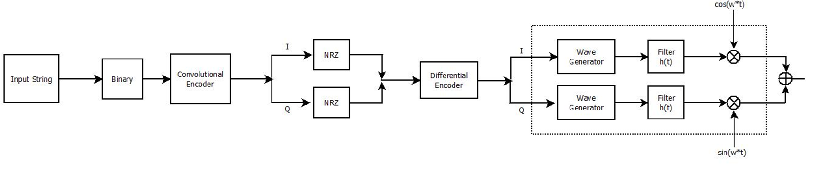
Transmitter

Slide 3

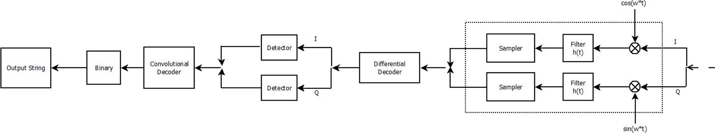
Receiver

Slide 4
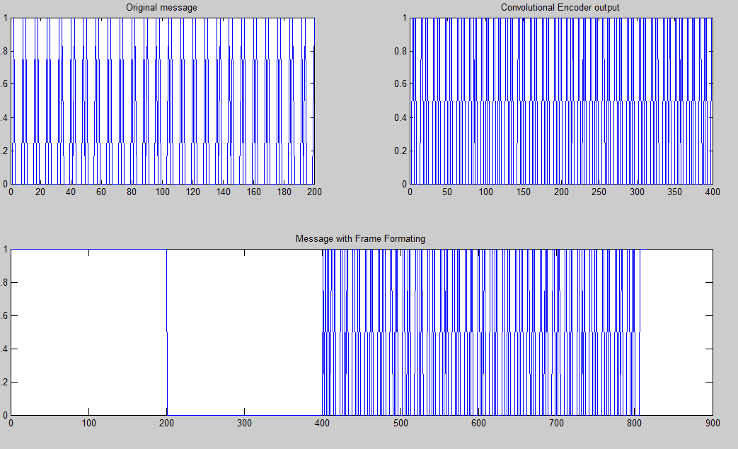
Transmitter A=100001

Slide 5
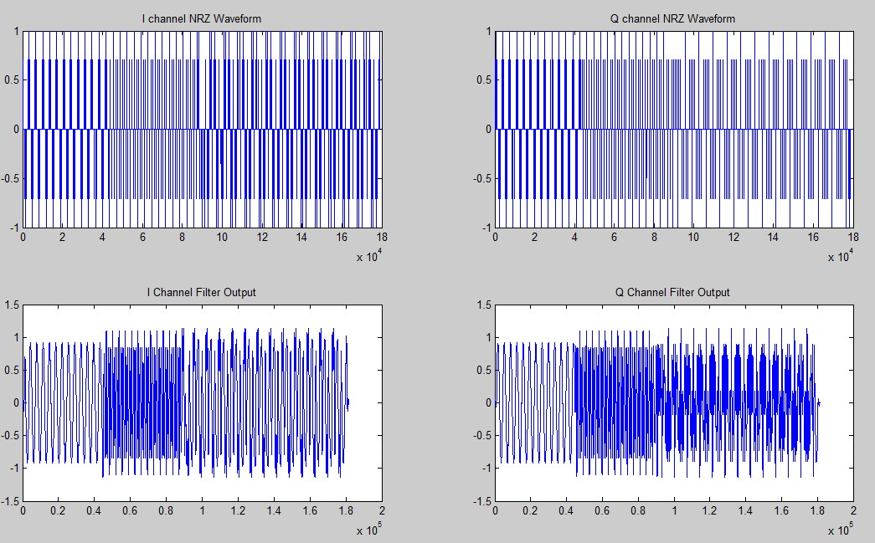
Transmitter

Slide 6
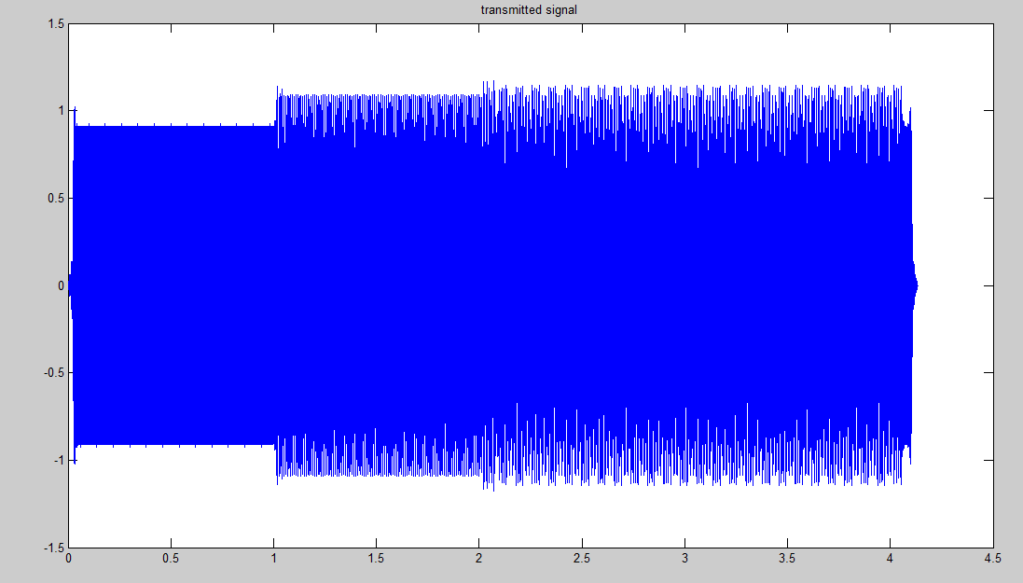
Transmitted Signal

Slide 7
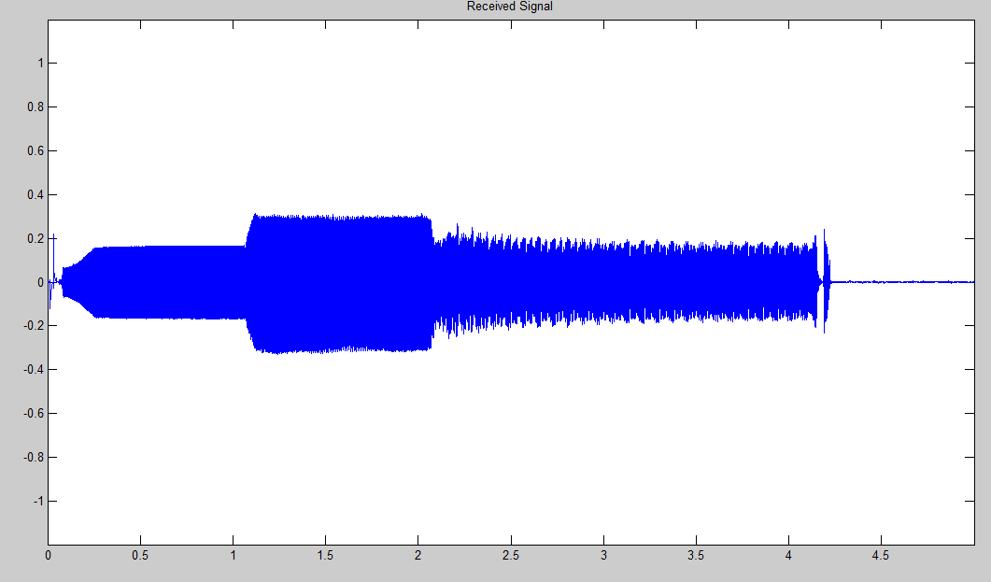
Received Signal

Slide 8
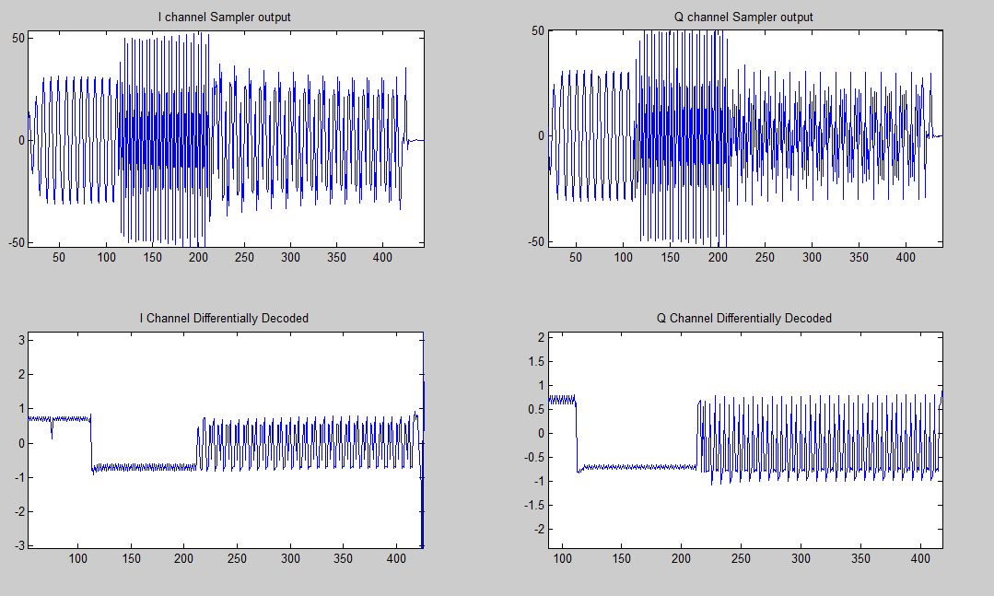
Processing the Received Signal

Slide 9
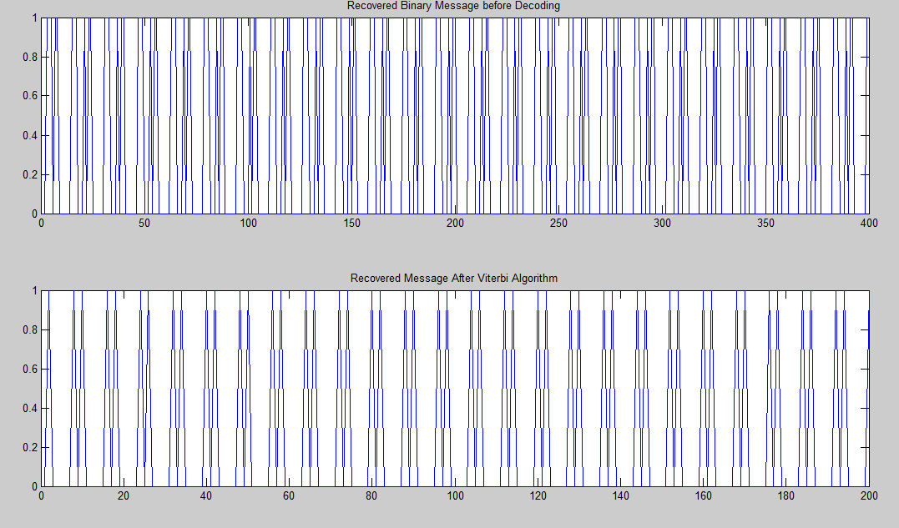
Results

Slide 10
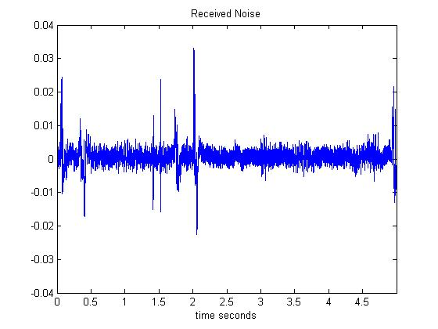
SNR
Empirically Calculated SNR of System:
15.85 dB

Slide 11
Demonstration

