Slide 1

TribiTrabi car parts market
Backend: Kovács Tibor
Frontend: Hézső Ádám Károly
Kiss Benedek

Slide 2
What purpose does our project serve?
Create an enviroment for car fanatics
1
Users can browse and purchase hundreds of car parts
2
Convenient and easy work environment for administrative staff
3

Slide 3
The road to our steady backend.
Server side connection
Communication between
the server and the database
the server and the website
Creating REST APIs
The server and the winform app

Slide 4
What we had in mind for our frontend
Making the design
01
User friendly
Good with our backend
Designing it so it is nice to look at and just as easy to use
02
Using the latest and most modern version of react.js so its convenient
03

Slide 5




Backend technologies for TribiTrabi
Server:
NodeJS
JavaScript
Express.js
Database:
MySQL

Slide 6



Frontend technologies for TribiTrabi
Design:
Figma
Trello
Coding:
Bootstrap
JavaScript
CSS
HTML

Slide 7
How our folder structure came to be
Frontend work (main folder)
Css → css file
Database → everything about our database
Docx → the project work’s documentations
Html → html file (webpages)
Images → image for the the html files
Upload → uploaded images for the uploaded recipes
Js → js files for the backend and the frontend

Slide 8
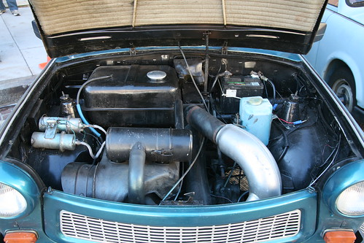
Thank you for your attention!

