Slide 1

Case Study: Big Data
Benefit of big data tools in the industry and how they are used
Adam Ahsan
2022

Slide 2
TABLE OF CONTENTS
01
02
03
04
05
06
What is Big Data?
Why Big Data? Why now?
How can the industry benefit from it
Impact of Big Data
Big Data tools
Opportunities and Challenges
2022

Slide 3
What is Big Data?
Case Study: Big Data
Big data is large and complex data that can’t be dealt with commonly used hardware environments and software tools to process data.
2022

Slide 4
Why Big Data? Why now?
1
2
3
VOLUME
VELOCITY
VARIETY
Amount of data created nowadays is immense
Huge speeds at which companies receive, store and manage data
Data is in different types; structured, unstructured, etc.
“Beginning of 2020, number of bytes in the digital universe was 40 times more than the stars in the observable universe.”
(World Economic Forum, 2019)
(Desjardins, J.,2019)

Slide 5
How can the industry benefit from Big Data
Big data analytics help organizations understand their data and use it to identify new opportunities.
That, in turn, leads to smarter business moves, more efficient operations, higher profits and happier customers.
Businesses use Big Data tools to gain value in ways, such as:
Reducing cost
Making faster, better decisions
Developing new products and services
(SAS, 2022)

Slide 6
Impact of Big Data in different sectors
Advanced healthcare | Big Data is used to predict potential virus outbreak locations and help identify issues in a human body before they occur using historical data.
Personalized advertising | Big Data is used to recommend products through adverts that are personalized for more relevance.
Easier commutes | Traffic lights react to traffic conditions, weather and accidents to streamline traffic.
Sports predictions | Big Data was used in 2012 to famously predict that the US would win 108 Olympic medals, they ended up winning 104.
Security | Police use Big Data tools to predict criminal activities, conduct investigations to catch criminals faster
Smart business decisions | Big Data tools improve and optimize ways we do business by making data driven decisions

Slide 7




What are the top Big Data tools?
Apache Hadoop
Apache Spark
It is used to store, process, and analyze Big Data through parallel processing on multiple machines simultaneously.
Hadoop's successor as it solves its shortcomings. It’s a general- purpose clustering solution that supports both real-time and batch processing.
Cloudera
MongoDB
Converts complex data sets into simple and actionable insights. It provides an enterprise data cloud for data, anywhere.
NoSQL DB provides cross-platform capabilities. Uses real-time data for decisions since it uses dynamic schemas, so data can be prepared quickly.

Slide 8
Opportunities and Challenges
Opportunities
Job creation, huge interest and investment in Big Data technologies so individuals having big data analytics skills are in huge demand
Big Data tools create value and savings from day one
Utilizing Big Data tools the organization can step into the world of Artificial Intelligence
Challenges
Lack of knowledge Professionals for big data related jobs
Difficult to manage data quality
Confusion with Big Data tool selection
Integrating data from different sources and Securing the data
(Jabir and Falih, 2021)

Slide 9
The MapReduce Model

Slide 10
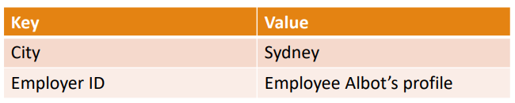
Key-Value Pairs: MapReduce’s Basic Data Model
MapReduce was a breakthrough in the history of big data technologies.
Input, output and intermediate records in MapReduce are represented as key-value pairs (aka name-value/attribute-value pairs).
The key is an identifier (e.g., the name of an attribute).
In MapReduce, the key is not required to be unique.
The value is the data of the key.
It may be simple value or a complex object

Slide 11
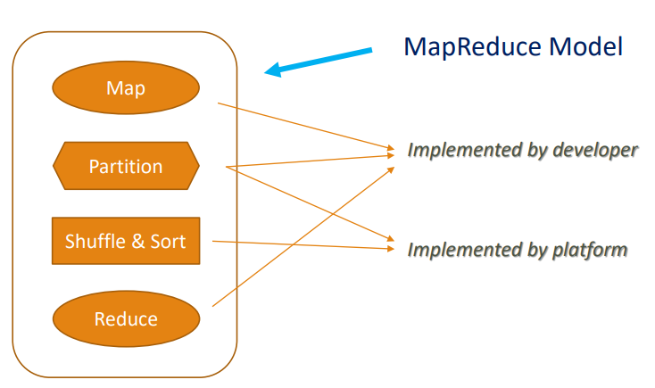
MapReduce Model

Slide 12
Map Phase
Map Phase uses input format and record reader functions to derive records in the form of key-value pairs for the input data
Map Phase applies a function or functions to each key-value pair over a portion of the dataset
In the case of a dataset hosted in HDFS, this portion is usually called a block.
If there are n blocks of data in the input dataset, there will be at least n Map tasks (also referred to as Mappers).

Slide 13
Examples of Map Functions
Common map() functions include filtering of specific keys, such as
filtering log messages if you only want to count or analyse ERROR log
messages:
let map (k, v) = if (ERROR in v) then emit (k, v)
Another example of a map() function would be to manipulate values,
such as a map() function that converts a text value to lowercase:
let map (k, v) = emit (k, v.toLowercase ( ))

Slide 14
Reduce Phase
Input of the Reduce phase is output of the Map phase (via shuffle-and sort) Each Reduce task (or Reducer) executes a reduce() function for each intermediate key and its list of associated intermediate values.
The output from each reduce() function is zero or more key-values:
reduce (intermediate_key, list (intermediate_value)) → (out_key, out_value)
Note that, in reality, the output from Reducer may be the input of
another Map phase in a complex multistage computational workflow

Slide 15
Shuffle and Sort
Shuffle-and-sort is the process where data are transferred from
Mapper to Reducer
It is “the heart of MapReduce where the ‘magic’ happens.”
The most important purpose of Shuffle-and-sort is to minimize data
transmit through network I/O.
In general, in Shuffle-and-Sort, the Mapper output is sent to the target
Reducer according to the partitioning function.

Slide 16
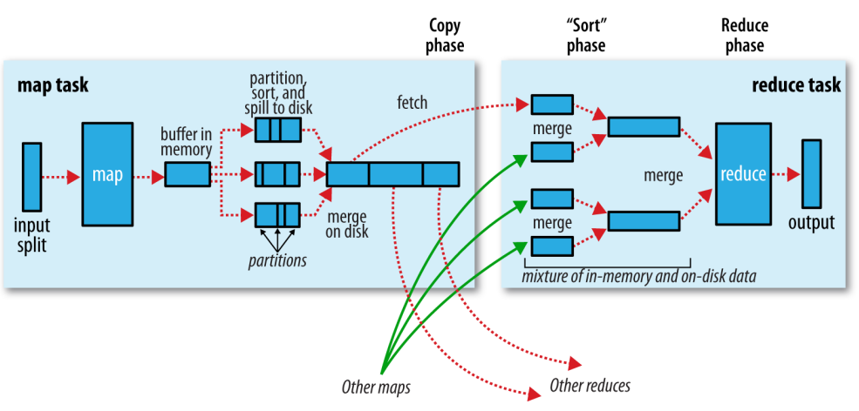
Shuffle and Sort in MapReduce

Slide 17
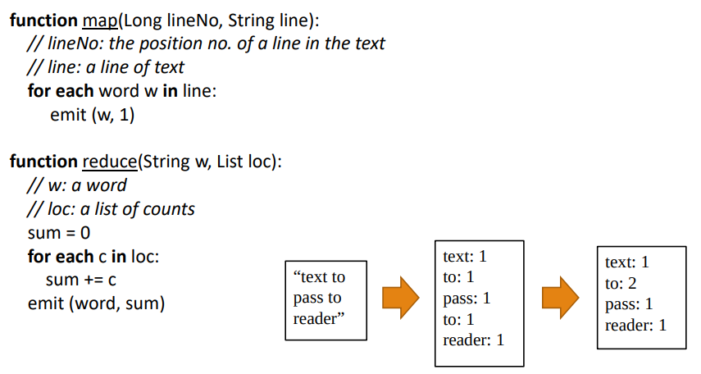
An Abstract MapReduce Program: WordCount

Slide 18
This is a text to pass to reader
This
is
a
text
to
pass
to
reader
This: 1
is : 1
a : 1
text : 1
to : 1
pass : 1
to : 1
reader : 1
This: 1
is : 1
a : 1
text : 1
to : 2
pass : 1
reader : 1

Slide 19
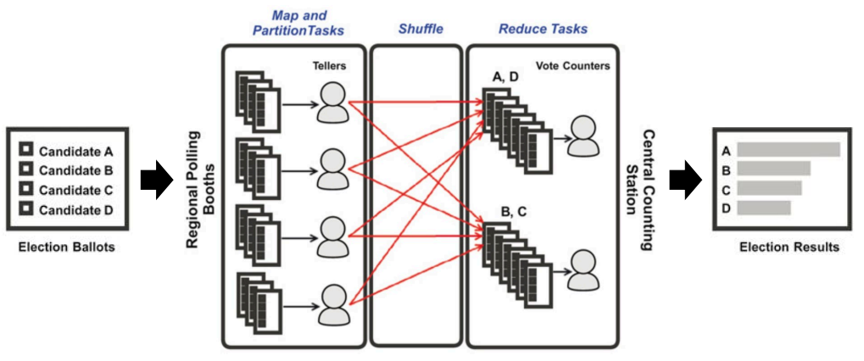
An Election Analogy for MapReduce

Slide 20

Meet Spark!
Apache Spark is a distributed computing engine, which is designed to be
fast and general-purpose.
On the speed, Spark extends the MapReduce model to efficiently
support more types of computation.
On the generality, Spark covers a wide ranges of workloads, including
batch applications, iterative queries, streaming and advanced analytics.

Slide 21
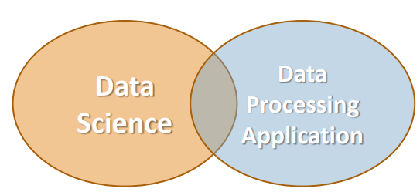
Spark in Big Data
Data Scientists
Analyze and model data
Make prediction based on data
Build data pipelines to fulfil certain tasks
Data Engineers
Develop data processing applications
Deploy the output of data scientists in production

Slide 22
Features of Spark
Speed − Spark helps to run an application in Hadoop cluster, up to 100
times faster in memory, and 10 times faster when running on disk.
This is achieve by reducing number of read/write operations to disk.
It stores the intermediate processing data in memory.
Supports multiple languages − Spark provides built-in APIs in Java,
Scala, Python, SQL and R. Therefore, you can write applications in
different languages.
Advanced Analytics − Spark supports not only “Map” and “Reduce” but
also relational (i.e. structural) operations, streaming processing,
machine learning (ML), and graph algorithms.

Slide 23
References
Big Data Analytics: What it is and why it matters | SAS. [online]. Available at: https://www.sas.com/en_ae/insights/analytics/big-data-analytics.html.
Desjardins, J. (2019). How much data is generated each day?. [online] weforum.org. Available at: https://www.weforum.org/agenda/2019/04/how-much-data-is-generated-each-day-cf4bddf29f/
Falih, B.J.N. and Jabir, B., Big data analytics opportunities and challenges for the smart enterprise. International Journal on Technical and Physical Problems of Engineering (IJTPE), (47), pp.20-26.
Z.H. Zhou, N. V. Chawla, Y. Jin and G. J. Williams. (2014) "Big Data Opportunities and Challenges: Discussions from Data Analytics Perspectives", IEEE Computational Intelligence Magazine, vol. 9, no. 4, pp. 62-74

