Slide 1
Galileo Payment Analyzer
An AI-Assisted Payment Repair Assistant
Proof of Concept | High Value Payments | Deutsche Bank

Slide 2
The Problem - Fatal Payments
• Deutsche Bank processes billions of euros in payments every day
• Even at a 99.5% straight-through rate, that leaves thousands of transactions for manual repair daily
• Each one falls into the repair queue because of small errors:
- A wrong currency code, a malformed BIC, an invalid charge bearer enum
• Each is repaired manually:
- Operator opens the message - reads the XML - spots the error - types the fix
- A second operator reviews and approves (four-eye control)
• Slow, error-prone, and SLA-critical - can AI help operators get to the fix faster?
2 / 11

Slide 3
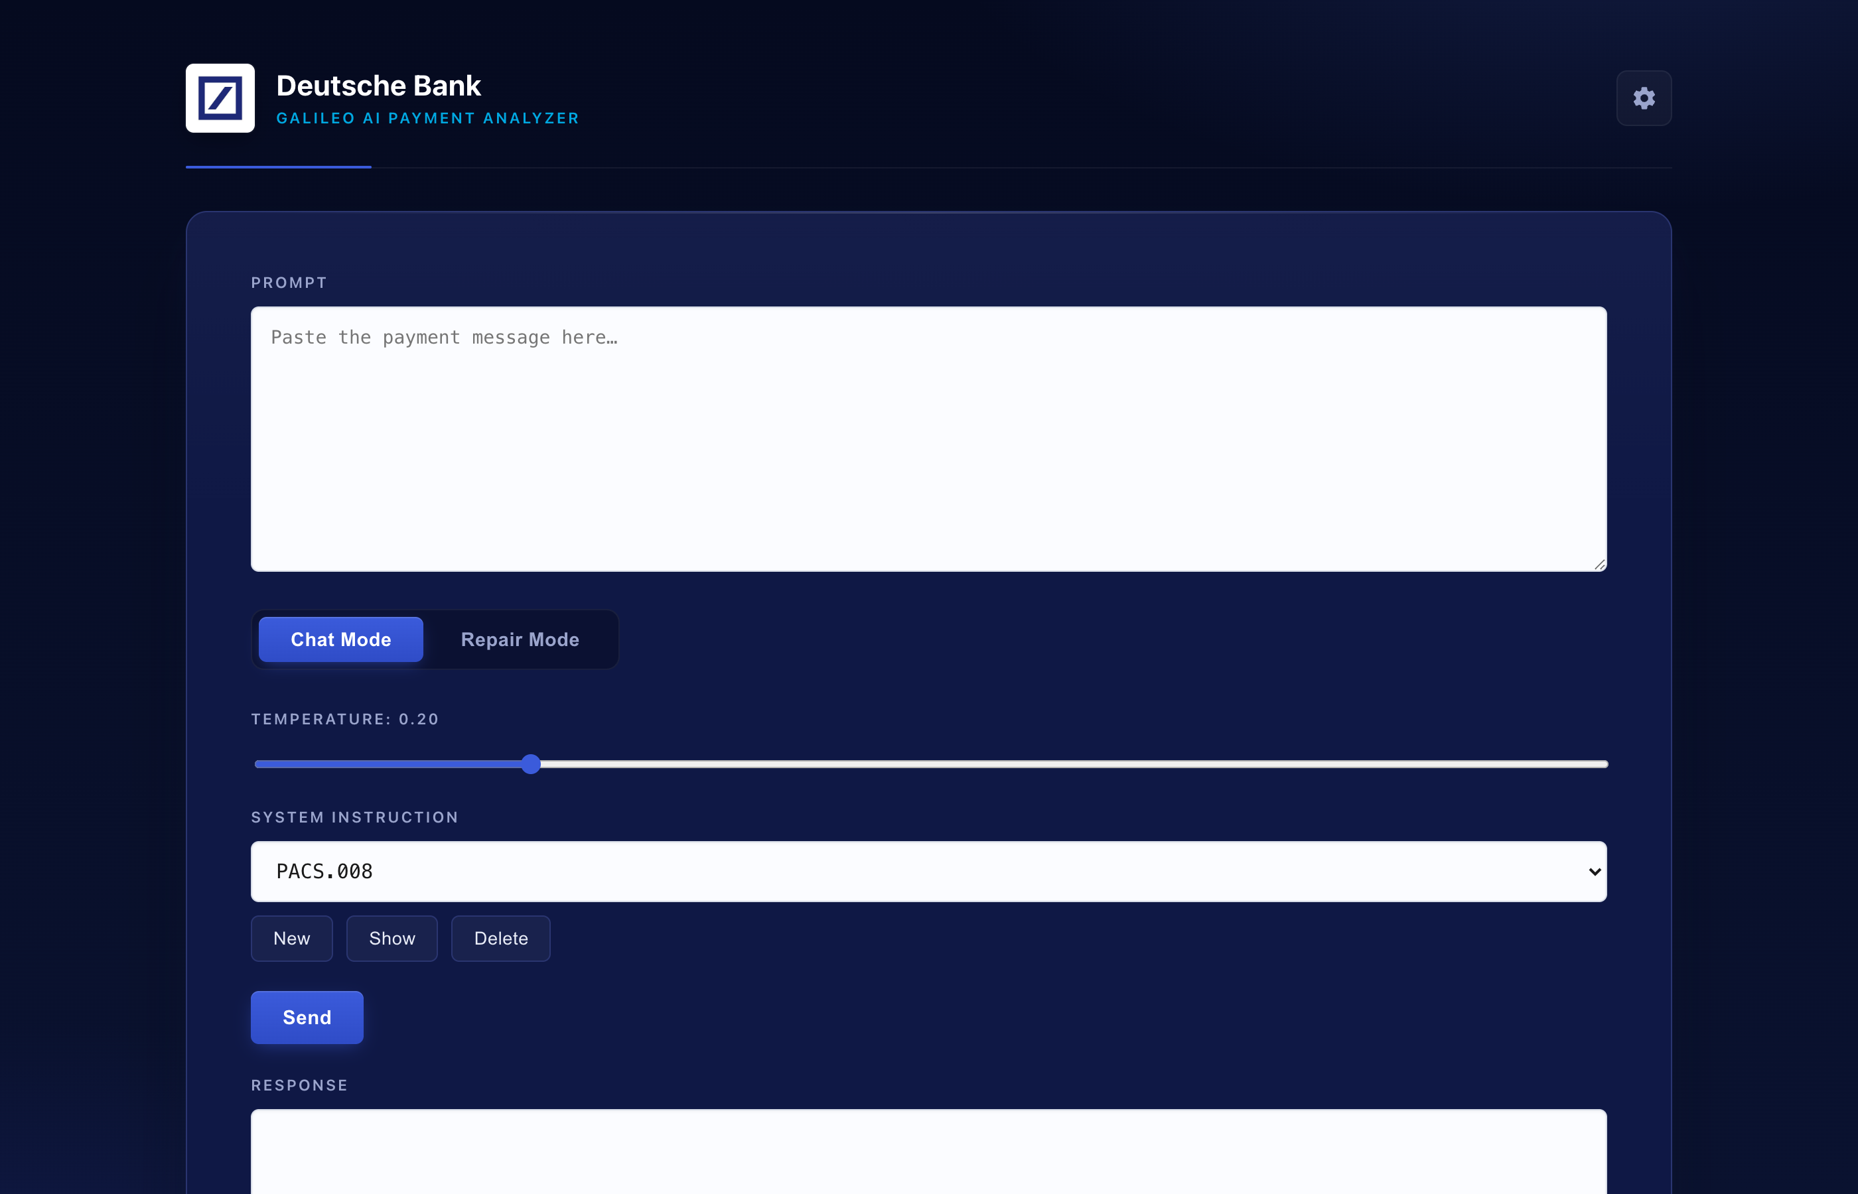
What We Built
• A simple web app that suggests repairs for fatal payment messages
• Operator pastes a broken payment, AI returns a corrected version
• Shows a clear before / after diff so the operator can verify the change
• Built quickly as an exploratory proof of concept
• Uses Deutsche Bank's hosted AI endpoint - no external services
• Operator always stays in control - AI suggests, the human approves
The Galileo Payment Analyzer interface
3 / 11

Slide 4
How AI Helps
• AI models are good at pattern recognition - they have seen enormous amounts of structured text
• Payment messages are structured text - PACS, CAMT, MT - with strict format rules
• The AI is asked to act as a payments domain expert and return only the corrected message
• Strengths today:
- Catches typos in static fields (currency, country, BIC)
- Knows ISO 4217 / 3166 / SWIFT enumerations
- Can explain why a change was made in plain English
• It is a suggestion engine - not a decision maker
4 / 11

Slide 5
How a Repair Works - Three Steps
01
Normalize
02
Repair
03
Verify
AI tidies up the message formatting first - consistent indentation, one element per line - without changing any content. This makes the diff honest.
AI returns the corrected payment message. Asked to make the minimum changes required and to preserve everything else.
The operator sees a red / green diff and decides. Optional Four Eye Check runs a second independent AI pass with a confidence score.
The operator is always the final approver - the AI suggests, the human decides.
5 / 11

Slide 6
LIVE DEMO
Five real fatal-payment scenarios
Currency code | BIC code | Charge bearer | Multi-issue | Country code
6 / 11

Slide 7
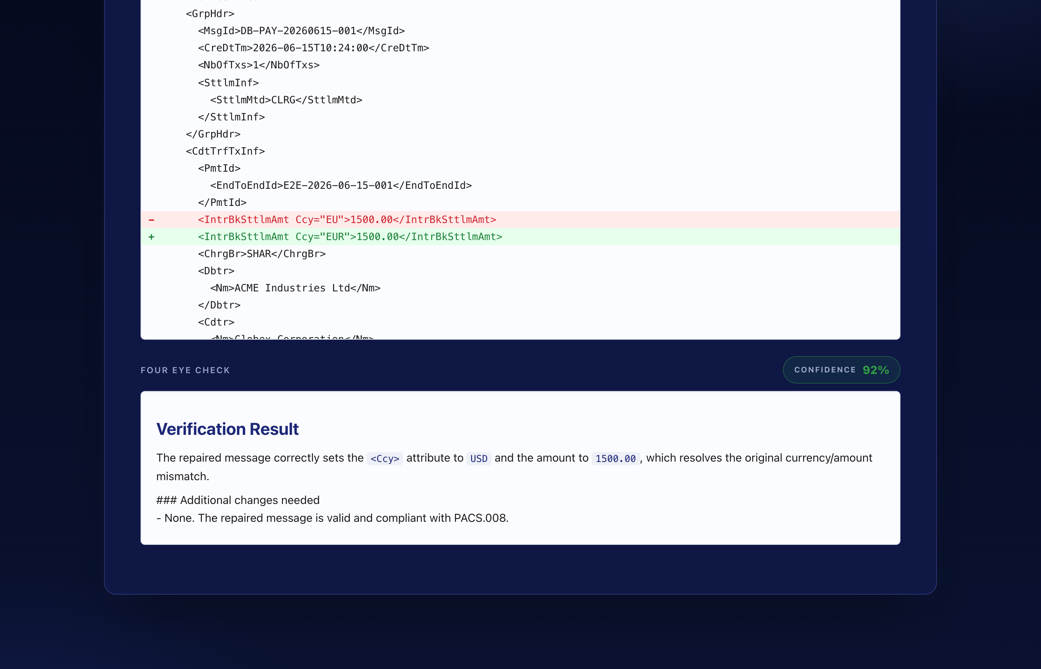
Beyond the Repair - Two Extra Controls
• Four Eye Check - an independent AI second pass:
- Runs the repaired payment through the AI again, as a second reviewer
- Returns a confidence score (0 to 100%) with a colour-coded badge
- Lists any additional changes still needed
• Explain It To Me - AI describes the changes in plain English:
- References specific fields and standards (ISO 4217, ISO 3166, etc.)
- Doubles as a knowledge tool for junior operators
• Both features keep the operator informed - no black box
Four Eye Check result with 92% confidence badge
7 / 11

Slide 8
This Is an Early Proof of Concept
• Built in a short timeframe to explore what's possible
• Was given access to the AI endpoint - built a thin UI on top
• What this is NOT today:
- Not integrated with the live repair queue - operators paste messages in
- Not production-hardened - no audit trail, no SSO, no rate limits
- Not validated against the full PACS / CAMT / MT schema library
- Not tuned on Deutsche Bank's own repair history - uses a general AI model
• Goal of today is to show the direction and gather feedback, not to propose immediate rollout
8 / 11

Slide 9
Where This Could Go Next
• Production hardening:
- Hook directly into the fatal-payment queue - no copy / paste
- Push approved repairs back into the workflow
• Better quality controls:
- Schema-aware validation on top of the AI output
- Confidence-tiered routing - high confidence to second eye, low confidence escalates
• Broader coverage:
- All payment formats - PACS, CAMT, MT, FedWire, CHIPS
- Format-specific tuning, owned by HVP operations
• Longer term:
- Fine-tune a model on Deutsche Bank's own anonymised repair history
- Pre-emptive screening - catch fatals on outbound payments before they hit CSM
9 / 11

Slide 10
Security, Compliance & Controls - To Be Built
• Authentication and authorisation:
- SSO integration, role-based access, per-operator entitlements
- No hardcoded tokens - managed via the bank's secret store
• Audit and traceability:
- Every repair logged with operator, model version, prompt version, confidence, and approver
- Signed before / after pairs for regulatory review
• Compliance:
- Data residency stays inside the bank - no external API calls
- Sanctions screening hooks before any repair is finalised
- Alignment with existing four-eye and segregation-of-duties rules
• Human-in-the-loop is non-negotiable - AI never auto-submits a payment
10 / 11

Slide 11
Summary
• Built a working proof of concept that suggests AI-assisted repairs for fatal payments
• Demonstrates real value: faster repairs, plain-English explanations, dual-control review
• Early and exploratory - not production-ready, by design
• Clear path forward: queue integration, schema validation, audit trail, security and compliance
• The exciting question is not 'can AI do this' but 'how do we build the right controls around it'
•
• Thank you - questions?
11 / 11

