Slide 1



Predicting machine learning
A Data Analysis And Modeling Project

Slide 2

PROJECT OVERVIEW
Key Points:
• The aim is to predict traffic conditions represented by the “Traffic Index” using machine learning.
• The key predictor variable is “JamsDelay.”
• Models used include Linear Regression, Logistic Regression, and K-means Clustering.
• The analysis provides insights into traffic patterns and possible strategies for traffic management.

Slide 3
Data Collection and Preparation
• Traffic data includes features like “JamsDelay” and “TrafficIndexLive.”
• Data was cleaned, and missing values were handled.
• Key features were extracted for analysis.
• Visual: Image of the cleaned dataset or correlation heatmap.

Slide 4
• Summary statistics reveal distributions in the data.
• Correlation analysis identifies that “JamsDelay” is strongly correlated with the traffic index.
correlation heatmap.

Slide 5
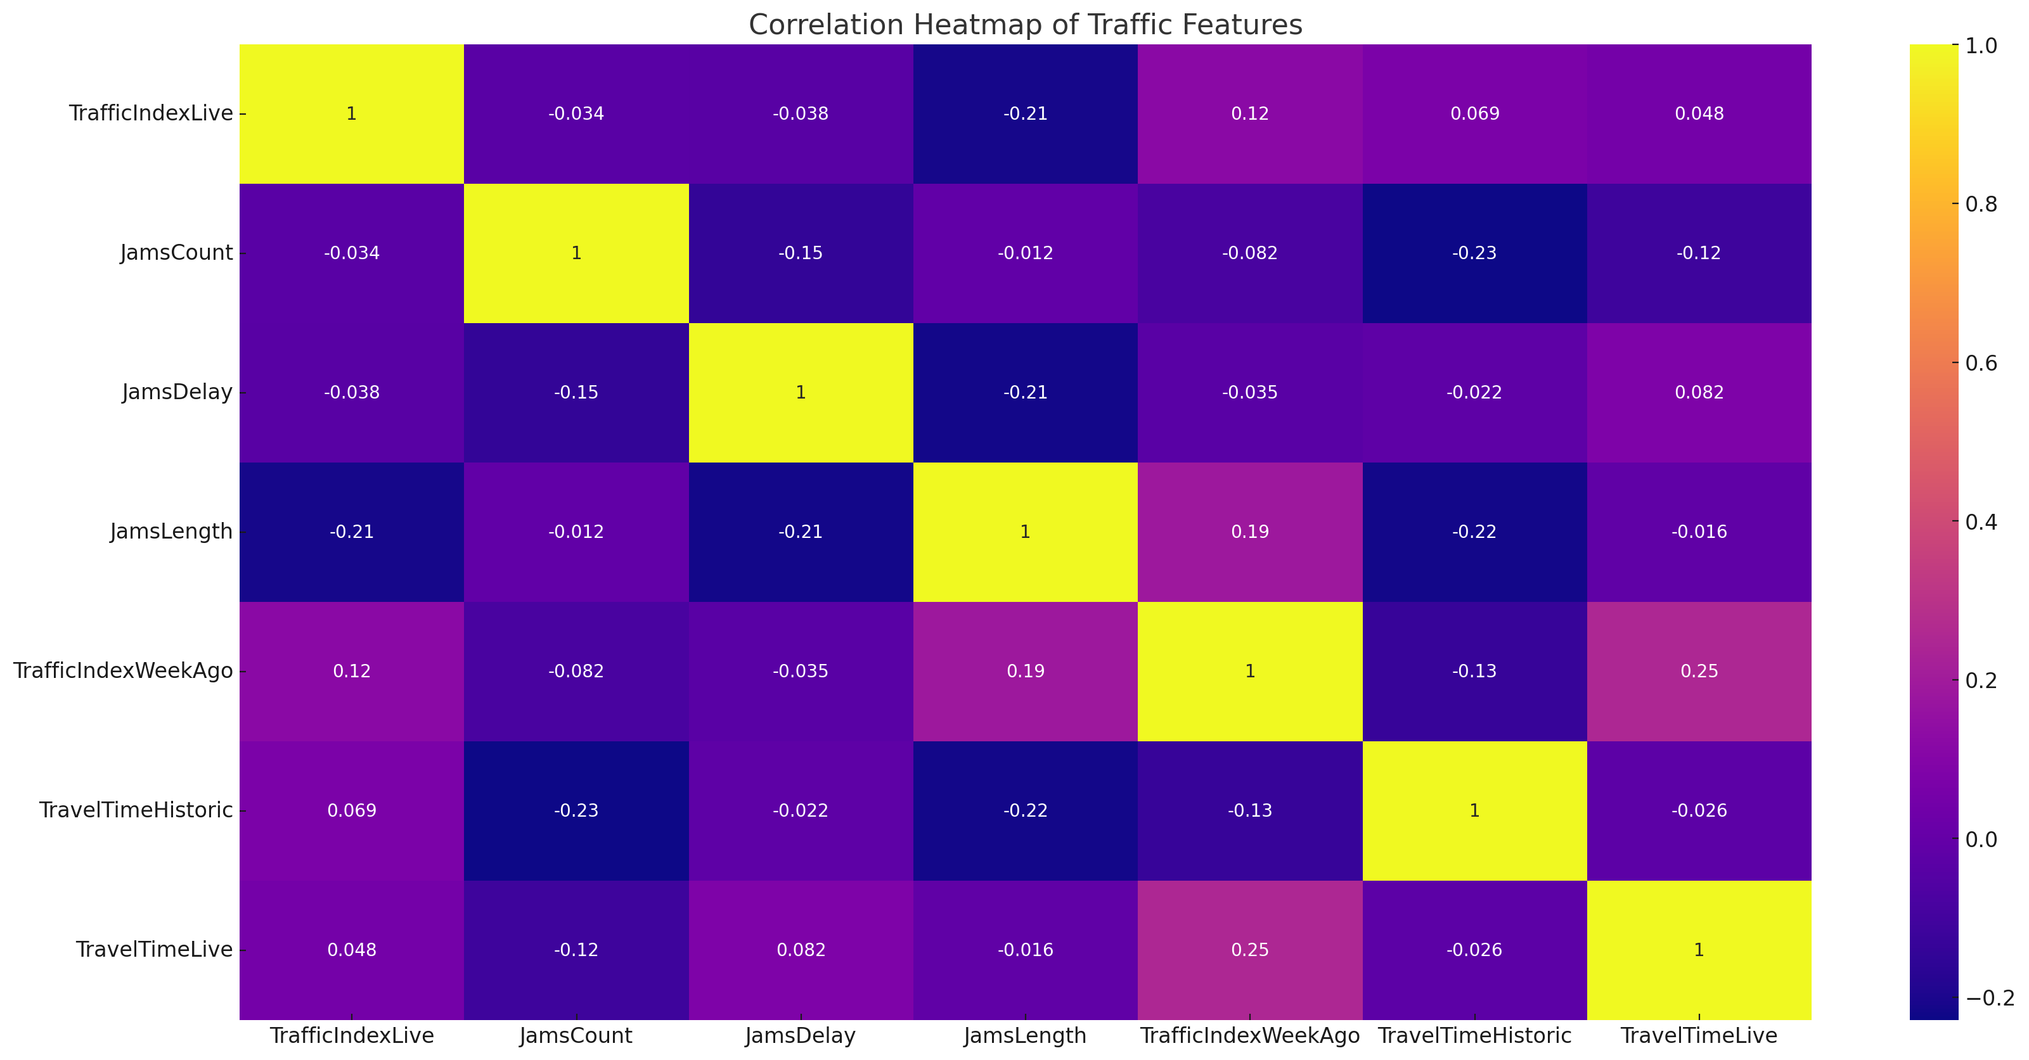

Slide 6
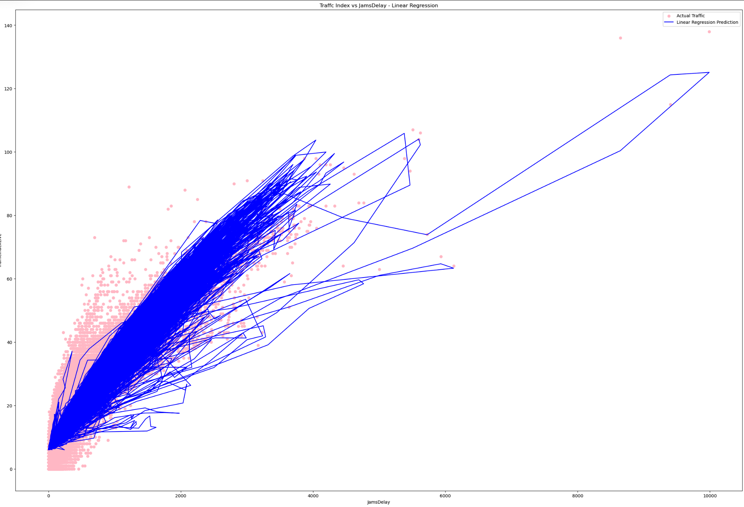
Linear Regression Model
Linear regression predicts traffic index based on “JamsDelay.”

Slide 7
K-means Clustering
• Achieved a silhouette score of 0.42, indicating moderate cluster separation.
• Clustering helps identify traffic patterns that are useful for traffic management.

Slide 8
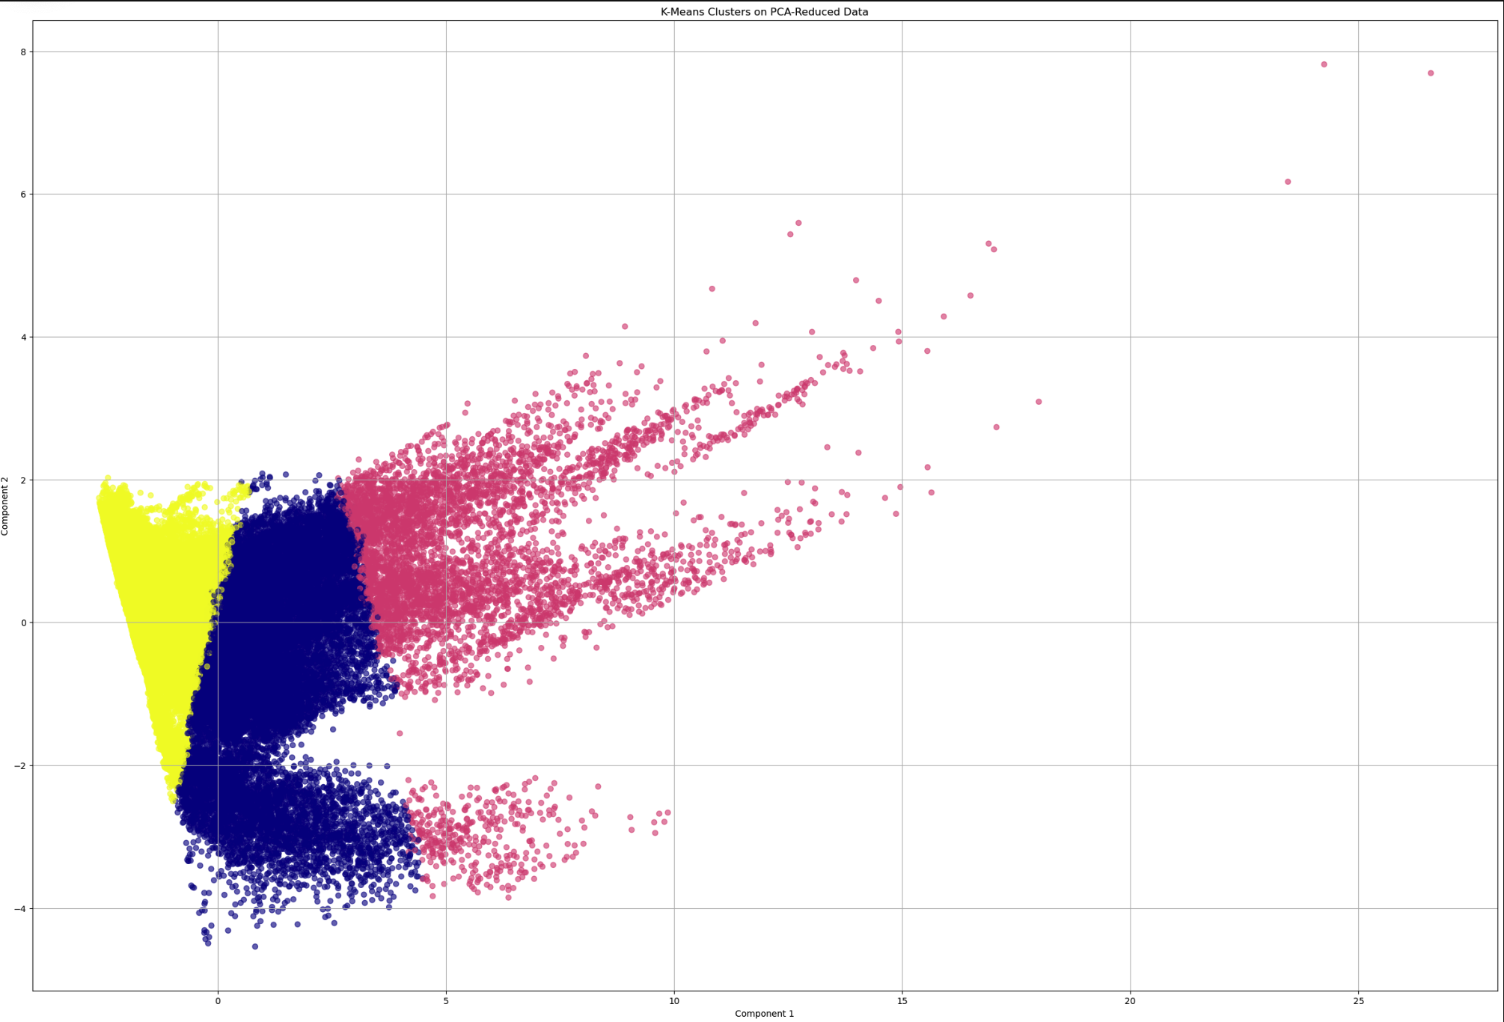

Slide 9
Quadratic Regression: Degree 2 Regression MSE: 30.58897350828845

Slide 10
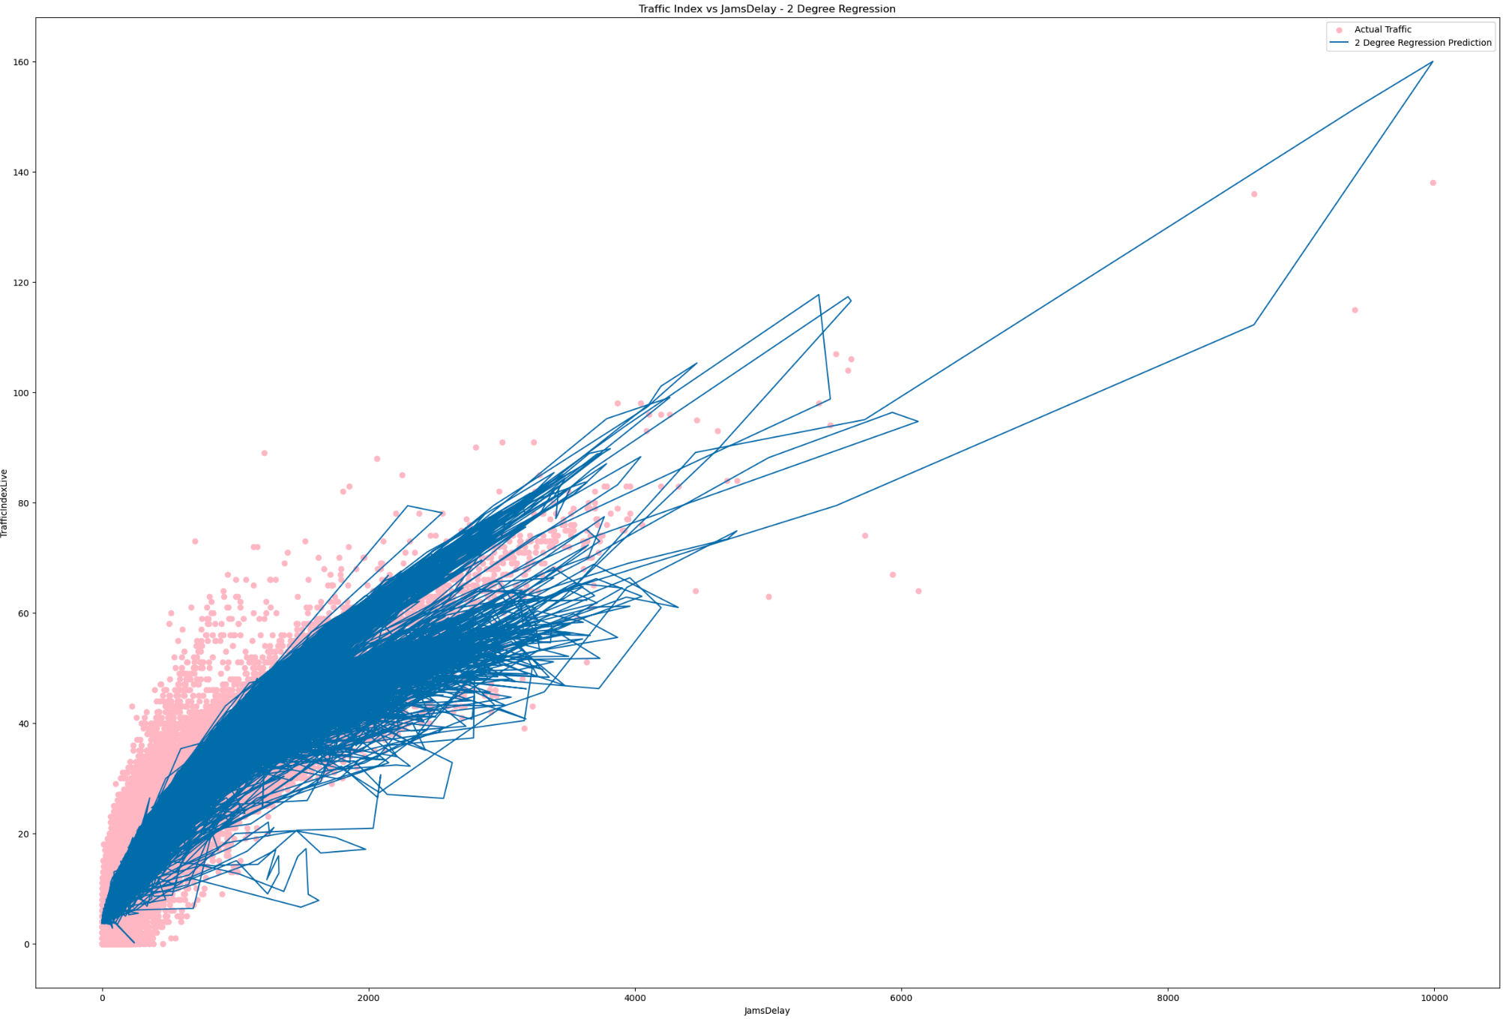

Slide 11
Cubic Regression: Results: Degree 3 Regression MSE: 25.990210807215693

Slide 12
