Slide 1
Ironhollow
Magnetism based Endless Runner

Slide 2
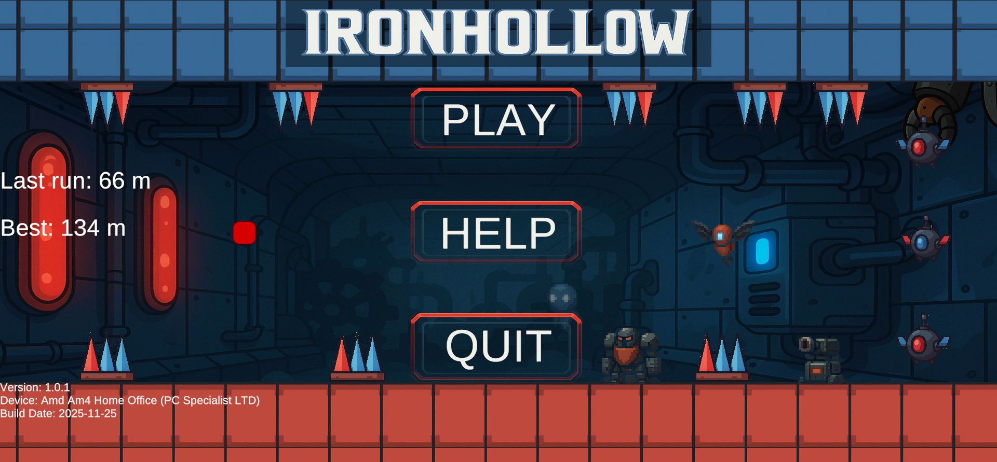
Hook and Pitch
Mobile-focused endless survival game
Core tension from polarity swaps (attract / repel mechanics)
Navigate dynamically generated tunnel segments
Survive against 6 unique enemy types + environmental hazards
Boss encounters every 250m (Bomb Factory)

Slide 3
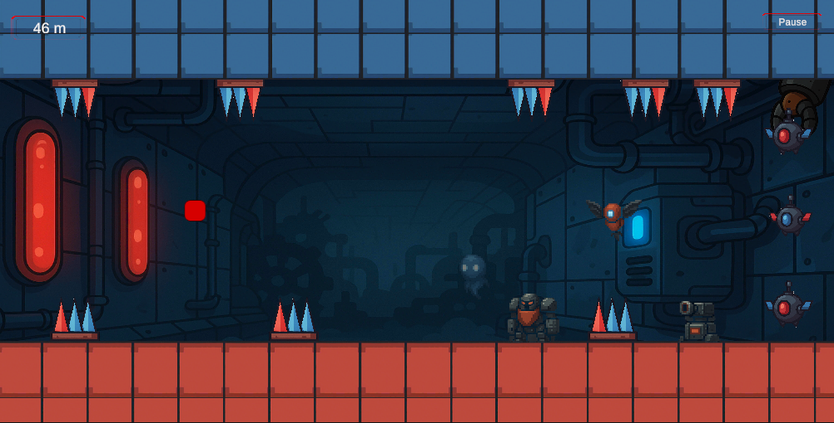
Core Gameplay Loop
Navigate procedurally spawned tunnel segments
Swap polarity to:
Push off terrain
Bend/deflect projectiles
Control your vertical drift
Avoid hazards (spikes, gaps, terrain)
Survive enemy patterns (turrets, flyers, ghosts, brutes, kamikazis)
Reach new distance milestones
Fight Bomb Factory boss every 250m

Slide 4
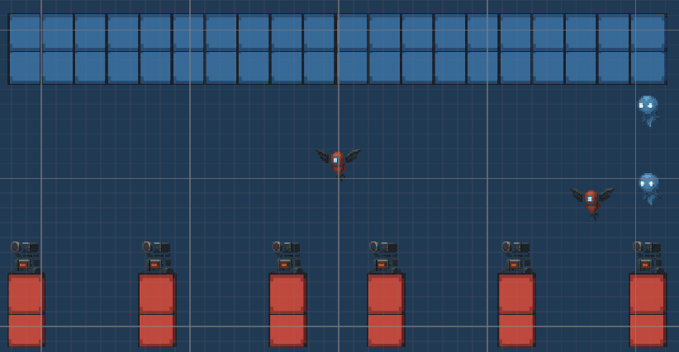
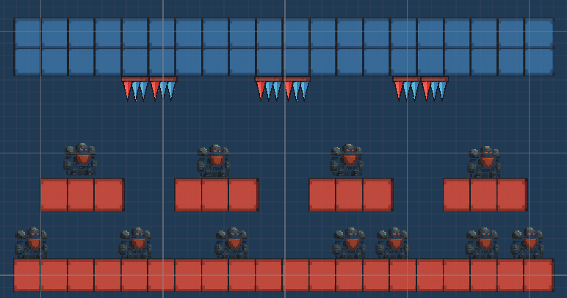
One Polished Lane
Designed around a fixed Row 5 safe zone rule
Each segment teaches/pressures a specific mechanic:
Flyer spread shots
Ceiling gauntlet
Brute corridor
KamiKazi choke point

Slide 5
Performance
Target device: Samsung Galaxy S20 FE
Avg FPS: ~60fps
Frame time: ~16 ms
Memory: ~200 MB
GC allocations: minimized through projectile pooling & segment recycling
TunnelSpawner keeps only 10 segments active at a time
Boss anchored to camera — no world overhead
Thermals:
No change over 10 minutes

Slide 6
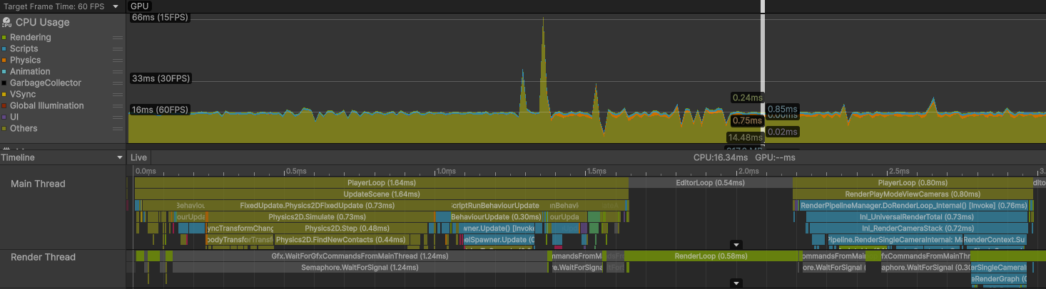
Metrics

Slide 7
Problems / Solutions
Problem #1 — Magnetism felt inconsistent
Projectiles were being influenced too strongly
Kamikazi units reacted from extreme distances
Solution:
Added falloff curves, capped magnetic distance
Tuned per-enemy magnetic multipliers
Improved collision layers
Problem #2 — Boss spawned twice
Player passing distance threshold twice in a single frame
Solution:
Introduced singleton BossManager
Anchored boss to screen for consistency

Slide 8
Knowledge Learned
Object pooling
Mobile Touch Controls
Creating custom events in the event system

Slide 9
Thank You!!!
We will now move on to a quick demo.

