Slide 1
Machine Learning applied to the Book of Mormon
By Adam Lenning

Slide 2
How it works!
Give program a lot of words, sentences and paragraphs and tell it which category it belongs to.
Program learns patterns and word frequencies
You can use the program to predict categories on future words, sentences and paragraphs.

Slide 3
file1 = open("./Lesson1.txt", "r") train = file1.readlines() count_vect = CountVectorizer() X_train_counts = count_vect.fit_transform(train::2]) tfidf_transformer = TfidfTransformer() X_train_tfidf = tfidf_transformer.fit_transform(X_train_counts) clf = ComplementNB().fit(X_train_tfidf, np.array([1, 1, 1, 1, 1, 1, 1, 1, 2, 2, 2, 2, 2, 2, 2, 2, 2, 2, 2, 2, 2, 3, 3, 3, 3, 3, 3, 3, 4, 4, 4, 4, 4, 4, 4, 4, 4, 4, 4, 4, 5, 5, 5, 5, 5, 5, 5])) dfObj = pd.DataFrame(columns=['Book', 'Restoration', 'PoS', 'Gospel', 'Commandments', 'Laws']) i = 0 # verse = "Insert Verse Here" # print(clf.predict(count_vect.transform([verse]))) for filename in os.listdir('bom'): file1 = open("./bom/" + filename, "r") book = file1.readlines() book = book[::2] resto = 0 pos = 0 gospel = 0 comm = 0 laws = 0 for verse in book: cat = clf.predict(count_vect.transform([verse])) if 1 in cat: resto = resto + 1 if 2 in cat: pos = pos + 1 if 3 in cat: gospel = gospel + 1 if 4 in cat: comm = comm + 1 if 5 in cat: laws = laws + 1 restoF = (resto / len(book)) posF = (pos / len(book)) gospelF = (gospel / len(book)) commF = (comm / len(book)) lawsF = (laws / len(book)) dfObj.loc[i] = [filename, restoF, posF, gospelF, commF, lawsF] i = i + 1
Here is most of the code, which turned out to be short despite taking me close to 20 hours to research and write.

Slide 4
Testing Individual Verses
ALM 11:29 And he answered, No.
Restoration- The program doesn’t know what to do with verses like these since it doesn’t pertain to any of the lessons out of context, meaning that the verses around it influence where this should be placed.
NE1 2:15 And my father dwelt in a tent.
Plan of Salvation- This adds an interesting take on this scripture. Is the tent symbolic of our earthly existence that it is only temporary?
NE3 18:20 And whatsoever ye shall ask the Father in my name, which is right, believing that ye shall receive, behold it shall be given unto you.
Restoration- This is a great scripture to use to help someone understand that you can receive answers to prayers which is a central concept of the message of the Restoration.

Slide 5


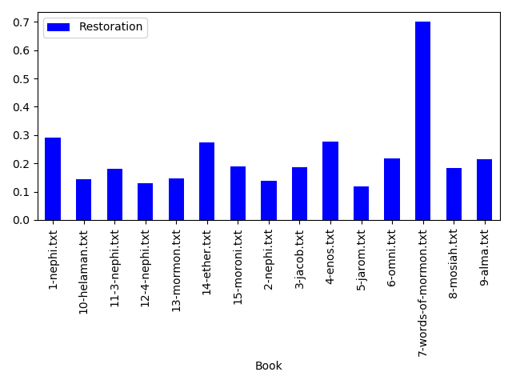
What percentage of Verses were classified as pertaining to the Restoration?

Slide 6
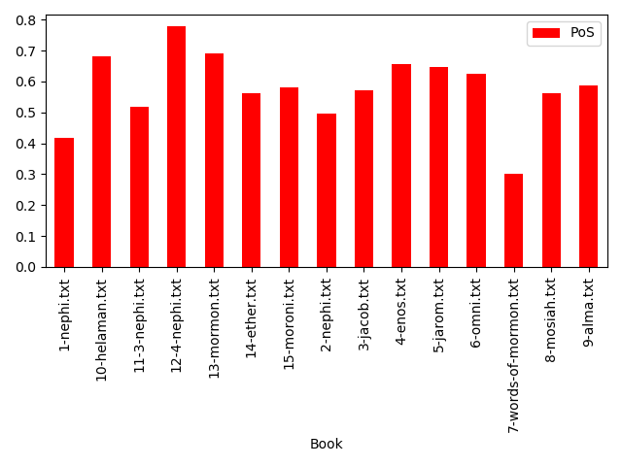
What percentage of Verses were classified as pertaining to the Plan of Salvation?

Slide 7
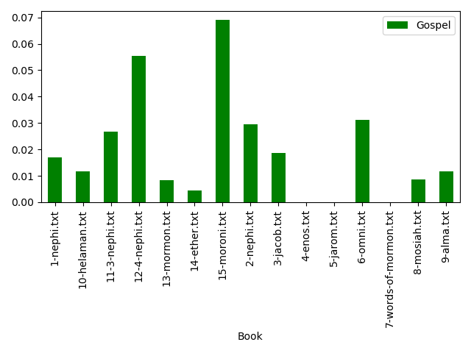
What percentage of Verses were classified as pertaining to the Gospel?

Slide 8
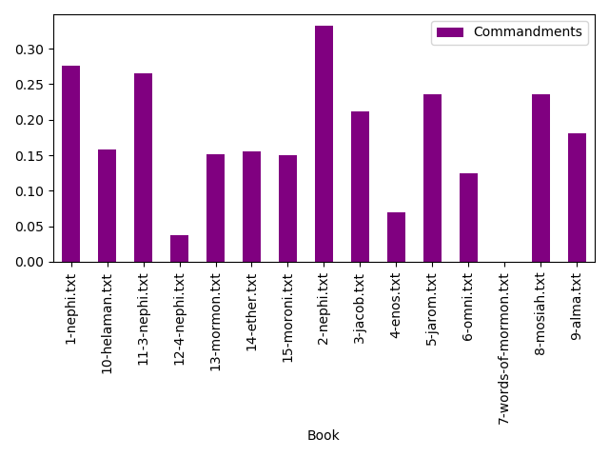
What percentage of Verses were classified as pertaining to the Commandments?

Slide 9
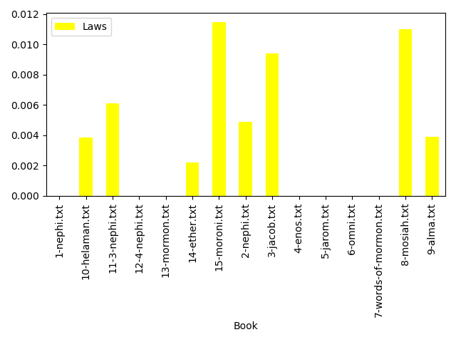
What percentage of Verses were classified as pertaining to the Laws and Ordinances?

Slide 10
Results!
Surprising how low the gospel and laws and ordinances were ranked
I would like to further search these results and see why
It would be great to get this program on a website in the future!

