Slide 1

Topic Trumps Emotionality
in Fake News Detection
By: Adam Harris, Adrian Duszkiewicz,
Elizaveta Baranova-Parfenova, Ismaila Elimane Ly
Exuberant Hibiscus (Pod id: 744)
Notes:
Some questions about fake news detection that we asked using deep learning

Slide 2
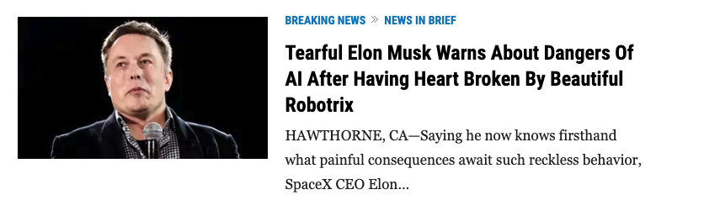
Introduction
Fake news are widespread and contribute to disinformation
What features distinguish real news for fake news?
Emotional language
General topic (e.g. celebrity gossip)
Is possible to detect fake news based on features
like emotional valence or topic?
Source: www.theonion.com

Slide 3
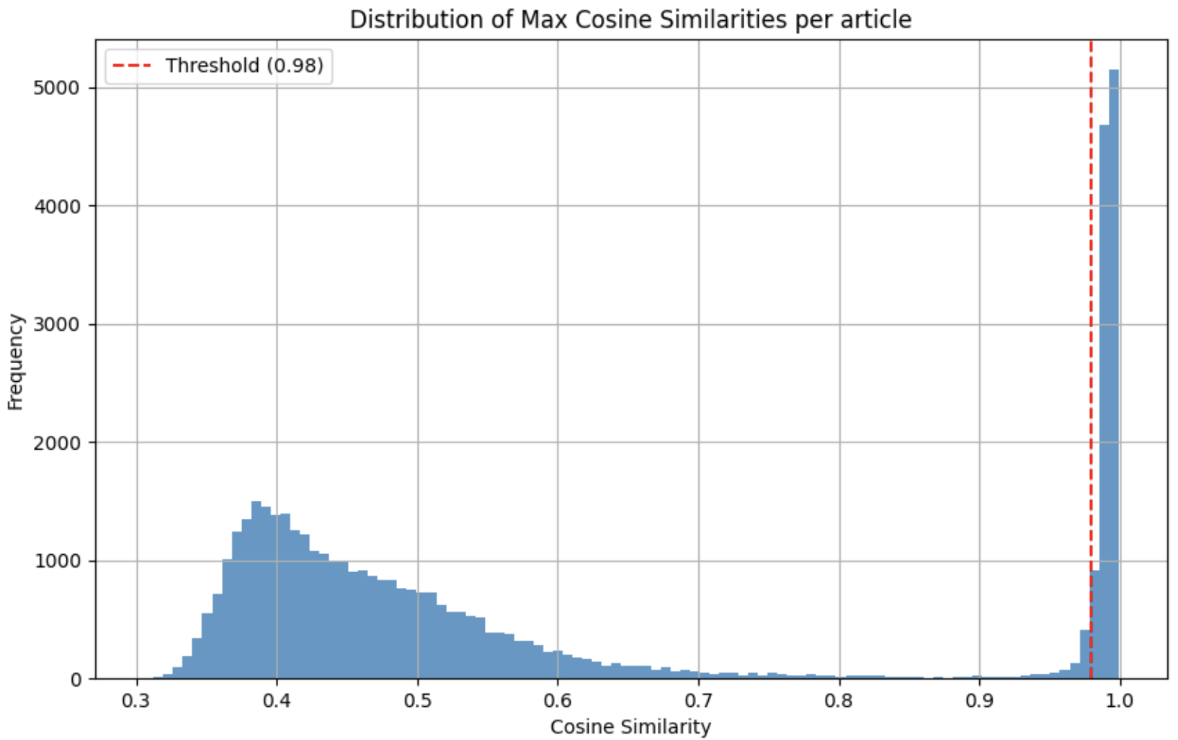
Dataset & Preprocessing
Data source: Fake News detection dataset from Kaggle
Description of the dataset: 44919 news articles: 23502 fake, and 21417 true.
Preprocessing steps:
lowercasing the words
Remove: punctuation, stopwords & web links, outlet tags (‘Reuters’)
Remove articles < 50 words
Remove duplicates using cosine similarity of embedding vector with 0.98 threshold
After preprocessing: 28982 articles (11900 + 17082)
Train\Test\Validation: 60/20/20

Slide 4
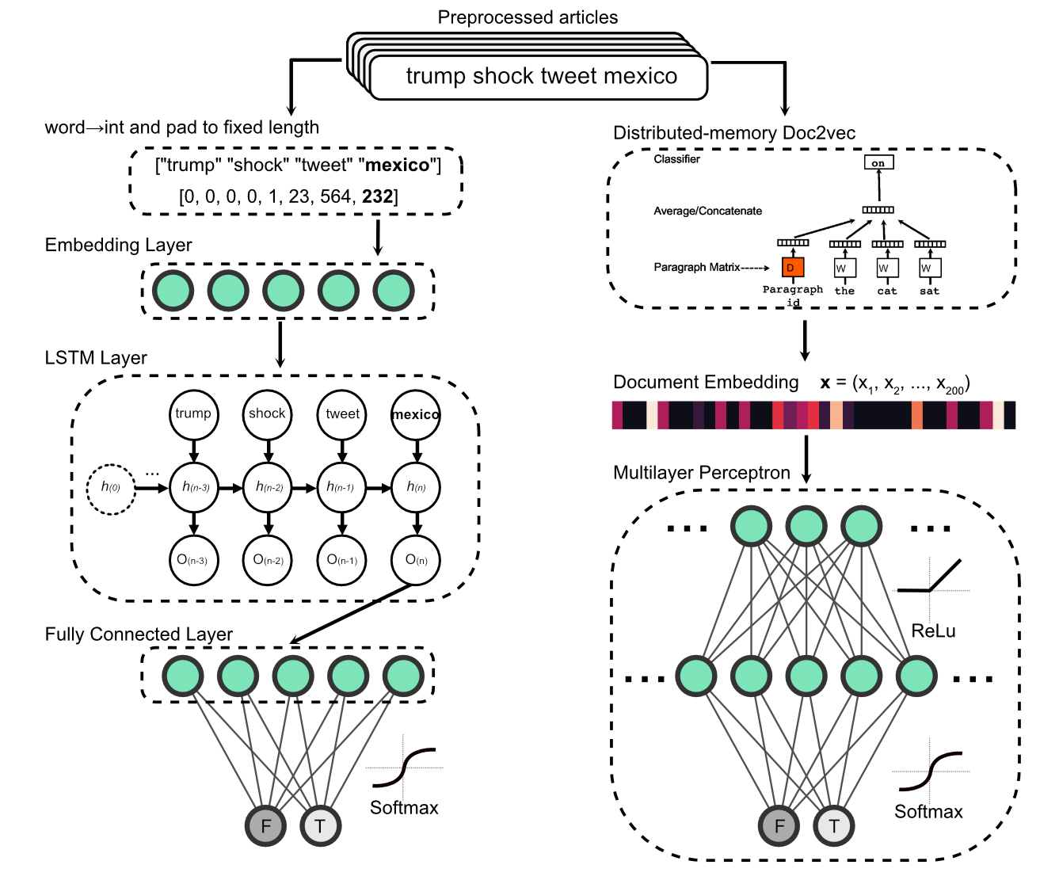
Benchmark: classification using whole article
Left: LSTM network that learns its own embedding
Precision, recall, F1-score all >0.98 on Test
Right: MLP with Doc2Vec embedding (200 features; sensitive to word order).
Precision, recall, F1-score all >0.95 on Test
Notes:
Before we focus on specific linguistic features, we wanted to do some benchmarking. How good can we get by using all the possible information?
We do this too ways:

Slide 5
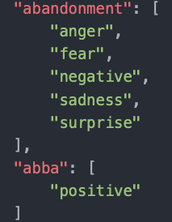
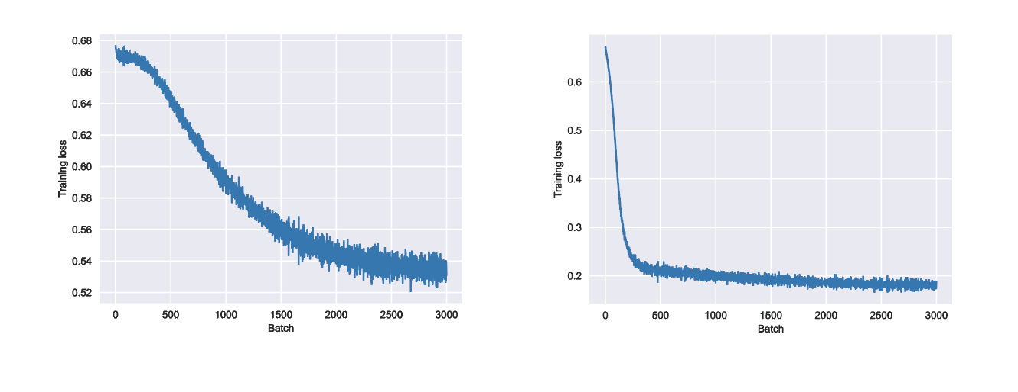
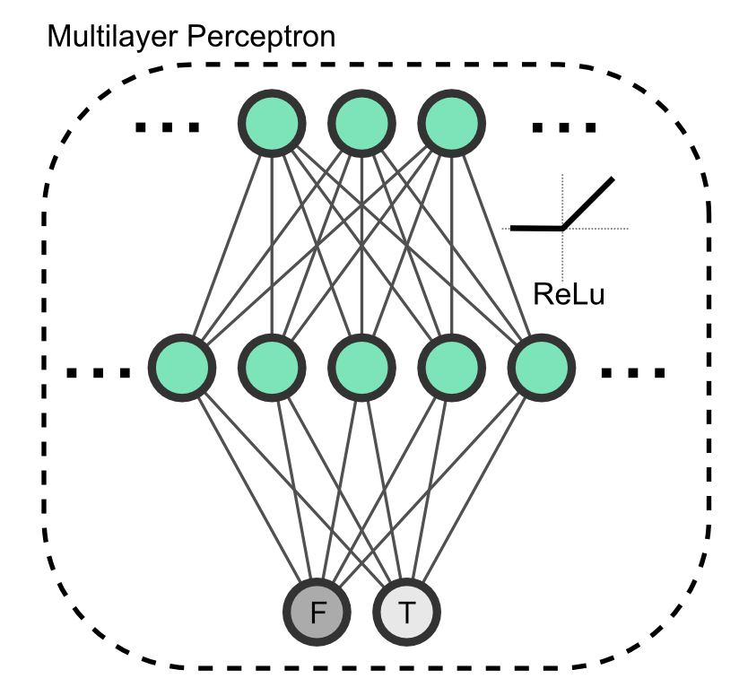
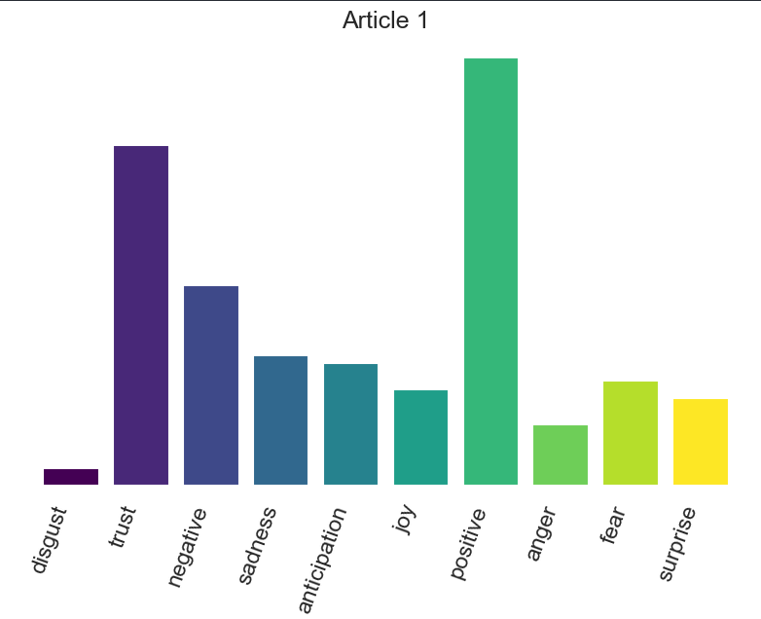
Results 1: MLP model using emotion scores
10 emotion scores
Accuracy > 74% F1 = 0.80, 0.63
NRCLex
Significantly above chance, but far from reliable!
Notes:
Training an MLP on the emotion scores, we achieved 74% accuracy - above chance (60%) but far from our benchmark accuracy.
The F1 score is calculated as the harmonic mean of the precision and recall scores

Slide 6
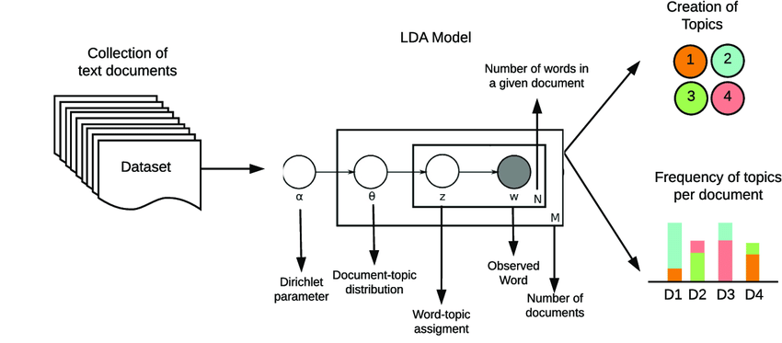
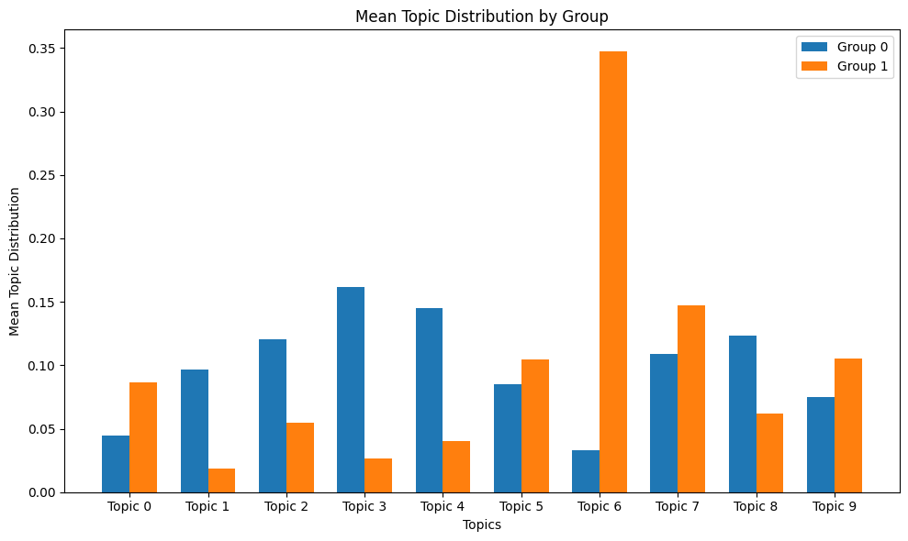
Results 2: MLP model using latent ‘topics’
10 topic scores
LDA
model
Accuracy > 92% F1 = 0.94, 0.91
Fake (Social media gossip)
True (Syria)
Works pretty well!
Notes:
We found that certain topics were radically overrepresented in real news (e.g. Syria conflict) and fake news (e.g. gossip).
Finally, we reliably classified fake news (92%) with a simple MLP using only the vectors of topic scores as features.
LDA - Latent Dirichlet Allocation: a probabilistic generative model - not a deep learning model

Slide 7

Conclusions
Emotionality does distinguish fake from real news, but is less informative than the topic of the article
However! LSTM > MLP(word embedding) > MLP(topics) > MLP(emotions)
Improvements:
Other methods for emotion detection (e.g. deep nets)
More diverse dataset (e.g. real news from Associated Press, not just Reuters)
More linguistic features (e.g. humor)
Emotion
Topic
Notes:
https://www.flickr.com/photos/24354425@N03/33023896856

Slide 8
Thank you!
Tutor: Sasan Azimi
Project TA: Dalia Nasr
And our pod members!
Exuberant Hibiscus (Pod id: 744)

