Slide 1



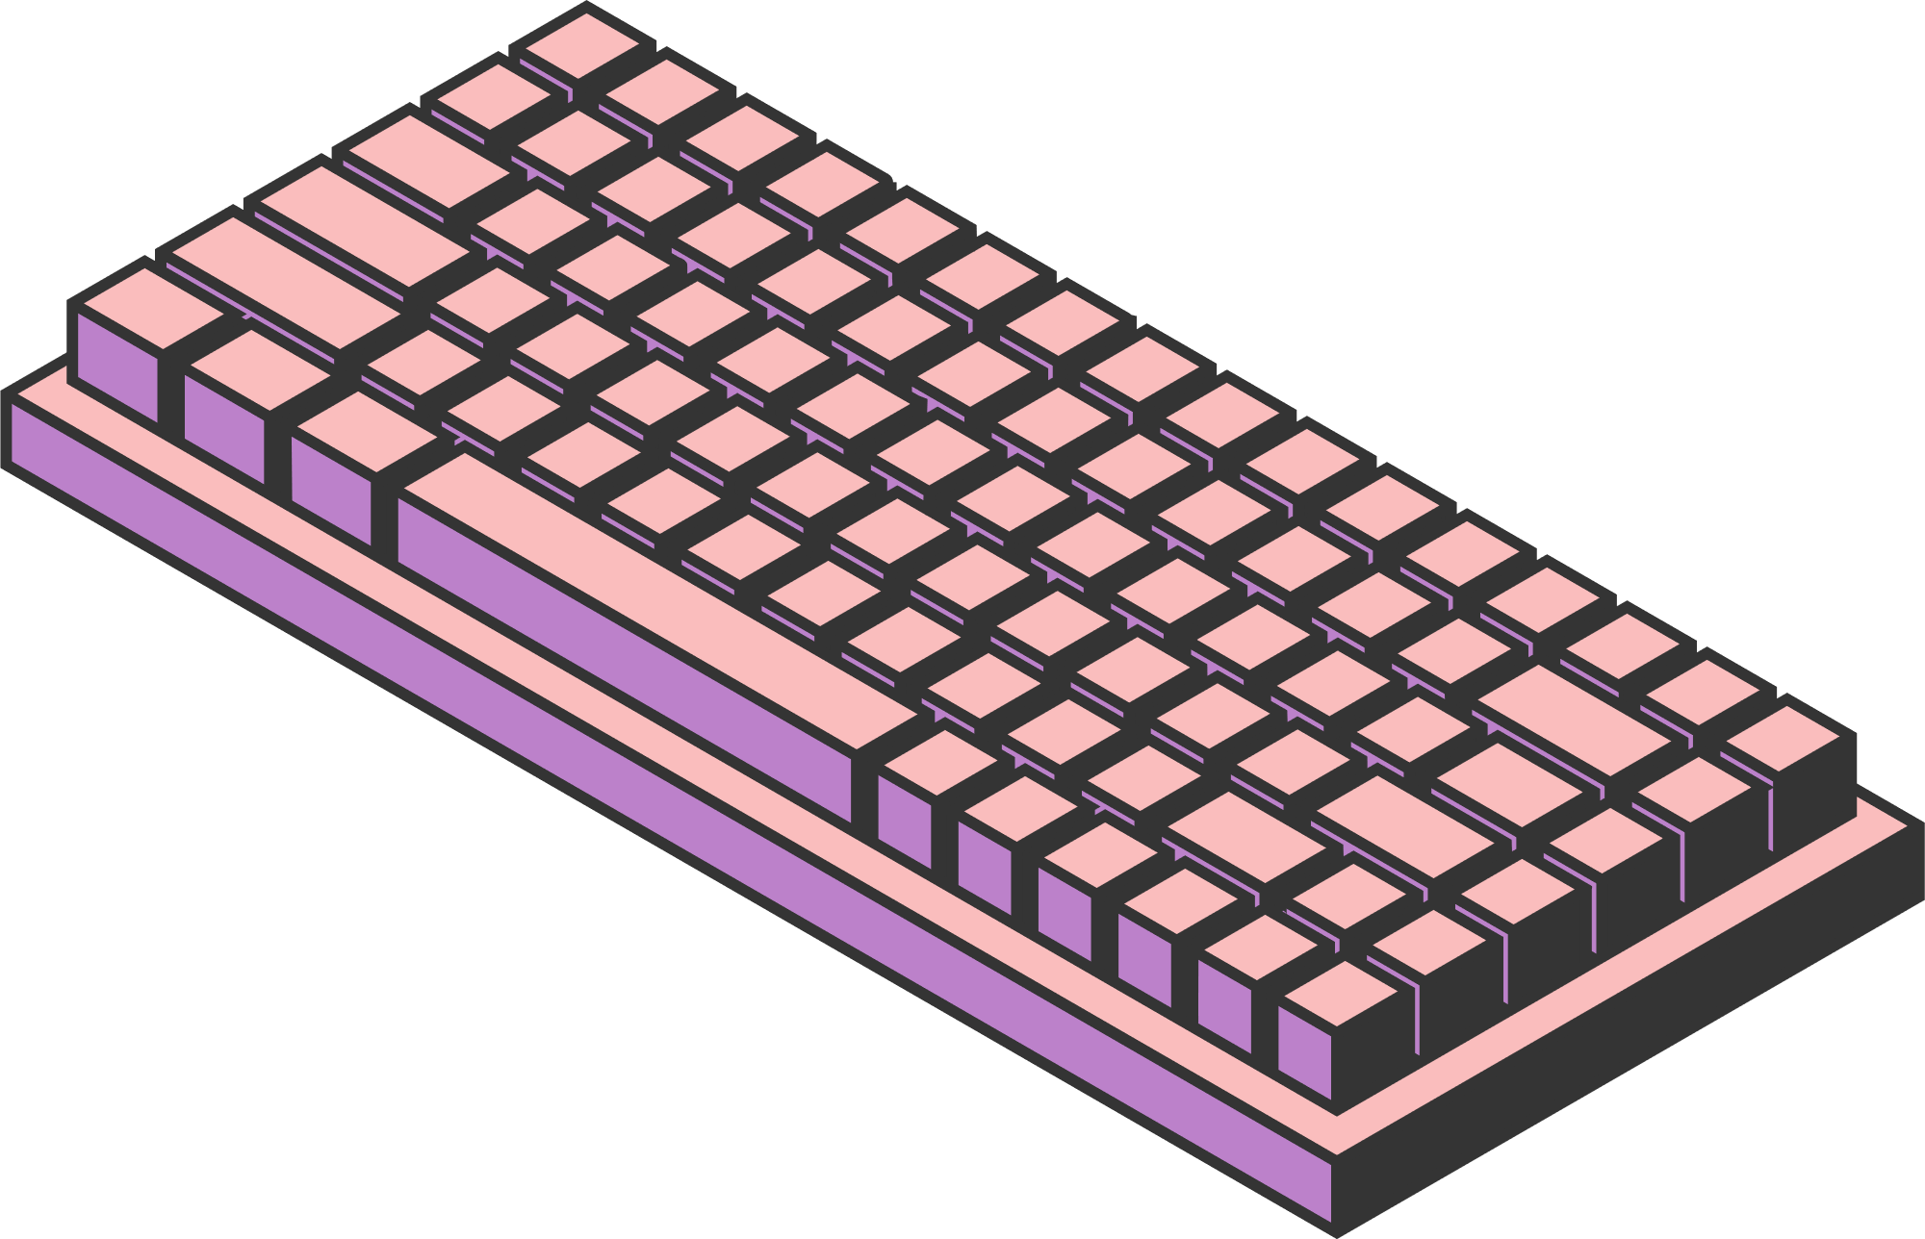
INTRO TO AI AND
NEURAL NETWORKS
By: ADAM MEHDI
Page 01

Slide 2

ARITIFICIAL INTELLIGENCE
Intelligence is the ability to take information, and make adaptable decisions to solve a problem
AI Is a system we design to do this
For example, a Chess bot or Siri
There are many ways to create an AI, we will focus on making a Neural Network
Page 02

Slide 3
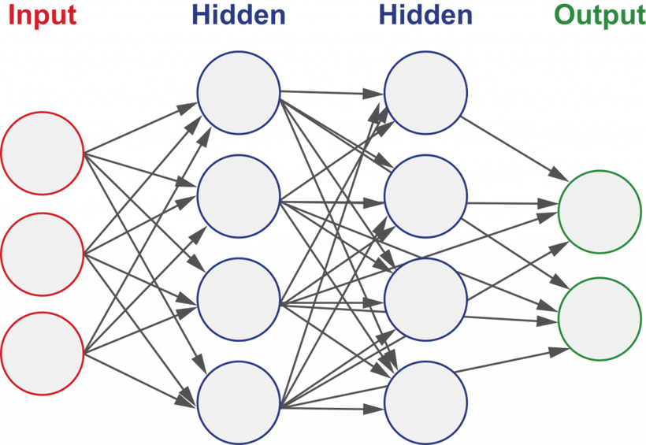
NEURAL NETWORKS
A Neural Network is a system, that takes some set of numbers as an input, and returns some set of numbers as an output
The circles in the image are all Neurons
The image has 4 “Layers”, which are the columns
Math is done with information in one layer to get information for each neuron in the next layer
Page 03

Slide 4
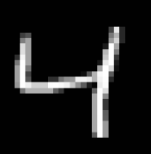
DIGIT DETECTION
We are going to construct a neural network to read a 28x28 image of a handwritten digit, and output what digit it is
Think of a neuron as a container for a number from 0 to 1
An image can be described as 28*28 = 784 neurons, valued from 0 to 1 depending on brightness
This means our input will have 784 neurons
Out output will have 10 neurons, representing the 10 possible digits, and whichever one is the most acitivated (Largest value) is our answer
The goal of a layer in the neural network is to give us more information than the last one
Page 04

Slide 5
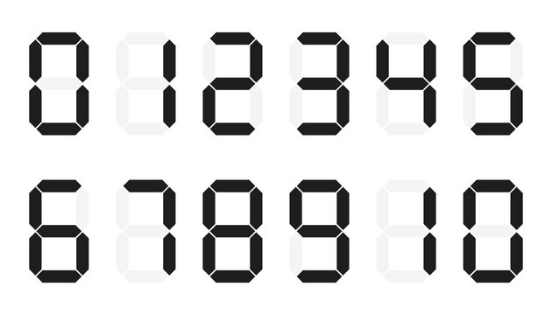
THE “GOAL” OF THE LAYERS
Consider that our neural network has 3 layers, 784 for input, 8 for the middle, 10 for the output
The first layer tells us which pixels are lit up
The next layer hopefully tells us about patterns it finds
Optimally for example, imagine our input looked like that of a digital digit
Each node in the second layer would correspond to a component on the digit, saying whether it exists
From knowing which components are on the digit, we can figure out the digit itself
Lots of problems can be abstracted into groups like this
Page 05

Slide 6
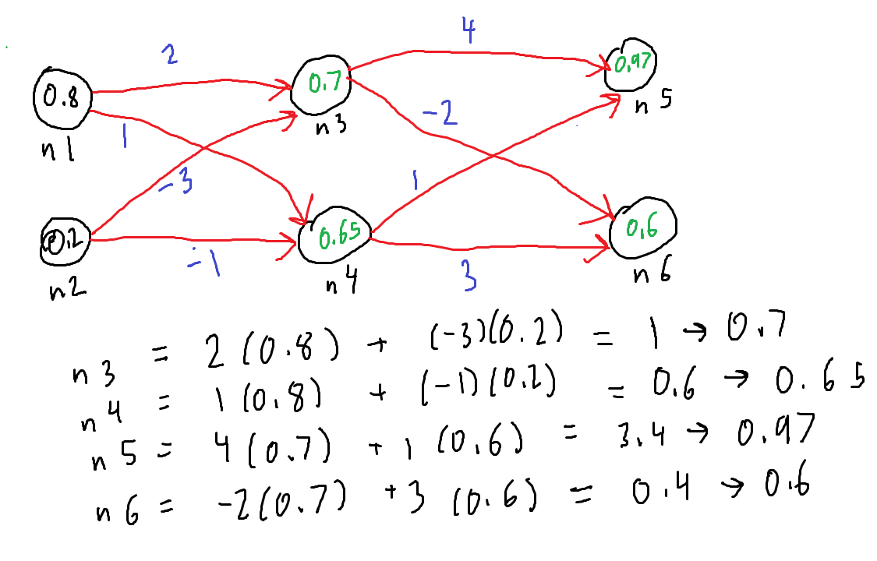
EDGES AND WEIGHTS
The information from one layer travels to the next layer through the edges
To get the value in a node, take its connections, multiply each by the edge weight
For each neuron, you can add a “Bias” after you get the sum from before
Then apply a function to make sure it stays between 0 and 1 (Activation function)
Many different types of activation functions
Page 06

Slide 7
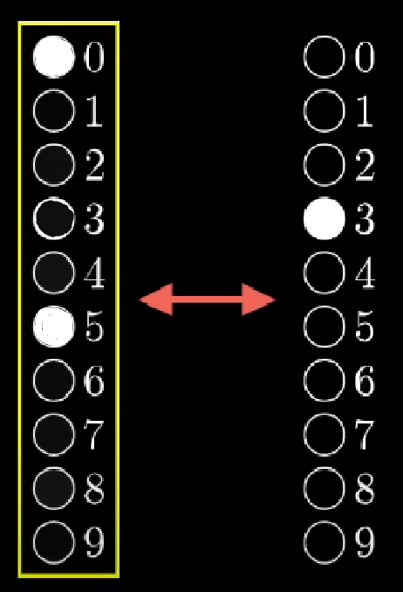
LEARNING AND TRAINING
When we say a neural network is learning, we are tweaking the edge weights and biases to more accurately produce our desired result
A neural network learns when we train it
Each drawn image the neural network receives has a desired result
The difference between the networks guess and the correct answer is what we want to minimize
Given a difference between what we want and what we have, we do some math to get our guesses closer
View 3B1B for descriptions of the actual math if you’re interested
Page 07

Slide 8
CREATING THE PROGRAM
We will now go into coding the actual project
We will use PyTorch, a Python library that helps with working with neural networks
We will construct a neural network in PyTorch to recognize handwritten digits
We will train it on a dataset from MNIST
We will test how accurate it is
Page 08

Slide 9




THANK YOU
Page 9

