Slide 1
MathBlitz
Team Data
Taishi Barth, Quinn Maloney, Adam Metz

Slide 2
What is MathBlitz?
Educational math practice site for Elementary level students
Dynamically generated math problem sets
Offers performance history for users to see their improvement over time

Slide 3
Why did we create MathBlitz?
Math for many students can be boring! Make it more fun!
We hope MathBlitz can provide a more enjoyable learning experience for young students!

Slide 4
Why MathBlitz’s Current State is a True MVP
The site is fully functional!
Offers all the functionality MathBlitz aims to offer
We completed not only one but two of the MVPs we set for ourselves

Slide 5
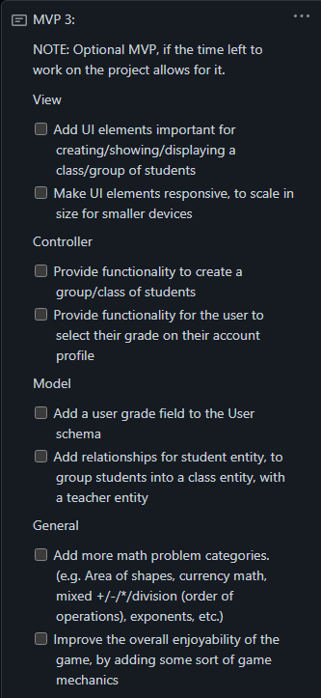
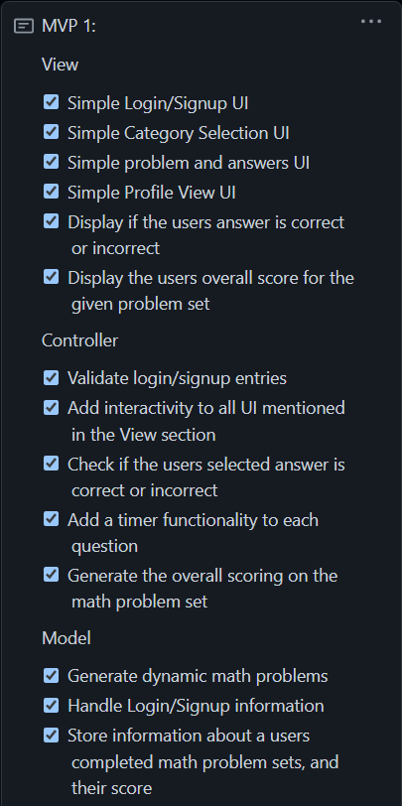
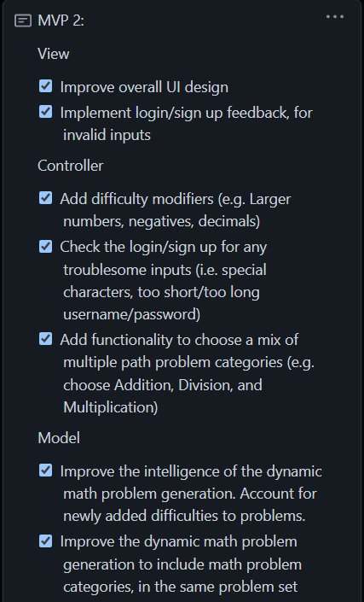
Minimum Viable Products

