Slide 1
MathBlitz
Team Data
Taishi Barth, Quinn Maloney, Adam Metz

Slide 2
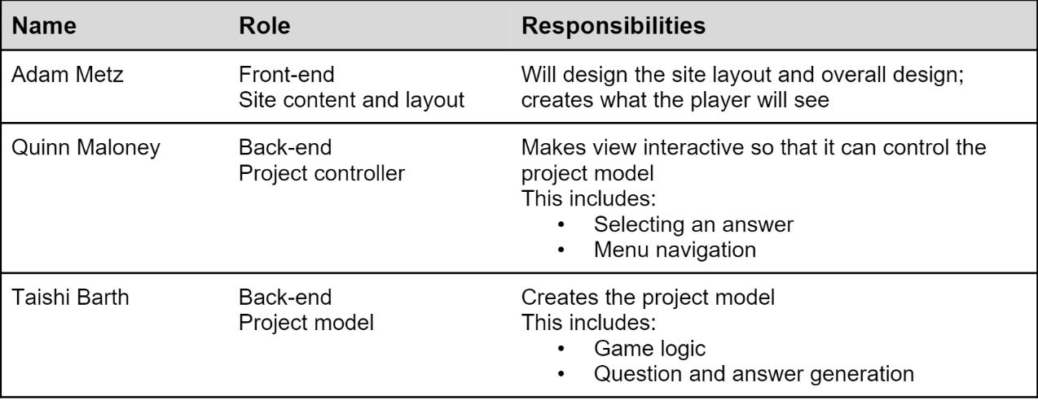
Team Members & Roles

Slide 3
Idea
Initial Idea
First idea was an education trivia game site, for educational use
Then we refined the scope to educational use for elementary/high school level students
Lastly, we refined the scope to elementary level math problems
Final Idea
Site that generates math problems at an Elementary grade level

Slide 4
Why
To create a more enjoyable learning environment for math in school
To provide a resource for students to learn outside of school
To be an option for teachers to create variety in their math classes

Slide 5
Project Plan

Slide 6
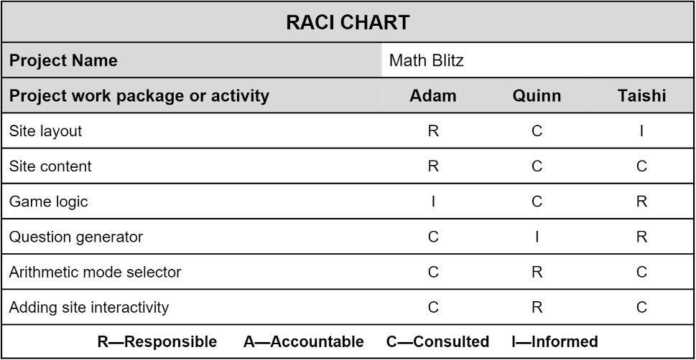
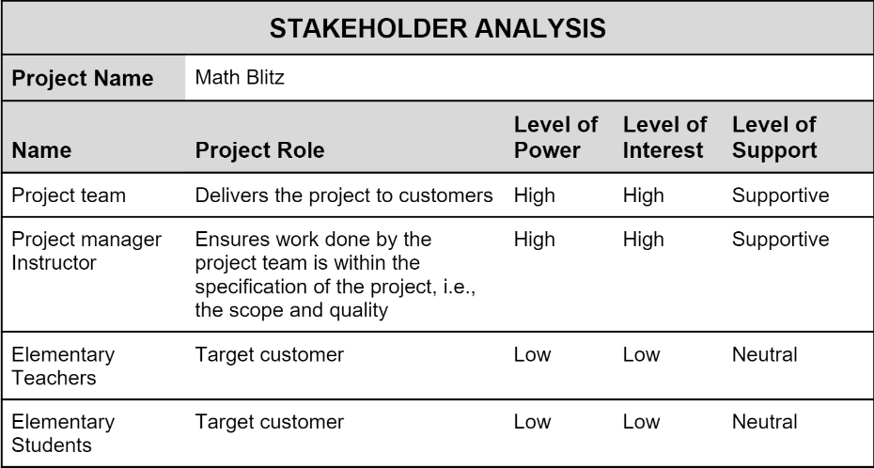
Project Planning Documents

Slide 7
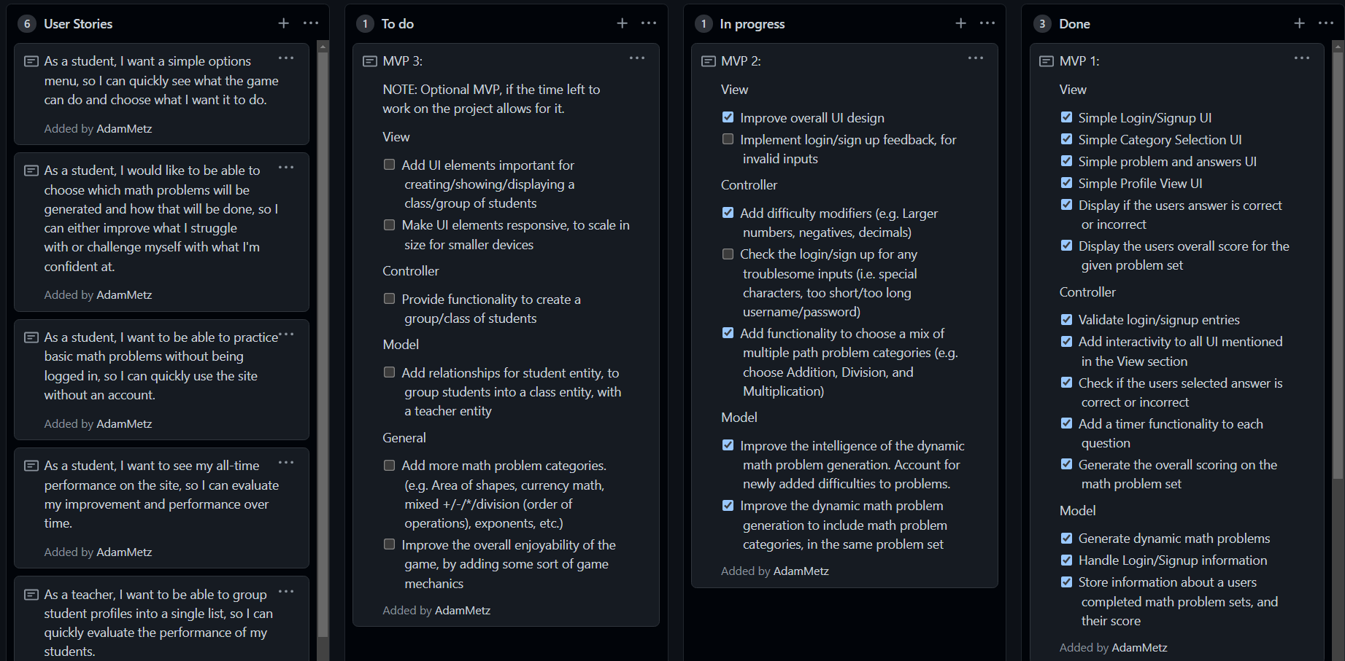
Kanban

Slide 8
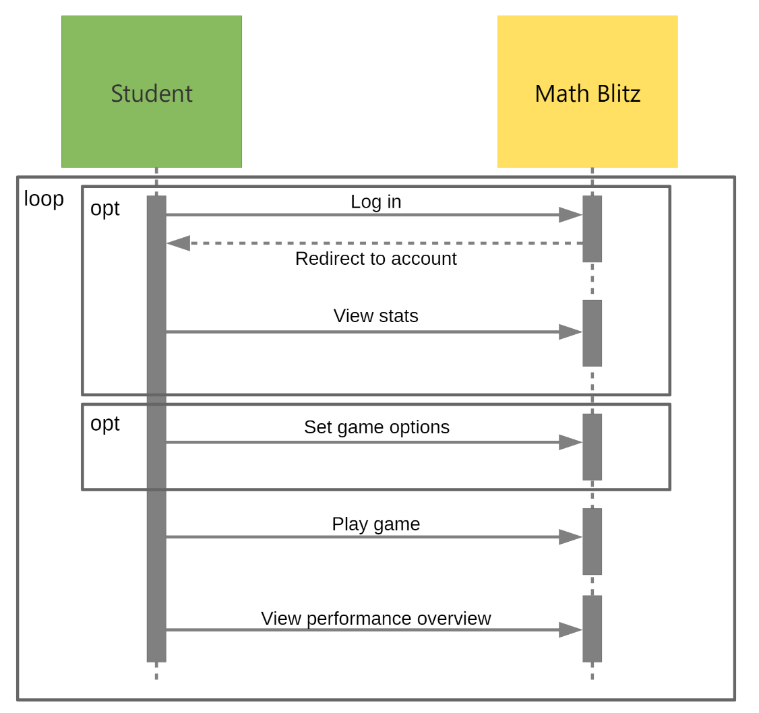
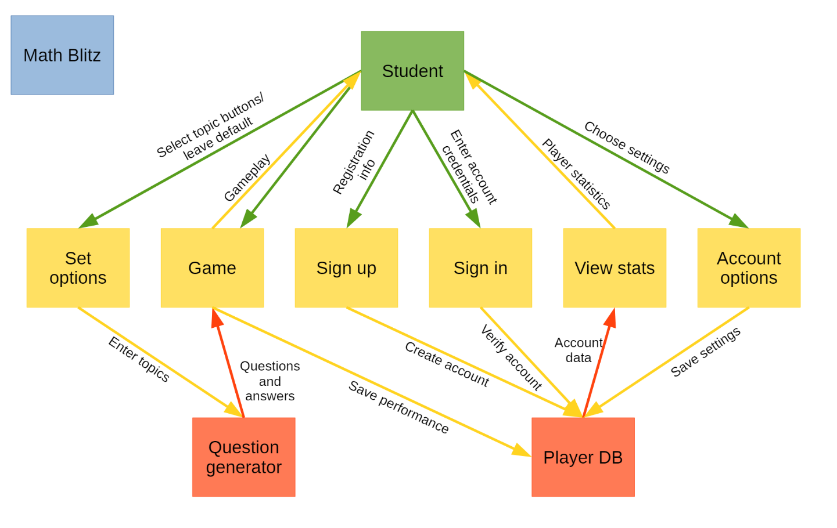
UML Diagrams

Slide 9
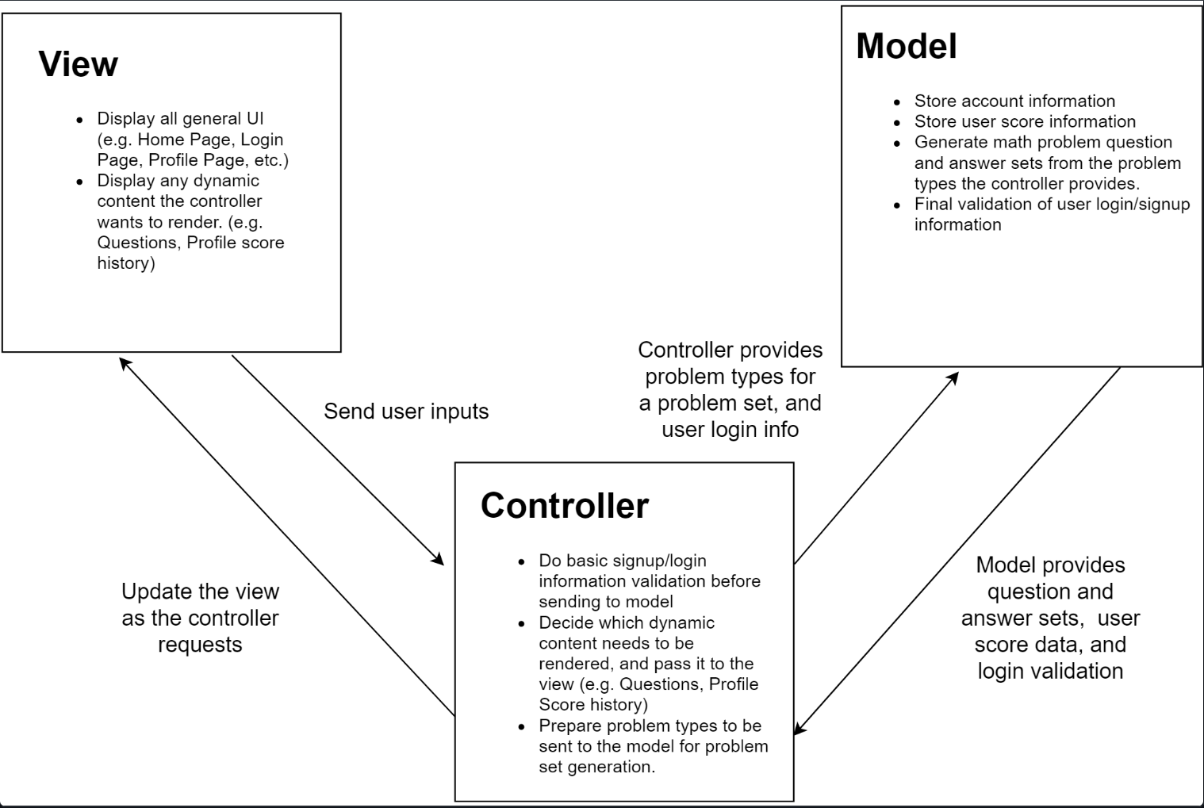
MVC Architecture

Slide 10
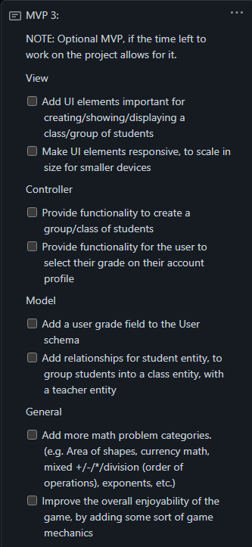
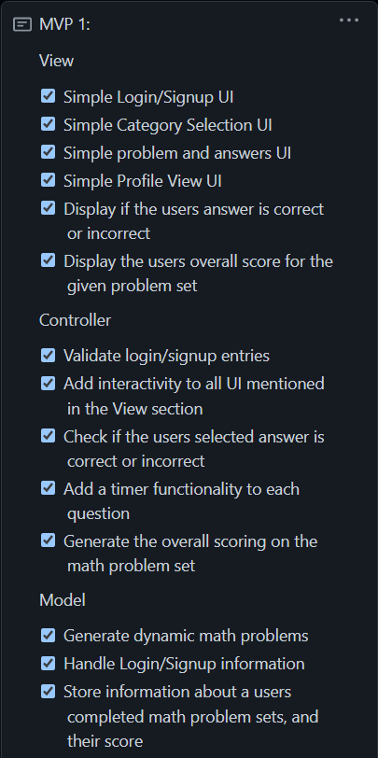
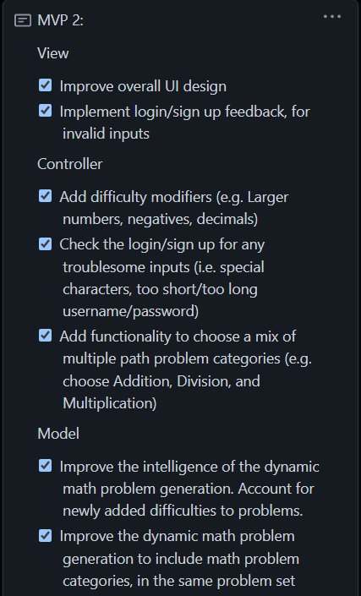
Minimum Viable Products

Slide 11
Student Feedback
“Also, I think it is very important to focus on keeping the application a game and not a standard quiz.”
“My advise would be to make sure to keep it as a trivia game and not like a UR Courses online quiz.”
“My only advice appears to be similar to my colleagues: Be sure to try and keep it as more of a game so kids will be more excited to use it.”

Slide 12
DEMO

Slide 13
Why MathBlitz's Current State is a True MVP
The site is fully functional!
All the core functionalities we aimed to offer with MathBlitz are present
Login/Signup
Dynamically generating a game for the user
Showing the user an overview of their correct and incorrect answers
Profile overview, allowing the user to see their past performance
We completed two out of three of the MVPs we planned for ourselves.

Slide 14
Team Reflection
How we felt about the project
What we were most proud of
What we will and won't use going forwards

Slide 15
Questions

