Slide 1
JavaScript
Sean Aryana

Slide 2
What is it?
Client side script – runs after you receive the page
Event driven – depending on what the user does, you can respond
Usability – can change the page without requiring refresh or server

Slide 3
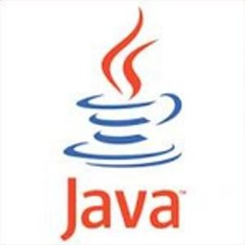

Like Java? NO!
+
Interpreted not compiled
Looser rules
Everything is a ‘var’ – no need to specify
Functions instead of classes
Link to it on the html page:
<sciptr src=“file.js” type=“text/javascript”></script>
Types:
Number, Boolean, String, Array, Object, Function, Null, Undefined

Slide 4
Why is this cool?
Demos
Var
Typeof
Math
Functions
if/else
Undefined- has not been declared, DNE
Null – exists but is nothing
Objects
Loops

Slide 5
jQuery – Quick Overview
The DOM – Document Object Model
document.getElementById() vs $(‘’)
Simplifies events and listerners

Slide 6
Make something
Fine

Slide 7
Nodejs
Server side JavaScript – Anything and everything you can think of it can do
More secure – any authorization or data handling should be done here
Express, MongoDB, Socket.io, and many more

Slide 8
New language?
Syntax is the same just different concepts
MVC – Model View Controller
Lets mess with it

