Slide 1

Arab Academy for Science, Technology and Maritime Transport
College of Engineering and Technology · Computer Engineering Department
Predictive Maintenance for OBD-II Engine Faults
Detecting developing engine faults from live 1 Hz sensor data
Presented by
Omar Hossam Eldin Mohamed Hafez — 20101737
Adam Mohamed Ibrahim — 20101978
Ahmed Abdelaal Saad — 16101027
Mohamed Sameh Mohamed El Bassuni — 18100896
Mohamed Mohamed Talaat Abokhatwa — 12103172
Supervised by
Dr. Yahia Elderiny
Dr. Rania Kadry
Defense — July 2026

Slide 2
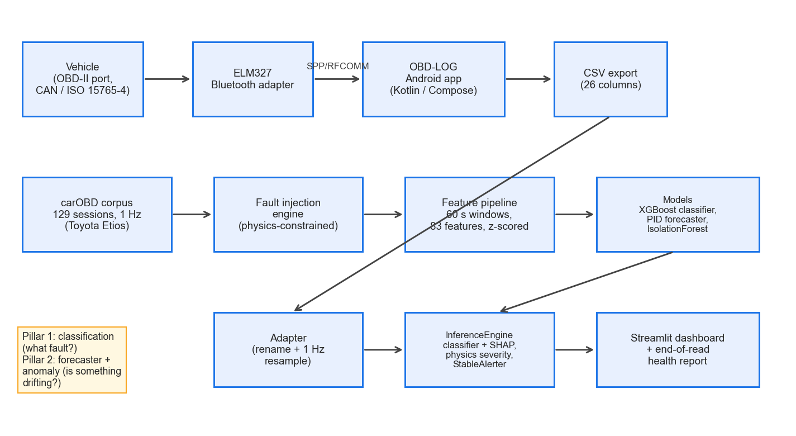
Agenda — one project, two halves
▪ Part 1 — Mechanical: the car, its sensors, the physics
▪ Part 2 — Computer Engineering: the data and the model
▪ What each engine fault looks like in the sensors
▪ How we detect a fault before the warning light
▪ Honest results — what works and what does not
▪ A live dashboard and where this goes next
System overview: car → adapter → phone → model → dashboard
AAST — Computer Engineering | Predictive Maintenance for OBD-II Engine Faults
2
Notes:
Team lead opens. Keep this to ~1 minute. The figure is the whole system in one picture; we walk it left to right later.

Slide 3
PART 1
Mechanical Engineering
Presented by Mohamed Sameh & Mohamed Abokhatwa
3
Notes:
[REVIEW-NEEDED] This mechanical-engineering content uses the task's default outline (OBD-II, test vehicle + ELM327, fault physics, data collection). Replace with the two mechanical students' actual contribution before the defense.

Slide 4
What every car already tells us
▪ Since ~1996 every car has an OBD-II diagnostic port
▪ The engine computer reports its sensors once a second
▪ Engine speed, coolant temp, fuel trims, throttle, and more
▪ A cheap adapter can read this live stream
▪ Standardized: SAE J1979 over ISO 15765-4 CAN
[FIGURE: photo of the OBD-II port
under the dashboard + connected adapter]
AAST — Computer Engineering | Predictive Maintenance for OBD-II Engine Faults
4
Notes:
[REVIEW-NEEDED] This mechanical-engineering content uses the task's default outline (OBD-II, test vehicle + ELM327, fault physics, data collection). Replace with the two mechanical students' actual contribution before the defense.
Keep it plain: the car is already publishing this data for free; we just listen.

Slide 5
The test car and the reader
▪ Test vehicle: 2015 Toyota Yaris
▪ ELM327 Bluetooth adapter plugs into the OBD-II port
▪ Our Android app (OBD-LOG) records every reading
▪ About $15 of hardware — no garage tools needed
▪ More sensors polled = slower rate (7 PIDs 1.10 Hz, 21 PIDs 0.37 Hz)
[FIGURE: 2015 Toyota Yaris +
ELM327 adapter + phone running OBD-LOG]
AAST — Computer Engineering | Predictive Maintenance for OBD-II Engine Faults
5
Notes:
[REVIEW-NEEDED] This mechanical-engineering content uses the task's default outline (OBD-II, test vehicle + ELM327, fault physics, data collection). Replace with the two mechanical students' actual contribution before the defense.
The poll-rate trade-off is measured, in the book Table 3.1. Say it simply: asking for more sensors slows all of them.

Slide 6
The sensors behind each fault
▪ Air leak → manifold pressure (MAP) and idle speed
▪ Fuel problem → short- and long-term fuel trims
▪ Temperature → the coolant sensor
▪ Throttle wear → throttle angle vs pedal position
▪ Each fault moves specific sensors in a known direction
AAST — Computer Engineering | Predictive Maintenance for OBD-II Engine Faults
6
Notes:
[REVIEW-NEEDED] This mechanical-engineering content uses the task's default outline (OBD-II, test vehicle + ELM327, fault physics, data collection). Replace with the two mechanical students' actual contribution before the defense.
This slide is the bridge: name the sensor for each fault so the physics on the next two slides lands.

Slide 7
The physics (1): air and fuel
▪ Vacuum leak: extra air sneaks in past the throttle
▪ Idle speed rises — like leaving the throttle cracked open
▪ Injector clog: less fuel sprayed, engine runs lean
▪ The computer adds fuel — long-term fuel trim climbs
▪ MAP stays normal for a fuel fault — that tells them apart
[FIGURE: simple diagram — intake manifold,
throttle, injector, airflow arrows]
AAST — Computer Engineering | Predictive Maintenance for OBD-II Engine Faults
7
Notes:
[REVIEW-NEEDED] This mechanical-engineering content uses the task's default outline (OBD-II, test vehicle + ELM327, fault physics, data collection). Replace with the two mechanical students' actual contribution before the defense.
Use the analogy out loud: a vacuum leak behaves like a stuck-open throttle. That single sentence explains the whole slide.

Slide 8
The physics (2): coolant and throttle
▪ Stuck coolant sensor: computer thinks the engine is cold
▪ It retards timing and over-fuels — trims go rich
▪ Throttle sensor wear: reported angle drifts from the pedal
▪ Only shows under load; commanded throttle stays correct
▪ That mismatch is a second, independent clue
AAST — Computer Engineering | Predictive Maintenance for OBD-II Engine Faults
8
Notes:
[REVIEW-NEEDED] This mechanical-engineering content uses the task's default outline (OBD-II, test vehicle + ELM327, fault physics, data collection). Replace with the two mechanical students' actual contribution before the defense.
Keep 'timing' light for a lay audience: the engine acts like it never warmed up.

Slide 9
Collecting real driving data
▪ Drives on public roads, with the driver's consent
▪ The phone logs every sensor once per second
▪ No fault was ever induced on the car — safety first
▪ We record a healthy baseline for each vehicle
▪ That baseline is what the model compares against
[FIGURE: map/photo of a data-collection drive
or the app logging screen]
AAST — Computer Engineering | Predictive Maintenance for OBD-II Engine Faults
9
Notes:
[REVIEW-NEEDED] This mechanical-engineering content uses the task's default outline (OBD-II, test vehicle + ELM327, fault physics, data collection). Replace with the two mechanical students' actual contribution before the defense.
End Part 1 on the ethics point: everything is healthy, real, consented data. Hand off to the CE team.

Slide 10
PART 2
Computer Engineering
Presented by Omar Hossam, Adam Mohamed & Ahmed Saad
10

Slide 11
The problem, stated honestly
▪ Goal: flag a developing fault before the warning light
▪ No public dataset of real, labeled OBD-II faults exists
▪ So we train on synthetic faults over real healthy data
▪ We report this as synthetic validation, not field proof
▪ That honesty shapes every number in this talk
The two-pillar pipeline: classify the fault, and watch for drift
AAST — Computer Engineering | Predictive Maintenance for OBD-II Engine Faults
11
Notes:
Say the hard truth early: the model has never seen a real fault. Everything after this is measured against that limit.

Slide 12
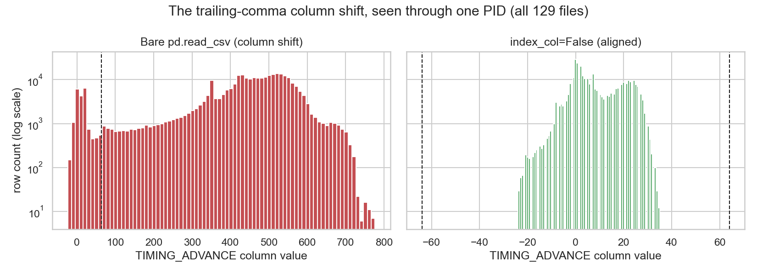
Rescuing the dataset
▪ First audit: 120 of 129 files looked physically impossible
▪ Real cause: a trailing comma shifted every column left
▪ Timing read catalyst temperatures — hence 776° readings
▪ One parser flag recovered all 129 files
▪ Data grew from 9 files (~4.4 h) to 129 (~84.5 h): 19× more
Timing advance, before vs after the one-line parser fix
AAST — Computer Engineering | Predictive Maintenance for OBD-II Engine Faults
12
Notes:
This is our best 'data engineering' story. The bug was silent and the symptom appeared two layers from the cause. 19x more data from one character.

Slide 13
Making faults we could learn from
▪ Inject 4 faults into real healthy drives
▪ Every written value obeys engine physics
▪ Coolant can't jump >1°C per second; fuel trims capped ±25%
▪ Ramp mode models gradual wear, not a sudden break
▪ Fully reproducible: seed, onset, magnitude all stored
[FIGURE: injected fuel-trim ramp
overlaid on a healthy drive]
AAST — Computer Engineering | Predictive Maintenance for OBD-II Engine Faults
13
Notes:
The physics constraints are the point. A naive injector writes signatures real ECUs never produce; ours refuses to.

Slide 14
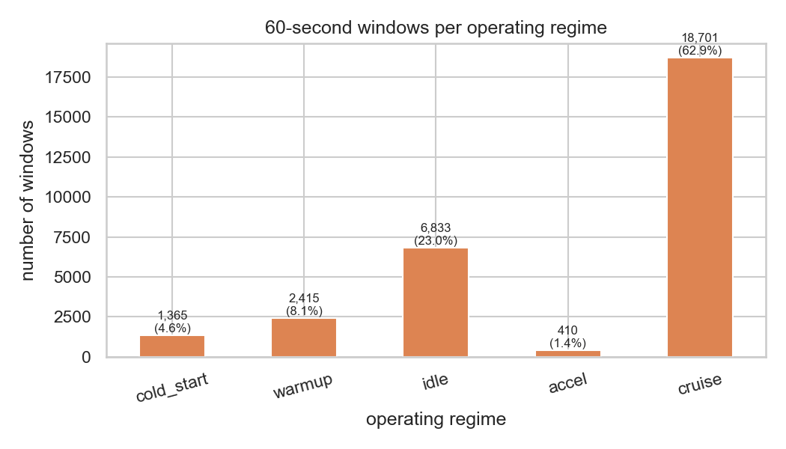
Turning sensors into features
▪ Each 60-second window → 83 numeric features
▪ Statistics, cross-sensor ratios, trajectories, regime flags
▪ Every feature z-scored vs that car's own healthy baseline
▪ So the model reads '4σ above normal for THIS car'
▪ That baseline trick is what lets one model fit many cars
Driving splits into regimes; cruise dominates the windows
AAST — Computer Engineering | Predictive Maintenance for OBD-II Engine Faults
14
Notes:
The z-scoring is the cross-vehicle mechanism. Raw values differ car to car for healthy reasons; deviations from each car's own normal are comparable.

Slide 15
The classifier, and knowing its limits
▪ XGBoost over 6 classes: healthy, cold start, 4 faults
▪ SHAP explains every call — which sensors, how much
▪ Untested contract: missing sensor → 'Untested', not a guess
▪ A MAF car with no MAP → air fault marked Untested
▪ The model is allowed to say 'I can't test this here'
AAST — Computer Engineering | Predictive Maintenance for OBD-II Engine Faults
15
Notes:
SHAP matters for a workshop: 'LTFT pushed this toward fuel by 0.43' is a checkable claim, not a black box.

Slide 16
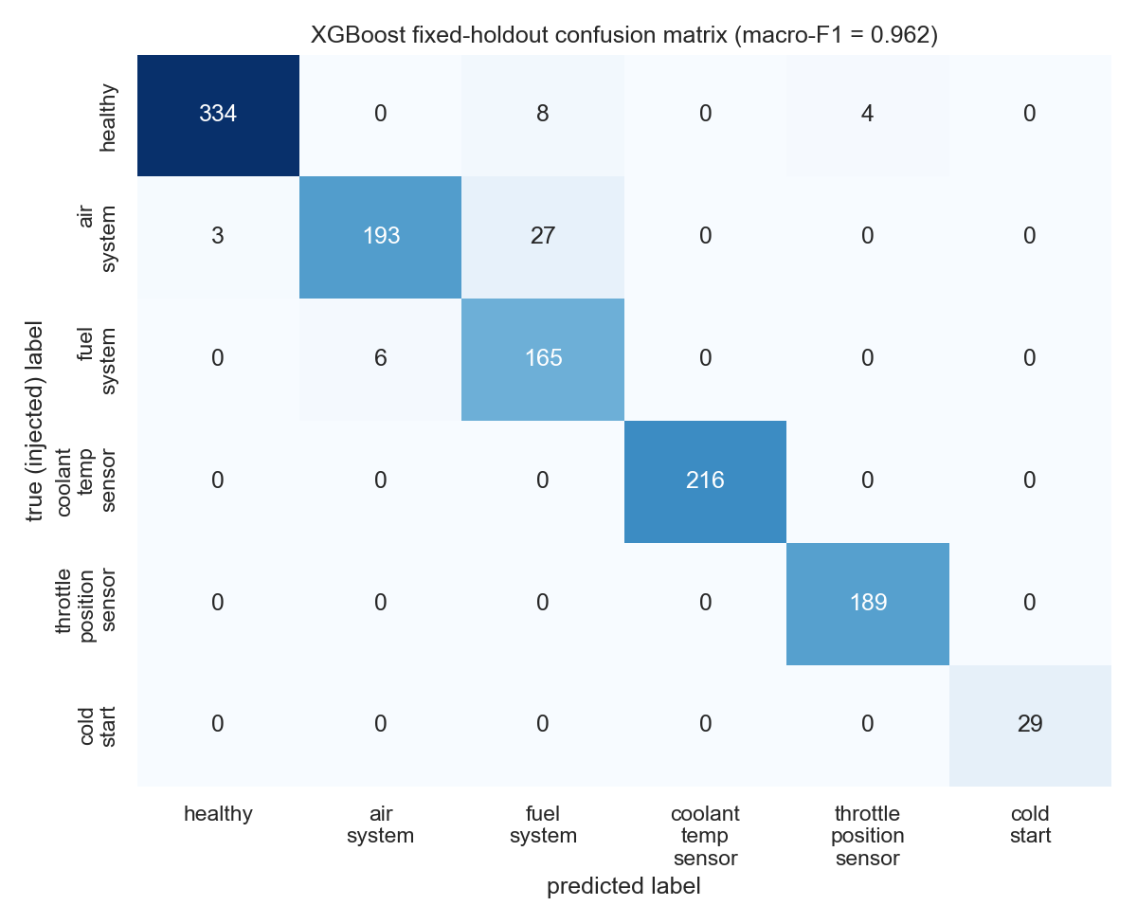
Results, read honestly
▪ Cross-context worst fold: macro-F1 0.958 (our headline)
▪ Hardest single session: 0.699 (the honest floor)
▪ Random Forest scored 1.000 — a memorization warning, not a win
▪ Withheld-settings gap only 0.033 — not just memorizing
▪ All numbers are synthetic self-consistency, not field detection
Fixed-holdout confusion matrix (macro-F1 0.962)
AAST — Computer Engineering | Predictive Maintenance for OBD-II Engine Faults
16
Notes:
Lead with 0.958, not the 1.000. The perfect Random-Forest score is the tell that the synthetic task is memorizable; we report it as a warning on purpose.

Slide 17
The live dashboard
▪ Shows the classification, fuel trims, and SHAP live
▪ Severity strip comes from physics, not the forecaster
▪ End-of-read report: one plain verdict per fault
▪ Refuses to score when the data is insufficient
▪ Explains itself so a mechanic can check it
[FIGURE: Streamlit dashboard screenshot —
status banner, severity strip,
SHAP panel, end-of-read report]
AAST — Computer Engineering | Predictive Maintenance for OBD-II Engine Faults
17
Notes:
No screenshot is committed to the repo, so this is a placeholder. Grab a live screenshot before the defense.

Slide 18
Testing on a real (healthy) car
▪ Healthy 2015 Yaris — MAF-based, no MAP sensor
▪ Air fault correctly marked 'Untested'
▪ Only 7 of 169 windows evaluable → 'Insufficient data'
▪ That refusal is the correct answer, not a failure
▪ An earlier version wrongly cried '97% air fault' — we fixed it
AAST — Computer Engineering | Predictive Maintenance for OBD-II Engine Faults
18
Notes:
This non-result is our strongest evidence the reporting layer works. The old version guessed with 97% confidence on a healthy car; the new one says 'I can't test this'.

Slide 19
What comes next
▪ Real fault data — the one change that matters most
▪ Live phone → cloud server feed (FastAPI, already built)
▪ Apache Kafka to score many cars at once
▪ Per-regime baselines and more fault shapes
▪ One real recording turns 'algorithm' into 'validated detector'
AAST — Computer Engineering | Predictive Maintenance for OBD-II Engine Faults
19
Notes:
Order is by impact, not chronology. Real data is item one because it is the only thing that converts synthetic scores into field proof.

Slide 20
Conclusion
▪ Built: a physics fault injector and a cross-vehicle detector
▪ Built: a live dashboard with an honest health report
▪ It reports what it cannot test and refuses to guess
▪ Not built: a proven real-fault detector — that needs real data
▪ The discipline of refusal is the real contribution
AAST — Computer Engineering | Predictive Maintenance for OBD-II Engine Faults
20
Notes:
Close on the honest framing. Fewer confident-looking numbers, but a tool you could actually trust on a car.

Slide 21
Thank you
Questions & discussion
github.com/AdamMohamedOmar/Predictive-MaintenanceV1
21

