Slide 1

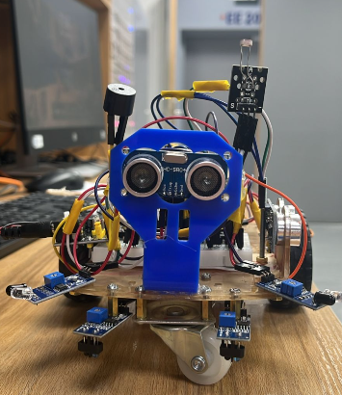
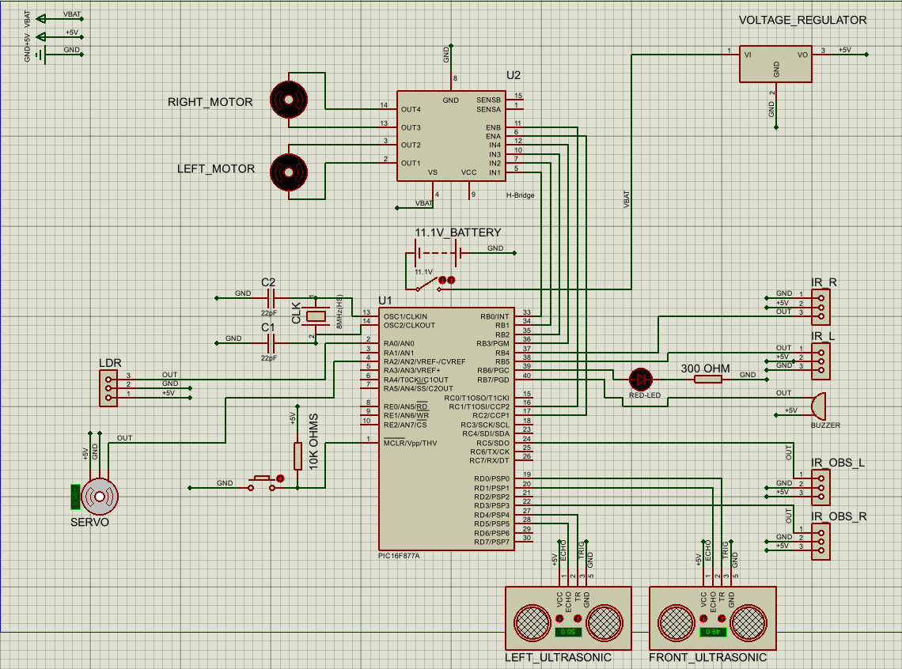
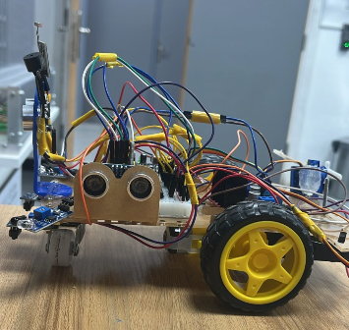
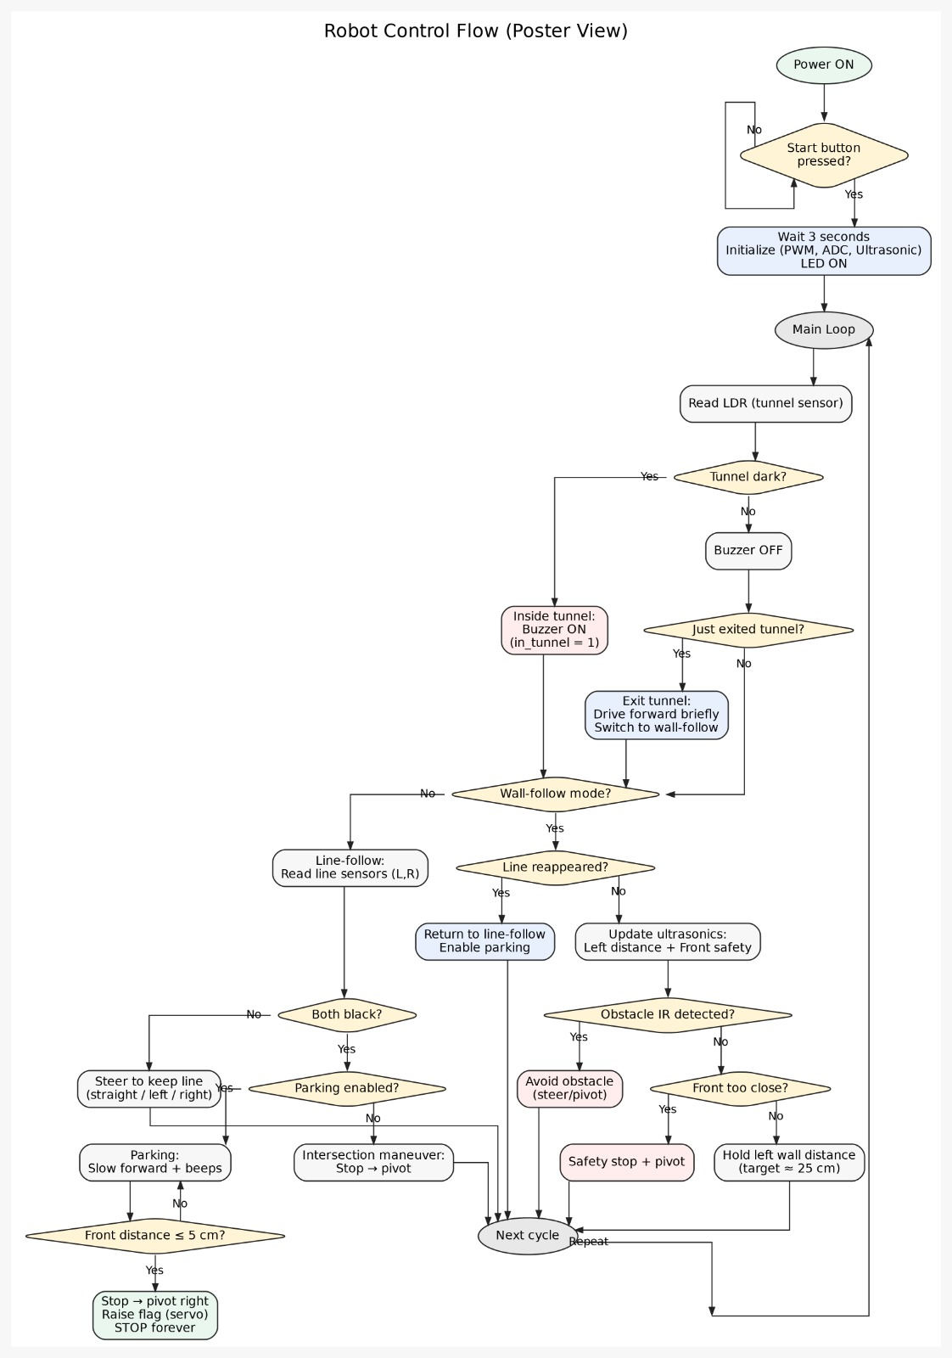

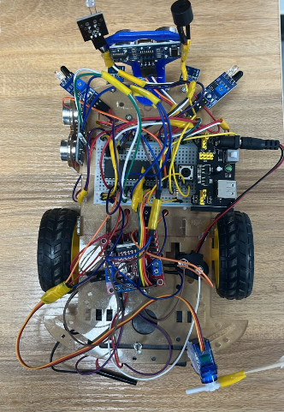
Autonomous Mobile Robots Challenge
M.Radwan,A.Habib,A.Alkhatib
Supervisor: Dr. Belal Sababha, Prof.Esam Al Qaralleh
Embedded Systems Final Design Project, Fall 2025
King Abdullah II School of Engineering
Princess Sumaya University for Technology
Introduction
This project focuses on the design and implementation of an autonomous mobile robot capable of navigating its environment without human intervention. The robot uses multiple sensors to follow paths, detect obstacles, and respond to changes in light conditions. Mechanical construction, electronic hardware, and embedded software were integrated to achieve reliable autonomous behavior.
Results
The robot successfully performed line following, obstacle detection, and light-based environmental response. Sensor inputs were processed in real time, enabling smooth motor control and reliable transitions between operating modes. The system operated autonomously and consistently under different test conditions.
Design
Figure(3):Front view
Figure(1): Electrical design
Figure(4):side view
Figure(2):Software design
Figure(5):top view
Conclusion
The project successfully demonstrates an autonomous robotic system that integrates sensing, control, and actuation. Through effective mechanical design and embedded programming, the robot was able to operate reliably and respond correctly to its environment. This work strengthened practical understanding of embedded systems and autonomous robotics.

