Slide 1



DARK EVIL GAME
This project created by :
Adam Najar
Tamim Amemi
Mohamed Yassine Attia
Iheb zeddini

Slide 2


Project Goals
the objective of this project is to create a 2D game by mastering our knowledge of language c with the SDL 1.2 library and to properly associate the arduino controller

Slide 3


Story Game
Description
All i remenber is that night.. The dragon of darkness closed the portal of the sun. All light is gone .All creatures are no more than dark figures .There is nothing left but eternal suffering… Darkness and the total absence of light give way
to base actions. So Orcs (character) defeat the black Dungean,save the light and overcome the eternal darkness by annihilating the dragon .

Slide 4
Video of the implementation

Slide 5
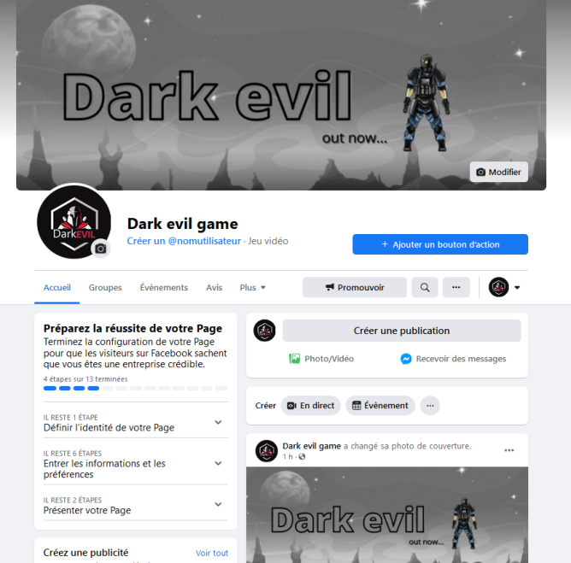
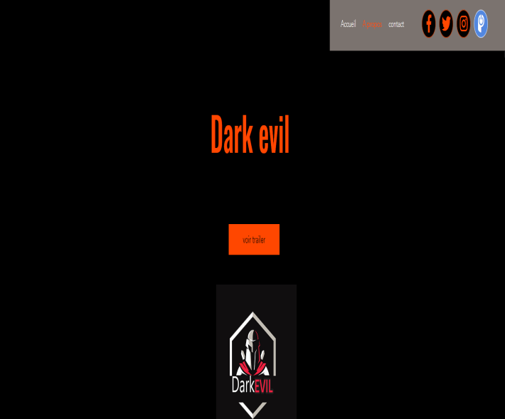
Marketing
we have created an official site where you can find the description and the trailer of the game which we droped the trailer on youtube and we created a facebook page
we will be guest in a tunisian podcoast to promote our game
https://www.facebook.com/Dark-evil-game-100584505560997

