Slide 1


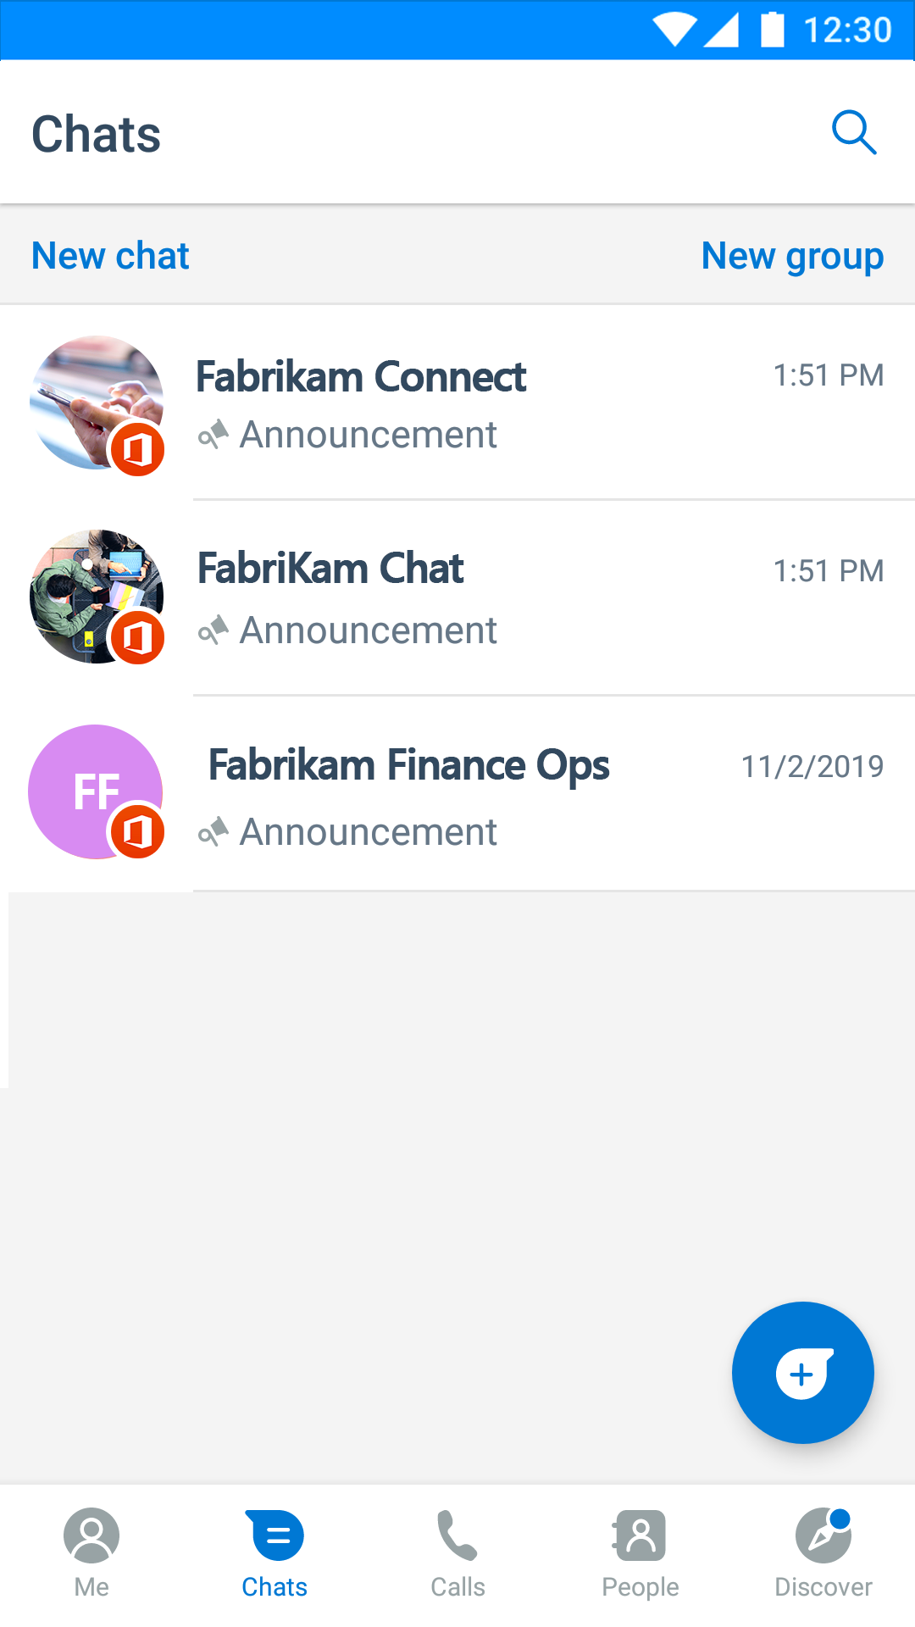

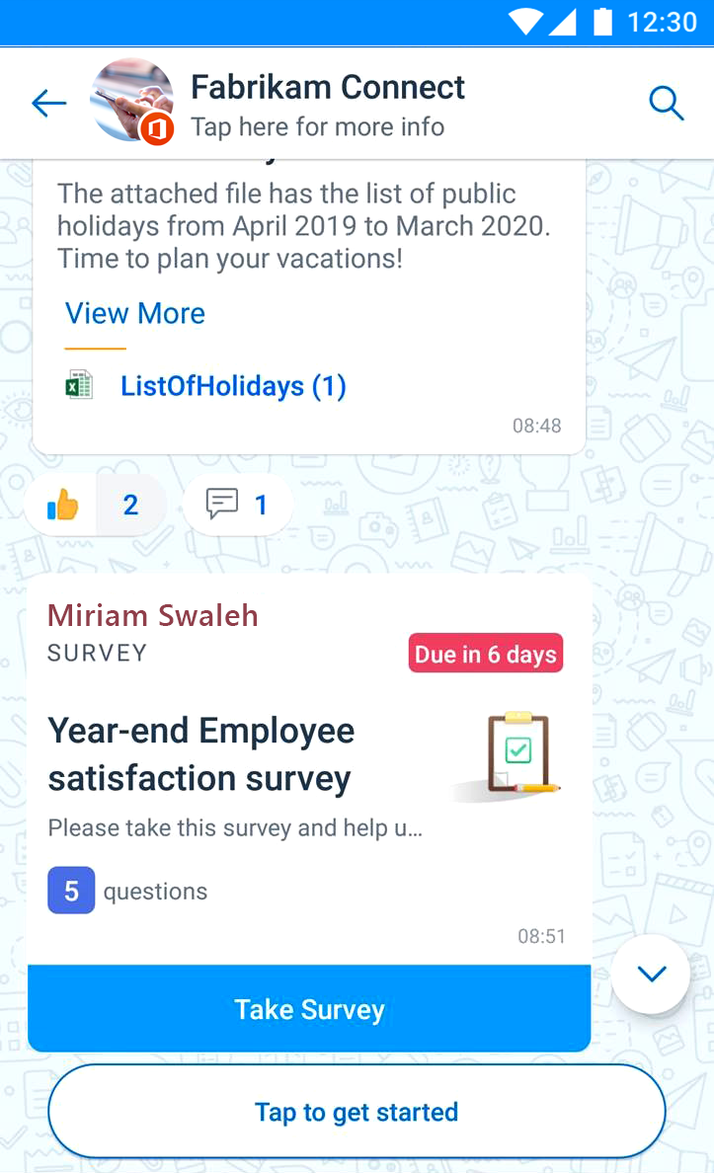





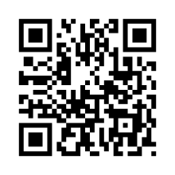



FABRIKAM launches
Kaizala
A Simple & Secure Mobile Chat App for work
Why Kaizala?
Find your contacts in one place
Connect with ALL your co-workers, suppliers and partners inside and outside FABRIKAM. Simply search for contacts and start chatting!
Stay Connected with FABRIKAM
Receive latest company updates, policy notifications, trainings and share your
feedback with FABRIKAM connect group.
Join Chat groups for work
Chat with coworkers, take part in discussions and share knowledge in FABRIKAM Chat and other similar groups.
Digitize everyday tasks
Save time and increase efficiency for processes like field data collection, attendance, trainings, surveys and many more.
FB
FB
Fabrikam
Fabrikam
App Installation Steps
Available on
1. Scan the QR code to install Kaizala app
2. Tap on icon
FABRIKAM Connect Group
FABRIKAM Chat
3. Select Join Group
QR code goes here
QR code goes here

