Slide 1



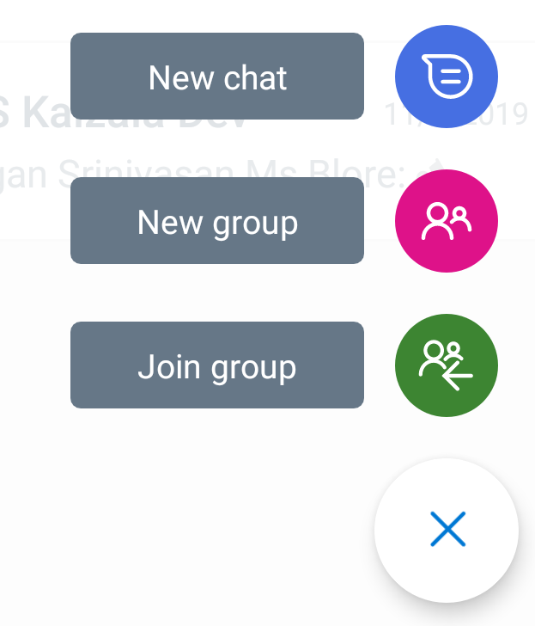

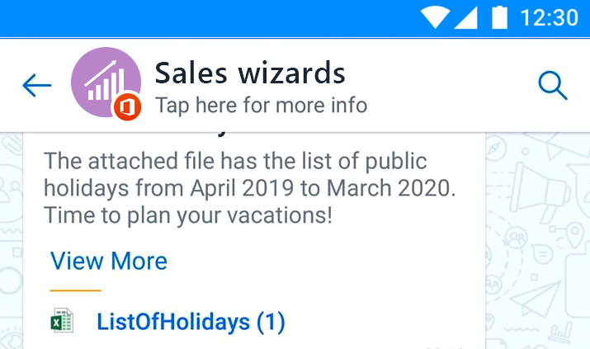
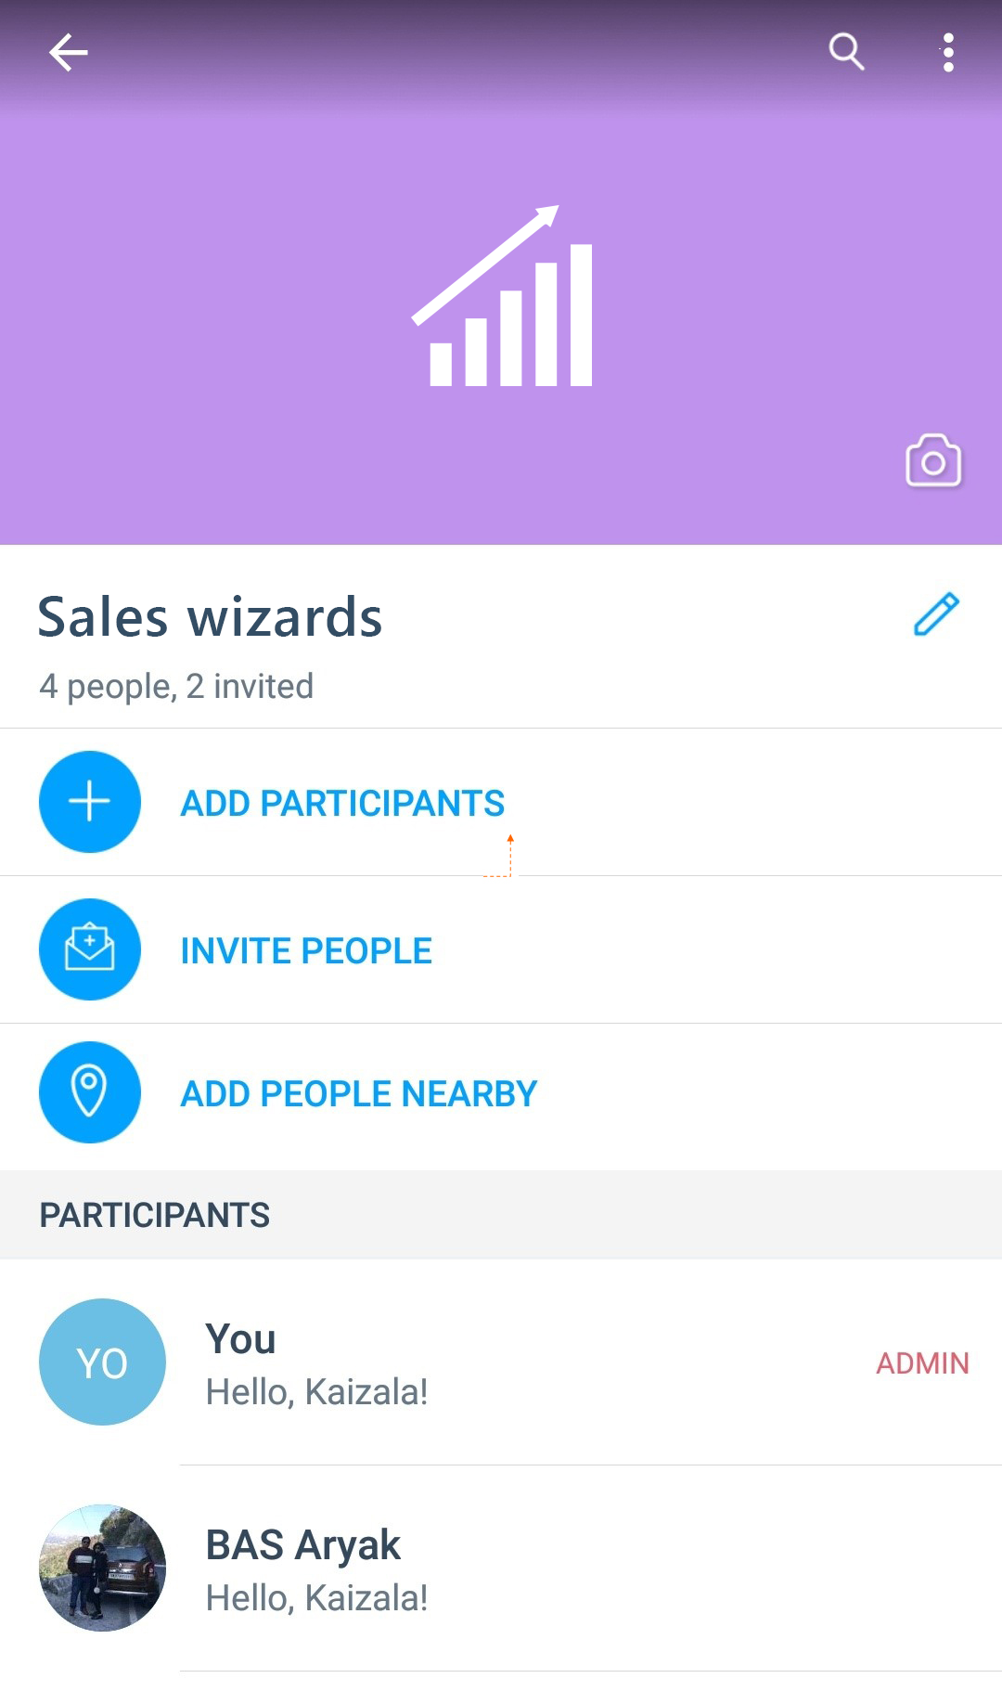



Move your groups to
Kaizala
Here’s how!
Follow these simple steps to move your work chats to Microsoft Kaizala
1
Open Kaizala on your phone, tap on the plus icon and then select new group. Follow the steps to create a group.
Now that the group is all setup, lets invite your colleagues. Open the group and tap on the group name in the header.
2
3
Select Invite people option and share the group link on your existing group on the other chat app.
Now let’s add the group to organization to help protect the organization data. Tap on the more options.
4
Disable chat history
Mute
Leave
Add to organization


5
Select ‘Add to organization’ option and follow the steps to successfully add the group to organization.
FB
Fabrikam

