Slide 1
CO
CH₂O
vinoxy
npropyloxy
frag_1
npropylooh
prod_1
well_1
ipropyl
allyloxy
prod_2
propoxide
C₃H₆
acrolein

Slide 2
CO
CH₂O
vinoxy
OH
npropyloxy
frag_1
npropylooh
prod_1
well_1
ipropyl
allyloxy
prod_2
propoxide
C₃H₆
acrolein

Slide 3
CO
CH₂O
vinoxy
OH
npropyloxy
frag_1
npropylooh
prod_1
well_1
ipropyl
allyloxy
prod_2
propoxide
C₃H₆
acrolein

Slide 4
CO
CH₂O
- OH
- OH
vinoxy
OH
npropyloxy
- OH
frag_1
npropylooh
- OH
prod_1
- OH
well_1
ipropyl
- OH
allyloxy
- OH
prod_2
propoxide
C₃H₆
acrolein

Slide 5
CO
CH₂O
- OH
- OH
vinoxy
OH
npropyloxy
- OH
frag_1
npropylooh
- OH
prod_1
- OH
well_1
ipropyl
- OH
allyloxy
- OH
prod_2
propoxide
C₃H₆
acrolein

Slide 6
CO
CH₂O
npropyloxy
vinoxy
OH
frag_1
npropylooh
prod_1
well_1
ipropyl
allyloxy
prod_2
propoxide
C₃H₆
acrolein

Slide 7
CO
CH₂O
npropyloxy
vinoxy
OH
frag_1
npropylooh
prod_1
well_1
ipropyl
allyloxy
prod_2
propoxide
C₃H₆
acrolein

Slide 8
CO
CH₂O
npropyloxy
OH
vinoxy
npropylooh
propoxide
frag_1
prod_1
well_1
ipropyl
acrolein
C₃H₆
prod_2
allyloxy

Slide 9
All chemistry using top 10 pathways v1
CO
CH₂O
npropyloxy
OH
vinoxy
npropylooh
propoxide
frag_1
prod_1
well_1
ipropyl
acrolein
C₃H₆
prod_2
allyloxy

Slide 10
All chemistry using top 10 pathways v1
CO
CH₂O
npropyloxy
OH
vinoxy
npropylooh
propoxide
frag_1
prod_1
well_1
ipropyl
acrolein
C₃H₆
prod_2
allyloxy

Slide 11
OH catalytic cycles using top 10 pathways
OH
vinoxy
npropylooh
frag_1
prod_1
well_1
prod_2

Slide 12
All chemistry using top 10 pathways
OH
vinoxy
npropylooh
frag_1
prod_1
well_1
prod_2

Slide 13
OH
vinoxy
npropylooh
frag_1
prod_1
Npropyl⬄
Npropyloo⬄
well_1⬄
QOOH_1
prod_2

Slide 14
OH
vinoxy
npropylooh
frag_1
prod_1
Npropyl⬄
Npropyloo⬄
well_1⬄
QOOH_1
prod_2

Slide 15
All chemistry using top 10 pathways v2
fuel
OH
npropyloxy
propoxide
vinoxy
frag_1
prod_1
well_1
npropylooh
prod_2
ipropyl
CO
CH₂O
C₃H₆
allyloxy
acrolein

Slide 16
All chemistry using top 10 pathways v2
CO
fuel
OH
npropyloxy
vinoxy
propoxide
well_1
frag_1
prod_1
npropylooh
prod_2
ipropyl
CH₂O
C₃H₆
allyloxy
acrolein

Slide 17
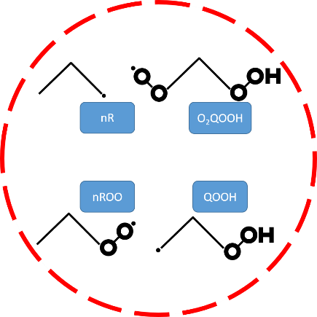
All chemistry using top 10 pathways v2
CO
fuel
OH
npropyloxy
vinoxy
propoxide
frag_1
prod_1
npropylooh
prod_2
ipropyl
CH₂O
allyloxy
HO₂
C₃H₆
acrolein

Slide 18
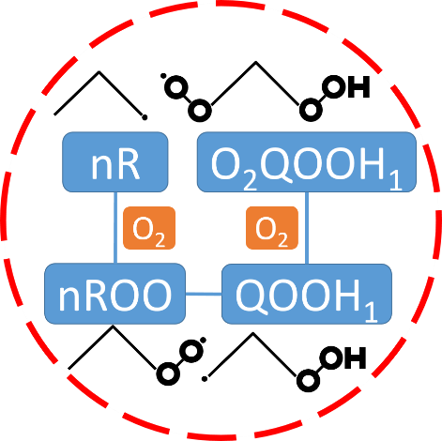
CO
OH
iR↔iROO
iROOH
HCO
vinoxy
iRO
OQ′O₁
OQ′OOH₁
acetaldehyde
CH₃↔CH₃OO
C₃H₈
nRO
nROOH
HO₂
CH₃OOH
CH₂O
CH₃CH₂ ↔ CH₃CH₂OO
CH₃CH₂OOH
ethoxy
O₂
C₃H₆
CH₃O

Slide 19
CO
OH
iR↔iROO
iROOH
HCO
vinoxy
iRO
OQ′O₁
OQ′OOH₁
acetaldehyde
CH₃↔CH₃OO
C₃H₈
nRO
nROOH
HO₂
CH₃OOH
CH₂O
CH₃CH₂ ↔ CH₃CH₂OO
CH₃CH₂OOH
ethoxy
O₂
C₃H₆
CH₃O

Slide 20
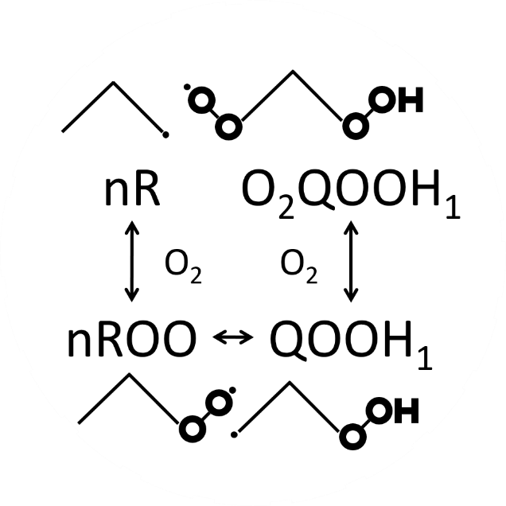
OH
CO
iR↔iROO
iROOH
vinoxy
iRO
R₂
acetaldehyde
OQ′O₁
OQ′OOH₁
CH₃↔
CH₃OO
C₃H₈
nROOH
R₁
HO₂
CH₃OOH
nRO
acetyl
CH₂O
CH₃CH₂↔
CH₃CH₂OO
CH₃O
HCO
CH₃CH₂OOH
ethoxy
O₂
C₃H₆

Slide 21
OH
CO
iR↔iROO
iROOH
vinoxy
iRO
R₂
acetaldehyde
OQ′O₁
OQ′OOH₁
CH₃↔
CH₃OO
C₃H₈
nROOH
R₁
HO₂
CH₃OOH
nRO
acetyl
CH₂O
CH₃CH₂↔
CH₃CH₂OO
CH₃O
HCO
CH₃CH₂OOH
ethoxy
O₂
C₃H₆

Slide 22
OH
CO
iR↔iROO
iROOH
vinoxy
iRO
R₂
acetaldehyde
OQ′O₁
OQ′OOH₁
CH₃↔
CH₃OO
C₃H₈
nROOH
R₁
HO₂
CH₃OOH
nRO
acetyl
CH₂O
CH₃CH₂↔
CH₃CH₂OO
CH₃O
HCO
CH₃CH₂OOH
ethoxy
O₂
C₃H₆

Slide 23
CO
OH
iR↔iROO
iROOH
vinoxy
iRO
R₂
acetaldehyde
OQ′O₁
OQ′OOH₁
CH₃↔
CH₃OO
C₃H₈
nROOH
R₁
HO₂
CH₃OOH
nRO
acetyl
CH₂O
CH₃CH₂↔
CH₃CH₂OO
CH₃O
HCO
CH₃CH₂OOH
ethoxy
O₂
C₃H₆

Slide 24
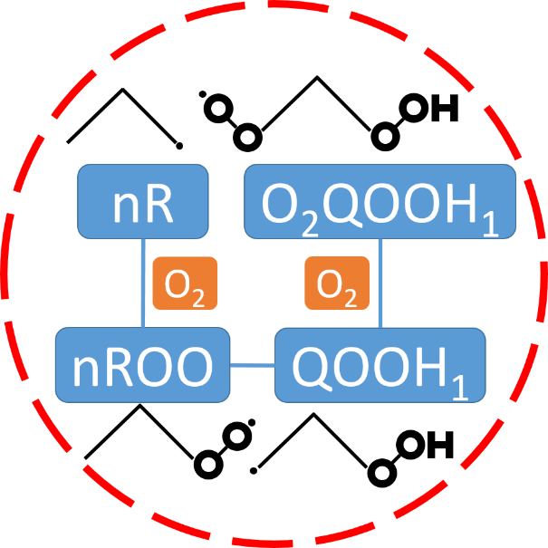
CO
OH
iR↔iROO
iROOH
vinoxy
iRO
R₂
acetaldehyde
OQ′O₁
OQ′OOH₁
CH₃↔
CH₃OO
C₃H₈
nROOH
R₁
HO₂
CH₃OOH
nRO
acetyl
CH₂O
CH₃CH₂↔
CH₃CH₂OO
CH₃O
HCO
CH₃CH₂OOH
ethoxy
O₂
C₃H₆

Slide 25
CO
OH
iR↔iROO
iROOH
vinoxy
HCO
iRO
acetaldehyde
OQ′O₁
OQ′OOH₁
CH₃↔CH₃OO
C₃H₈
nROOH
R1
HO₂
CH₃OOH
nRO
acetyl
C₃H₆
CH₂O
CH₃CH₂↔
CH₃CH₂OO
O₂
CH₃O
CH₃CH₂OOH
ethoxy

Slide 26
CO
OH
iR↔iROO
iROOH
vinoxy
HCO
iRO
acetaldehyde
OQ′O₁
OQ′OOH₁
CH₃↔CH₃OO
C₃H₈
nROOH
R1
HO₂
CH₃OOH
nRO
acetyl
C₃H₆
CH₂O
CH₃CH₂↔
CH₃CH₂OO
O₂
CH₃O
CH₃CH₂OOH
ethoxy

Slide 27
CO
OH
iR↔iROO
iROOH
vinoxy
HCO
iRO
acetaldehyde
OQ′O₁
OQ′OOH₁
CH₃↔CH₃OO
C₃H₈
nROOH
R1
HO₂
CH₃OOH
nRO
acetyl
C₃H₆
CH₂O
CH₃CH₂↔
CH₃CH₂OO
O₂
CH₃O
CH₃CH₂OOH
ethoxy

Slide 28
CO
OH
iR↔iROO
iROOH
vinoxy
HCO
iRO
acetaldehyde
OQ′O₁
OQ′OOH₁
CH₃↔CH₃OO
C₃H₈
nROOH
R1
HO₂
CH₃OOH
nRO
acetyl
C₃H₆
CH₂O
CH₃CH₂↔
CH₃CH₂OO
O₂
CH₃O
CH₃CH₂OOH
ethoxy

Slide 29
CO
OH
iR↔iROO
iROOH
vinoxy
HCO
iRO
acetaldehyde
OQ′O₁
OQ′OOH₁
CH₃↔CH₃OO
C₃H₈
nROOH
R1
HO₂
CH₃OOH
nRO
acetyl
C₃H₆
CH₂O
CH₃CH₂↔
CH₃CH₂OO
O₂
CH₃O
CH₃CH₂OOH
ethoxy

Slide 30
CO
OH
iR↔iROO
iROOH
vinoxy
HCO
iRO
acetaldehyde
OQ′O₁
OQ′OOH₁
CH₃↔CH₃OO
C₃H₈
nROOH
R1
HO₂
CH₃OOH
nRO
acetyl
C₃H₆
CH₂O
CH₃CH₂↔
CH₃CH₂OO
O₂
CH₃O
CH₃CH₂OOH
ethoxy

Slide 31
CO
OH
iR↔iROO
iROOH
vinoxy
HCO
iRO
acetaldehyde
OQ′O₁
OQ′OOH₁
CH₃↔CH₃OO
C₃H₈
nROOH
R1
HO₂
CH₃OOH
nRO
acetyl
C₃H₆
CH₂O
CH₃CH₂↔
CH₃CH₂OO
O₂
CH₃O
CH₃CH₂OOH
ethoxy

Slide 32
CO
OH
iR↔iROO
iROOH
vinoxy
iRO
OQ′O₁
OQ′OOH₁
C₃H₈
CH₃↔CH₃OO
nROOH
CH₃OOH
nRO
CH₃CH₂↔
CH₃CH₂OO
CH₃O
CH₃CH₂OOH
ethoxy

Slide 33
species

Slide 34
Chattering group
nR
O₂QOOH
O₂
O₂
nROO
QOOH

Slide 35
Chattering group
nR
O₂QOOH₁
O₂
O₂
nROO
QOOH₁

Slide 36
Chattering group
nR
O₂QOOH₁
O₂
O₂
nROO
QOOH₁

Slide 37
Chattering group
nR
O₂QOOH₁
O₂
O₂
nROO
QOOH₁

Slide 38
Chattering group
nR
O₂QOOH₁
nR
O₂QOOH
O₂
O₂
O₂
O₂
nROO
QOOH
nROO
QOOH₁

Slide 39
Chattering group
nR
O₂QOOH
O₂
O₂
nROO
QOOH

