Slide 1


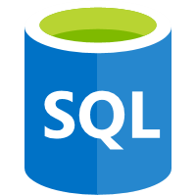







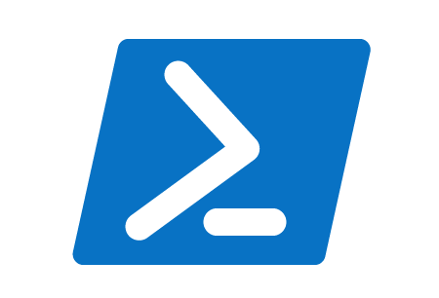

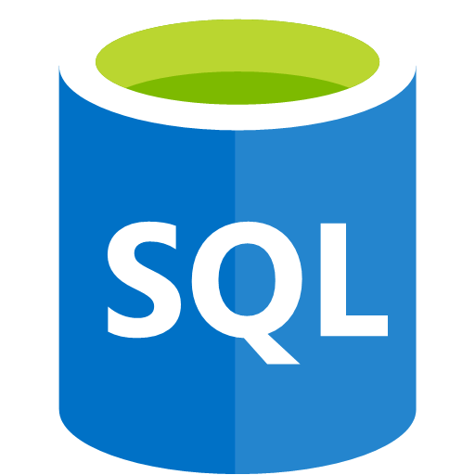

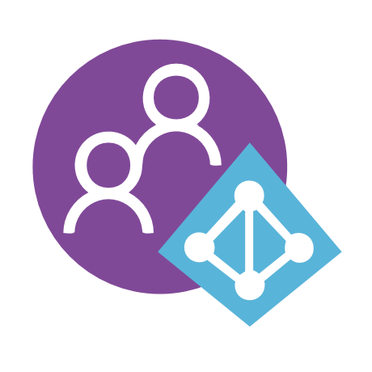
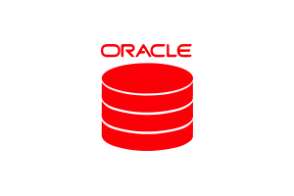




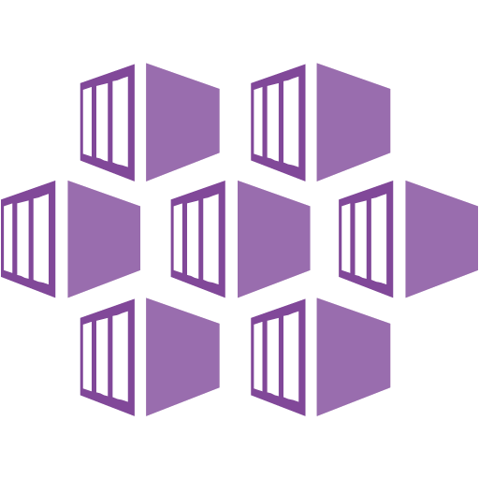





Big Data / Machine Learning One-Click Azure Solution
Ingestion
Process Ingestion
Transformations / Data Lake
“Interactive” Query
Reporting / Semantic Layer
FTP
Schema
Data Share
cURL
Option 1: SQL On-Demand
Batch Ingestion
Serverless
Data Flows
Wrangling
Data Lake
Power BI
Databricks
Option 2: Databricks
Change Data Capture
Databricks
Streaming Ingestion
Publish
Consume
Data Exploration
ML Training
Model Hosting
Model Scoring
Data Catalog
Dev Ops and ML Ops
Security and Secret Management
Logging and Monitoring

Slide 2
Data Lake Architecture - Notes
Which Query option to choose This architecture assumes you are using PowerBI with its composite modeling capability.
SQL On-Demand is new and is not meant for quick interactive query performance. This is great for reports that refresh overnight or have very few hits that cause Power BI to execute a direct query.
Databricks is an option but does not support a high degree of concurrency or workload management. This can work for when you have few queries that need to pushed from PowerBI to Spark. A large amount of queries will cause issues and most reporting tools generate SQL for relational database which can pose a problem for Spark SQL.
Other Options
SQL Hyperscale Database is used for its row level security and can grow to 100+ TB. SQL Database is great for handling lots of concurrency (it has read only replicas as well) and can also be queried directly from REST APIs or such. It is typically cheaper than spinning up a data warehouse.
SQL DW is required when your queries are too big to be executed on a single server. If your workload can be handled by SQL Hyperscale then that is typically your first option (you have large amounts of data, but your queries do not require scale out). When your queries cause SQL Database to fail to handle requests then you need to start using a MPP database.

Slide 3



Customer Learnings:
Do not let customers directly bind to storage accounts. You will eventually need to rotate your storage keys and/or upgrade accounts to new ones.
You need to support many options with the goal of the next stage of the ingestion process to be abstracted from these options.
Ingestion Zone (Landing Files to Blob Storage)
This represents how to land files that are being transferred from 3rd parties to your data lake. FTP is still highly utilized so a pattern is provided. The more modern technique allows customers to upload directly to cloud storage which eliminates the need to transfer from FTP sites.
Option 1: REST API / Az Copy / cURL / PowerShell / Bash / Etc.
Option 2: On-Prem / Existing - FTP
Option 3: Azure Hosted FTP
Step 1
Upload
The customer calls an Azure Function that passes in their secret (provided by your organization) which returns a SAS token of where to upload.
You should support calls such as:
Rotate Secret
Get SAS Token
FTP Server
ADF runs on a schedule to pull files from the FTP server.
Upload
Blobfuse
Currently, blobfuse does not work with ADLS Gen 2. This would need to be a separate storage account
This is the preferred modern method.
Step 2
Upload
You will need to configure your FTP software for high availability.
The customer uploads their files using the SAS token using the technology of their choice.

Slide 4
Customer Learnings:
Allow for Windows or Linux
Do not expose anything Azure to the customer in terms of dependencies. Customers should be able to upload files with any required Azure APIs.
Ingestion Zone (Landing Files to Blob Storage)
This is the details the Option 1 approach for customers uploading their own files.
NOTE: The storage account is an Azure Blob v2 with Hierarchical namespace enabled. This account type will support Events and will allow ADF to copy data from the storage account when Events are enabled. A V2 account, with events, without Hierarchical namespace is not currently supported when copying files with ADF.
Option 1: REST
Goals
Do not expose the exact DNS/storage account to the customer since these could change.
Do not send a SAS token with long expiration (security risk).
Be able to rotate storage keys on your storage account.
File Upload
Customer is delivered a Secret (not a SAS token) they need to keep safe in order to request SAS tokens.
Customer calls with their secret to a REST API (Azure Functions also require a code to call which is an additional layer of security).
The secret is verified
A container is created if it does not exist
The following is returned
Storage account name (this allows you to change the storage account in the future and does not tie the customer to the exact DNS)
Container name (this allows you to have a separate container per customer)
A short-lived SAS token is provided which only has write (upload) access
If an employee leaves, he/she cannot read the uploaded files
They could “overwrite” files (if they knew the name) or they could upload “random” files
Security
Azure Function could be whitelisted for customers IP address. This only works if all the customers have a known IP.
The SAS token could have the callers IP address embedded as part of the signature.
This means if the SAS token was emailed to another party, they could not use to upload data.
The Azure storage account used for uploading files is isolated from other storage accounts in your Azure subscription.
Secret Rotation (Optional)
Customer would call the REST API with their existing key and receive a new key.
Customer would be responsible for rotating their own keys on a set schedule.
If customers fail to rotate, then they would need to call and have their secret reset manually.
Rotating the secrets really depends on how sophisticated the customer is at IT. A lot of customers use (s)FTP(s) and never rotate their FTP passwords.
Step 1
Step 2
Upload

Slide 5
Customer Learnings:
Pulling in reference data to the lake makes for faster processing than pulling the data using Spark and/or trying to reference the data between Spark and other data stores. With Spark you want to optimize your parallelism with files loading directly to each worker nodes versus using database connections that require the driver node which can introduce bottlenecks.
Ingestion Zone (Data to Blob Storage)
This represents how to copy data from your data lake from 3rd parties where your system can pull the data. On-prem and cloud databases can also be considered external data sources for your data lake your system will need to ingest.
Relational or Data Stores
ADF runs on a schedule to pull full or incremental data to land on the lake.

Slide 6
Customer Learnings:
Customer who bind directly to blob triggers have had issues. ADF can take a long time to disable/enable triggers during deployments (hours).
Binding all events together makes A/B testing difficult and makes pausing your system difficult. By letting items queue your system will have more control.
By inserting an item into the queue a file can be re-processed.
Ingestion Zone (File Processing)
Once files have been ingested basic processing will need to be performed such as un-zipping, decrypting and possibly re-assembly of some files. Once the files have landed, a trigger is fired to start the process. Some processes start on a per file bases; others require several uploads which requires indication that all files have been transferred. A meta-data store of CosmosDB is used to store information about what, when and if processes should be executed. This acts as a basic job meta-data store (and can be replaced by more complex software if required).
Triggering Processing
Stores if the system is ready for processing (or paused). This can customer information or whatever criteria you need for file processing.
Blob Created Event
Event Grid Schema
REST API Call
Data Lake -> Landing Zone
On the storage account (from the prior slide), an Event is configured for Blob Created event. This event can have filters for only raising events for certain files.
A check is needed to ensure the file is fully written since this is a blob created event and not completely written event.
If the customer is uploading multiple files, then you want to have the customer write a “completed-upload” marker file. You will filter for this event.
An Azure Queue is used for simplicity. Azure Storage Explorer lets you easily view the queue.
Service Bus can be used instead of blob queues configured to remove duplicates in case of duplicated events.
The Azure Function will run on a schedule and poll the queue. The reason for this is the system should be able to pause processing. If the Azure Function is event bound, then you would need to disable the Azure Function to pause.
Uses the ADF Copy activity to unzip files to the landing zone in your data lake. If you need to un-zip large files or decrypt files you need to write a custom ADF activity or use Azure Batch for processing of these files.
The unzipped files are now in data lake.

Slide 7
Customer Learnings:
Determining your partitioning strategy can be complicated and ensure that your Modeled state is desired for performance.
You can hide the file paths of your data lake by placing Hive (or tables) on top of your lake and hiding the files.
If you are using Databricks you can use DBFS path for Hive tables (some systems understand this), if not you should use the full ADLS path
Data Lake Zones / Partitioning
This represents how data moves through your data lake. The zones can be named anything you prefer, but the basic strategy should be followed.
Landing Zone
Raw Zone “Bronze”
Obfuscated Zone
Transformed “Silver”
Enriched “Gold”
Modeled
Data Sharing
This contains the files without any processing (exactly how they arrived from the customer/3rd party). They will typically be un-zipped/decrypted at this point.
Files should be partitioned. For example: Customer | File Type | Year | Month | Day or Year | Month | Day | File Type
This will convert the files to parquet.
The files should be re-partitioned if necessary, for transformations.
Sensitive data is removed
PII data is removed
Credit card data is removed
This typically matches the Raw Zone partitioning
Data scientists will typically access this area of the data lake.
Data is transformed and normalized according to business rules of your organization.
There can be many transformation steps to manipulate the data.
The files should be re-partitioned if necessary, for enrichment.
Data is enriched with existing data, AI services, custom AI models, etc.
The enrichment of data does not necessarily mean the files need to be repartitioned.
Data is modeled to standard Star or Data Vault schema
Files are partitioned for query performance.
Data can be duplicated to partition more than one way. (Yes, data lakes can store data in more than one structure).
This area will also be used for direct query access by tools such as Spark SQL, Presto, Hive and SQL On-Demand.
Data is copied to a sharing area. This data can be placed in a format that is easy for customers to work with. Direct access could be provided to the modeled data, but this means a schema change would affect customers (this may or may not be desired)
Data Sharing can also be used as a materialization zone to ingest data into a data warehouse or tabular model. This materialization zone can be hidden or just a staging area for loading systems where the modeled data requires complex large Spark queries to process.

Slide 8

Customer Learnings:
Customers don’t always need a data warehouse for doing large scale reporting.
Customers might want a cube for “instant” reporting off a subset of data
Azure Analysis Services – Processing with SQL On-Demand
1
ADF starts the Databricks job (cluster auto starts/stops)
Workflow
2
ADF calls Azure Function
1
2
ADF Pipeline
Databricks
Azure Function
1
Databricks materializes model to partitioned parquet files on data lake.
The partitions should be the same partitioning as represented in AAS.
AAS Dynamic Refresher
1
1
Azure Function receives JSON
The function will scale AAS (if needed)
The function will add AAS partitions (as required)
The function will update data source credentials (not implemented)
The function will start the model refresh (by partitions)
The function will scale down AAS (if needed)
The function will pause AAS (if specified)
Data Flow
1
3
2
Databricks
Data Lake
SQL OD
Analysis Services
2
AAS will have a SQL Connection using a SQL Authentication as its data source.
AAS will calls a standard SQL View to load data
SQL OD - Security
3
SQL OD will have Views created (in advance). The views will point to the parquet files on the data lake outputted by Databricks
SQL OD will connect to the data lake via MSI credentials. The MSI account will have Storage Blob Data Contributor access
Azure AD users will be able to login to SQL OD with their Azure AD account. When accesses files on the data lake their Azure AD credentials will be passed through.
The AAS model will use a SQL username/password to access SQL OD. The SQL user will be mapped to use the MSI account that is part of Synapse. Any SQL auth accessing SQL OD will essentially be impersonating the MSI account. Therefore, caution should be used, since this account might have access to files beyond a persons normal Azure AD access.
CREATE CREDENTIAL [UserIdentity] WITH IDENTITY = 'User Identity'
CREATE CREDENTIAL [ManagedIdentity] WITH IDENTITY = 'Managed Identity'
TIP: If your SQL OD view has a lot of char columns you should specify the specific SQL Server schema in your view definition (e.g. VARCHAR(80). SQL OD would need to compute this otherwise which can take time. SQL OD will map parquet strings to VARCHAR(4000) by default.

Slide 9
Customer Learnings:
Security
Security can be implemented in many ways with the architecture depending on your IT needs. The below are some notes:
MSI
The entire solution uses MSI for resource to resource communications (not service principals)
Storage keys are in Key Vault which allows for key rotation
VNETs
VNET endpoints and Private Link can be implemented
Storage accounts can have whitelisted IPs and Azure AD ACLs on files/folders
Databricks can be on VNET
SQL Servers can be on a VNET or use Private link
SQL OD can use Azure AD pass-through security to the ACLs on the data lake.
If you implement VNETS you might need some self hosted integration runtimes within your VNET for intra-VNET security.
Azure AD
Azure AD auth can be used for the various components
Azure AD can do pass-through SQL Authentication which can then be used to do column and row level security the data inside each table
Other
Work in progress….

Slide 10
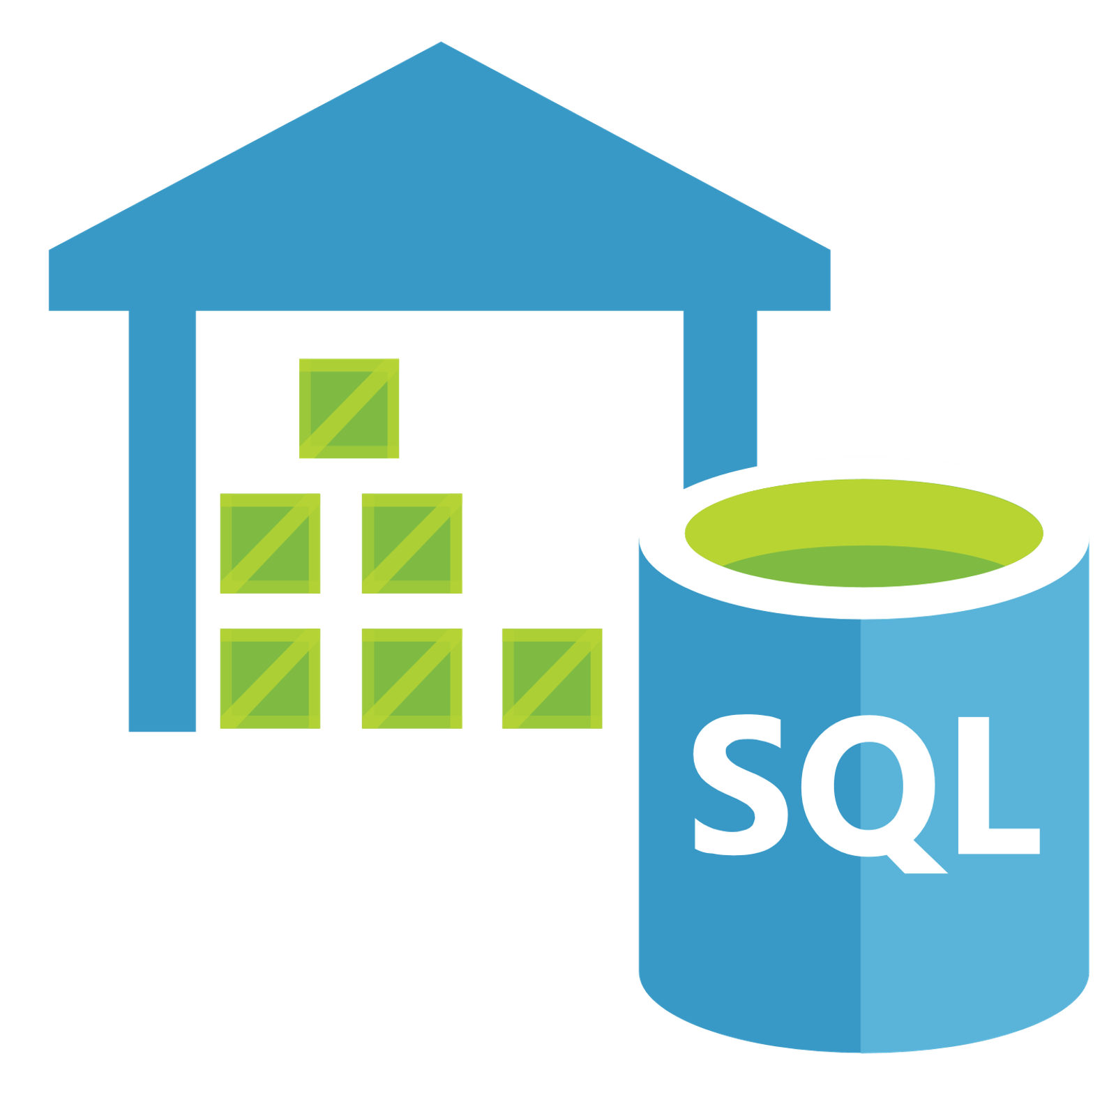
Big Data / Machine Learning One-Click Azure Solution
Ingestion
Process Ingestion
Transformations / Data Science
Query
Semantic Layer
Serve / Data Sharing
Data Flows or Databricks or Both
Option 1: SQL On-Demand
FTP
SQL On-Demand
Data is read directly from the lake
{ REST API}
Data Flows
Databricks
Serverless
REST API
cURL
Option 2: SQL Database(s)
ADF
Batch Ingestion
SQL Hyperscale
Data Share
Option 3: Data Warehouse
Data Lake
ADF
SQL Pools
Analysis Services
Power BI
Option 4: Databricks
Change Data Capture
Streaming Ingestion
Schema
Databricks
Real Time Streaming Reports
Publish
Consume
Data Exploration
ML Training
Model Hosting
Model Scoring
Data Catalog
Dev Ops and ML Ops
Security and Secret Management
Logging and Monitoring

Slide 11
Data Lake Architecture - Notes
Which Query option to choose This architecture assumes you are using PowerBI with its composite modeling capability. If that is not the case, see the next slide.
SQL On-Demand is new and is not meant for quick interactive query performance. This is great for reports that refresh overnight or have very few hits that cause Power BI to execute a direct query.
SQL Hyperscale Database is used for its row level security and can grow to 100+ TB. SQL Database is great for handling lots of concurrency (it has read only replicas as well) and can also be queried directly from REST APIs or such. It is typically cheaper than spinning up a data warehouse.
SQL DW is required when your queries are too big to be executed on a single server. If your workload can be handled by SQL Hyperscale then that is typically your first option (you have large amounts of data, but your queries do not require scale out). When your queries cause SQL Database to fail to handle requests then you need to start using a MPP database.
Databricks is an option but does not support a high degree of concurrency or workload management. This can work for when you have few queries that need to pushed from PowerBI to Spark. A large amount of queries will cause issues and most reporting tools generate SQL for relational database which can pose a problem for Spark SQL.
Notes:
Options 1, 2, 3 allow for row level security
Option 4 does not ingest the data to Databricks, the data is ingested to AAS
Composite models can be used which means AAS is inside Power BI. This will allow push down the Options 2,3, 4 for large queries that PowerBI with AAS cannot execute.
The system will also have components to process the Analysis Service Cube and for providing 3rd parties SAS upload tokens
Upload Provider
Cube Processor

