Slide 1

Factors contributing to passenger traffic
Adam Peetz
Regis University
MSDS670 Week 8 Assignment
10/16/2022
Professor John Koenig
An exploration of correlating variables in airport traffic

Slide 2
What factors impact airport traffic?
Connectivity
Demand
Tourism
Business Travel
Competition
Source: (Rodrigue, 2020)

Slide 3
Purpose and Methodology
Purpose: Prove the correlation between connectivity, demand, and competition for the 5 busiest airports.
Methodology:
Identify top 5 busiest airports.
Use scatterplots to illustrate correlation between connectivity, demand, to airport traffic.
Use network graphs to visualize connectivity.
Compare neighboring airports to demonstrate effects of competition.
Datasets: Airport/traffic related datasets drawn from Kaggle. Please see references on each slide.
Used data from 2016 to standardize years to available routes data.
Tools: Python, MS Excel

Slide 4
The World’s Five Busiest Airport
Which airports served the most passengers?
Hartsfield–Jackson Atlanta Intl Airport (ATL)
United States
104.1M
94.3M
Beijing Capital Intl Airport (PEK)
China
Dubai Intl Airport (DXB)
United Arab Emirates
83.6M
80.9M
Los Angeles Intl Airport (LAX)
United States
79.6M
Tokyo Intl Airport (HND)
Japan
Source: (Jonah, 2017)

Slide 5
Money to Travel
How does GPD relate to passenger traffic?
Higher GPD means more money is available for spending on business and leisuree travel.
Both passenger traffic and the total number of airports on the top 50 list is correlated to GPD.
United States has 17 airports in top 50.
China has 7 airports in top 50.
Dubai does not fit the pattern, with more traffic but a lower GPD.
Dubai is notorious for its luxury.
DXB is the headquarters of Emirates Airlines, a major global carrier.
Los Angles
Atlanta
18.8T
12.2T
Beijing
GDP
4.1T
Frankfurt
Tokyo
Dubai
356B
35M
70M
104M
Passengers
Source: (Jonah, 2017) & (Paullier, 2022)

Slide 6
Well Connected
How does connectivity relate to passenger traffic?
250
Higher connectivity means more destinations are available from an airport.
Passenger traffic is strongly correlated to the number of connection an airport has.
Most connections belongs to Frankfurt in Germany, with 238 connections.
Tokyo, HND, the 5th highest airport does not fit this pattern.
Tokyo is the largest city in the world, with 39 million people.
Japan has the 3rd highest GDP, a variable correlated to traffic.
Frankfurt, 238
Atlanta, 216
Beijing, 206
Dubai, 182
150
Los Angles, 148
Connections
Tokyo, 74
50
35M
70M
104M
Passengers
Source: (Jonah, 2017) & (Potakillio, 2017)

Slide 7
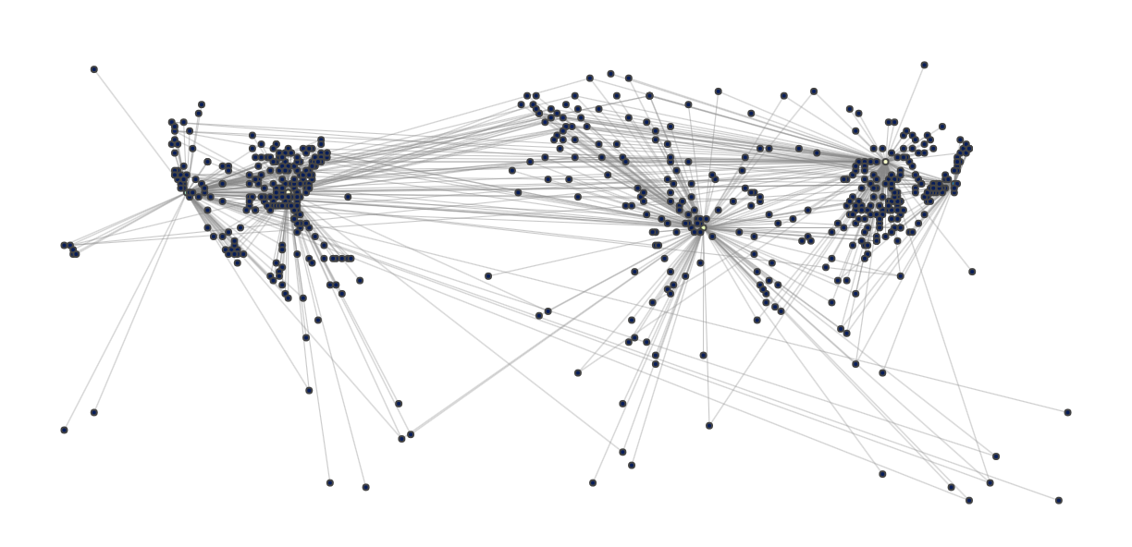
Geographic Connectivity
Where could you fly from the top 5 airports?
Beijing, 206
Atlanta, 216
Los Angles, 148
Tokyo, 74
Dubai, 182
Source: (Jonah, 2017), (Potakillio, 2017), & (Yoihenba, 2022)

Slide 8
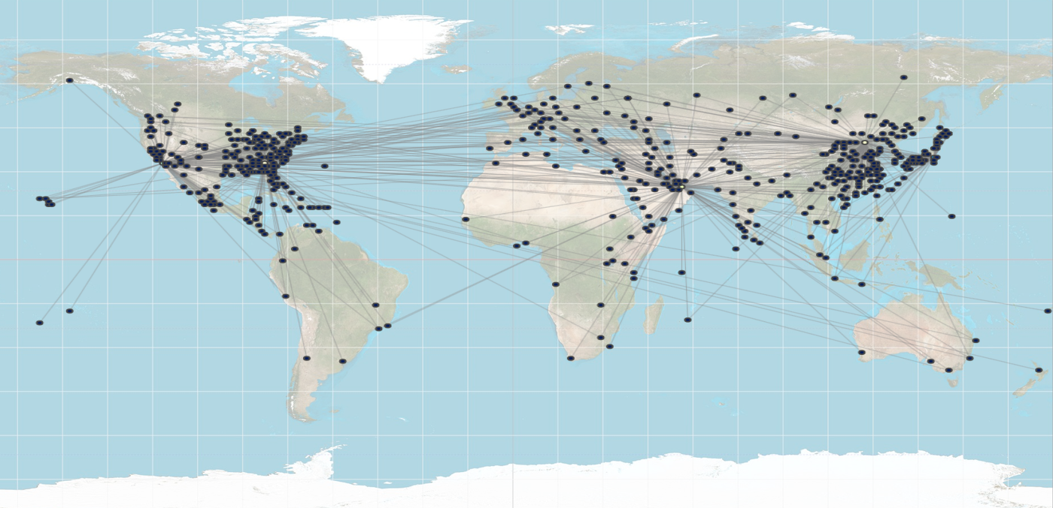
Equirectangular Overlay
Source: (Jonah, 2017), (Potakillio, 2017), (Wikipedia, 2022), & (Yoihenba, 2022)

Slide 9
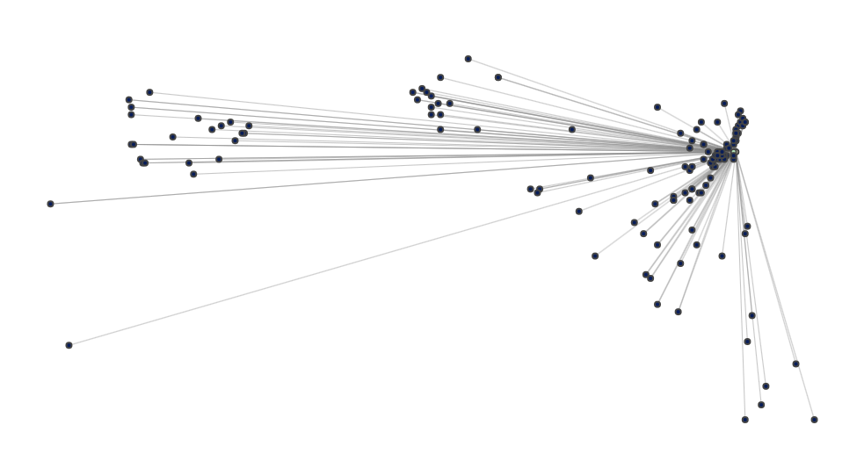
Competition
Haneda vs Narita in Tokyo
Competition between local airports effects passenger traffic.
Tokyo is the largest city in the world and Japan has a high GPD.
HND and NRT are less than 80 kilometers (1-hour drive) from each other in Tokyo.
If their passenger traffic was combined, they would have the highest traffic numbers in the world
They share connections to 34 airports including other large international airports such as Los Angeles, Atlanta, Beijing, and Dubai.
You can even catch a flight from HND to NRT and skip the 1-hour drive.
 | HND | NRT
Rank | 5 | 48
Passengers | 79.6M | 39.0M
Connections | 74 | 103
34 Shared Connections, including LAX, ATL, DXB, and PEK
About 80 km Apart
Source: (Jonah, 2017), (Potakillio, 2017), (Paullier, 2017), & (Yoihenba, 2022)

Slide 10
Conclusions
Passenger traffic is correlated to GDP.
So much that the countries with high GPD make up a large portion of the top 50 airports.
Passenger traffic is correlated to connectivity.
Flights can be booked to pretty much anywhere in the world from the 5 listed airports.
Airports are concentrated in the northern hemisphere.
Competition from nearby airports will reduce the number of passengers and airport services regardless of GDP and connectivity.

Slide 11
References
Jonah, Mary. (2017). Busiest Airports by Passenger Traffic. Kaggle.com. Retrieved 10/04/2022 from https://www.kaggle.com/datasets/jonahmary17/airports
Paullier, Alejo. (2022). GDP By Country 1999-2022. Kaggle.com. Retrieved 10/5/2022 form https://www.kaggle.com/datasets/alejopaullier/-gdp-by-country-1999-2022
Potakallio, Jani. & Contentshare. (2019). Flight Route Database. OpenFlights.org. retrieved 10/05/2022 from https://www.kaggle.com/datasets/open-flights/flight-route-database
Rodrigue, Jean Paul. (2020). Factors Impacting Airport Traffic. Transportgeography.org retrieved 10/05/2022 from https://transportgeography.org/contents/chapter6/airport-terminals/factors-impacting-airport-traffic/
Wikipedia. (2022). Equirectangular Projection. Wikipedia.com retrieved 10/5/2022 from https://en.wikipedia.org/wiki/Equirectangular_projection
Yoihenba, Thoudam. (2022). Airports. Kaggle.com. retrieved 10/05/2022 from https://www.kaggle.com/datasets/thoudamyoihenba/airports

