Slide 1
Armed Conflict in Africa
Adam Peetz
Regis University
MSDS670 Week 4 Assignment
09/18/2022
Professor John Koenig
An exploration of fatalities between 1997 and 2016.
Notes:
Hi my name is Adam and today I will be presenting a visual analysis of armed conflict in Africa.

Slide 2

Armed Conflict Data for Africa
The Armed Conflict Location & Event Data Project (ACLED)
Collects information on global armed conflicts.
Non-profit, Non-Government Organization in Wisconsin.
Aggregated the data used in this project.
ACLED Conflict Data for Africa 1997-2016
More than 150,000 rows of conflict data.
Data from reported incidents only.
Notes:
The data that was used to construct this report was collected by the armed conflict location & event data project. They are a non-profit NGO headquarter in Wisconsin.
The dataset used in this analysis contains conflict information for African for events between 1997 and 2016. The data is assembled from journalistic reports, if something did not get reported on it is not present in this dataset.

Slide 3
Exploring the Data (Methodology)
Purpose: Understand fatalities from armed conflict.
Created an analysis of fatalities by latitude and longitude to highlight areas of interest.
Focused on telling the story of those areas.
Time series analysis to show how conflict occurred over time.
Actor analysis to show who was responsible for conflict in those areas.
Tools: MS Excel Pivot Tables, PowerPoint
Notes:
The purpose of my research is to understand fatalities from armed conflict in Africa.
To explore this vast dataset the first thing I did was create an analysis of fatalities that have occurred by latitude and longitude to highlight a few areas of interest.
I then focused on telling the story of those areas in two different ways.
First I did a time series analysis to show how conflict occurred there over time. Then I performed an actor analysis to show who was responsible for the conflict in those areas.
The tools I used to put this together were excel pivot tables and PowerPoint.

Slide 4
Hotspots of Conflict Which areas had the most fatalities between 1997 and 2016?
Eritrea and Ethiopia
102K deaths
Border dispute
Ethnic cleansing
The DRC and Burundi
89K deaths
Disputes with rebel forces
Ethnic cleansing
Mogadishu, Somalia
17K deaths
Terrorism by Al Shabaab
Counterterrorist response
Kuito, Angola
122K deaths
Civil war
Ethnic cleansing
Sahara and Kalahari Deserts
The voids in the north and south are low population areas of arid desert.
Source: ACLED Conflict Data for Africa 1997-2016
Notes:
This is a map of Africa that shows where fatalities from armed conflict occurred between 1997 and 2016.
Four areas stuck out to me that have been highlighted on the map.
The first is a hotspot of conflict between Eritrea and Ethiopia. One hundred and two thousand deaths occurred in this highlighted area as a result of a border dispute and ethnic cleansing.
The next spot that is highlighted is in the democratic republic of the Congo and Burundi. Government disputes with rebel forces and ethnic cleansing caused eighty nine thousand deaths to occur here.
To the right of that is Mogadishu in Somalia. Terrorism by al Shabab and deaths from the counterterrorist response caused seventeen thousand people to die in the circled area.
The last spot contains more casualties than any other. The areas around the city of Kuito in Angola were the site of ethnic cleaning and civil war which claimed the lives of 122 thousand people.
There are a couple voids in the map in the north and south. These areas are the arid deserts of the Sahara and Kalahari deserts.

Slide 5
Conflict Over Time How did these countries experience fatalities between 1997 and 2016?
143K
Angola and Eritrea experienced most of their fatalities during wars between 1997-1999. Fatalities stopped accumulating at a drastic rate after the conflicts subsided.
Angola
79K
The Dominican Republic of the Congo has seen a linear increase in fatalities over time as a result of non-stop unresolved regional conflict with rebel groups.
Eritrea
75K
Ethiopia continued to have conflict with its neighbors after the war with Eritrea ended. Civil unrest, military action, and terrorism continue to increase casualties in the country.
DRC
48K
Ethiopia
Somalia has seen an exponential rise in fatalities since the mid 2000’s. This coincides with the rise of Al Shabaab and increase of Islamic terrorism in the 21st century.
35K
Somalia
22K
Violence in Burundi subsided after the government signed a peace treaty with rebel forces in 2003. UN peacekeepers began operations in 2004.
Burundi
1997
2016
Source: ACLED Conflict Data for Africa 1997-2016
BBC News (2018)
Klobucista et al. (2021)
Notes:
So how did conflict occur over time in these areas.
Angola and Eritrea experienced most of their fatalities during wars in the late 90’s. They stopped accumulating casualties at a drastic rate after conflicts subsided.
The Dominican republic of the Congo has seen a linear increase of fatalities over time as a result of unresolved conflict with rebel groups in the region.
Ethiopia has a spike from its war with Eritrea but continued to see casualties after the war due to civil unrest, terrorism, and the military response.
Somalia has seen an exponential rise in fatalities since the mid 2000’s. This coincides with the rise of al Shabab and increase of Islamic terrorism in the 21st century.
There is a good news story in this, violence in Burundi subsided after the government signed a peace treaty with rebel forces in 2003, without this treaty they would likely have a curve similar to their neighbors in the DRC.

Slide 6
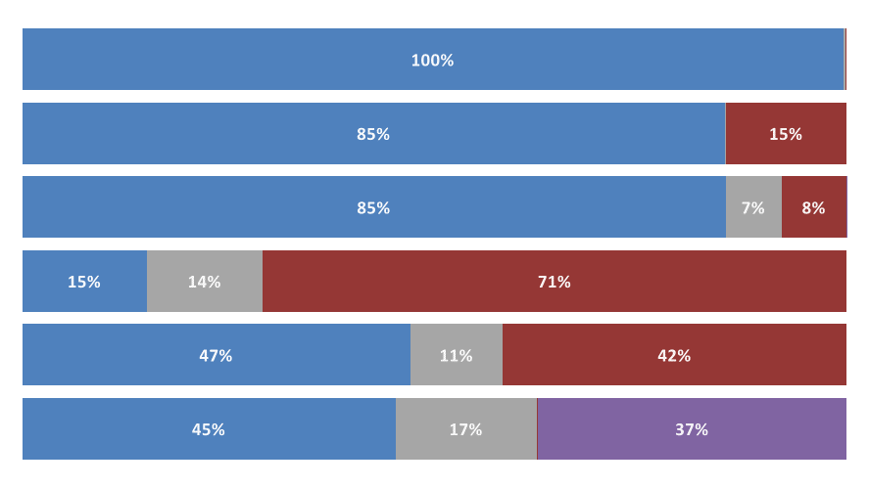
Perpetrators of Conflict Were deaths caused by Militaries, Rebels, Terrorists, or Others?
Militaries caused almost all the fatalities from conflict in Eritrea and significant portion in Angola and Ethiopia.
Eritrea
Angola
Other groups that caused fatalities include local militias, police forces, and civil unrest.
Ethiopia
Rebel groups caused much more death in the Central African nations of The DRC and Burundi than other places.
DRC
Burundi
Terrorist activity stands out in Somalia as a result of attacks from the Al Shabaab insurgency.
Somalia
Source: ACLED Conflict Data for Africa 1997-2016
BBC News (2018)
Klobucista et al. (2021)
Notes:
The next chart explores who the perpetrators of conflict were in these 6 countries.
The military caused almost all of the fatalities in Eritrea and a significant portion of those in Angola and Ethiopia.
Rebel groups caused much more death in the central African nations of the DRC and Burundi when compared to other places.
Terrorist activity stands out as a cause of fatalities in Somalia as a result of attacks from the al Shabab insurgency.
Other groups the caused fatalities include local militias, police forces, and civil unrest. They did not cause enough fatalities' to be distinctly represented on this chart.

Slide 7
Conclusion
There is so much tragedy in Africa. More than can be done justice with this presentation. A decision was made to focus on events in 4 areas that popped out when grouping fatalities by latitude and longitude. Zooming in on the map around Central Africa will reveal places like Darfur in the Sudan where significant violence occurred over a much wider area.
The areas highlighted on the map experienced violence at different rates over time.
The groups perpetrating violence are different among countries but have regional similarity.
Peace and negotiation make a lasting difference.
Fatalities in Burundi slowed after rebels and government officials negotiated peace.
Notes:
There is so much tragedy in Africa. More than can be done justice with a 3-slide presentation. A decision was made to focus on events in 4 areas that popped out when grouping fatalities by the latitude and longitude. Zooming in on the map around Central Africa will reveal places like Darfur in the Sudan where significant violence occurred over a much wider area
Some key take aways from this analysis are.
1. These areas experience violence at different rates over time
2. The groups perpetrating violence are different among countries but have regional similarity.
3. Peace and negotiation make a lasting difference. The success of Burundi in curbing armed conflict should be used as a model else ware to reduce fatalities on the continent.

Slide 8
References
Armed Conflict Location and Event Data Project, The. (2017). ACLED Conflict Data for Africa 1997-2016. Retrieved 09/05/2022 from https://data.world/acled/71d852e4-e41e-4320-a770-9fc2bb87fb64
BBC News. (2018). Burundi profile – Timeline. BBC. Retrieved 09/16/2022 from https://www.bbc.com/news/world-africa-13087604
Klobucista, C., Masters, K., & Sergie, M. A. (2021). Al-Shabab. Council on Foreign Relations. Retrieved 09/16/2022 from https://www.cfr.org/backgrounder/al-shabab
Notes:
Thank you for your time. Here are the references I used to construct this report.

