Slide 1
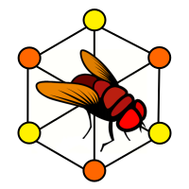
NeuroNLP
https://neuronlp.fruitflybrain.org/
NeuroNLP, is a key application on the Fruit Fly Brain Observatory platform that provides a modern web-based portal for exploring fruit fly brain circuit data.
Using Natural language, NeuroNLP allows users to construct intricate circuits from multiple data sources, to gain novel insights into brain structure and function.
Neuroinformatics tutorial
1.7 Open source initiatives
Notes:
<number>

Slide 2
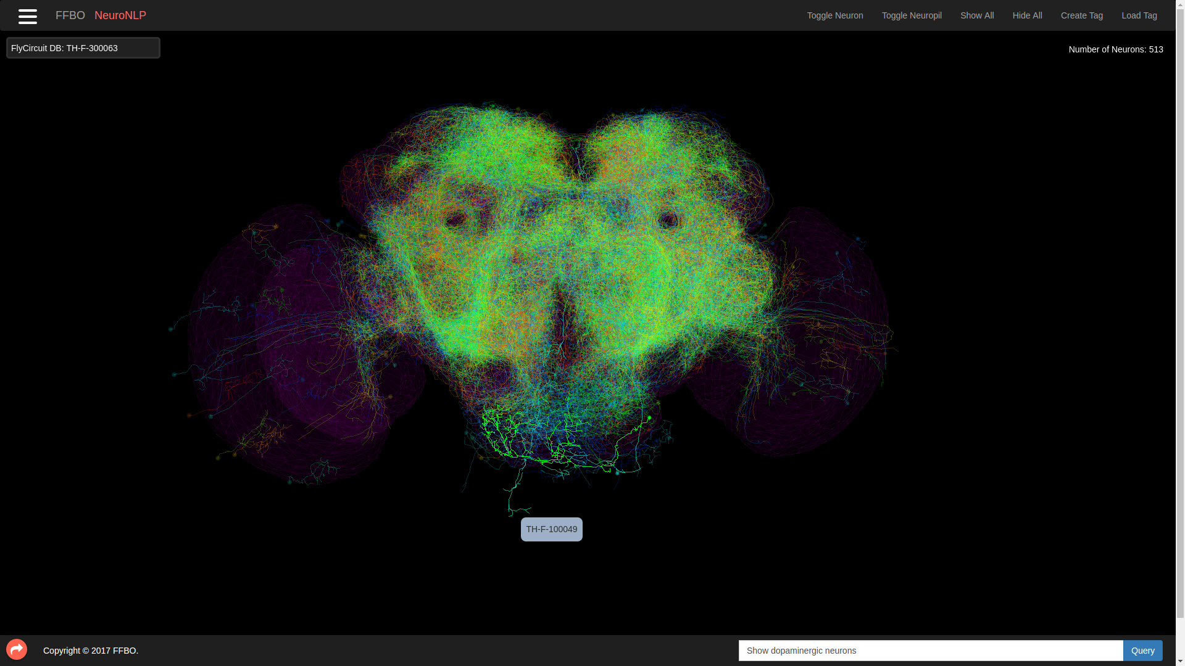
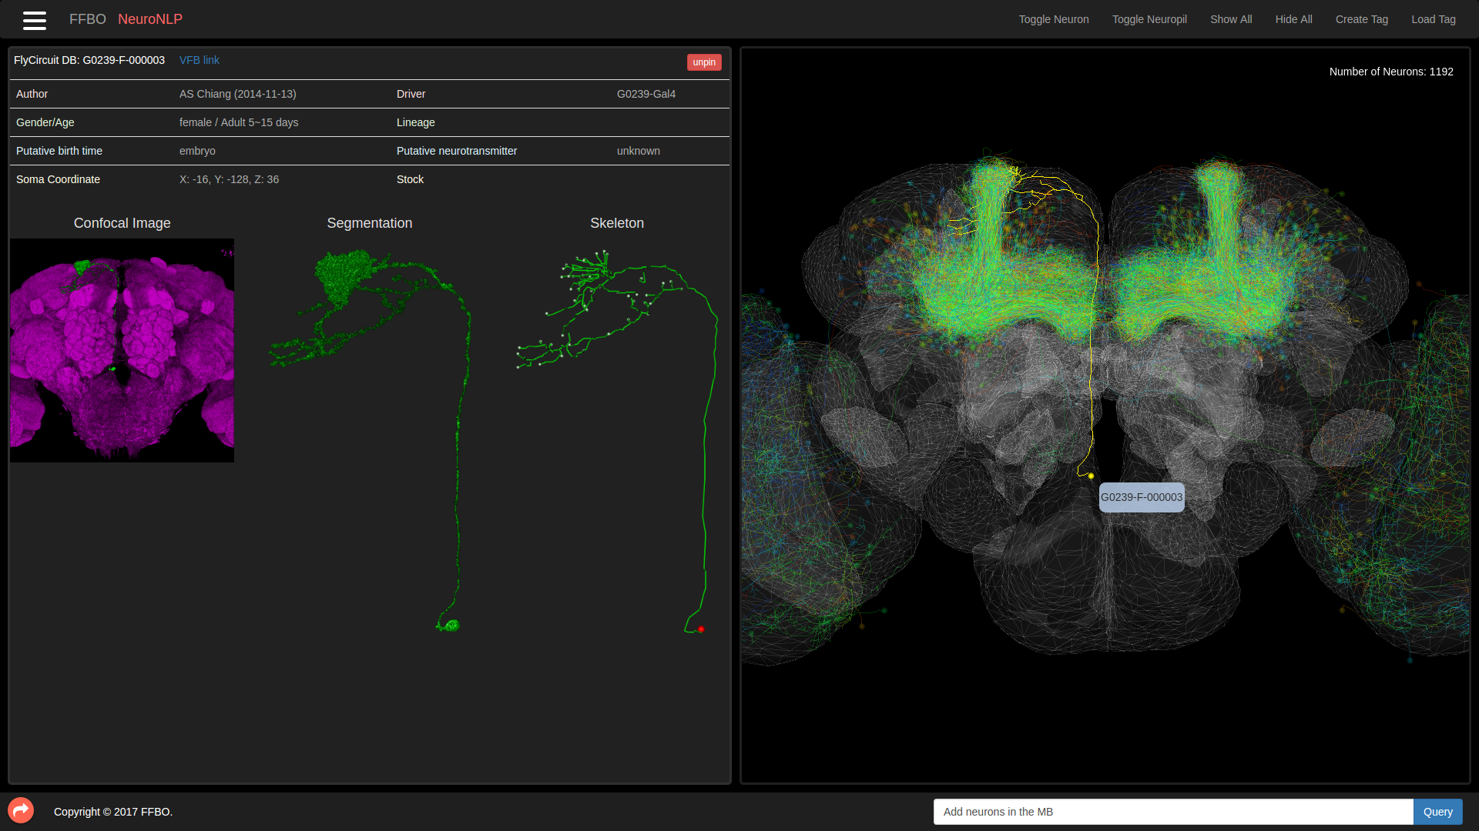
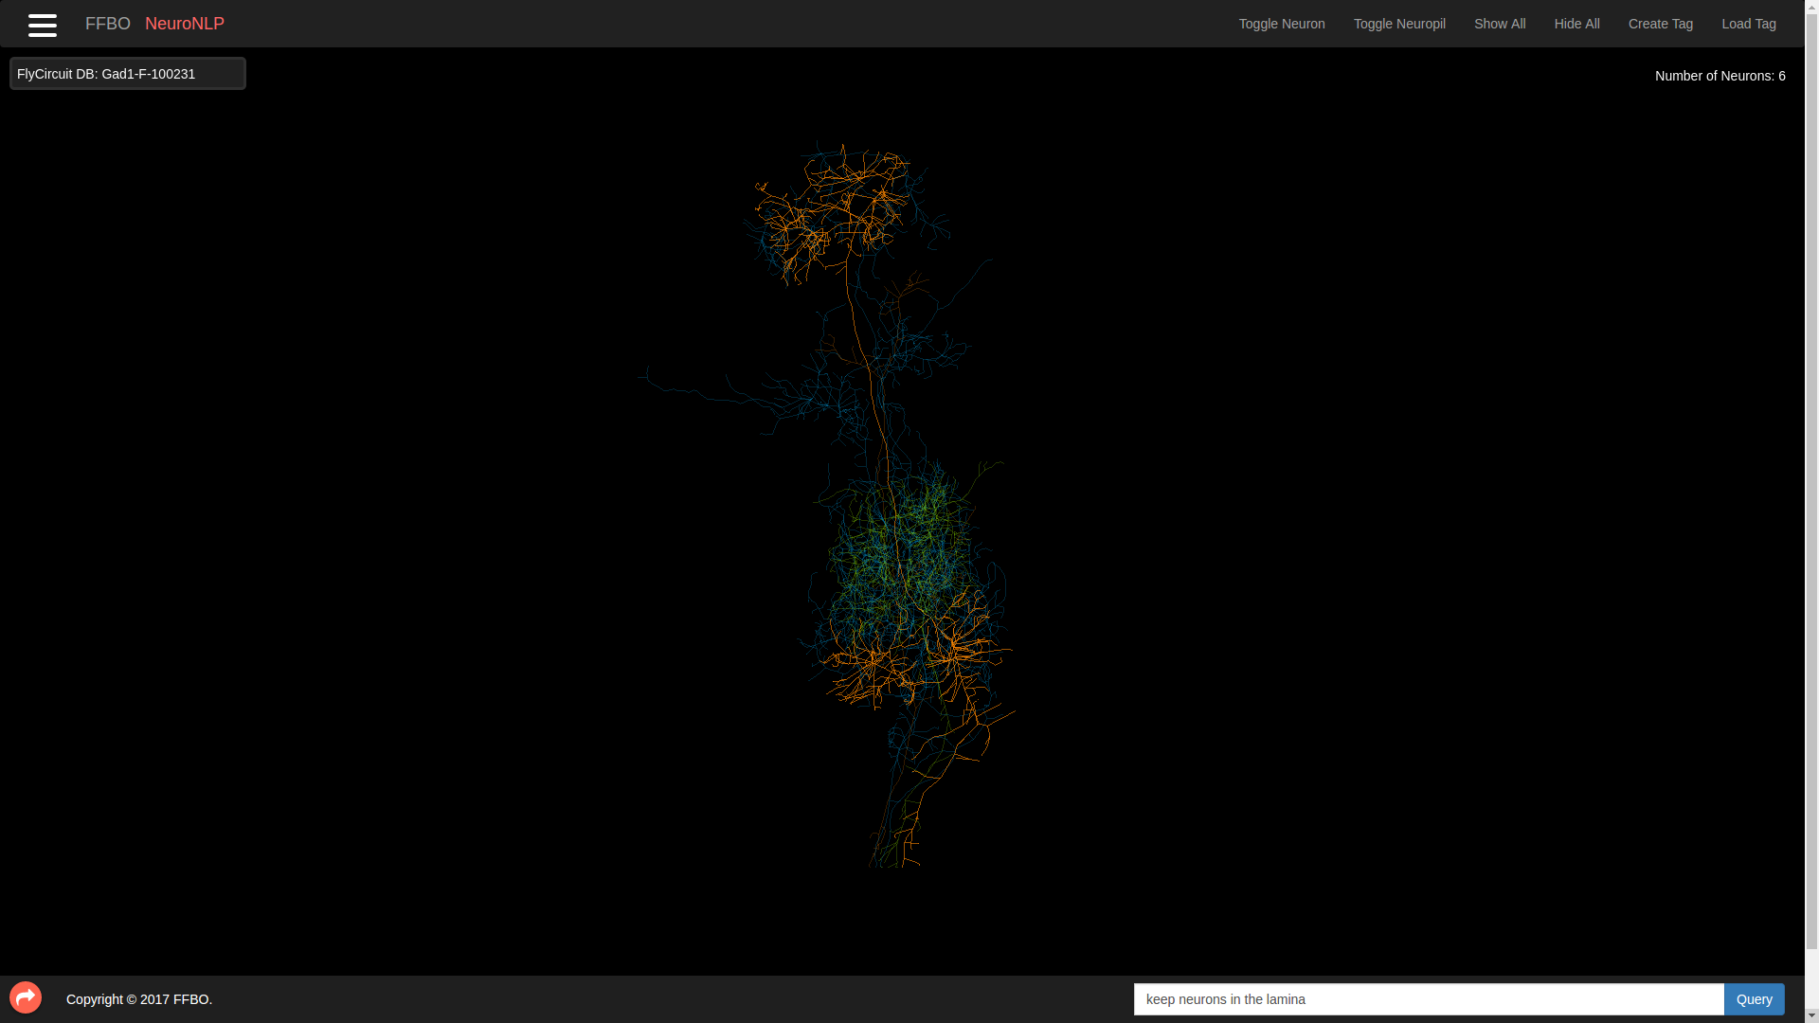
B) “Show Dopaminergic Neurons”
NeuroNLP runs upon the NeuroArch database, which codifies fly connectome data from both the meso-scale connectome data FlyCircuit database (B) and the micro-scale synaptic Janelia Fly Medulla data (C).
A) Exploring neuron data sources
C) “Show neurons in a single cartridge in lamina”
Notes:
<number>

Slide 3
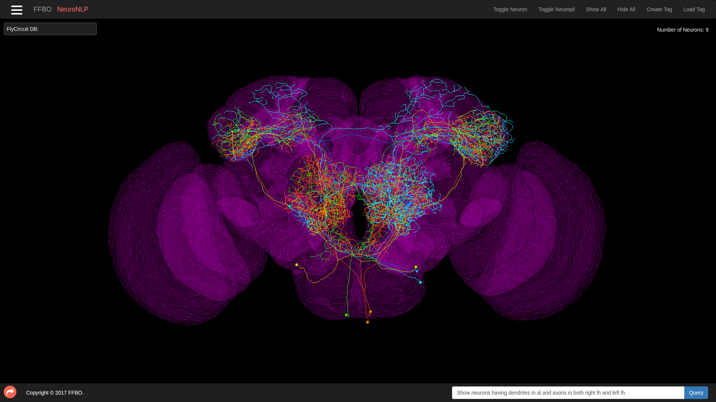
NeuroNLP allows for both complex single queries, as well as chaining multiple queries using stateful workspaces, to create intricate circuits.
Circuits can be queried by Parent LPU, neuron types, Tracts and Projections, Putative Neurotransmitters, Innervations and axonal and Dendritic arbourizations and Pre-synaptic and Post-synaptic connections.
Show neurons having dendrites in the right antenal lobe and axons in both right lateral horn and left lateral horn
Notes:
<number>

Slide 4
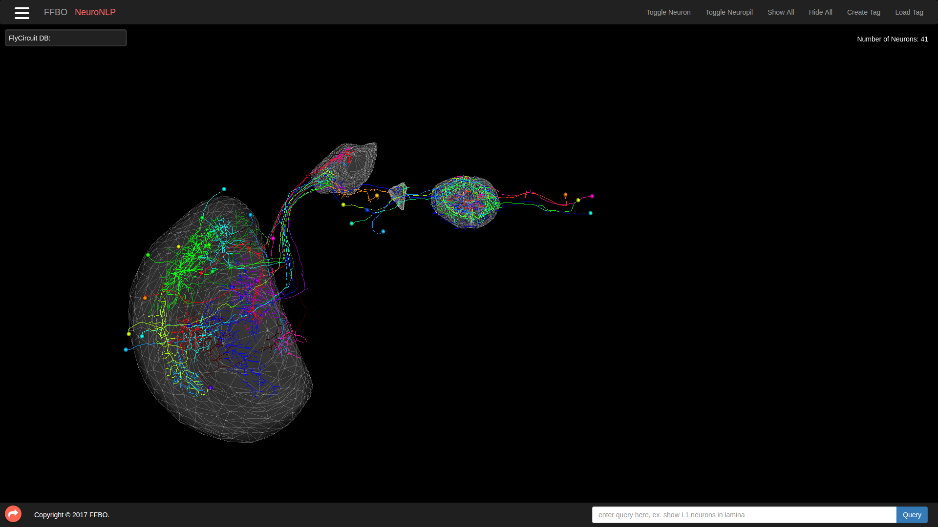
Exploring and Enriching Research
NeuroNLP can be used to recreate drosophila circuits from the literature, in order to more deeply explore the research.
Below we see a reconstruction of the a a feedforward visual pathway from the medulla to the central complex, as reported in Sun Yi et. al. (2017).
Notes:
<number>

