Slide 1
APOTHECARY

Slide 2
ABOUT
Pharmacy Rush is a 2D Educational mobile game wherein you play as a pharmacy intern who was assigned to work at a drug store for a month and will provide the customers the medicine they are asking for within a limited time.

Slide 3
TARGET MARKET
We aim to sell this game to people who love to play reaction-time based games and also to the people who want to learn the basic information of what purpose each medicine can cure or treat certain diseases.

Slide 4
FEATURES
Reaction time-based
  Time limit to pick medicine for customer to buy
Upgrade shop
  More medicine to offer
  Medicine stocks
  Power-ups (slow time, double payment, etc.)
Level-based
  Days as basis
  30 days work
Money as score
  Earn as much as possible

Slide 5
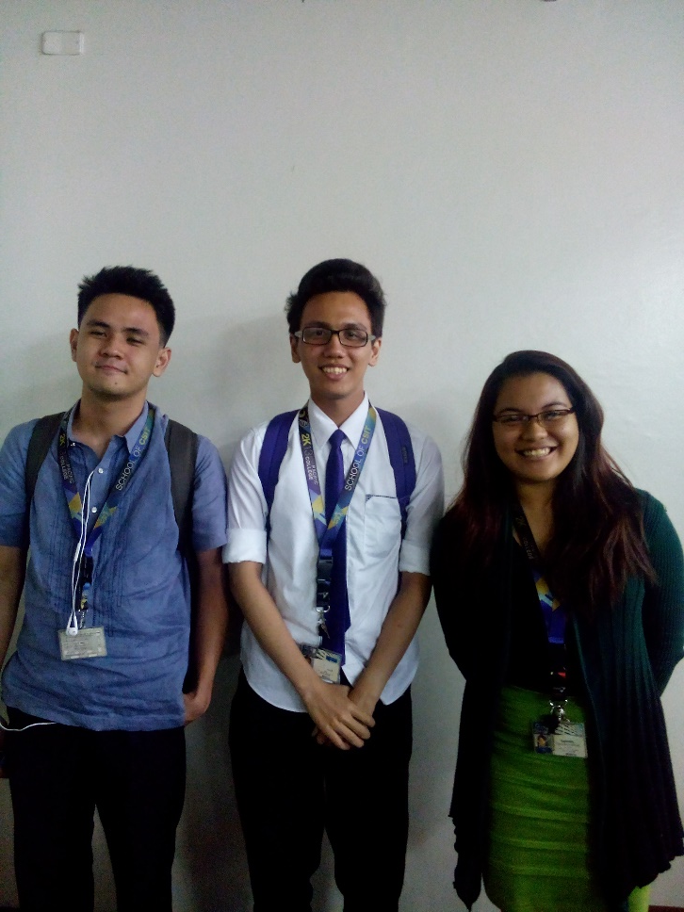
ABOUT THE TEAM (TEAM AVC)
Adam Reyes (left)
  Team Leader
  Lead Designer
  Programmer
Vince Belleza (middle)
  Lead Programmer
  Level Designer
  Lead Documentation
Cheska Espinola (right)
  Game Artist
  Programmer
  Documentation

Slide 6

GAME REFERENCE
Diner Dash
  Casual gameplay
  Tap to assist customers
  Shop for upgrades for better restaurant

Slide 7
COMPARISON
Similarities
APOTHECARY
DINER DASH
First Person view
Power-ups available
Inventory maintenance
Reaction time dependent
Challenged by time
Level system
To gather as much money as possible
Shift at work
Experience points
Customer satisfaction dependent
Better restaurants

Slide 8
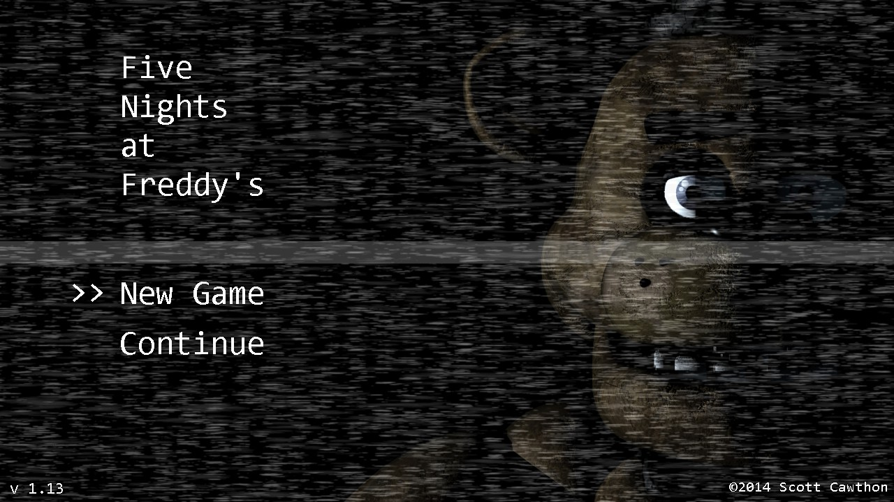
OTHER GAME REFERENCE
5 Nights at Freddy’s
  First person view
  No movement of player needed

Slide 9
SOURCES
http://pixelperfectgaming.com/2012/10/29/diner-dash-now-available-for-kindle-fire/
http://freddy-fazbears-pizza.wikia.com/wiki/Five_Nights_at_Freddy's

