Slide 1



Slide 2
CLIENT BACKGROUND

Slide 3


Apothecary is a 2D Educational mobile game wherein you play as a pharmacy intern who was assigned to work at a drug store and will provide the customers the medicine they are asking for within a limited time.

Slide 4
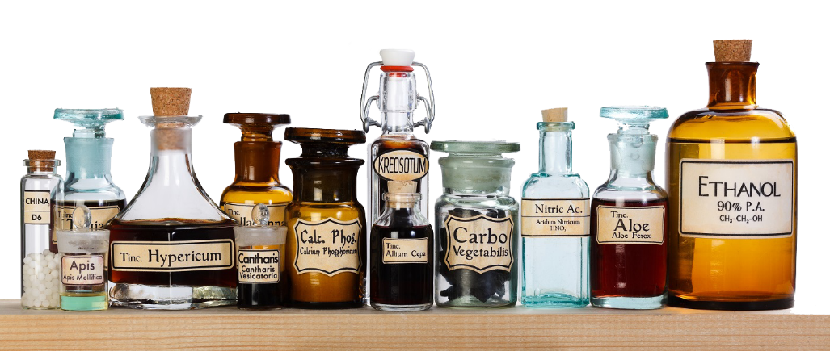
TARGET MARKET
We aim to sell this game to people who love to play reaction-time based games and also to the people who want to learn the basic information of what purpose each medicine can cure or treat certain diseases.

Slide 5
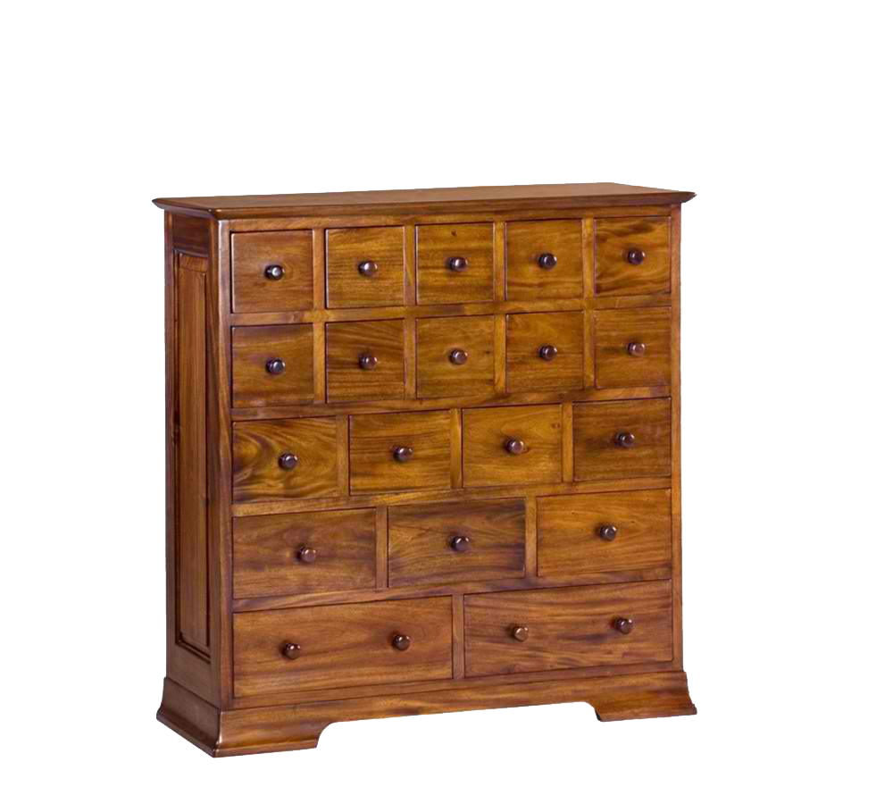
FEATURES
Reaction time-based
Time limit to pick medicine for customer to buy
Upgrades & Powerups
More medicine to offer
Medicine stocks
Power-ups (slow time, double payment, etc.)
Endless level with time
60 seconds
Adds every 10th interval of satisfied customers
Money as score
Earn as much as possible

Slide 6

GAME REFERENCE
Diner Dash
Casual gameplay
Tap to assist customers
Shop for upgrades for better restaurant

Slide 7
COMPARISON
APOTHECARY
sSimilarities
DINER DASH
First Person view
Power-ups available
Inventory maintenance
Reaction time & knowledge dependent
Challenged by time
To gather as much money as possible
Timer
Experience points
Customer satisfaction dependent
Better restaurants
Level-based

Slide 8
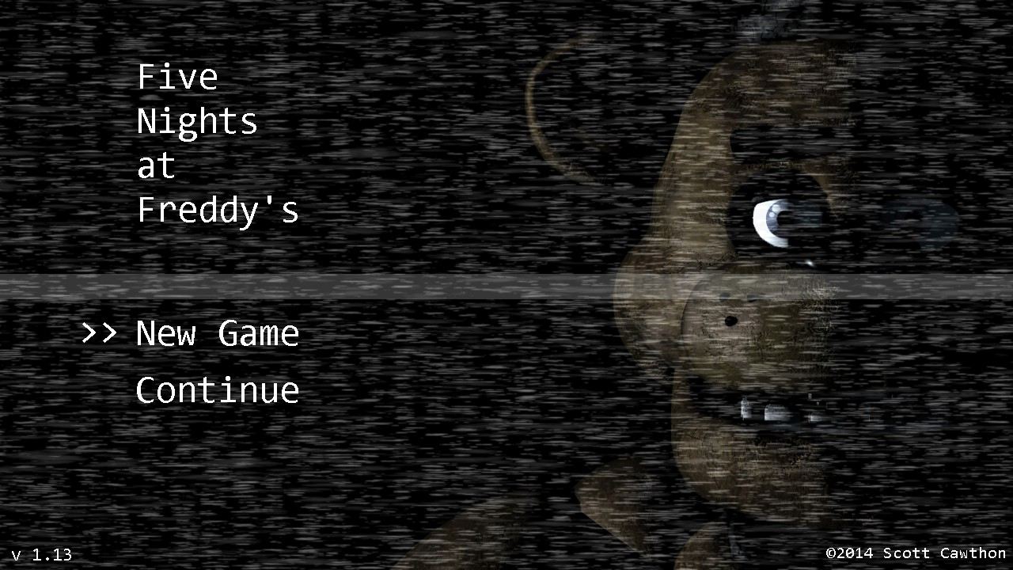
OTHER GAME REFERENCE
5 Nights at Freddy’s
First person view
No movement of player needed

Slide 9
MILESTONES

Slide 10
TECHNICAL DESIGN
Process flow
Tools used
Sample of engine

Slide 11
ITERATIONS

Slide 12
CONTRIBUTIONS

Slide 13
DEMO, CURRENT STATUS, NEXT STEP

Slide 14
SOURCES
http://pixelperfectgaming.com/2012/10/29/diner-dash-now-available-for-kindle-fire/
http://freddy-fazbears-pizza.wikia.com/wiki/Five_Nights_at_Freddy's
http://greymountainherbs.com/wp-content/uploads/2014/11/apothecary-bottles1.jpg
http://multayindonesia.com/img/p/491-1892-thickbox.jpg
http://ecrustationery.com/wp-content/uploads/2012/10/ECRU-Halloween-Labels.jpg

