Slide 1
OrbitFlow
A hands-on tutorial
Build a browser app, review the result,
and request a change through Telegram.
orbitflow.adamroch.com
Current v2 interface · September 16, 2026
01
Notes:
This tutorial uses the protected cloud studio. The worked exercise is a persistent checklist followed by a search feature. Screenshots show the existing cloud instance and its retained checklist. Example requests are instructions for your own next run. Agent execution spends provider credit. The studio supports bounded browser applications, and human inspection remains the acceptance step.
Sources: /Users/adam/orbitflow-v2/README.md; /Users/adam/orbitflow-v2/docs/PRODUCTION.md
Live interface: https://orbitflow.adamroch.com, inspected September 16, 2026.

Slide 2
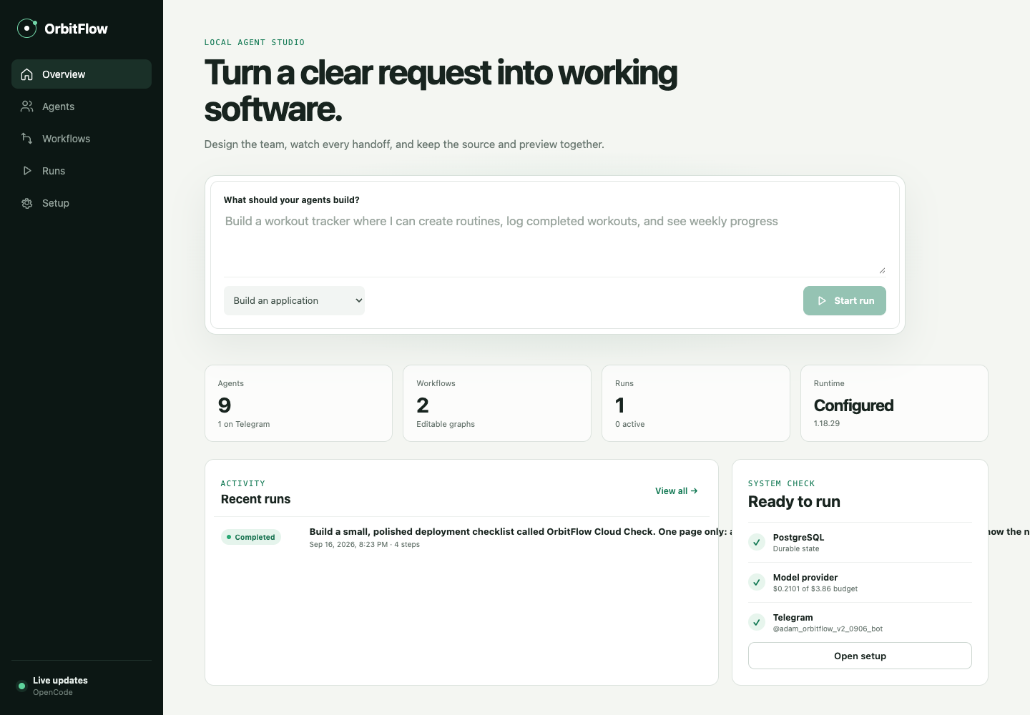
The studio at a glance
Overview
Submit a request.
Runs
Follow work and inspect the app.
Agents
Edit instructions and permissions.
Workflows
Connect agents and feedback routes.
Setup
Check integrations and spending.
02
Notes:
Use the left sidebar to move between pages. Overview is the shortest path to a new build. Runs contains the request, messages, tools, retained source, preview, usage, and decisions. Agents controls each participant. Workflows controls the route between them. Setup reports readiness and spending. The words Local agent studio still appear in the current cloud interface. They do not change the cloud URL.
Sources: /Users/adam/orbitflow-v2/src/web/App.tsx
Live interface: https://orbitflow.adamroch.com, inspected September 16, 2026.

Slide 3
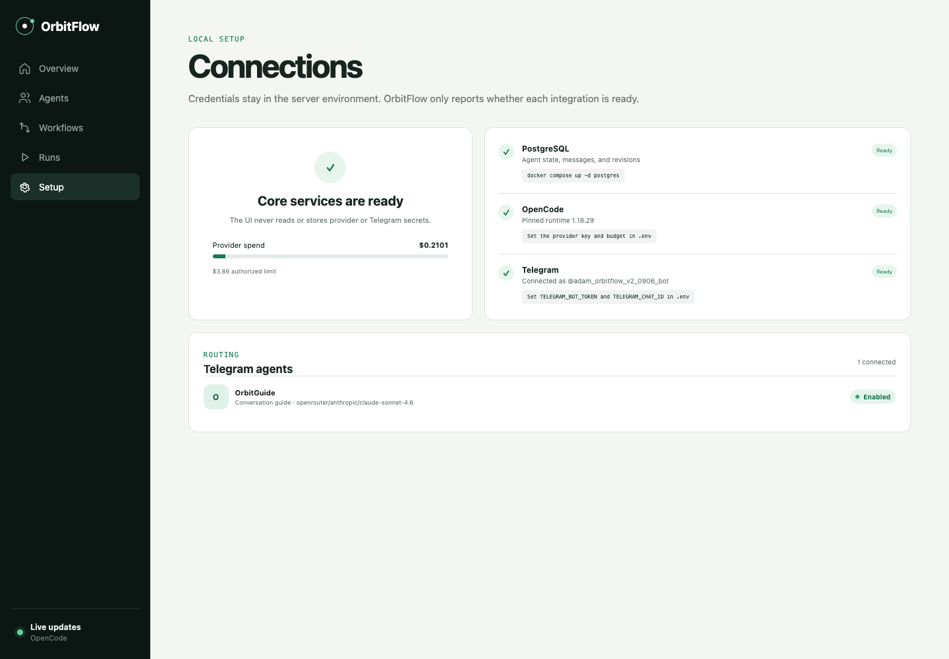
Access and readiness
The cloud studio is already configured. These are the checks before a new run.
01
Open the studio
Sign in with your operator login at orbitflow.adamroch.com.
02
Check Setup
Look for ready core services, a provider budget, and Telegram.
Supported output
Browser apps with local storage. No app login, payments, or custom backend.
03
Notes:
The operator login is stored privately in .local/deployment/operator.json. Do not put credentials in prompts or share that file. Setup reports configuration, rather than editing server secrets. The current allowance and recorded spend can change, so use the live Setup page. Provider reporting may lag, and an in-flight response can exceed the application allowance. New builds, improvements, conversations, and schedules can spend credit. You can inspect existing history without making a model request. The production bot is configured, but the full cloud Telegram improvement and Adam's production walkthrough remain pending acceptance in the deployment record.
Sources: /Users/adam/orbitflow-v2/docs/PRODUCTION.md; /Users/adam/orbitflow-v2/PRODUCT.md; /Users/adam/orbitflow-v2/README.md; /Users/adam/orbitflow-v2/src/web/App.tsx
Live interface: https://orbitflow.adamroch.com, inspected September 16, 2026.

Slide 4
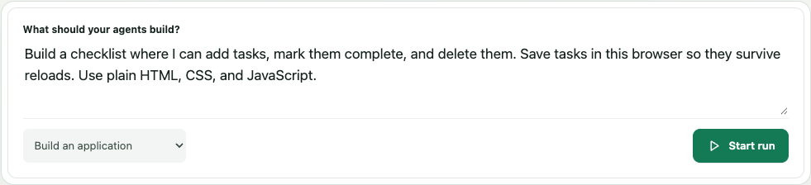
Your first build request
Overview: choose “Build an application”, enter a request, then click “Start run”.
Build a checklist where I can add tasks, mark them complete, and delete them. Save tasks in this browser so they survive reloads. Use plain HTML, CSS, and JavaScript.
A useful prompt names the interactions and what must survive a reload.
04
Notes:
Paste this complete example into the request field: Build a checklist where I can add tasks, mark them complete, and delete them. Save tasks in this browser so they survive reloads. Use plain HTML, CSS, and JavaScript.
Choose Build an application before starting. A new request creates a run and opens Runs. If no workflow exists, use Workflows, Browse templates, and load Build an application once. The current studio already has both templates. Starting this request uses the configured provider allowance. The screenshot shows a draft request in the real form.
Sources: /Users/adam/orbitflow-v2/src/web/App.tsx; /Users/adam/orbitflow-v2/src/server/seed.ts; /Users/adam/orbitflow-v2/README.md
Live interface: https://orbitflow.adamroch.com, inspected September 16, 2026.

Slide 5
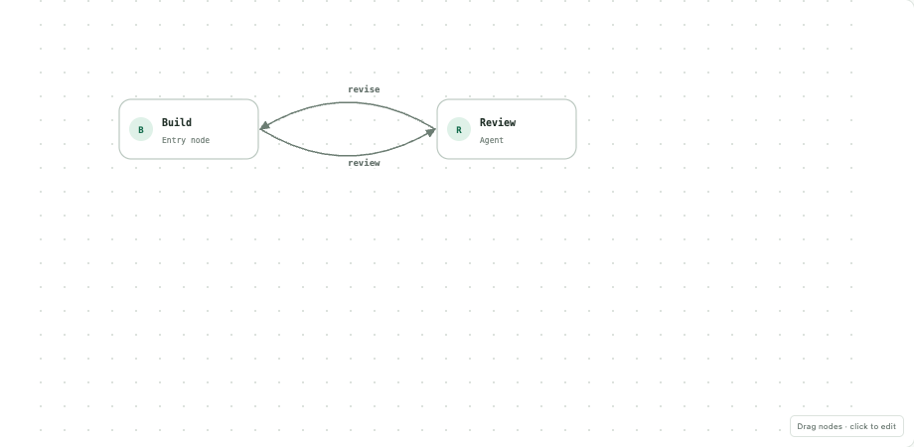
The build and review loop
The default template sends source review feedback back to the builder.
01
Builder produces the app
Its “review” outcome passes the files to Reviewer.
02
Reviewer checks the source
A “revise” outcome returns specific feedback to Builder.
03
Review reaches “approved”
The graph ends. The default policy then asks for your approval.
05
Notes:
Workflows contains an editable build/review graph. Default Build routes outcome review to Review. Review routes revise back to Build and treats approved as a terminal outcome. The improve template uses the same pattern with Improver and Regression Reviewer. Reviewer checks source. The default review does not prove that a person has used the app in a browser. Exact outcome strings are part of execution, so agent instructions and route conditions must agree.
Sources: /Users/adam/orbitflow-v2/src/server/seed.ts; /Users/adam/orbitflow-v2/src/web/App.tsx; /Users/adam/orbitflow-v2/README.md
Live interface: https://orbitflow.adamroch.com, inspected September 16, 2026.

Slide 6
Run history explains what happened
Runs: select a request, then inspect its recorded work.
01
Live trail
02
Saved execution setup
Read addressed messages and tool calls. Expand Tool output when useful.
Check the exact agents, models, tools, and graph captured for this run.
Current node shows where the run is working or where it stopped.
Later edits to agents or workflows apply to new runs. Existing runs keep their saved setup.
06
Notes:
The illustrated completed cloud checklist ran four actual turns: build, review feedback, revision, and review approval. The screenshot shows the retained token and cost records for that run. It is an example, not a price estimate. While work runs, the UI labels cost as completed-turn cost because the current turn may still be unreported. Saved execution setup exposes the runtime inputs used by this run. Template loading creates agent copies, so inspect the saved identities before editing a similarly named agent.
Sources: /Users/adam/orbitflow-v2/src/web/App.tsx; /Users/adam/orbitflow-v2/docs/cloud-deployment-evidence.md; /Users/adam/orbitflow-v2/README.md
Live interface: https://orbitflow.adamroch.com, inspected September 16, 2026.

Slide 7
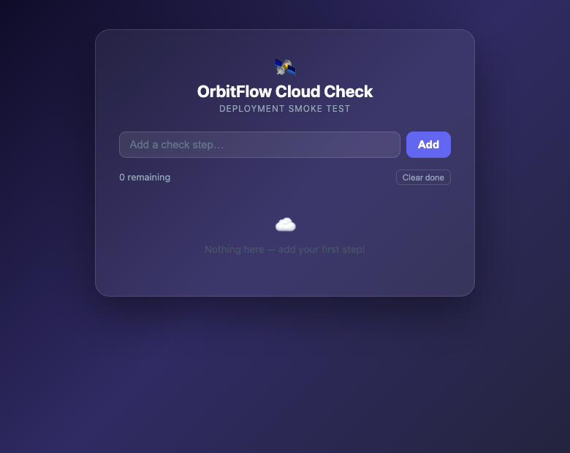
Source inspection and a browser check
The run’s “Source” and “Preview” buttons give you two ways to inspect the result.
Source
Read the retained files for this revision.
Preview
Add two tasks. Complete one. Reload. Check that both tasks and their states remain.
Use the same browser profile for later revisions. Another profile has separate saved data.
07
Notes:
Open Source to inspect the immutable retained files. Open Preview to use the generated browser app on its own origin. For the checklist, add two example tasks, mark one complete, reload, then delete one and reload again. Check the displayed remaining count. If the browser blocks the new preview window, allow pop-ups for this studio and retry Preview. App data lives in the browser profile's localStorage. OrbitFlow retains source in its database. Improvements keep the same application origin, but the generated code must also preserve storage compatibility. This screenshot opens the existing cloud checklist in a fresh browser profile, so its list is empty.
Sources: /Users/adam/orbitflow-v2/src/web/App.tsx; /Users/adam/orbitflow-v2/docs/cloud-deployment-evidence.md; /Users/adam/orbitflow-v2/README.md
Live interface: https://orbitflow.adamroch.com, inspected September 16, 2026.

Slide 8
Your approval decision
With the default approval policy, the run pauses at “Review this revision”.
Approve revision
Reject with feedback
Use this after the preview behaves as requested. The completed revision becomes a source for improvements.
Describe one concrete failure. OrbitFlow returns your feedback to the workflow with the retained files.
Example feedback
Completed tasks lose their checked state after reload. Preserve their completion state.
“Allow turn” is a separate permission to start the next agent turn.
08
Notes:
The approval area appears only while a run awaits a decision. Inspect the exact current source and preview before choosing Approve revision. Rejection requires nonempty feedback and returns to the entry node with retained files. A run using Approve every turn first shows Allow the next agent turn and the Allow turn button. That permission differs from final revision acceptance. Approval does not deploy the generated app to a new public site. The autonomous policy can finish without this human pause. The feedback sentence on this slide is hypothetical.
Sources: /Users/adam/orbitflow-v2/src/web/App.tsx; /Users/adam/orbitflow-v2/README.md
Live interface: https://orbitflow.adamroch.com, inspected September 16, 2026.

Slide 9
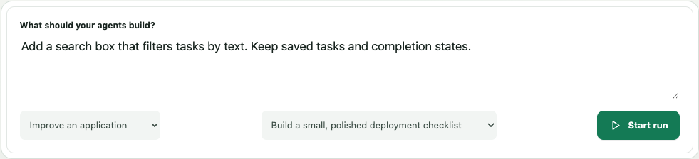
An improvement starts from an approved app
Runs: select the completed run and click “Improve application”.
Add a search box that filters tasks by text. Keep saved tasks and completion states.
Alternative: in Overview, choose “Improve an application” and select the approved source.
09
Notes:
The Improve application button on a completed run asks what should change and starts the improvement from that run's approved revision. Alternatively, Overview exposes the improvement workflow and Approved source application selector. Use this example request: Add a search box that filters tasks by text. Keep saved tasks and completion states.
After the new run reaches approval, test search with matching and nonmatching text. Clear the query and confirm that every saved task returns. Reload and confirm completion states survive. Approve only the revision you inspected. The screenshot shows an unsent form.
Sources: /Users/adam/orbitflow-v2/src/web/App.tsx; /Users/adam/orbitflow-v2/README.md
Live interface: https://orbitflow.adamroch.com, inspected September 16, 2026.

Slide 10
The same improvement through Telegram
Use your configured private chat with @adam_orbitflow_v2_0906_bot.
01
Send the command
03
Inspect the returned revision
/improve
Open its preview, test the change, and use the exact approval command in the bot reply.
02
Reply with the change
Add a search box that filters tasks by text. Keep saved tasks and completion states.
04
Check progress when needed
/status <run ID>
Open the OrbitFlow bot
/help lists commands. Ordinary messages converse with the connected agent.
10
Notes:
The short /improve flow requires exactly one loaded improvement workflow. It selects the latest approved application and then asks for a change. /improve followed by the change in the same message also works. For a specific app, use /improve <workflow ID> <approved run ID> <request>. Copy workflow IDs from Workflows and run IDs from Runs. Telegram-created runs support /approve <run ID> <approval token> and /reject <run ID> <approval token> <feedback>. Copy the full current command from the bot reply rather than guessing a token. The allowlisted private chat is the only accepted sender. Ordinary conversation also uses provider credit. A full local Telegram build-improvement flow was recorded. The cloud bot is configured, and the production Telegram walkthrough remains pending acceptance in the deployment evidence.
Sources: /Users/adam/orbitflow-v2/README.md; /Users/adam/orbitflow-v2/src/server/integrations.ts; /Users/adam/orbitflow-v2/docs/PRODUCTION.md; /Users/adam/orbitflow-v2/docs/cloud-deployment-evidence.md
Live interface: https://orbitflow.adamroch.com, inspected September 16, 2026.

Slide 11
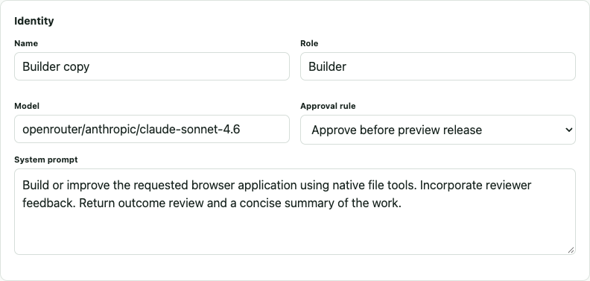
Agent identity and approval settings
Agents: use the pencil beside the agent you want to change, then “Save agent”.
Name and role
Identify who owns a step in the workflow.
Model and system prompt
Choose a valid provider/model ID and describe the job and expected outcome.
Approval rule
Choose autonomy, final revision approval, or approval before every turn.
Find the workflow’s actual agent before editing. Loaded templates create copies.
11
Notes:
To create an agent, click New agent and fill its required name, role, system prompt, and model. The exact approval labels are Work autonomously, Approve before preview release, and Approve every turn. Changes apply to new runs. The screenshot is Builder copy, which participates in the existing loaded build workflow, rather than the original seed Builder. A configured model ID is required. To remove an agent, use its trash control. An agent referenced by a workflow cannot be deleted until that reference is removed.
Sources: /Users/adam/orbitflow-v2/src/web/App.tsx; /Users/adam/orbitflow-v2/src/server/index.ts; /Users/adam/orbitflow-v2/src/server/seed.ts
Live interface: https://orbitflow.adamroch.com, inspected September 16, 2026.

Slide 12
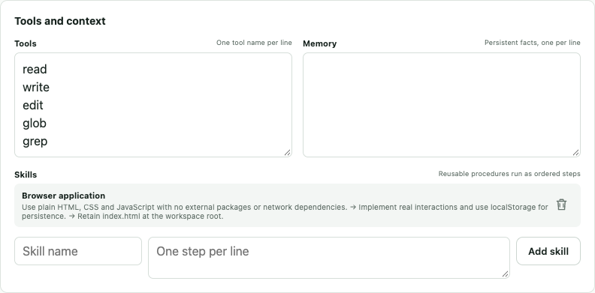
Tools, memory, and reusable skills
Tools
Enter allowed native tool names, one per line. Builders need write access.
Memory
Save facts or preferences the agent should receive in future turns.
Skills
Name a procedure, enter its steps, click Add skill, then Save agent.
Example memory: Prefer concise interfaces with clearly labeled controls.
12
Notes:
Tools and Memory each accept one entry per line. Supported static-file tools include read, write, edit, glob, and grep. Reviewer defaults use read, glob, and grep. Blocked actions remove tools even if the Tools list includes them. Memory entries and named skill steps enter future runtime turns. Add skill updates the form draft. Save agent persists the whole configuration. The example memory text is a suggested preference and was not saved. The generated-app boundary does not gain shell access just because an arbitrary name appears in the form.
Sources: /Users/adam/orbitflow-v2/src/web/App.tsx; /Users/adam/orbitflow-v2/src/server/runtime.ts; /Users/adam/orbitflow-v2/src/server/seed.ts; /Users/adam/orbitflow-v2/README.md
Live interface: https://orbitflow.adamroch.com, inspected September 16, 2026.

Slide 13
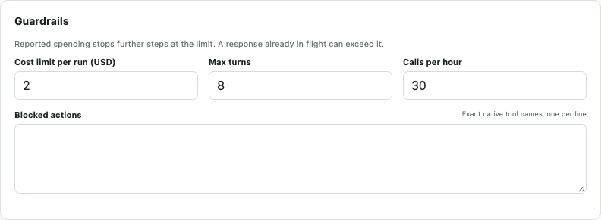
Limits that bound agent work
Agents: the Guardrails section controls spending, turns, and allowed actions.
Cost limit per run
Max turns and calls per hour
Blocked actions
Bounds this agent’s reported spending within one run.
Bound feedback loops and how often the agent can start.
Use exact tool names. A blocked tool stays unavailable.
13
Notes:
The global provider allowance and the agent's remaining per-run limit both apply. Before a turn, OrbitFlow uses the smaller remaining allowance. Runtime reporting can lag an in-flight request, so the application limit is not a guaranteed hard billing cap. Unknown cost blocks further paid turns until reconciled. Max turns counts that agent's invocations within the run. Calls per hour checks recent invocations. Keep the first exercise bounded and leave schedules off until deliberate recurring work is needed. Do not increase the authorized total simply because the provider account permits more spending.
Sources: /Users/adam/orbitflow-v2/src/web/App.tsx; /Users/adam/orbitflow-v2/src/server/engine.ts; /Users/adam/orbitflow-v2/README.md
Live interface: https://orbitflow.adamroch.com, inspected September 16, 2026.

Slide 14
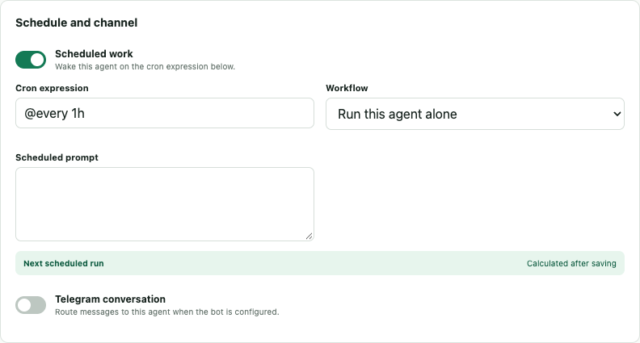
Schedules and a conversation channel
Scheduled work
Enable it, enter an interval or cron expression, choose the workflow, and supply the scheduled prompt.
After Save agent, check the next scheduled run. The chosen workflow must contain this agent.
Telegram conversation
Enable it on exactly one agent. Setup shows which agent receives messages.
14
Notes:
The screenshot exposes schedule fields in an unsaved form. Schedules remain off in the existing deployment. The expression field accepts cron syntax or an interval such as @every 1h. Select Run this agent alone or a workflow that actually contains the agent, enter a scheduled request, and save. The next wake or an error appears after saving. Scheduled work can create paid turns. Switch it off and save when finished. The Telegram conversation toggle controls which saved agent receives ordinary messages from the configured allowlisted chat. Keep exactly one agent connected. Bot credentials and chat identity belong in server configuration.
Sources: /Users/adam/orbitflow-v2/src/web/App.tsx; /Users/adam/orbitflow-v2/src/server/integrations.ts; /Users/adam/orbitflow-v2/README.md
Live interface: https://orbitflow.adamroch.com, inspected September 16, 2026.

Slide 15
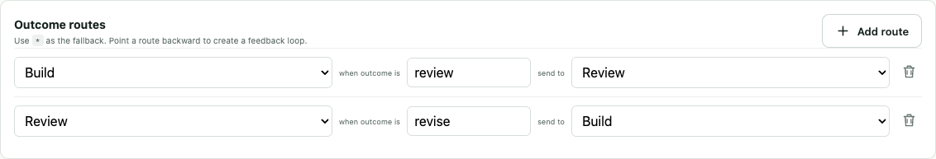
Editing a workflow
Workflows: choose “Edit”, change the graph and routes, then “Save workflow”.
01
Choose participating agents
Click an agent to add a node. Drag nodes to arrange them. Set the Entry node.
Outcome routes
Terminal outcomes
Match the outcome your agent returns. A backward route creates a feedback loop.
Click a node and enter outcomes that end the graph, such as approved.
15
Notes:
Use Browse templates for an independent editable copy, or New workflow for an empty graph. A new empty graph needs agents, an entry node, and routes or terminal outcomes. Add route lets you select From node, Outcome condition, and To node. The default builder uses review and the default reviewer returns approved or revise. Resolution checks an exact route first, then an explicit terminal outcome, then the wildcard * route. An unmatched outcome fails with its allowed values instead of silently taking a guessed path. Enable Requires an approved source application for an improvement workflow. Save changes before a new run. Older runs retain their original graph snapshot.
Sources: /Users/adam/orbitflow-v2/src/web/App.tsx; /Users/adam/orbitflow-v2/src/server/seed.ts; /Users/adam/orbitflow-v2/README.md
Live interface: https://orbitflow.adamroch.com, inspected September 16, 2026.

Slide 16
When a run needs attention
Awaiting approval
Open the decision area. Inspect the revision or allow the next turn.
Failed
Read “Run stopped” and the trail. Resolve the cause before using Resume.
Unknown provider cost
Use “Reconcile provider usage” with the provider’s actual record.
Work should stop
Click Cancel on the active run. Inspect retained work and reported usage.
Resume keeps the saved setup. Start a new run when you need different agent or workflow settings.
16
Notes:
Resume is shown for failed runs and is disabled while provider cost remains unknown. Enter only verified provider usage in Reconcile provider usage, then resume from the retained node. A resumed run keeps its original configuration and does not replay completed turns. If the saved configuration caused the failure, editing the current agent will not change that snapshot. Use a new run after changing settings. For a depleted total allowance, seek authorization before raising it. Cancellation stops further work, but usage already in flight may be incomplete. In the preview, an apparently empty app in another browser profile reflects separate localStorage. If short Telegram /improve cannot select an app, use its explicit workflow and approved-run form.
Sources: /Users/adam/orbitflow-v2/src/web/App.tsx; /Users/adam/orbitflow-v2/README.md
Live interface: https://orbitflow.adamroch.com, inspected September 16, 2026.

Slide 17
A complete first exercise
A working app and a checked improvement are the finish line.
01
Build the checklist
04
Request search
Use the example request in Overview.
Send /improve in Telegram, then the change request.
02
Inspect the handoff
05
Check the improvement
Read the build and review messages in Runs.
Filter tasks. Clear the query. Confirm saved states survive.
03
Check and approve
06
Approve the new revision
Add tasks, reload, and approve the working revision.
Use the exact command in the bot reply.
17
Notes:
This exercise uses real provider turns and the existing authorized budget. You can start by inspecting the retained cloud checklist before creating another app. Success means you personally used the new app, observed the review conversation, verified saved data after reload, and checked the improved version before approving it. If multiple approved apps exist, make sure Telegram targets the intended one. Use the explicit /improve form to remove ambiguity. Local and cloud history are separate. The recorded demo is at docs/demo/orbitflow-real-demo.mp4 and shows the earlier local workout-tracker flow.
Sources: /Users/adam/orbitflow-v2/docs/PRODUCTION.md; /Users/adam/orbitflow-v2/docs/WALKTHROUGH.md; /Users/adam/orbitflow-v2/README.md
Live interface: https://orbitflow.adamroch.com, inspected September 16, 2026.

Slide 18
Appendix: running OrbitFlow locally
Prerequisites
Node.js 22.12 or newer and Docker Desktop.
From /Users/adam/orbitflow-v2
npm run setup
Keep the command running, then open http://127.0.0.1:4310.
Local and cloud data are separate. Keep the local Telegram consumer off while the cloud consumer uses the same bot.
18
Notes:
Run npm run setup from the repository after installing Node 22.12+ and starting Docker Desktop. Setup installs locked packages, starts this project's PostgreSQL container, builds the runtime image and web UI, then starts the studio. Editing and history inspection work without a configured model provider. Real turns require an authorized provider credential and budget in .env. Copy .env.example for a new local configuration, never include secrets in a prompt. Ctrl-C stops the application executor and its active turn while retaining the database volume. docker compose stop stops this repository's database. Do not delete the volume merely to restart. The v2 Telegram bot currently belongs to the cloud consumer. Do not start a second local consumer with the same token. Preview apps use separate origins on port 4312 and per-profile localStorage.
Sources: /Users/adam/orbitflow-v2/README.md; /Users/adam/orbitflow-v2/docs/PRODUCTION.md; /Users/adam/orbitflow-v2/scripts/setup.sh
Live interface: https://orbitflow.adamroch.com, inspected September 16, 2026.

