Slide 1




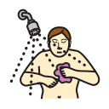







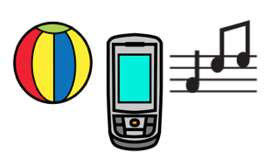


Top page
Yes
No
Chatting
Questions
Personal Care
Things
Action words
People
Describing
My day
Places
Leisure
Little words

Slide 2

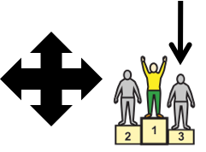








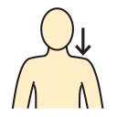


chatting
Yes
No
Top Page
About me
WML
I can’t find what I want to say?
Hello
I’m fine
ok
I’m not so good
My stories
sorry
I don’t know
bye

Slide 3







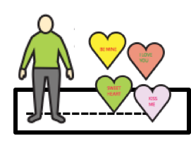


About me
Yes
No
Top Page
My name is
I live in
birthday
--------------
--------------
About my family
pet
school/work
TV
--------------
--------------
--------------
I like
I don’t like
Tell me about you.
--------------

Slide 4
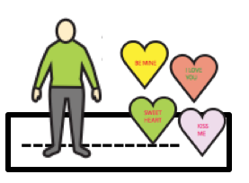
I like
Yes
No
Top Page
I like

Slide 5


I don’t like
Yes
No
Top Page
I don’t like

Slide 6



Tell me about you
Yes
No
Top Page
What name?
Where live?
Birthday?
--------------
--------------
You live with?
Any pets?
school/work
How old?
--------------
--------------
--------------
What do you like?
What don’t you like?
Do you have?
--------------
--------------

Slide 7

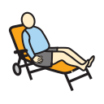








WML
Yes
No
Top Page
chill out
go away
wow
I love you.
whatever
no way
shut up
don’t
not
well
cool

Slide 8
My stories
Yes
No
Top Page
Let me tell you something

Slide 9

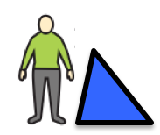







questions
Yes
No
Top Page
Can I see that?
What’s next?
when
where
what
where
What do you think?
How are you?
who
why

Slide 10
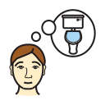



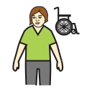



Personal care
Yes
No
Top Page
I need the toilet
I don’t feel well.
body parts
I need some help
I’d like a shower
I’d love a bath
Can you cut my nails
I need to get changed
Can you do my hair?

