Slide 1



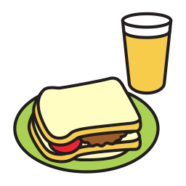

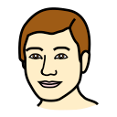





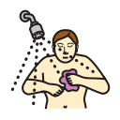













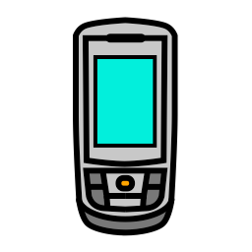
Top page
Yes
Yes
No
Hello
I want to talk to you.
Chatting
Questions
Food
I
People
Personal Care
Little Words
My Day
Action words
go
want
Describing
Things
Time
Places
Leisure
Delete Word

