Slide 1
The Effects of the Minimum Wage on Earnings and Employment in New England
Adam Sabol

Slide 2
Overview
Literature Review
Theoretical Foundations
Model Specification
Sample Construction
Results
Public Policy

Slide 3
Minimum Wage Literature
Regional Case Study Approach:
Card and Krueger (1994)
Neumark and Wascher (2000)
Card and Kreuger (2000)
Dube, Naidu, and Reich (2007)
Jardim, et al (2017)
National Panel Study Approach:
Neumark and Wascher (1992)
Neumark and Wascher (2007)
Dube, Lester, and Reich (2010)
Allegretto, Dube, and Reich (2011)
We begin by showing that states experiencing greater increases in minimum wages over the past two decades have systematically different labor market characteristics that are unrelated to the minimum wage policy. These states have experienced more severe economic downturns; they have experienced greater job polarization in the form of sharper reduction in routine task intensive jobs; and they have seen faster growth in upper-half wage inequality.
-Allegretto, Dube, Reich, Zipperer (2017)

Slide 4
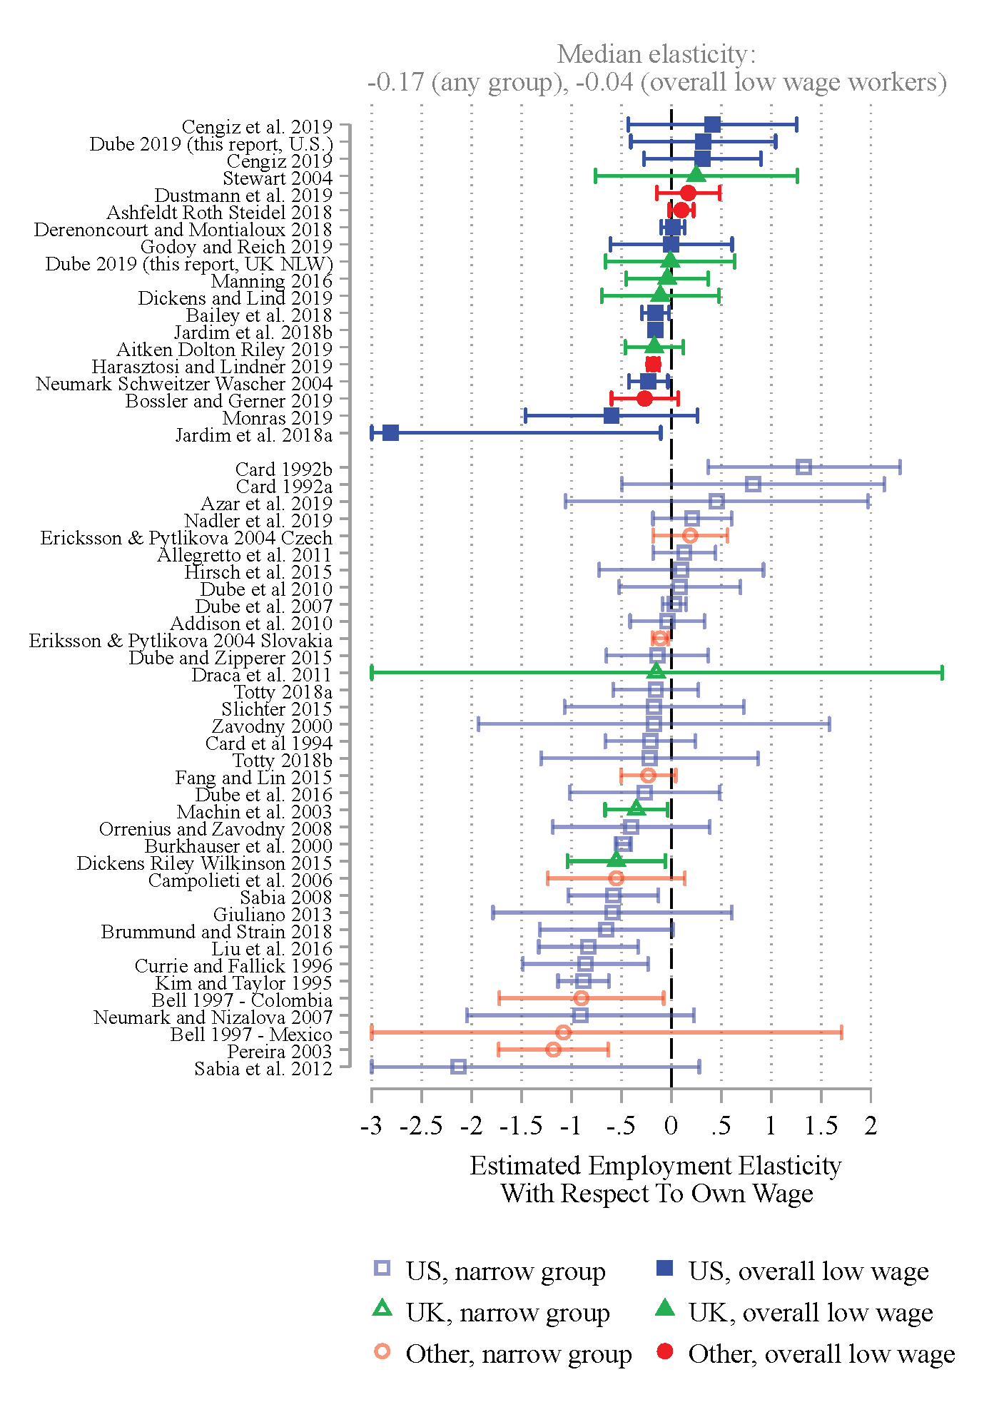
Source: Dube (2019)

Slide 5
Labor Market Models
D
S
D
MLC
S
W₂
W₂
W₁
W₁
L₂
L₁
L₁
L₂

Slide 6
Empirical Models
ln($y_{it})= β_{0}+ β_{1}ln\left({MW}_{it}\right)+ β_{2}ln(y_{it}^{TOT}$) + $β_{3}ln\left({pop}_{it}\right)+δ_{i}+ τ_{t}+ ε_{it}$
However, they do not test this hypothesis directly and, indeed, provide no convincing evidence that the counterfactual employment growth that comes from states in other Census divisions does not provide a good control. Moreover, there is considerable heterogeneity among states within Census divisions (e.g., Maryland vs. South Carolina, West Virginia vs. Florida, or Connecticut vs. Maine), and some divisions have many states and cover huge areas (e.g., the Mountain division), so the a priori argument for why the within-division states provide better controls is unclear.
–Neumark, Salas, Wascher (2014)
${ln(y}_{BCt})= β_{0}+ β_{1}ln\left({MW}_{BCt}\right)+ β_{2}ln(y_{BCt}^{TOT}$) + $β_{3}ln\left({pop}_{BCt}\right)+δ_{BC}+ τ_{t}+ ε_{BCt}$

Slide 7
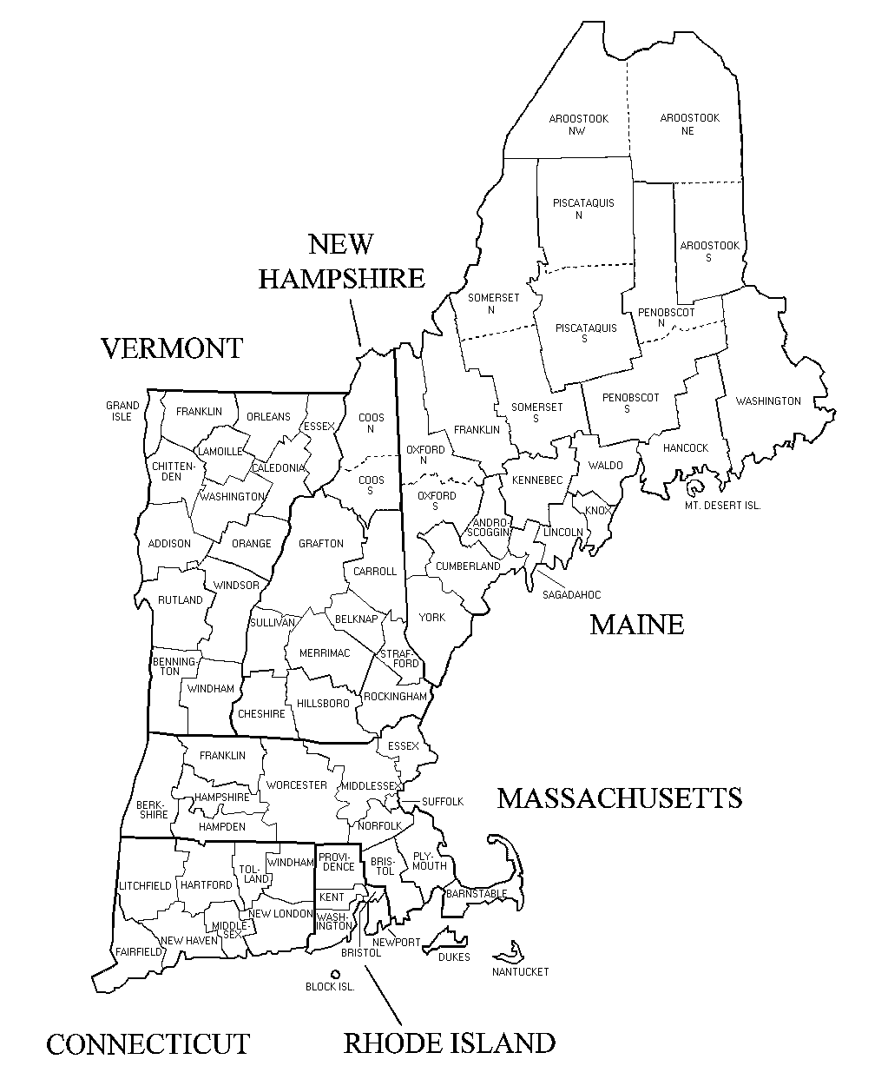
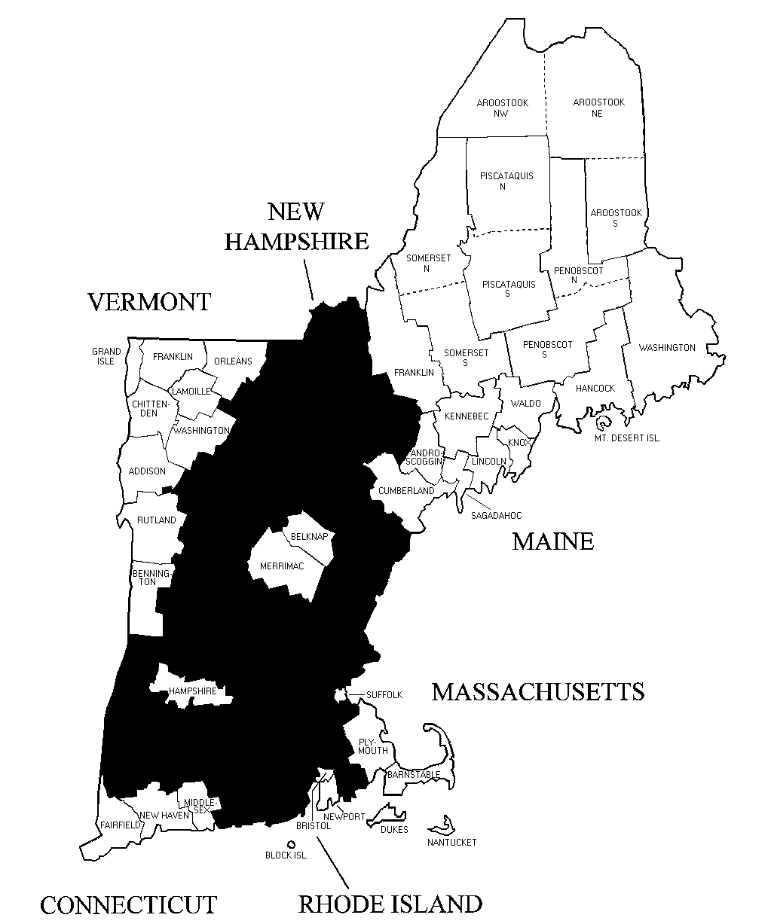
Sample Construction

Slide 8
Summary Statistics
Descriptive Statistics (Border Counties) (Table 2)
 | Full Service |  | Limited Service
Number of Observations: | 912 |  | 884
 | Mean | Standard Deviation | Mean | Standard Deviation
Employment | 5,552.5 | 620.3 | 2962.2 | 338.05
Private Sector Employment | 126,597.6 | 8,730 | 130874.1 | 8867.6
Earnings | 362.2 | 40.9 | 290.94 | 32.58
Population | 316,779.5 | 6,640.9 | 327679 | 6745.1
Minimum Wage | 8.53 | .896 | 8.52 | .90
Descriptive Statistics (All Counties) (Table 1)
 | Full Service |  | Limited Service
Number of Observations: | 1,953 |  | 1,811
 | Mean | Standard Deviation | Mean | Standard Deviation
Employment | 4,358.8 | 634.2 | 2,286.5 | 316.7
Private Sector Employment | 96,501 | 7,821.3 | 103,407.1 | 8,118.0
Earnings | 365.1 | 45.6 | 239.5 | 35.4
Population | 236,367.8 | 5,588.8 | 252,703.1 | 5,801.5
Minimum Wage | 8.53 | .89 | 8.6 | .90

Slide 9
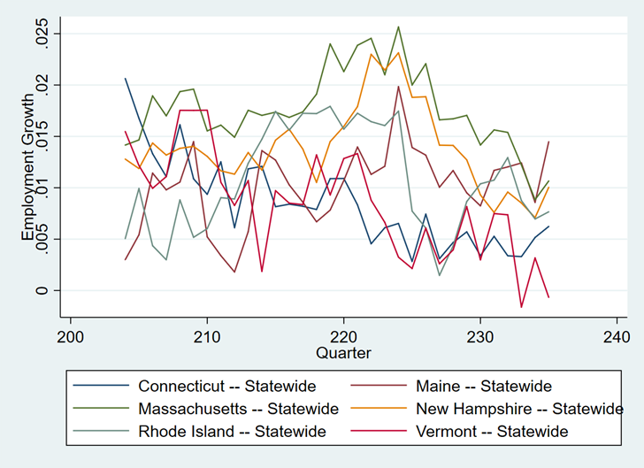

Slide 10
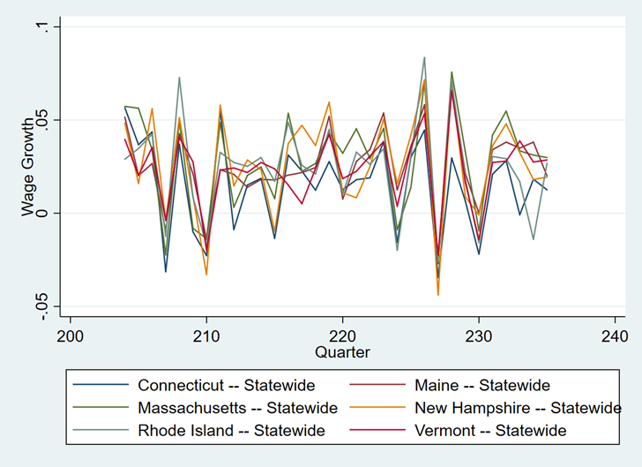

Slide 11
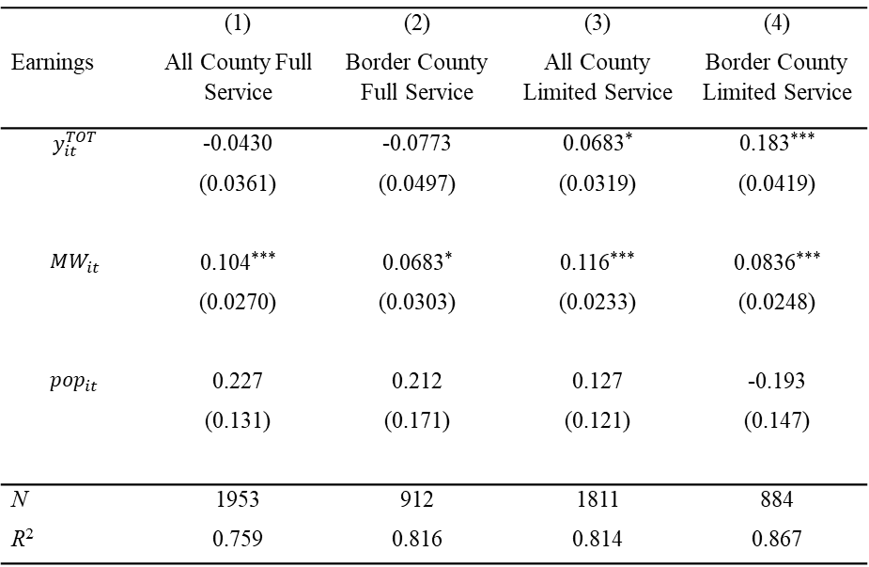
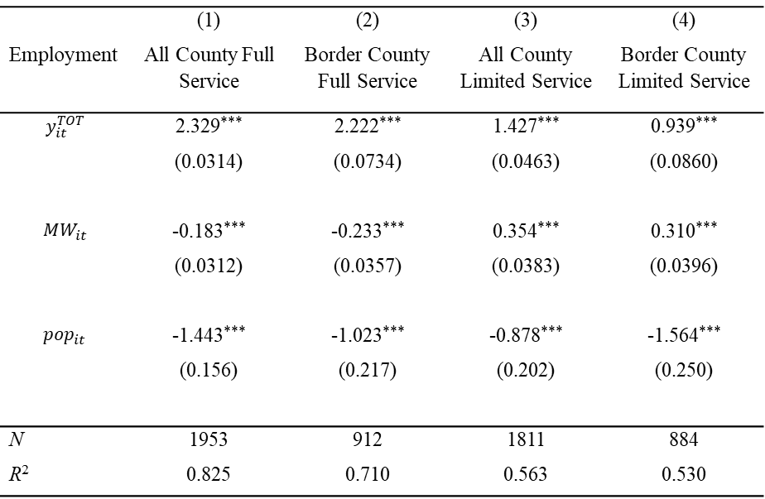
Model Results
 | (1) | (2) | (3) | (4)
Employment | All County Full Service | Border County Full Service | All County Limited Service | Border County Limited Service
$$y_{it}^{TOT}$$ | 2.329*** | 2.222*** | 1.427*** | 0.939***
 | (0.0314) | (0.0734) | (0.0463) | (0.0860)
$${MW}_{it}$$ | -0.183*** | -0.233*** | 0.354*** | 0.310***
 | (0.0312) | (0.0357) | (0.0383) | (0.0396)
$${pop}_{it}$$ | -1.443*** | -1.023*** | -0.878*** | -1.564***
 | (0.156) | (0.217) | (0.202) | (0.250)
N | 1953 | 912 | 1811 | 884
R² | 0.825 | 0.710 | 0.563 | 0.530
 | (1) | (2) | (3) | (4)
Earnings | All County Full Service | Border County Full Service | All County Limited Service | Border County Limited Service
$$y_{it}^{TOT}$$ | -0.0430 | -0.0773 | 0.0683* | 0.183***
 | (0.0361) | (0.0497) | (0.0319) | (0.0419)
$${MW}_{it}$$ | 0.104*** | 0.0683* | 0.116*** | 0.0836***
 | (0.0270) | (0.0303) | (0.0233) | (0.0248)
$${pop}_{it}$$ | 0.227 | 0.212 | 0.127 | -0.193
 | (0.131) | (0.171) | (0.121) | (0.147)
N | 1953 | 912 | 1811 | 884
R² | 0.759 | 0.816 | 0.814 | 0.867

Slide 12
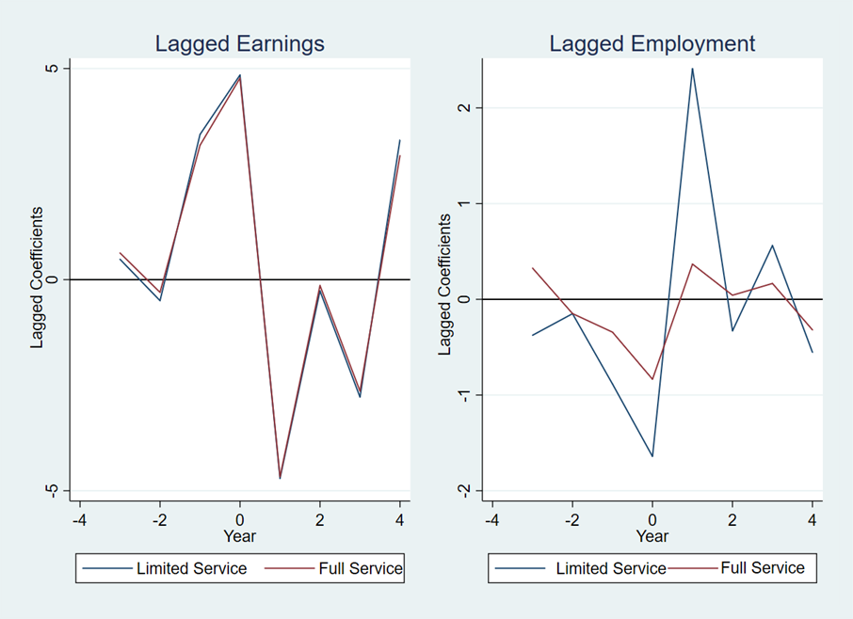
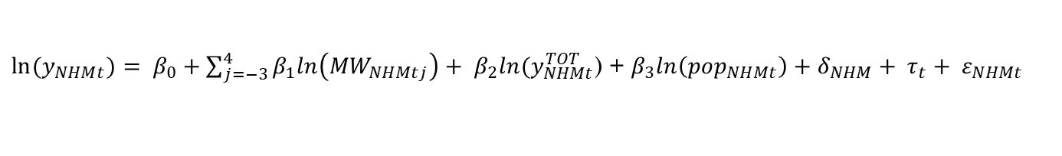
Delayed Effects of the Minimum Wage
${ln⁡(y}_{NHMt})= β_{0}+\sum_{j=−3}^{4}{β_{1}ln\left({MW}_{NHMtj}\right)}+ β_{2}ln(y_{NHMt}^{TOT}$) + $β_{3}ln\left({pop}_{NHMt}\right)+δ_{NHM}+ τ_{t}+ ε_{NHMt}$

Slide 13
Public Policy
Kaitz index represent the ratio between the minimum wage and median wage.
Historically in the United States during the 1950’s and 60’s the kaitz index ranged form .5-.6.
Since the 1970’s the Kaitz index has declined at the federal level.
In Dube (2014) Arindrajt Dube recommends a minimum wage at .5 the median wage at a localized level tied to inflation.
In 2019 given new data changed the recommendation form .5 to .6-.66.
Source: Tedeschi (2019)

