Slide 1
AI Life Recommender
Context-Aware Multi-Domain Recommendations
with Hybrid Collaborative Filtering and Agentic LLM Orchestration
Adam Sabry • Rammy Baroudi • Stephen Taylor
CMPE 256 — Recommender Systems — SJSU

Slide 2
The Problem
• Single-domain recommenders dominate the field — Netflix, Amazon, Spotify pick within one catalog
• Real decisions are cross-domain: a person planning their evening wants a movie + meal + book + habit that go together
• Rating matrices cannot represent mood, context, or constraints — "I'm tired but want to feel productive" has no place in user × item space
• No public habit-rating dataset exists, so collaborative filtering literally cannot recommend habits

Slide 3
Our System — Joint CF Backbone + Agentic LLM Layer
• Joint multi-domain matrix factorization trained on MovieLens 25M + Food.com 1M + Amazon Books 3M
• Shared user embedding across domains plus a per-domain context vector
• Four LangGraph agents (entertainment, food, learning, habit) re-rank MF candidates using LLM
• Orchestrator node enforces cross-domain coherence
• FAISS session memory + Upstash Redis profile persistence + multi-turn classification

Slide 4
System Architecture
[ PLACEHOLDER — End-to-end architecture diagram — user intent → Redis profile → FAISS memory → joint MF scoring → S1/S2 augmentation → four LangGraph agents → orchestrator → Gradio output ]

Slide 5
Joint Matrix Factorization — Scoring Function
score(user, item, domain) = (user_emb + domain_emb) · item_emb
+ user_bias + item_bias + global_bias
• One user embedding shared across all three domains
• Domain context vector added to the user embedding before the inner product
• Trained jointly with Adam + MSE on explicit ratings
• Approximately 29 million interactions total across three datasets

Slide 6
LangGraph Agent Pipeline
• retrieve_memory — FAISS lookup of similar past sessions
• entertainment_agent — MF top-30 → LLM picks 1 movie + reason
• food_agent — MF top-30 → LLM picks 1 meal + reason
• learning_agent — MF top-30 → LLM picks 1 book + reason
• habit_agent — LLM-only (no public habit-rating data)
• orchestrator — synthesizes the four picks into a coherent response

Slide 7
Novelty — Two Hybrid Augmentations
• S1: Semantic Cross-Domain Retrieval with User-Profile Anchor
• — embed item metadata via sentence-transformers, fuse with MF scores
• — query is mean of user's positively-rated item embeddings
•
• S2: Per-User Multi-Cluster Taste Model
• — KMeans on user history → K context-activated taste centroids
• — softmax posterior identifies which cluster is currently active

Slide 8
S1 — How Semantic Retrieval Works
• Each item: title + genre tags + description → sentence-transformer embedding
• Shared FAISS IndexFlatIP across all items in all domains
• User profile vector: L2-normalized mean of embeddings of their rated items
• Fused score: α · normalize(MF score) + (1 − α) · normalize(semantic similarity)
• Addresses cold-start, cross-domain bridging, long-tail surfacing

Slide 9
S2 — How Cluster Conditioning Works
• Fit K = 3 KMeans clusters on a user's rated-item embeddings
• Context vector (most recent positive interaction) → softmax over cosine sim to centroids
• MF candidate scores re-ranked by proximity to the active centroid
• Posterior entropy = ambiguity signal for future clarifying-question elicitation
• Treats user as multi-tasted with context-activated modes, not a single average

Slide 10
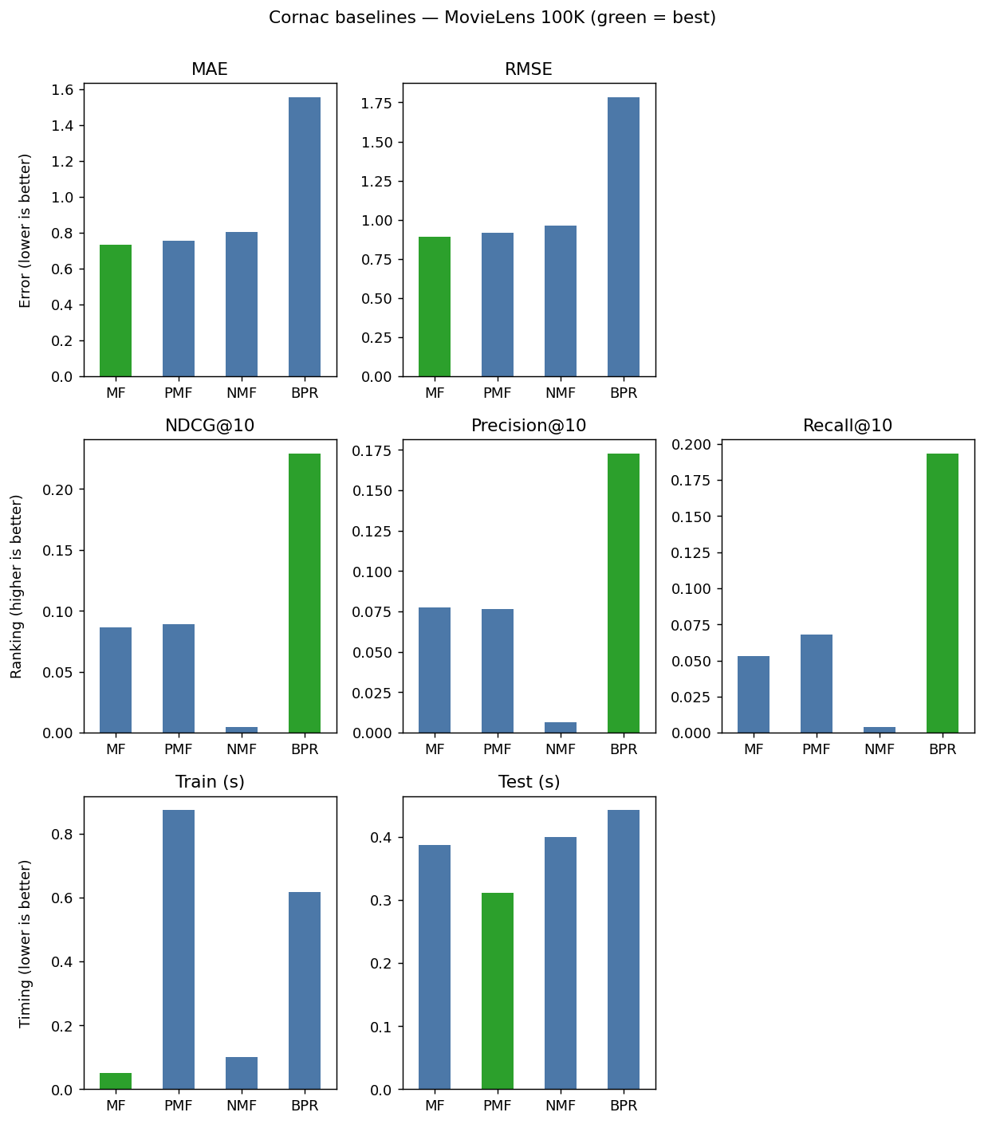
Baselines — Cornac on MovieLens 100K
MF wins rating prediction (RMSE 0.89). BPR wins ranking (NDCG@10 0.23) — different optimization targets.

Slide 11
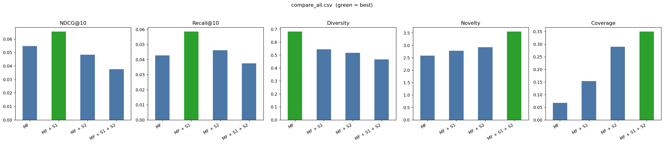
Four-Way Comparison — MF / +S1 / +S2 / +Both

Slide 12
Numerical Results
Configuration | NDCG@10 | Recall@10 | Diversity | Novelty | Coverage
MF | 0.0548 | 0.0428 | 0.6802 | 2.5814 | 0.0669
MF + S1 | 0.0654 | 0.0585 | 0.5434 | 2.7804 | 0.1538
MF + S2 | 0.0483 | 0.0462 | 0.5165 | 2.9223 | 0.2900
MF + S1 + S2 | 0.0375 | 0.0375 | 0.4660 | 3.5474 | 0.3495
S1 wins accuracy. S2 dominates coverage. Both combined peaks exploration metrics. Trade-off slides cleanly along the explore/exploit axis.

Slide 13
Interpretation — Discovery vs. Reproduction
• NDCG and Recall against held-out ratings implicitly reward predicting items the user already interacted with
• Held-out items skew toward popular — they had to be popular enough to get rated
• Coverage, Novelty, Diversity capture what a discovery system actually does
• Every additional layer of our system contributes measurable expansion of what the user sees
• Trade-off is a tunable design parameter (α weights), not a fixed property

Slide 14
Live Demo
[ PLACEHOLDER — Live demo screenshots — baseline HF Space vs. augmented HF Space for the same user intent; to be captured before presentation ]
• Baseline: huggingface.co/spaces/asabry1233/ai-recommender
• Augmented (S1 + S2): [TO DEPLOY]
• Backup video recorded on USB if live demo fails

Slide 15
Lessons Learned
• Cold-start handled cleanly by the semantic layer (S1) — no retraining needed
• Joint multi-domain MF scales linearly; FAISS approximate nearest neighbor is sublinear
• Offline rating metrics under-represent discovery objectives — report coverage and novelty too
• LangGraph appropriate because the pipeline is a state machine, not a chain
• Two hybrid layers compose without being redundant — different mechanisms, complementary effects

Slide 16
Team Contributions
Member | Primary Work
Adam Sabry | Joint MF training, LangGraph pipeline, FAISS memory, Redis profiles, Gradio frontend, baseline HF Space deployment
Rammy Baroudi | Dataset acquisition and preprocessing, sparsity analysis, train-test methodology, report sections on data and lessons
Stephen Taylor | Cornac baseline sweep, semantic retrieval (S1), cluster conditioning (S2), 4-way comparison, test suite, augmented HF Space
[ PLACEHOLDER — Confirm contribution table is accurate before final submission ]

Slide 17
Future Work
• Entropy-triggered clarifying questions — primitive already implemented in S2, not yet exposed
• Online cluster discovery — spawn a new taste cluster when current session matches none
• Cross-domain user studies — offline metrics are insufficient for discovery evaluation
• Deep model swap — replace shallow joint-MF with a Two-Tower neural backbone
• Domain expansion — music, fitness content, podcasts (no cross-domain training data required thanks to S1)

Slide 18
Thank You — Questions?
Repository: github.com/AdamSabry1233/AI-Life-Recommender-
Baseline demo: huggingface.co/spaces/asabry1233/ai-recommender

