Slide 1
AI Life Recommender
Context-Aware Multi-Domain Recommendations
with Hybrid Collaborative Filtering and Agentic LLM Orchestration
Adam Sabry · Rammy Baroudi · Stephen Taylor
CMPE 256 · Recommender Systems · San José State University

Slide 2
The Problem
Production recommenders pick within a single domain — movies, products, or songs — and optimize for rating prediction. The real decision a person faces is rarely single-domain and almost never captured by a rating matrix.
Single domain
No mood signal
No cross-domain coherence
Empty domains
Netflix picks movies.
Amazon picks products.
Spotify picks songs.
Nobody picks the whole evening.
User-item rating matrices have no place for "tired but want to feel productive."
Context is invisible to CF.
Independent picks per domain produce mismatched packages — a three-hour movie next to a two-hour recipe.
No public rating dataset exists for daily habits, so CF cannot recommend them at all.
AI Life Recommender · CMPE 256 · 2 / 22

Slide 3
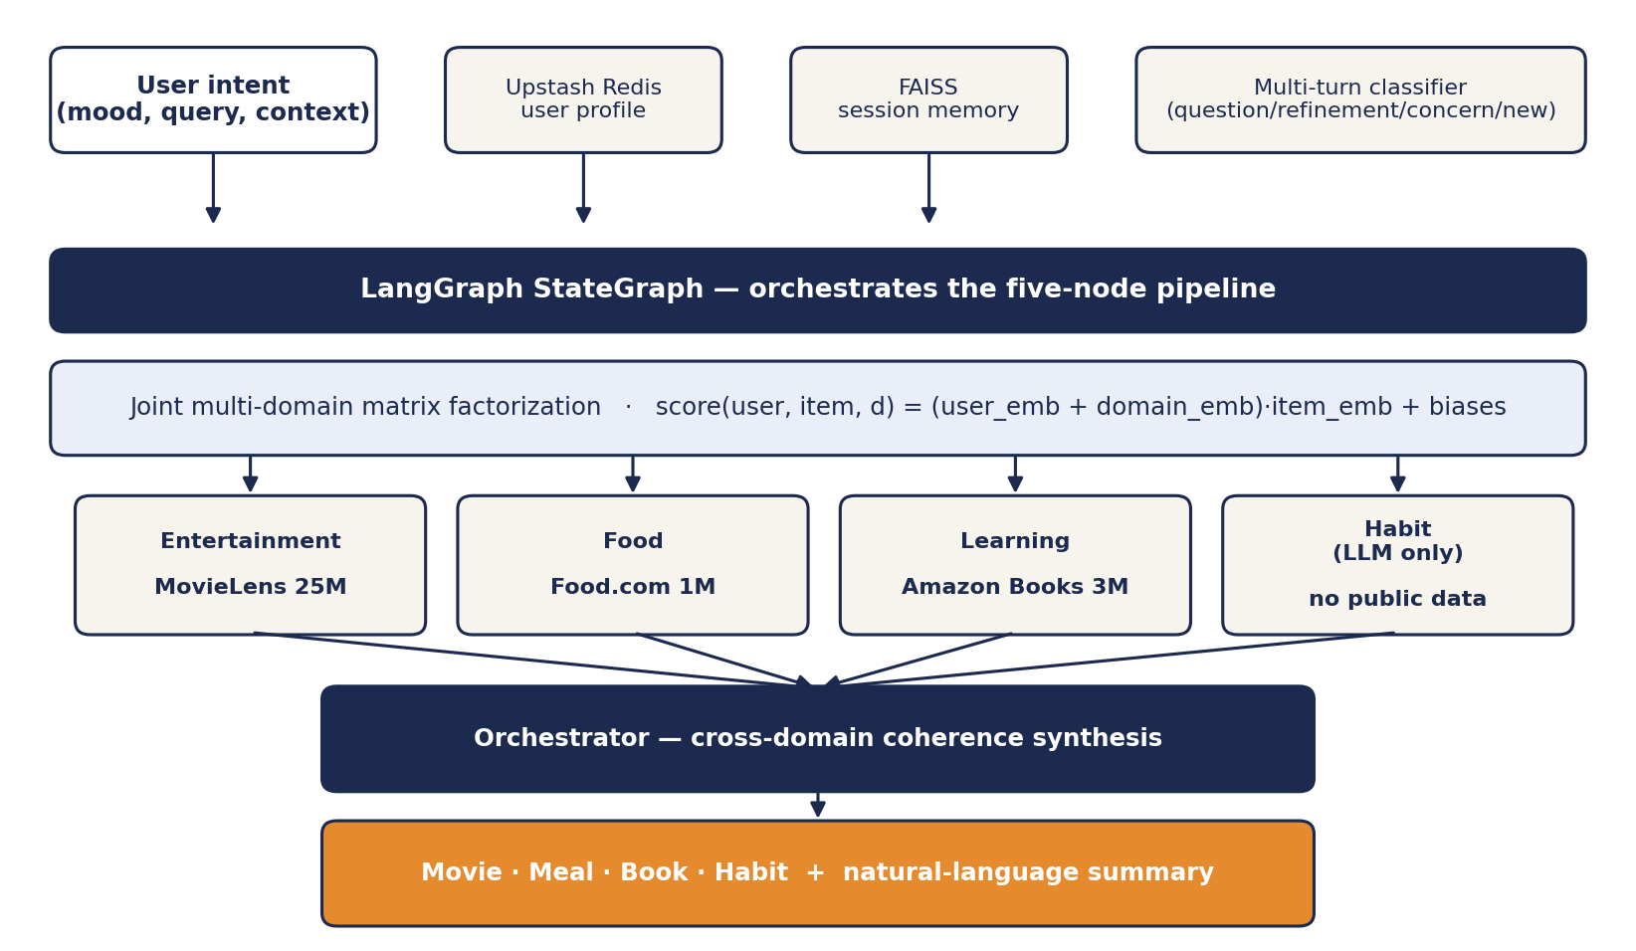
System Architecture
End-to-end pipeline from user intent to coherent recommendation
AI Life Recommender · CMPE 256 · 3 / 22

Slide 4
Datasets — Three Domains, One User Space
Domain | Source | Interactions | Items | Density
Entertainment | MovieLens 25M | ≈ 25,000,000 | 62,000 | ≈ 0.25 %
Food | Food.com Recipes | ≈ 1,000,000 | 230,000 | < 0.05 %
Learning | Amazon Books | ≈ 3,000,000 | 200,000 | ≈ 0.015 %
Habit | — no public data — | — | — | LLM-only domain
Combined corpus ≈ 29 million interactions. The joint user space is sparser than any single domain because most users participate in only one — this is the architectural motivation for a shared user embedding rather than three independent collaborative filters.
29M
3
1
+1
AI Life Recommender · CMPE 256 · 4 / 22
interactions
rating domains
shared user space
LLM-only domain

Slide 5

Joint Multi-Domain Matrix Factorization
Scoring backbone — shared user embedding plus per-domain context
Why joint
Why domain vector
Training
Most users participate in only one domain.
A shared user embedding lets collaborative signal in one domain inform predictions in others.
Adding domain_emb to the user embedding lets a single model express that the same user has different latent profiles per domain.
Adam optimizer.
MSE on explicit ratings.
Time-split 80/20.
29M interactions.
AI Life Recommender · CMPE 256 · 5 / 22

Slide 6
LangGraph Pipeline — Five Sequential Nodes
retrieve_memory
entertainment_agent
food_agent
learning_agent
habit_agent
FAISS lookup
of past sessions
MF top-30 →
LLM picks 1 movie
MF top-30 →
LLM picks 1 meal
MF top-30 →
LLM picks 1 book
LLM-only
(no MF data)
Orchestrator — synthesizes the four picks into a coherent response
Movie · Meal · Book · Habit + natural-language summary
AI Life Recommender · CMPE 256 · 6 / 22

Slide 7
Two Hybrid Contributions on Top of the CF Backbone
Each layer is independently toggleable and addresses a distinct weakness of pure CF
S1 — Semantic Cross-Domain Retrieval
S2 — Per-User Multi-Cluster Taste Model
Encode item metadata via sentence-transformers.
Build a single FAISS index over all three domains.
Query = mean of the user's positively-rated item embeddings.
Fuse MF score with semantic similarity via tunable weight α.
Addresses cold-start, cross-domain bridging, long-tail surfacing.
KMeans on each user's rated-item embeddings → K taste centroids.
Softmax over cosine(current context, centroid) → active cluster.
Re-rank MF candidates by proximity to the active centroid.
Posterior entropy is the ambiguity signal for elicitation.
Treats user as multi-tasted with context-activated modes.
AI Life Recommender · CMPE 256 · 7 / 22

Slide 8
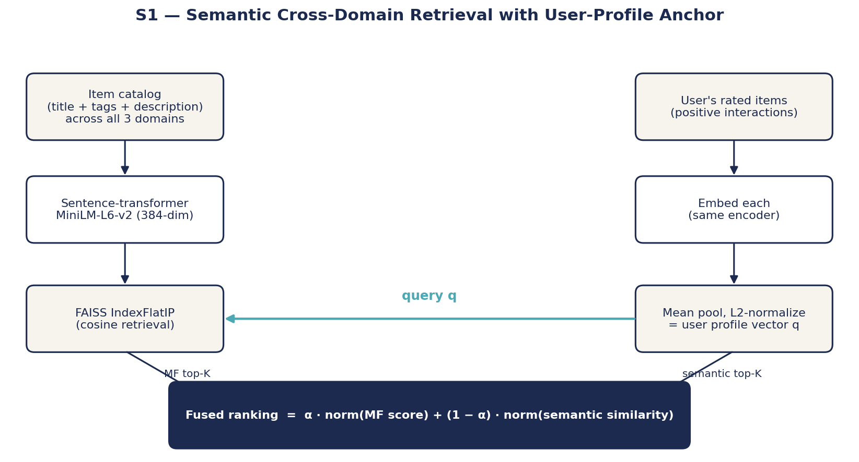
S1 — Mechanism
AI Life Recommender · CMPE 256 · 8 / 22

Slide 9


S1 — Key Equations
User profile vector (mean-pooled, L2-normalized)
Fused ranking — min-max normalized weighted sum
α tunes the explore/exploit trade-off — closer to 1 favors collaborative accuracy; closer to 0 favors content-based discovery.
AI Life Recommender · CMPE 256 · 9 / 22

Slide 10
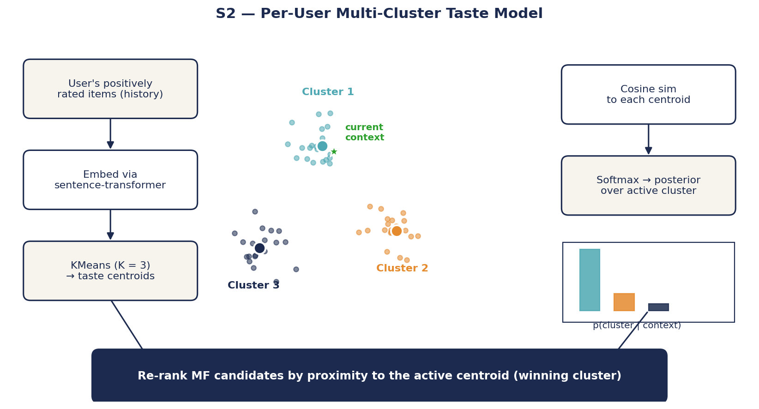
S2 — Mechanism
AI Life Recommender · CMPE 256 · 10 / 22

Slide 11


S2 — Key Equations
Cluster posterior — softmax over cosine similarity to centroids
Posterior entropy — ambiguity signal for elicitation
Low entropy → one cluster dominates → re-rank MF candidates by that centroid.
High entropy → no cluster dominates → ask one disambiguating question grounded in the centroid contents.
AI Life Recommender · CMPE 256 · 11 / 22

Slide 12
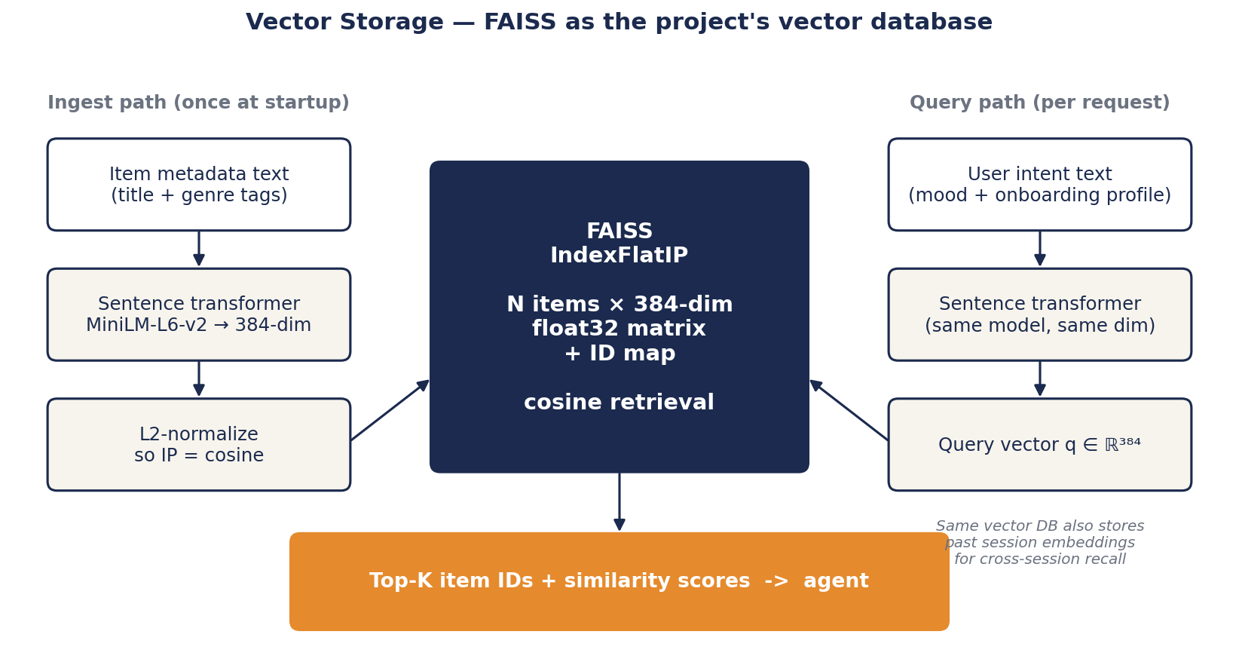
Vector Storage — FAISS as our vector database
One index serves item-metadata retrieval (S1) and session memory (Adam's existing path)
AI Life Recommender · CMPE 256 · 12 / 22

Slide 13
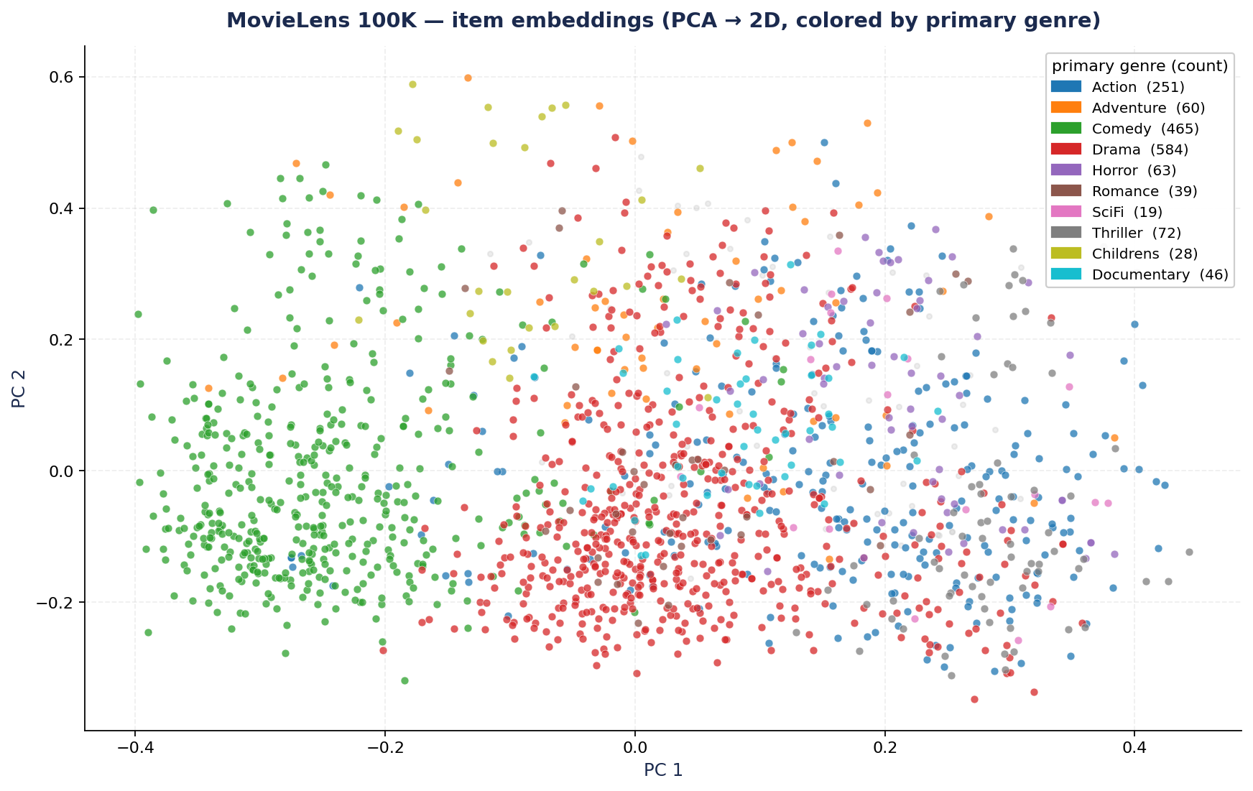
Item Embedding Space — what's in the vector DB
1,682 MovieLens items embedded with MiniLM-L6-v2, projected to 2D via PCA
Action and Adventure share the right cluster; Comedy and Drama spread across the left half; Documentaries sit apart. The structure is what FAISS searches against.
AI Life Recommender · CMPE 256 · 13 / 22

Slide 14
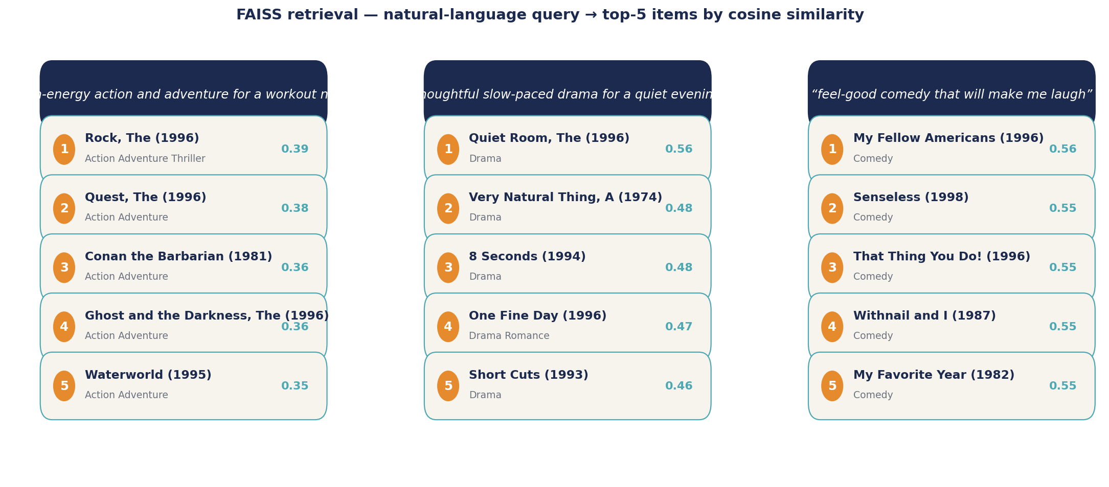
Live Retrieval — natural-language query into FAISS
Same embedder, same index — three intents, top-5 nearest items
No keyword matching, no rules. The query "feel-good comedy that will make me laugh" returns Comedy titles by cosine similarity in embedding space alone. This is the retrieval primitive S1 uses to augment MF candidates.
AI Life Recommender · CMPE 256 · 14 / 22

Slide 15
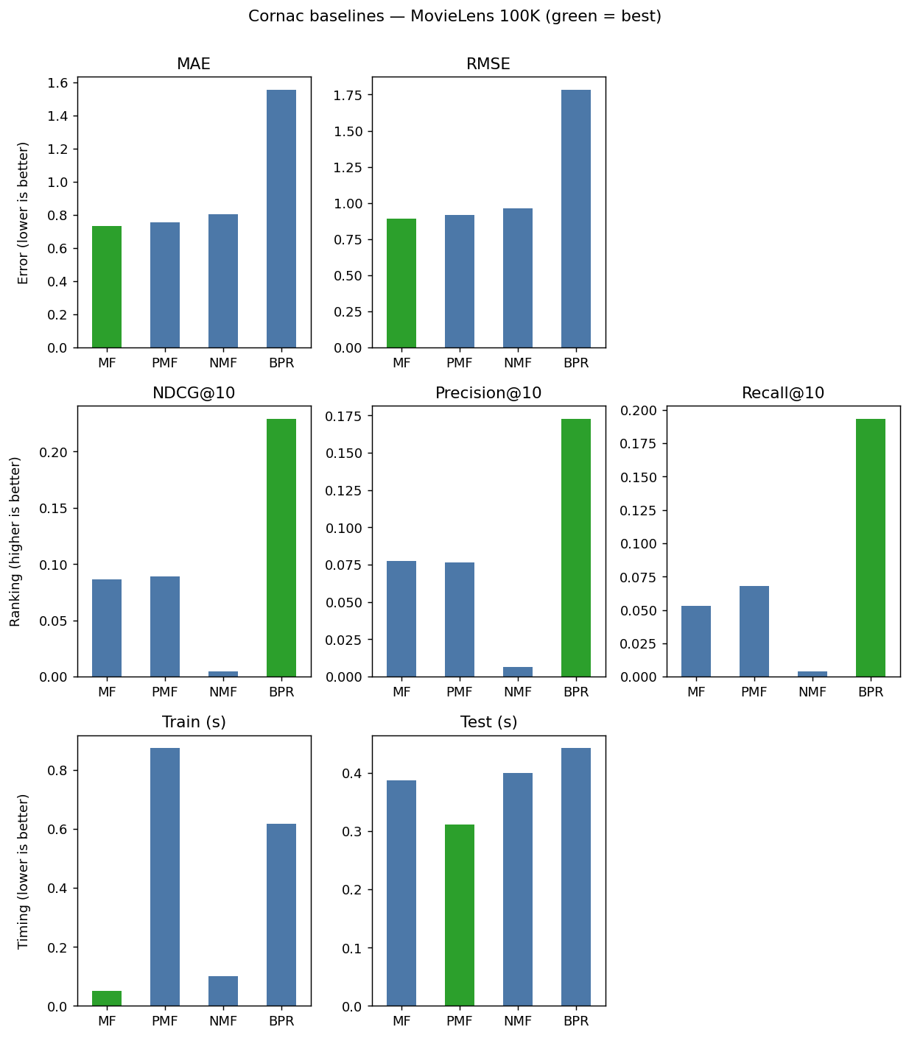
Baseline Sweep — Cornac on MovieLens 100K
MF wins rating prediction (RMSE 0.89). BPR wins ranking metrics (NDCG@10 0.23) because it optimizes a pairwise ranking loss rather than reconstruction. The split motivates reporting both metric families for the hybrid comparison.
AI Life Recommender · CMPE 256 · 15 / 22

Slide 16
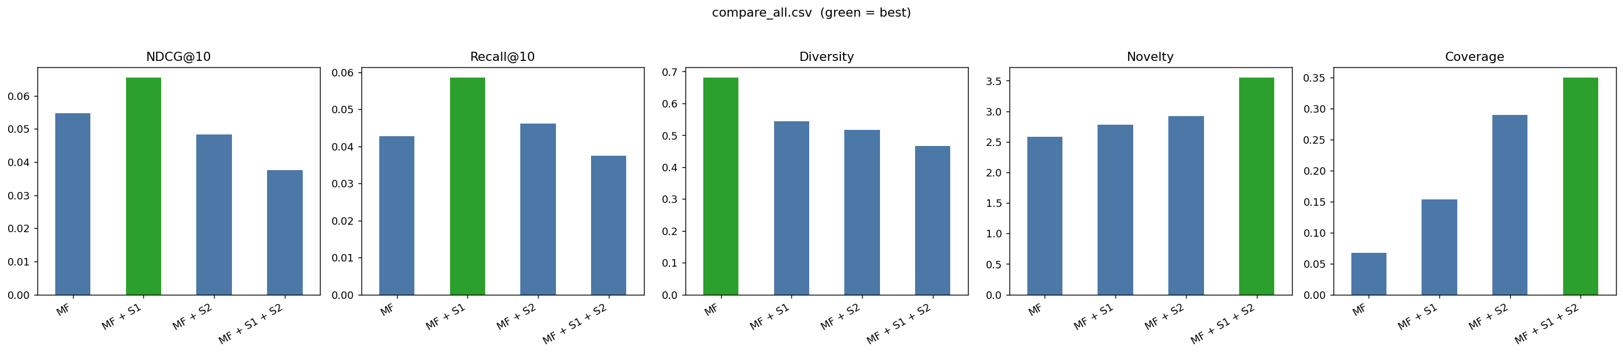
Four-Way Comparison — MF / +S1 / +S2 / +Both
Five metrics across four configurations on the same MovieLens 100K split. Accuracy on the left (NDCG, Recall). Exploration on the right (Diversity, Novelty, Coverage). Read across to see each layer's contribution.
AI Life Recommender · CMPE 256 · 16 / 22

Slide 17
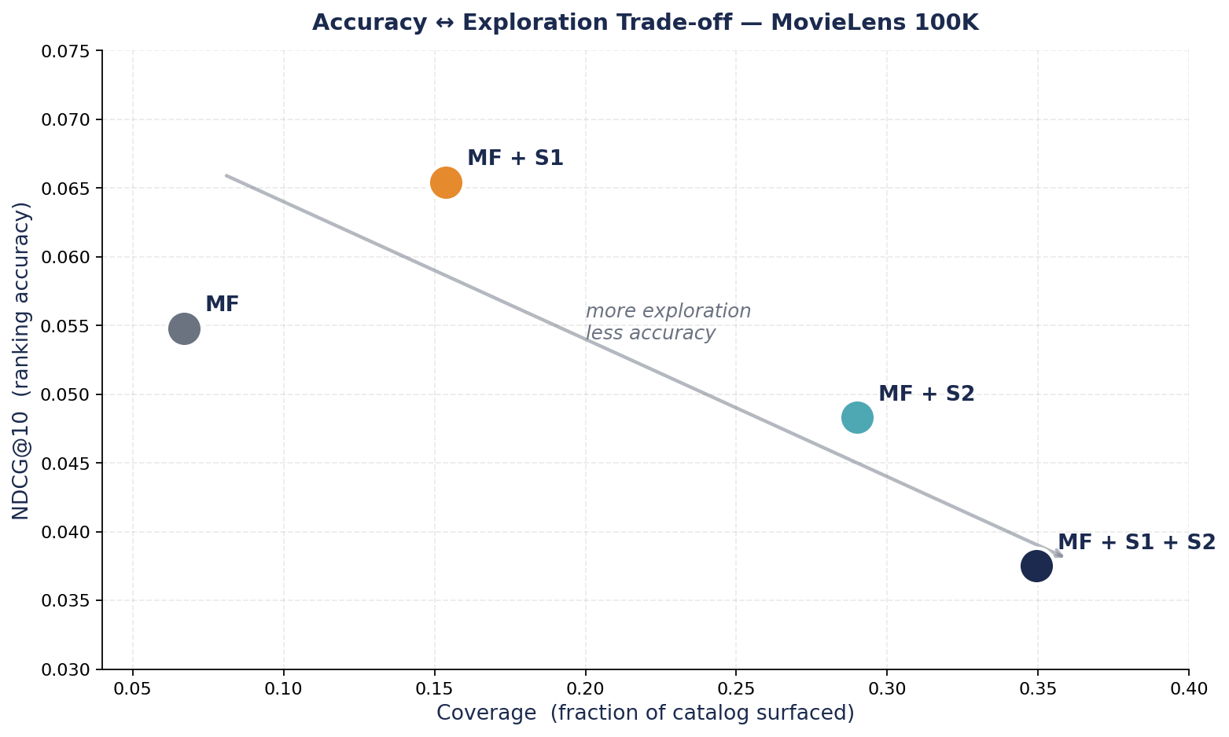
Accuracy ↔ Exploration Trade-off
Every additional layer slides the system along an explore-exploit axis. S1 alone is the only point that wins accuracy and gains coverage. S2 trades accuracy for coverage. Both combined pushes coverage and novelty to their peaks at the lowest accuracy.
AI Life Recommender · CMPE 256 · 17 / 22

Slide 18
Numerical Results & Reading
Configuration | NDCG@10 | Recall@10 | Diversity | Novelty | Coverage
MF | 0.0548 | 0.0428 | 0.6802 | 2.5814 | 0.0669
MF + S1 | 0.0654 | 0.0585 | 0.5434 | 2.7804 | 0.1538
MF + S2 | 0.0483 | 0.0462 | 0.5165 | 2.9223 | 0.2900
MF + S1 + S2 | 0.0375 | 0.0375 | 0.4660 | 3.5474 | 0.3495
S1 wins accuracy
S2 wins coverage
Both — peak exploration
NDCG up 19 %, Recall up 37 %. Anchoring retrieval to the user's profile beats pure CF popularity on a sparse dataset like ML-100K.
Coverage up 333 %, Novelty up 13 %. Cluster conditioning routes different users into different parts of the catalog.
Coverage 35 %, Novelty 3.55. Lowest NDCG. The two layers compose multiplicatively along the explore-exploit axis.
AI Life Recommender · CMPE 256 · 18 / 22

Slide 19
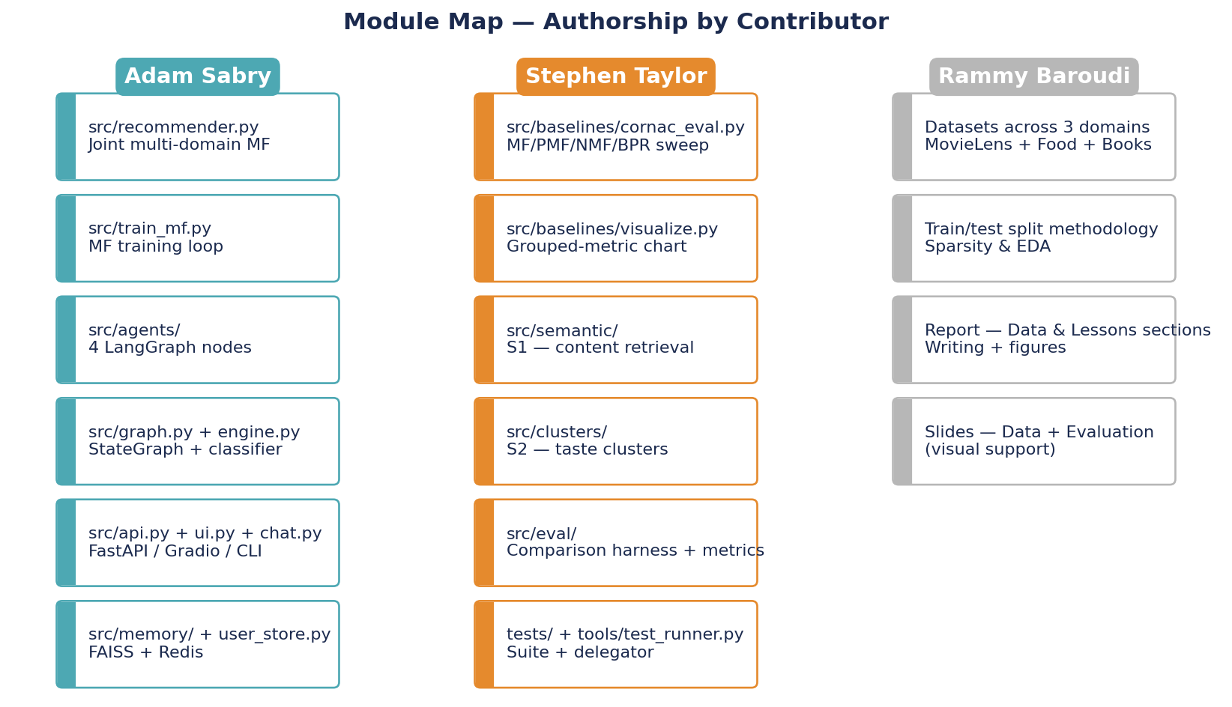
Contribution Map
Who built what
AI Life Recommender · CMPE 256 · 19 / 22

Slide 20
Live Demo
Baseline vs. augmented on the same user intent
Baseline — Adam's HF Space
Augmented — comparison build
huggingface.co/spaces/asabry1233/ai-recommender
MF + LangGraph + LLM agents.
No semantic retrieval. No cluster conditioning.
Same pipeline with S1 + S2 toggled on.
Side-by-side execution on the same intent shows the trade-off live.
[ PLACEHOLDER — live demo screenshots and 2-minute backup video to be captured before presentation ]
AI Life Recommender · CMPE 256 · 20 / 22

Slide 21
Lessons Learned & Next Steps
Lessons Learned
Future Work
Offline rating metrics under-represent discovery objectives — report coverage and novelty alongside NDCG.
The semantic layer (S1) cleanly addresses cold-start without retraining.
LangGraph is the right level of the stack when the pipeline is a stateful graph, not a linear chain.
The two hybrid layers compose without being redundant — different mechanisms, complementary effects.
Expose the entropy-triggered clarifying-question elicitation (primitive already implemented in S2).
Online cluster discovery — spawn a new cluster when the current session matches none well.
Swap the shallow joint-MF for a deep Two-Tower backbone (NeuMF / LightGCN).
Domain expansion (music, fitness, podcasts) — S1 makes this free of cross-domain training data.
AI Life Recommender · CMPE 256 · 21 / 22

Slide 22
Thank you — questions?
Repository: github.com/AdamSabry1233/AI-Life-Recommender-
Baseline demo: huggingface.co/spaces/asabry1233/ai-recommender
Adam Sabry · Rammy Baroudi · Stephen Taylor

