Slide 1
"The Regulation of Queue Size by Levying Tolls" by P. Naor (1969)
Paper presentation for BZAN605
Adam Spannbauer

Slide 2
A little queueing theory

Slide 3
A little queueing theory
Lines build when things arrive faster than we process
A queue can be modeled with parameters like

Slide 4
A little queueing theory
Lines build when things arrive faster than we process
A queue can be modeled with parameters like
Arrival rate

Slide 5

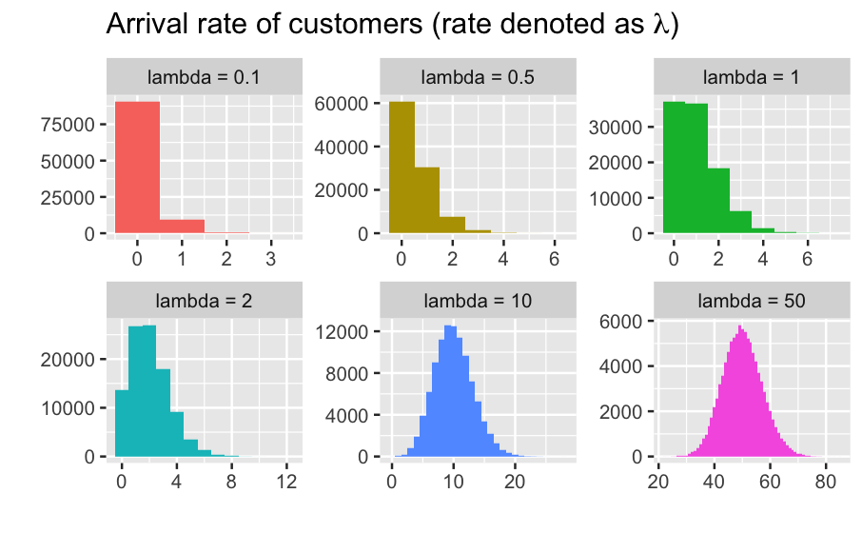
A little queueing theory
Lines build when things arrive faster than we process
A queue can be modeled with parameters like
Arrival rate
Ex: can be a Poisson process with arrival rate $λ$

Slide 6
A little queueing theory
Lines build when things arrive faster than we process
A queue can be modeled with parameters like
Arrival rate
Ex: can be a Poisson process with arrival rate $λ$
Service rate

Slide 7

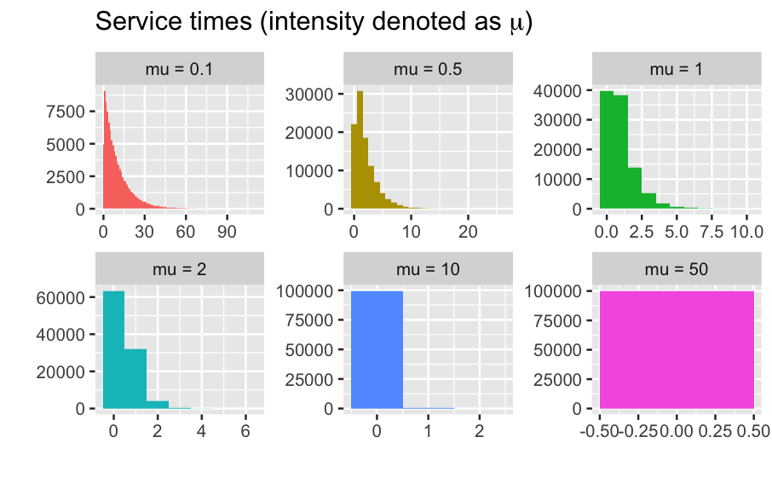
A little queueing theory
Lines build when things arrive faster than we process
A queue can be modeled with parameters like
Arrival rate
Ex: can be a Poisson process with arrival rate $λ$
Service rate
Ex: can be exponentially distributed with intensity $μ$

Slide 8
A little queueing theory
Metrics
Some common ways to measure queues are
Expected queue length ($L_{q}$)
Average waiting time ($W$)
Utilization ($ρ$)
$ρ=\frac{λ}{μ}$ (ratio of arrival rate to service rate)
Kendall, D. G. (1953). Stochastic processes occurring in the theory of queues and their analysis by the method of the imbedded Markov chain. The Annals of Mathematical Statistics, 338-354.

Slide 9

A little queueing theory
Metrics
Ex:
5 customers arrive per hour ($λ=5$)
We can service 10 customers per hour ($μ=10$)
$$ρ=\frac{5}{10}=0.5$$
50% of service capacity is being utilized
Some common ways to measure queues are
Expected queue length ($L_{q}$)
Average waiting time ($W$)
Utilization ($ρ$)
$ρ=\frac{λ}{μ}$ (ratio of arrival rate to service rate)

Slide 10

A little queueing theory
Metrics
We’re in a “steady state” when these metrics have stabilized and no longer change over time.
(i.e. viewing things “in the long run”)
Our analyses take place with this steady state view.
Some common ways to measure queues are
Expected queue length ($L_{q}$)
Average waiting time ($W$)
Utilization ($ρ$)
$ρ=\frac{λ}{μ}$ (ratio of arrival rate to service rate)

Slide 11

A little queueing theory
Metrics
Some common ways to measure queues are
Expected queue length ($L_{q}$)
Average waiting time ($W$)
Utilization ($ρ$)
$ρ=\frac{λ}{μ}$ (ratio of arrival rate to service rate)
If $ρ>1$, the arrival rate is outpacing service. Queues can grow indefinitely*, and the system will not reach a steady state.
*without mechanisms like “balking”, “finite capacity”, or tolls

Slide 12



A little queueing theory
Metrics
Some common ways to measure queues are
Expected queue length ($L_{q}$)
Average waiting time ($W$)
Utilization ($ρ$)
$ρ=\frac{λ}{μ}$ (ratio of arrival rate to service rate)
“Even when the arrival rate is smaller than the service rate (so that the server can accommodate all arrivals), queues are formed due to the variability in service and inter-arrival times.”
Hassin, R., & Haviv, M. (2003). To queue or not to queue: Equilibrium behavior in queueing systems (Vol. 59). Springer Science & Business Media.

Slide 13
Background to Naor’s work

Slide 14
Pay to getting in line?
Ideas cited by Naor
Leeman proposes tolls to manage queue size
Saaty argues Leeman’s queue toll is unjust unless queueing for a luxury
i.e. we shouldn’t toll things like healthcare lines
$5 to get in line
Leeman, W. A. (1964). The reduction of queues through the use of price. Operations Research, 12(5), 783-785. https://pubsonline.informs.org/doi/pdf/10.1287/opre.12.5.783
Saaty, T. L., & Leeman, W. A. (1965). The Burdens of Queuing Charges-Comments on a Letter by Leeman. Operations Research, 13(4), 679–681. http://www.jstor.org/stable/167860

Slide 15

Pay to getting in line?
Also suggests dynamic pricing to discourage queueing in busy times and stimulate demand in less busy times
Ideas cited by Naor
Leeman proposes tolls to manage queue size
Saaty argues Leeman’s queue toll is unjust unless queueing for a luxury
i.e. we shouldn’t toll things like healthcare lines
$5 to get in line
$2 to get in line
Leeman, W. A. (1964). The reduction of queues through the use of price. Operations Research, 12(5), 783-785. https://pubsonline.informs.org/doi/pdf/10.1287/opre.12.5.783
Saaty, T. L., & Leeman, W. A. (1965). The Burdens of Queuing Charges-Comments on a Letter by Leeman. Operations Research, 13(4), 679–681. http://www.jstor.org/stable/167860

Slide 16
Queues are like traffic?
This is the fastest road for me… but there’s so much traffic…
Ideas cited by Naor
Drivers focus on optimizing their own routes, this does not optimize the overall system
Tolls on roads can help redistribute traffic?
VS
Toll is worth it today, I need to get there quick
It’s not worth the toll, I’m going to avoid it
From a lecture by Professor Martin Beckmann (of Brown University and Bonn University) at Colloquium on "Decision Making in Traffic Planning" (organized in summer 1965 by Professor Arne Jensen of the Technical University, Copenhagen)

Slide 17
Queues are like traffic?
This is the fastest road for me… but there’s so much traffic…
Ideas cited by Naor
Drivers focus on optimizing their own routes, this does not optimize the overall system
Tolls on roads can help redistribute traffic?
We’d try to set tolls in a way that aligns self-interested utility with overall utility
VS
Toll is worth it today, I need to get there quick
It’s not worth the toll, I’m going to avoid it
From a lecture by Professor Martin Beckmann (of Brown University and Bonn University) at Colloquium on "Decision Making in Traffic Planning" (organized in summer 1965 by Professor Arne Jensen of the Technical University, Copenhagen)

Slide 18
Big impact of paper

Slide 19
Customers act in their own self interest
We can model this with $v_{service}=\frac{Rμ}{C}$ (reward of service per unit of cost)
“Naor (1969) appears to be the first to incorporate customer decisions into a queueing model.”
Naor outlines a framework for addressing $R$ewards and $C$osts for consumers
hmm… is it worth it?
Huang, T., Allon, G., & Bassamboo, A. (2013). Bounded rationality in service systems. Manufacturing & Service Operations Management, 15(2), 263-279.

Slide 20
Customers act in their own self interest
We can model this with $v_{service}=\frac{Rμ}{C}$ (reward of service per unit of cost)
$$\begin{matrix} & R=\$10 \\ & C=\$8\text{per minute} \\ & μ=5\text{minutes to service per person}\end{matrix}$$
“Naor (1969) appears to be the first to incorporate customer decisions into a queueing model.”
Naor outlines a framework for addressing $R$ewards and $C$osts for consumers
hmm… is it worth it?
Huang, T., Allon, G., & Bassamboo, A. (2013). Bounded rationality in service systems. Manufacturing & Service Operations Management, 15(2), 263-279.

Slide 21
Customers act in their own self interest
We can model this with $v_{service}=\frac{Rμ}{C}$ (reward of service per unit of cost)
$$\begin{matrix} & R=\$10 \\ & C=\$8\text{per minute} \\ & μ=5\text{minutes to service per person} \\ & n=10\text{people to go including me}\end{matrix}$$
“Naor (1969) appears to be the first to incorporate customer decisions into a queueing model.”
Naor outlines a framework for addressing $R$ewards and $C$osts for consumers
hmm… is it worth it?
Huang, T., Allon, G., & Bassamboo, A. (2013). Bounded rationality in service systems. Manufacturing & Service Operations Management, 15(2), 263-279.

Slide 22
Customers act in their own self interest
We can model this with $v_{service}=\frac{Rμ}{C}$ (reward of service per unit of cost)
$$\begin{matrix} & R=\$10 \\ & C=\$8\text{per minute} \\ & μ=5\text{minutes to service per person} \\ & n=10\text{people to go including me}\end{matrix}$$
$$v_{s}(n)=R-\frac{Cn}{μ}$$
(utility for customer given $n$ people wait)
“Naor (1969) appears to be the first to incorporate customer decisions into a queueing model.”
Naor outlines a framework for addressing $R$ewards and $C$osts for consumers
hmm… is it worth it?
Huang, T., Allon, G., & Bassamboo, A. (2013). Bounded rationality in service systems. Manufacturing & Service Operations Management, 15(2), 263-279.

Slide 23
Customers act in their own self interest
We can model this with $v_{service}=\frac{Rμ}{C}$ (reward of service per unit of cost)
$$\begin{matrix} & R=\$10 \\ & C=\$8\text{per minute} \\ & μ=5\text{minutes to service per person} \\ & n=10\text{people to go including me}\end{matrix}$$
$$v_{s}(n)=R-\frac{Cn}{μ}$$
(utility for customer given $10$ people wait)
$$v_{s}(10)=10-\frac{80}{5}=-6$$
“Naor (1969) appears to be the first to incorporate customer decisions into a queueing model.”
Naor outlines a framework for addressing $R$ewards and $C$osts for consumers
Sometimes the juice isn’t worth the squeeze and they won’t queue
nope, not today.
Huang, T., Allon, G., & Bassamboo, A. (2013). Bounded rationality in service systems. Manufacturing & Service Operations Management, 15(2), 263-279.

Slide 24
Customers act in their own self interest
We can model this with $v_{service}=\frac{Rμ}{C}$ (reward of service per unit of cost)
$$\begin{matrix} & R=\$10 \\ & C=\$8\text{per minute} \\ & μ=5\text{minutes to service per person} \\ & n=10\text{people to go including me}\end{matrix}$$
$$v_{s}(n)=R-\frac{Cn}{μ}$$
(utility for customer given $10$ people wait)
$$v_{s}(10)=10-\frac{80}{5}=-6$$
“Naor (1969) appears to be the first to incorporate customer decisions into a queueing model.”
Naor outlines a framework for addressing $R$ewards and $C$osts for consumers
Sometimes the juice isn’t worth the squeeze and they won’t queue
nope, not today.
Arriving at a queue, assessing utility, and deciding not to join is called “balking”.
Huang, T., Allon, G., & Bassamboo, A. (2013). Bounded rationality in service systems. Manufacturing & Service Operations Management, 15(2), 263-279.

Slide 25
Customers act in their own self interest
We can model this with $v_{service}=\frac{Rμ}{C}$ (reward of service per unit of cost)
$$\begin{matrix} & R=\$10 \\ & C=\$8\text{per minute} \\ & μ=5\text{minutes to service per person} \\ & n=10\text{people to go including me}\end{matrix}$$
$$v_{s}(n)=R-\frac{Cn}{μ}$$
(utility for customer given $10$ people wait)
$$v_{s}(10)=10-\frac{80}{5}=-6$$
“Naor (1969) appears to be the first to incorporate customer decisions into a queueing model.”
Naor outlines a framework for addressing $R$ewards and $C$osts for consumers
Sometimes the juice isn’t worth the squeeze and they won’t queue
nope, not today.
Since they chose not to queue they don’t receive $R$ and don’t incur $C$ $→v_{0}=0$
Huang, T., Allon, G., & Bassamboo, A. (2013). Bounded rationality in service systems. Manufacturing & Service Operations Management, 15(2), 263-279.

Slide 26
Naor’s model in more depth

Slide 27
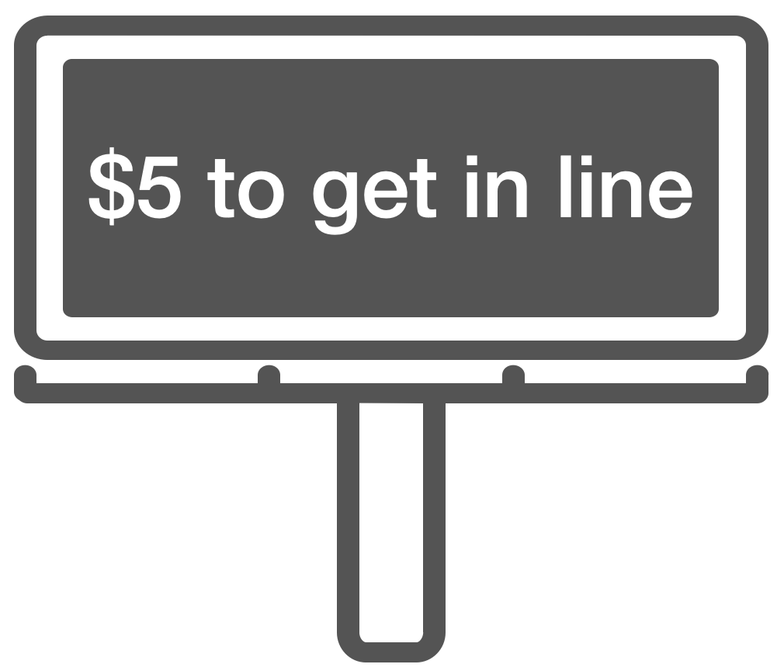
Problem statement
Can queue tolls be used to optimize the system for all?
Excessive queue lengths cause inefficiencies
e.g. wasted time & reduced customer satisfaction)
Proposal: Charge customers to enter the queue
just like auto traffic this can reroute individuals for the overall good of the system
Naor, P. (1969). The regulation of queue size by levying tolls. Econometrica: journal of the Econometric Society, 15-24. https://doi.org/10.2307/1909200

Slide 28
Conditions for model
$$R,C,λ,μ,ρ,v_{s},p_{i},g(z),E[i],ζ,b$$
There exists a public good (aka well-being) that can be maximized via some objective function.
“Customers are liable to be diverted from the service station”
Naor, P. (1969). The regulation of queue size by levying tolls. Econometrica: journal of the Econometric Society, 15-24. https://doi.org/10.2307/1909200

Slide 29
Conditions for model
$$R,C,λ,μ,ρ,v_{s},p_{i},g(z),E[i],ζ,b$$
There exists a public good (aka well-being) that can be maximized via some objective function.
“…the expected overall profit (in unit time) accruing to arriving customers is a proper objective function representing public good…”
This can have a centralized decision maker (public transportation, govt healthcare, etc) or decentralized decision makers (customers act for themselves to max their own utility)
“Customers are liable to be diverted from the service station”
Naor, P. (1969). The regulation of queue size by levying tolls. Econometrica: journal of the Econometric Society, 15-24. https://doi.org/10.2307/1909200

Slide 30


Conditions for model
$$R,C,λ,μ,ρ,v_{s},p_{i},g(z),E[i],ζ,b$$
There exists a public good (aka well-being) that can be maximized via some objective function.
“Customers are liable to be diverted from the service station”
Big contrast to prior queueing models that assumed we serve all customers
Some will queue and some will not, those that don’t have utility 0
A toll can influence the decision of queuing vs leaving
To queue…
or not to queue…
https://www.istockphoto.com/photo/lego-minifigures-series-8-figurine-the-thespian-gm458926969-22139332
Naor, P. (1969). The regulation of queue size by levying tolls. Econometrica: journal of the Econometric Society, 15-24. https://doi.org/10.2307/1909200

Slide 31
Defining the model
$$R,C,λ,μ,ρ,v_{s},p_{i},g(z),E[i],ζ,b$$
Inputs
$R$ - reward for being serviced (e.g $)
$C$ - cost per unit of time for queueing (e.g. $ per minute; assumed all customer $C$s are equal)
$λ$ - arrival rate of customers (e.g. Poisson distributed)
$μ$ - service rate (e.g. exponential distributed)
Naor, P. (1969). The regulation of queue size by levying tolls. Econometrica: journal of the Econometric Society, 15-24. https://doi.org/10.2307/1909200

Slide 32
Defining the model
$$R,C,λ,μ,ρ,v_{s},p_{i},g(z),E[i],ζ,b$$
Additional variables
$ρ=\frac{λ}{μ}$ - classic utilization factor (ratio of arrival rate to service rate)
Note! A different metric will be used to calculate service’s “busy fraction” to account for queue length of 0
$i$ - queue size at a given time (randomly distributed)
$n$ - queue capacity (if $i>n$ a customer will not queue; a customer will queue if $i≤n$)
Kendall, D. G. (1953). Stochastic processes occurring in the theory of queues and their analysis by the method of the imbedded Markov chain. The Annals of Mathematical Statistics, 338-354.
Naor, P. (1969). The regulation of queue size by levying tolls. Econometrica: journal of the Econometric Society, 15-24. https://doi.org/10.2307/1909200

Slide 33

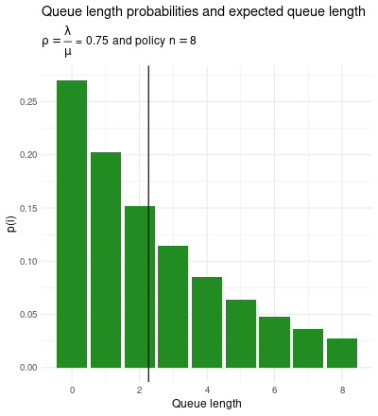
Steady state equations
$$R,C,λ,μ,ρ,v_{s},p_{i},g(z),E[i],ζ,b$$
PMF of queue length: $p_{i+1}=p_{i}ρ→p_{i}=\frac{ρ^{i}(1-ρ)}{1-ρ^{n+1}}$
The probability of line being length $i$ as a function of $ρ$ ($\frac{λ}{μ}$ - utilization factor) and $n$ (queue capacity)
Probability Generating Function: $g(z)=\overset{n}{\underset{i=0}{∑}}p_{i}z^{i}=\frac{1-ρ}{1-ρ^{n+1}}⋅\frac{1-(ρz)^{n+1}}{1-ρz}$
Expected length of queue: $E[i]=\frac{ρ[1-(n+1)ρ^{n}+nρ^{n+1}]}{(1-ρ)(1-ρ^{n+1})}=\frac{ρ}{1-ρ}-\frac{(n+1)ρ^{n+1}}{1-ρ^{n+1}}$
Kendall, D. G. (1953). Stochastic processes occurring in the theory of queues and their analysis by the method of the imbedded Markov chain. The Annals of Mathematical Statistics, 338-354.
Naor, P. (1969). The regulation of queue size by levying tolls. Econometrica: journal of the Econometric Society, 15-24. https://doi.org/10.2307/1909200

Slide 34
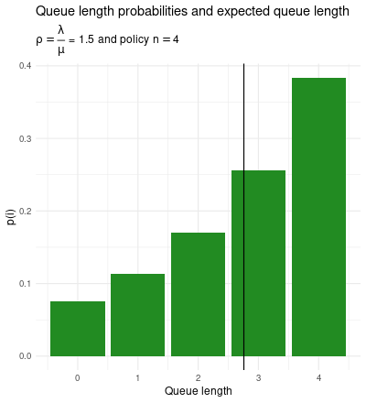
Steady state equations
$$R,C,λ,μ,ρ,v_{s},p_{i},g(z),E[i],ζ,b$$
PMF of queue length: $p_{i+1}=p_{i}ρ→p_{i}=\frac{ρ^{i}(1-ρ)}{1-ρ^{n+1}}$
The probability of line being length $i$ as a function of $ρ$ ($\frac{λ}{μ}$ - utilization factor) and $n$ (queue capacity)
Probability Generating Function: $g(z)=\overset{n}{\underset{i=0}{∑}}p_{i}z^{i}=\frac{1-ρ}{1-ρ^{n+1}}⋅\frac{1-(ρz)^{n+1}}{1-ρz}$
Expected length of queue: $E[i]=\frac{ρ[1-(n+1)ρ^{n}+nρ^{n+1}]}{(1-ρ)(1-ρ^{n+1})}=\frac{ρ}{1-ρ}-\frac{(n+1)ρ^{n+1}}{1-ρ^{n+1}}$
Kendall, D. G. (1953). Stochastic processes occurring in the theory of queues and their analysis by the method of the imbedded Markov chain. The Annals of Mathematical Statistics, 338-354.
Naor, P. (1969). The regulation of queue size by levying tolls. Econometrica: journal of the Econometric Society, 15-24. https://doi.org/10.2307/1909200

Slide 35
Steady state equations
$$R,C,λ,μ,ρ,v_{s},p_{i},g(z),E[i],ζ,b$$
nope, not today.
Balking rate (arrival rate x probability of being at capacity)
$$ζ=λp_{n}=\frac{λρ^{n}(1-ρ)}{1-ρ^{n+1}}$$
Effective arrival rate (arrival - rejection): $λ-ζ=λ(1-p_{n})$
“Busy fraction” (exclude case of no one in system)
$b=\overset{n}{\underset{i=1}{∑}}p_{i}=1-p_{0}=\frac{ρ(1-ρ^{n})}{1-ρ^{n+1}}$
Effective service rate (service * busy fraction): $μb=μ(1-p_{0})$
Kendall, D. G. (1953). Stochastic processes occurring in the theory of queues and their analysis by the method of the imbedded Markov chain. The Annals of Mathematical Statistics, 338-354.
Naor, P. (1969). The regulation of queue size by levying tolls. Econometrica: journal of the Econometric Society, 15-24. https://doi.org/10.2307/1909200

Slide 36
The big contribution
Modeling customers’ net gain
“The newly arrived customer weighs the two alternatives - to join or not to join the queue - by the net gains associated with them.”
hmm… is it worth it?
Naor, P. (1969). The regulation of queue size by levying tolls. Econometrica: journal of the Econometric Society, 15-24. https://doi.org/10.2307/1909200

Slide 37
The big contribution
Modeling customers’ net gain
“The newly arrived customer weighs the two alternatives - to join or not to join the queue - by the net gains associated with them.”
$$\text{not to join:}G_{i}=0$$
hmm… is it worth it?
Naor, P. (1969). The regulation of queue size by levying tolls. Econometrica: journal of the Econometric Society, 15-24. https://doi.org/10.2307/1909200

Slide 38
The big contribution
Modeling customers’ net gain
“The newly arrived customer weighs the two alternatives - to join or not to join the queue - by the net gains associated with them.”
$$\text{not to join:}G_{i}=0$$
$$\text{to join:}G_{i}=R-(i+1)C\frac{1}{μ}$$
hmm… is it worth it?
Naor, P. (1969). The regulation of queue size by levying tolls. Econometrica: journal of the Econometric Society, 15-24. https://doi.org/10.2307/1909200

Slide 39
The big contribution
Modeling customers’ net gain
“The newly arrived customer weighs the two alternatives - to join or not to join the queue - by the net gains associated with them.”
$$\text{not to join:}G_{i}=0$$
$$\text{to join:}G_{i}=R-(i+1)C\frac{1}{μ}$$
Cost of waiting for everyone’s service
(including the one joining)
Reward for being serviced
hmm… is it worth it?
Naor, P. (1969). The regulation of queue size by levying tolls. Econometrica: journal of the Econometric Society, 15-24. https://doi.org/10.2307/1909200

Slide 40
“Self-optimization” leads to lines of length $n_{s}$
Customers optimize for their own self-interest and the system suffers
“The newly arrived customer weighs the two alternatives - to join or not to join the queue - by the net gains associated with them.”
$$\text{not to join:}G_{i}=0$$
$$\text{to join:}G_{i}=R-(i+1)C\frac{1}{μ}$$
Notice this gain ($G_{i}$) does not consider the arrival rate ($λ$)!
If left to self-optimize, just like traffic, customers will not optimize the system overall.
hmm… is it worth it?
From a lecture by Professor Martin Beckmann (of Brown University and Bonn University) at Colloquium on "Decision Making in Traffic Planning" (organized in summer 1965 by Professor Arne Jensen of the Technical University, Copenhagen)
Naor, P. (1969). The regulation of queue size by levying tolls. Econometrica: journal of the Econometric Society, 15-24. https://doi.org/10.2307/1909200

Slide 41
“Overall optimization” leads to lines of length $n_{o}$
Maximize expected sum of customer net gains
“We note that the expected total net gain, $P$, under some strategy $n$ is given by”
$$P=(λ-ζ)R-CE[i]$$
Cost multiplied by expected number of customers in queue
Reward multiplied by expected number of customers joining queue.
This assumes once customers join the queue, they will not leave (i.e. no “reneging”)
Naor, P. (1969). The regulation of queue size by levying tolls. Econometrica: journal of the Econometric Society, 15-24. https://doi.org/10.2307/1909200

Slide 42
“Beneficial Toll Imposition” to lower $n_{s}$ to $n_{o}$
Lowering self utility via toll can raise overall utility
“a toll $θ$ is imposed on customers joining the queue and their (individually) expected net gain is reduced in such a way that $n_{o}$ is the current criterion of newly arrived customers”
Naor, P. (1969). The regulation of queue size by levying tolls. Econometrica: journal of the Econometric Society, 15-24. https://doi.org/10.2307/1909200

Slide 43
“Beneficial Toll Imposition” to lower $n_{s}$ to $n_{o}$
Lowering self utility via toll can raise overall utility
“a toll $θ$ is imposed on customers joining the queue and their (individually) expected net gain is reduced in such a way that $n_{o}$ is the current criterion of newly arrived customers”
$$R-\frac{C(n_{o}+1)}{μ}<θ^{*}≤R-\frac{C(n_{o})}{μ}$$
“If a toll taken from this range is levied on customers joining the queue, the combined income (in unit time) of customers and the revenue agency is maximized.”
Naor, P. (1969). The regulation of queue size by levying tolls. Econometrica: journal of the Econometric Society, 15-24. https://doi.org/10.2307/1909200

Slide 44
“Revenue Maximization”
Tolls to zero out customers gain and maximize revenue
“The toll collecting agency may be completely divorced from the individual and collective economic interests of the customers. In that case the agency will seek to impose a toll, $θ_{r}$, designed to maximize its own revenue rather than to optimize the whole system.”
$$M=(λ-ζ)θ$$
Toll value
Expected number of customers joining queue.
Naor, P. (1969). The regulation of queue size by levying tolls. Econometrica: journal of the Econometric Society, 15-24. https://doi.org/10.2307/1909200

Slide 45
“Revenue Maximization” to lower $n_{s}$ to $n_{o}$
Tolls to zero out customers gain and maximize revenue
Set the toll to be equal to the customers’ profit from waiting in line and being serviced
$$θ_{r}=R-\frac{Cn_{r}}{μ}$$
Relies on a net neutral experience being good enough to retain customers
Naor, P. (1969). The regulation of queue size by levying tolls. Econometrica: journal of the Econometric Society, 15-24. https://doi.org/10.2307/1909200

Slide 46

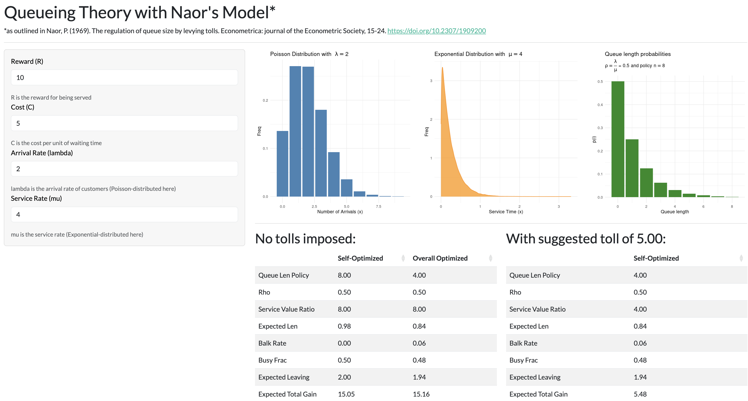
Examples via hands-on demo 🤞
https://spannbaueradam.shinyapps.io/naor/

Slide 47
Critiques

Slide 48

Adam thoughts
Before consulting the literature
Doesn’t seem to consider how the toll affects an overall gain, just the queue size
We start optimizing overall gain: $P=(λ-ζ)R-CE[i]$, but after setting a toll to bring down queue size we don’t readdress how this affects $P$
$P$ with the toll incorporated could be expressed with: $P=(λ-ζ)⋅(R-θ)-CE[i]$
😐
😐
😐
😐
😐
😐
😐
😐
Trust us, 3 is best
😠
😐
😐
😐
😠
😠
😠
Naor, P. (1969). The regulation of queue size by levying tolls. Econometrica: journal of the Econometric Society, 15-24. https://doi.org/10.2307/1909200

Slide 49
Adam thoughts
Before consulting the literature
Doesn’t seem to consider how the toll affects an overall gain, just the queue size
This could be considered net neutral because we’re optimizing for firm and customers?
“if the toll revenue may be used for redistribution of income among the population or for socially useful purposes the proposed imposition of tolls is an optimal procedure”
The “if” might hint at a tradeoff in firm’s favor
😐
😐
😐
😐
😐
😐
😐
😐
Trust us, 3 is best
😠
😐
😐
😐
😠
😠
😠
Naor, P. (1969). The regulation of queue size by levying tolls. Econometrica: journal of the Econometric Society, 15-24. https://doi.org/10.2307/1909200

Slide 50
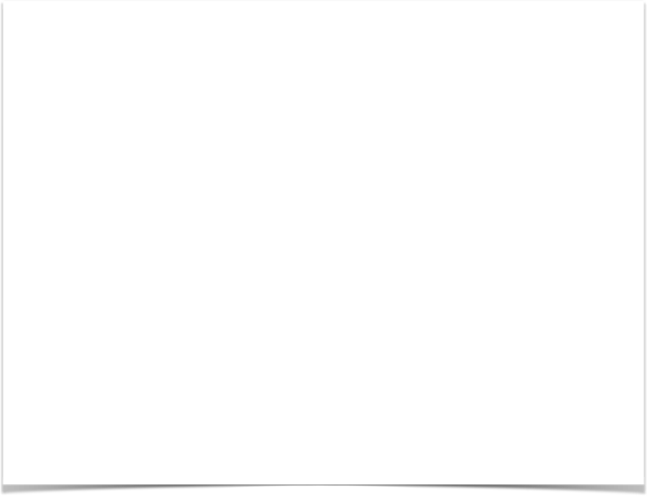
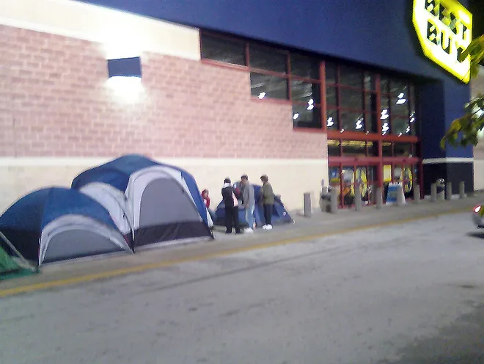
Adam thoughts
Before consulting the literature
When considering customer utility we don’t consider a cost for arriving early
One of the cited works brings up the point:
“Some have argued that the man ahead in a queue imposes a cost on those who wait behind him and must pay for it. But I say that he has already paid for it by coming earlier.”
But, to be fair, this seems like a useful simplification for most applications where we focus on steady state
https://www.jacksonville.com/story/news/2009/11/26/stub-505/15965432007/
Naor, P. (1969). The regulation of queue size by levying tolls. Econometrica: journal of the Econometric Society, 15-24. https://doi.org/10.2307/1909200

Slide 51
Critiques
Some other considerations
Are customer’s rewards and costs really all the same?
Saaty’s point against tolls on non-luxuries still stands - can be viewed as unjust to toll in some cases
Relies on assumptions that customer’s can gauge the cost-benefit accurately
Hassin, R., & Haviv, M. (2003). To queue or not to queue: Equilibrium behavior in queueing systems (Vol. 59). Springer Science & Business Media.
Huang, T., Allon, G., & Bassamboo, A. (2013). Bounded rationality in service systems. Manufacturing & Service Operations Management, 15(2), 263-279.
Saaty, T. L., & Leeman, W. A. (1965). The Burdens of Queuing Charges-Comments on a Letter by Leeman. Operations Research, 13(4), 679–681. http://www.jstor.org/stable/167860
Naor, P. (1969). The regulation of queue size by levying tolls. Econometrica: journal of the Econometric Society, 15-24. https://doi.org/10.2307/1909200

Slide 52
Implementations and extensions

Slide 53
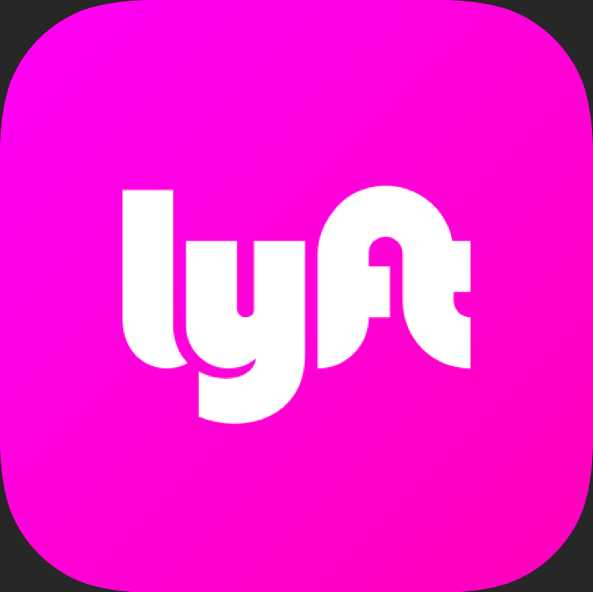


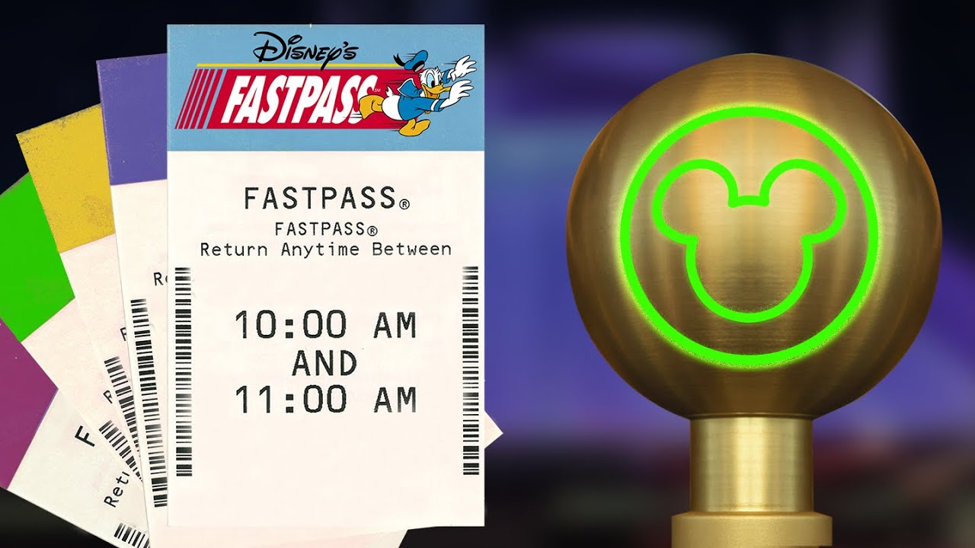
Real life implementations
Results, not just ideas
Dynamic pricing in ride share
You observe cost before entering the queue to find a driver
Uber/Lyft/etc can affect queues with this dynamic pricing like Naor’s toll
Fast track services in amusement parks
Pay toll to enter a special fast track queue
https://i.ytimg.com/vi/9yjZpBq1XBE/maxresdefault.jpg

Slide 54

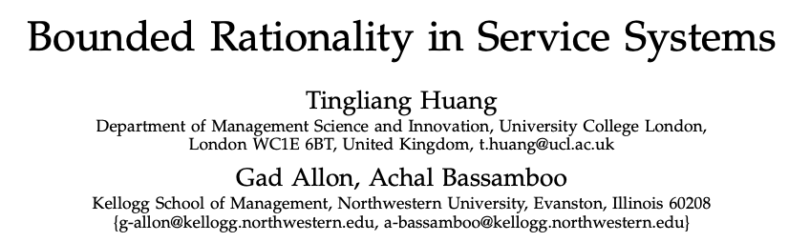
Extensions
Provided by a familiar name
“Yechiali (1971, 1972) extends Naor’s model to allow for GI/M/1 queues. Knudsen (1972) extends Naor’s model to allow for a multiserver queueing system in which arriving customers’ net benefits are heterogeneous. Lippman and Stidham (1977) extend the Naor model to the finite-horizon and discounted cases, showing that, in these settings, the economic notion of an external effect has a precise quantitative interpretation. Hassin (1986) considers a revenue maximizing server who has the opportunity to suppress information on actual queue length, leaving customers to decide whether to join the queue on the basis of the known distribution of waiting times. See Van Mieghem (2000), Hassin and Haviv (2003), Afèche (2004), and Hsu et al. (2009) for other extensions and a comprehensive literature review”
Huang, T., Allon, G., & Bassamboo, A. (2013). Bounded rationality in service systems. Manufacturing & Service Operations Management, 15(2), 263-279.

Slide 55

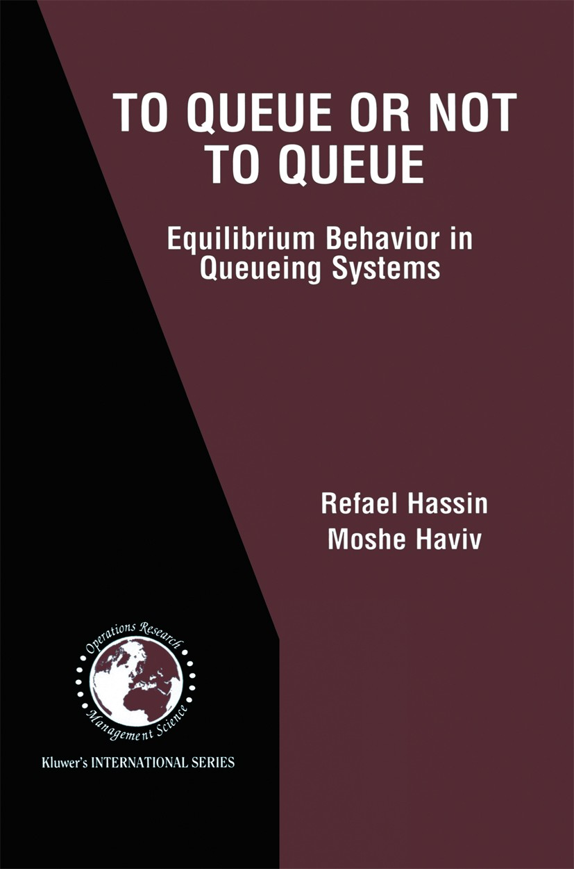
Extensions
Provided by a familiar name
“Yechiali (1971, 1972) extends Naor’s model to allow for GI/M/1 queues. Knudsen (1972) extends Naor’s model to allow for a multiserver queueing system in which arriving customers’ net benefits are heterogeneous. Lippman and Stidham (1977) extend the Naor model to the finite-horizon and discounted cases, showing that, in these settings, the economic notion of an external effect has a precise quantitative interpretation. Hassin (1986) considers a revenue maximizing server who has the opportunity to suppress information on actual queue length, leaving customers to decide whether to join the queue on the basis of the known distribution of waiting times. See Van Mieghem (2000), Hassin and Haviv (2003), Afèche (2004), and Hsu et al. (2009) for other extensions and a comprehensive literature review”
Huang, T., Allon, G., & Bassamboo, A. (2013). Bounded rationality in service systems. Manufacturing & Service Operations Management, 15(2), 263-279.

Slide 56
Qs?

