Slide 1
Hardware.Astronomy Housekeeping Box (h.aHKBox) Chassis
As Worked On By Adam Stammer

Slide 2
Project Goal
To design and build an open source, modular Eurocard system to be used as astronomical control equipment
To replace existing ZEUS2 control equipment with a cheaper, simpler, more robust system
My Goals
Design Prototyping Daughtercard (P-Card) to aid in development
Design Eurocard Backplane to connect and control modular cards
Choose Power Supplies
Put it all together in the case
Program Controllers as foundation for card interaction
Context

Slide 3
Existing Equipment

Slide 4
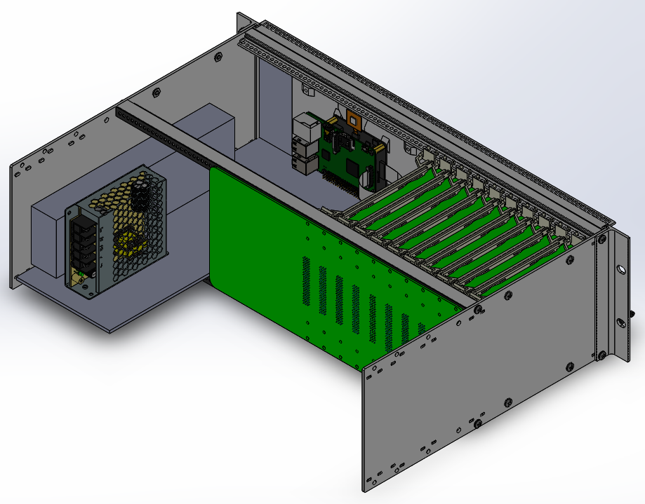
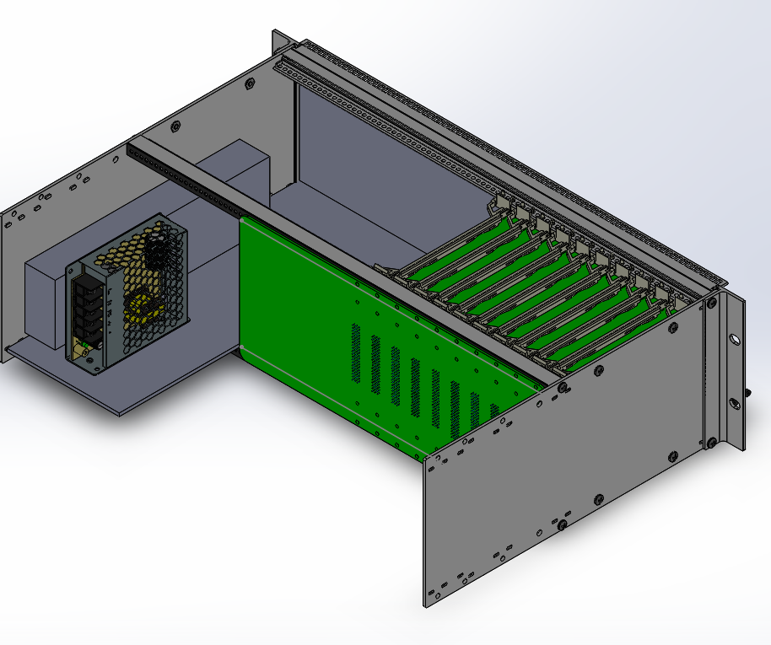
Chassis Render
Back

Slide 5
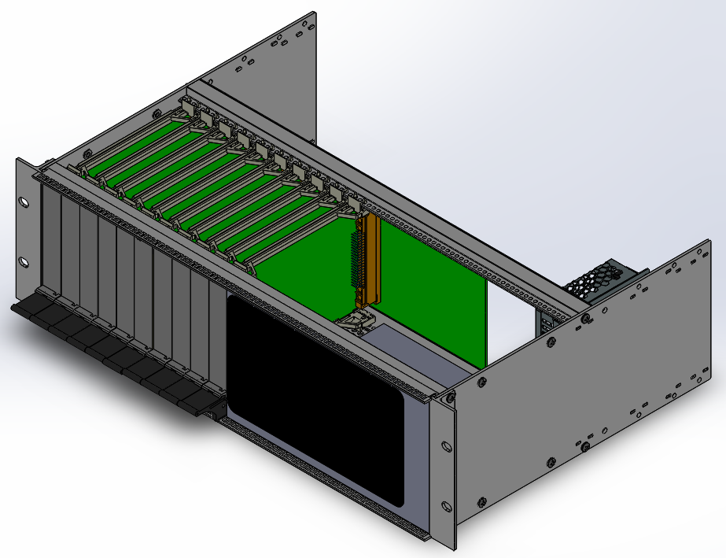
Chassis Render
Front

Slide 6
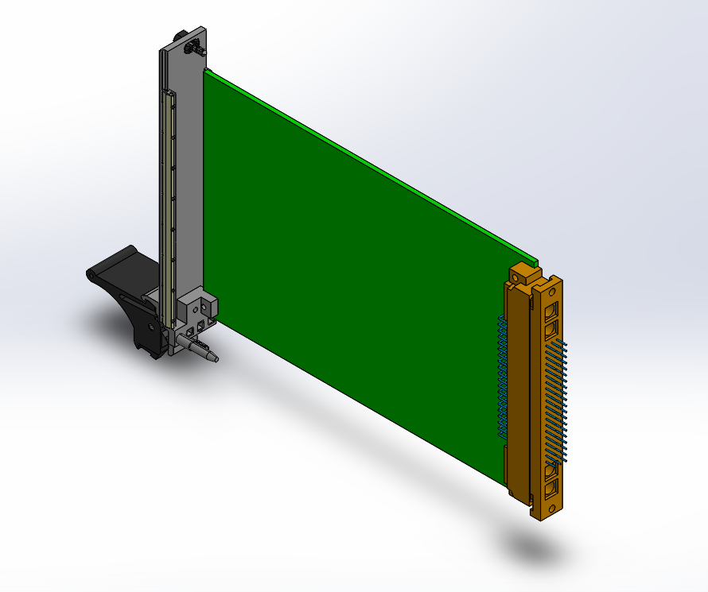
Card Render

Slide 7
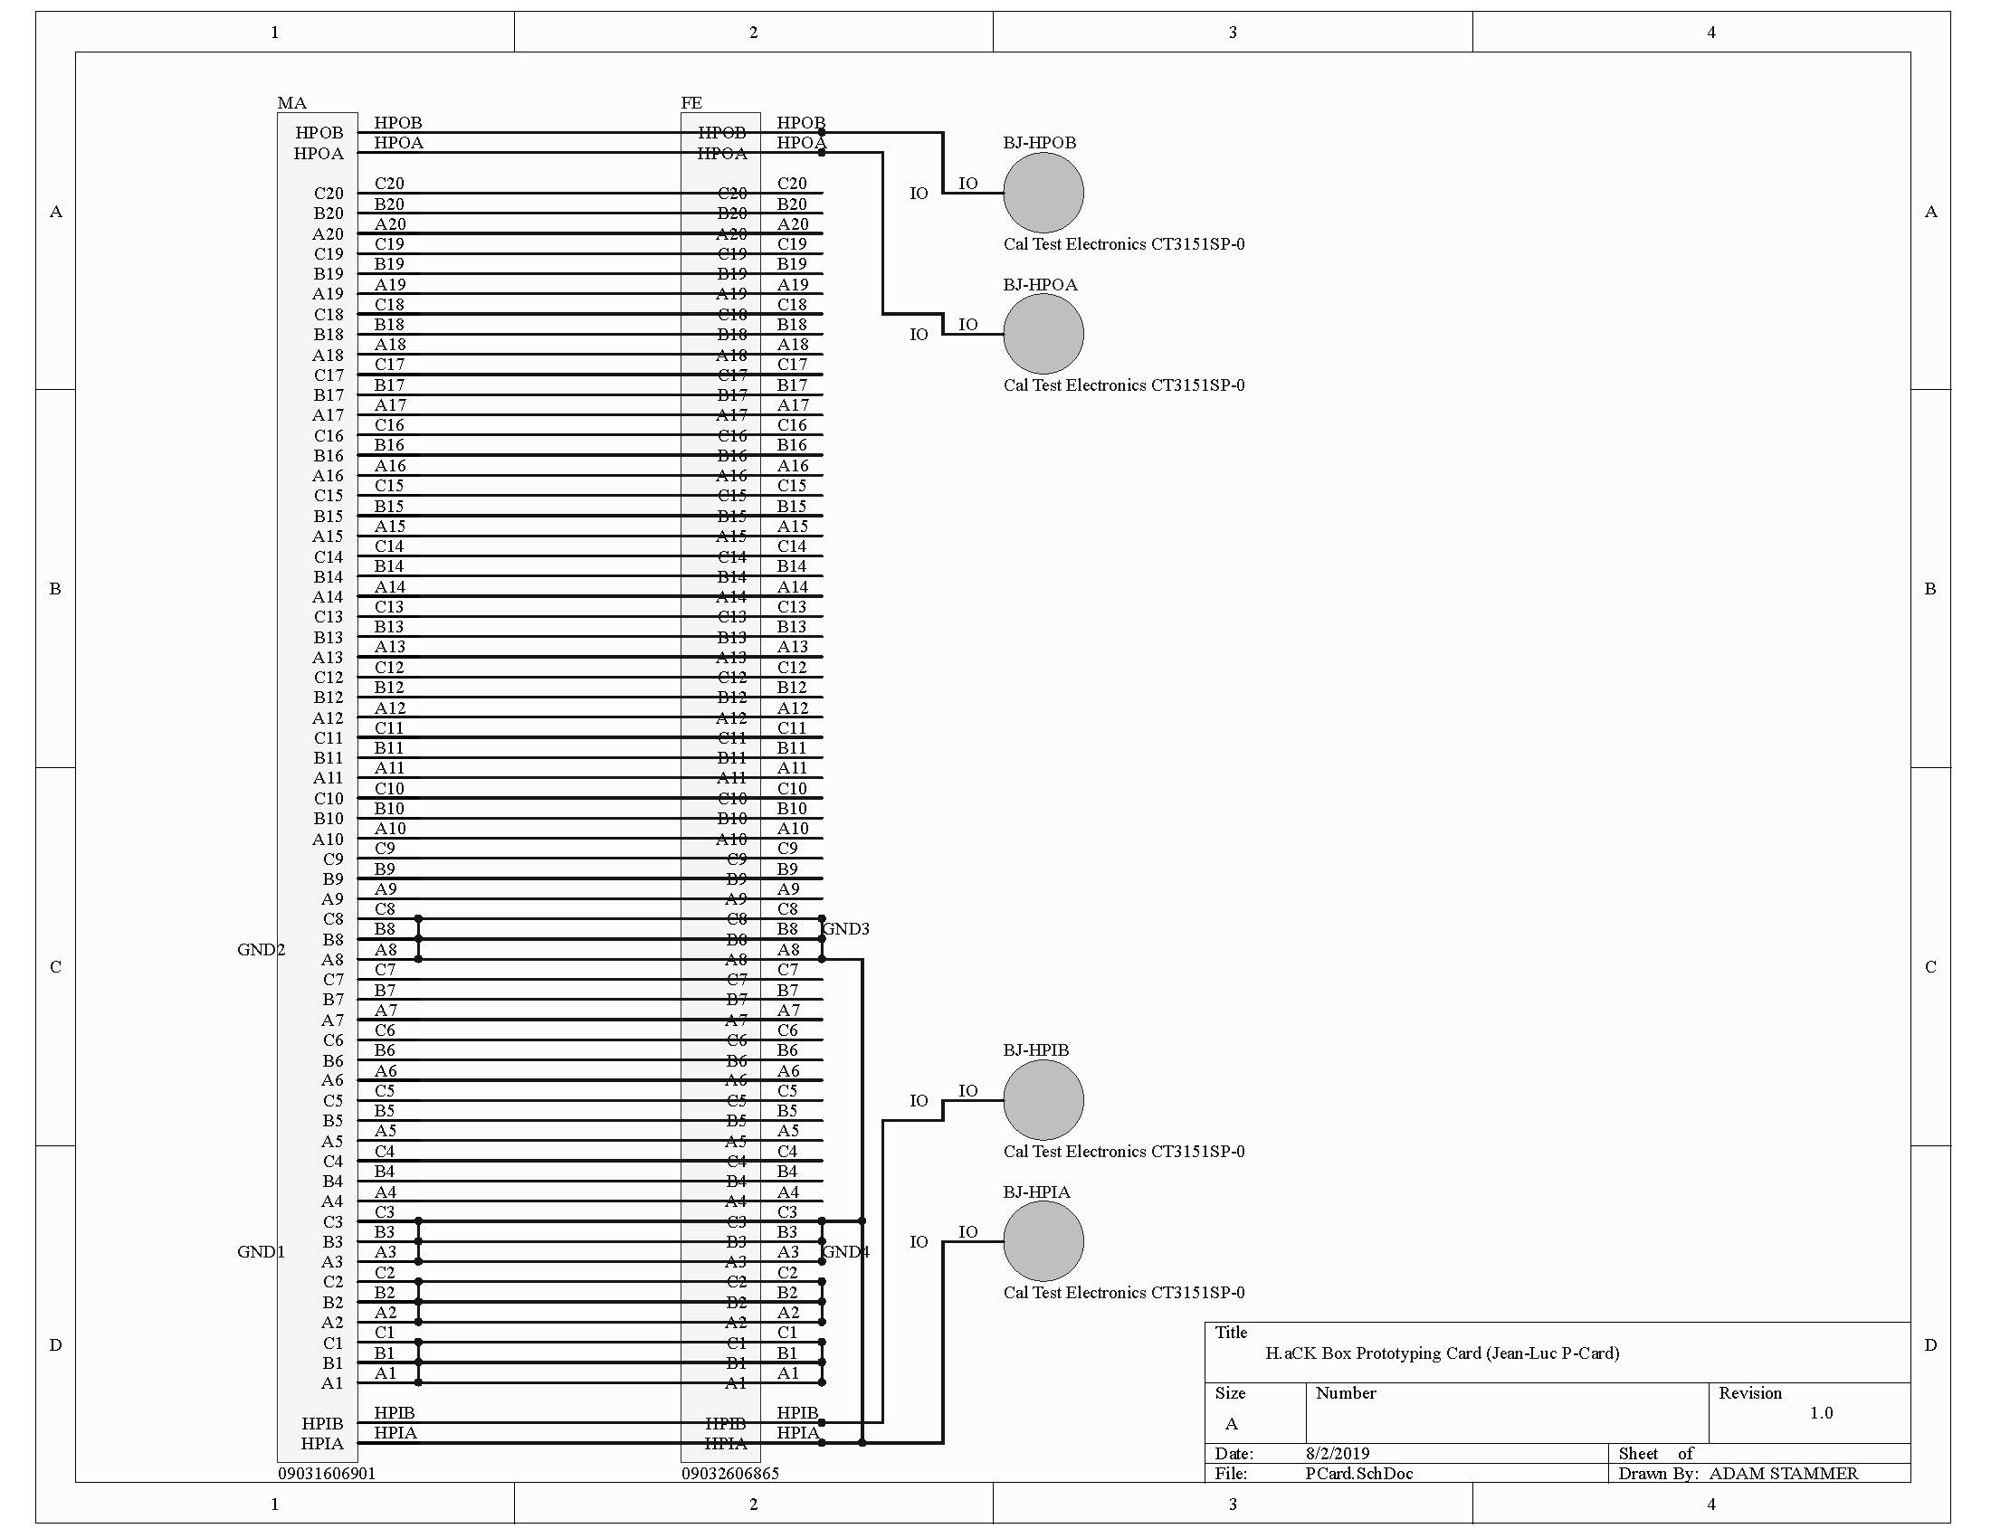
Male Socket, Female Socket, Breadboard, High Power Banana Jacks, Double Length For Easy Access
Prototyping Card (P-Card)

Slide 8
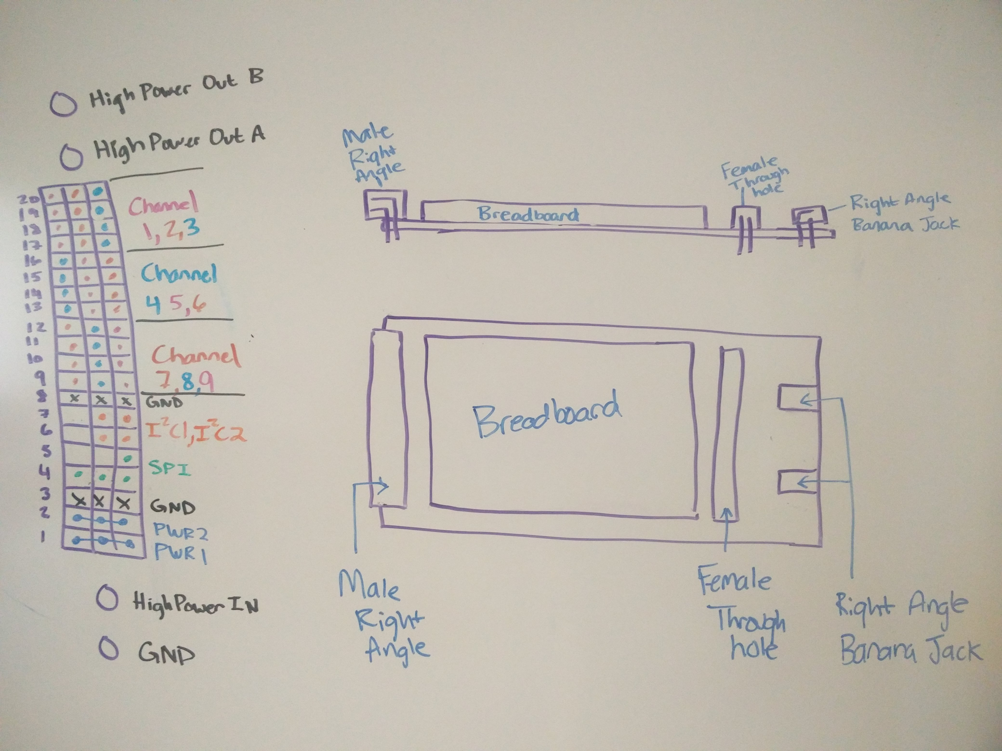
P-Card Sketch

Slide 9
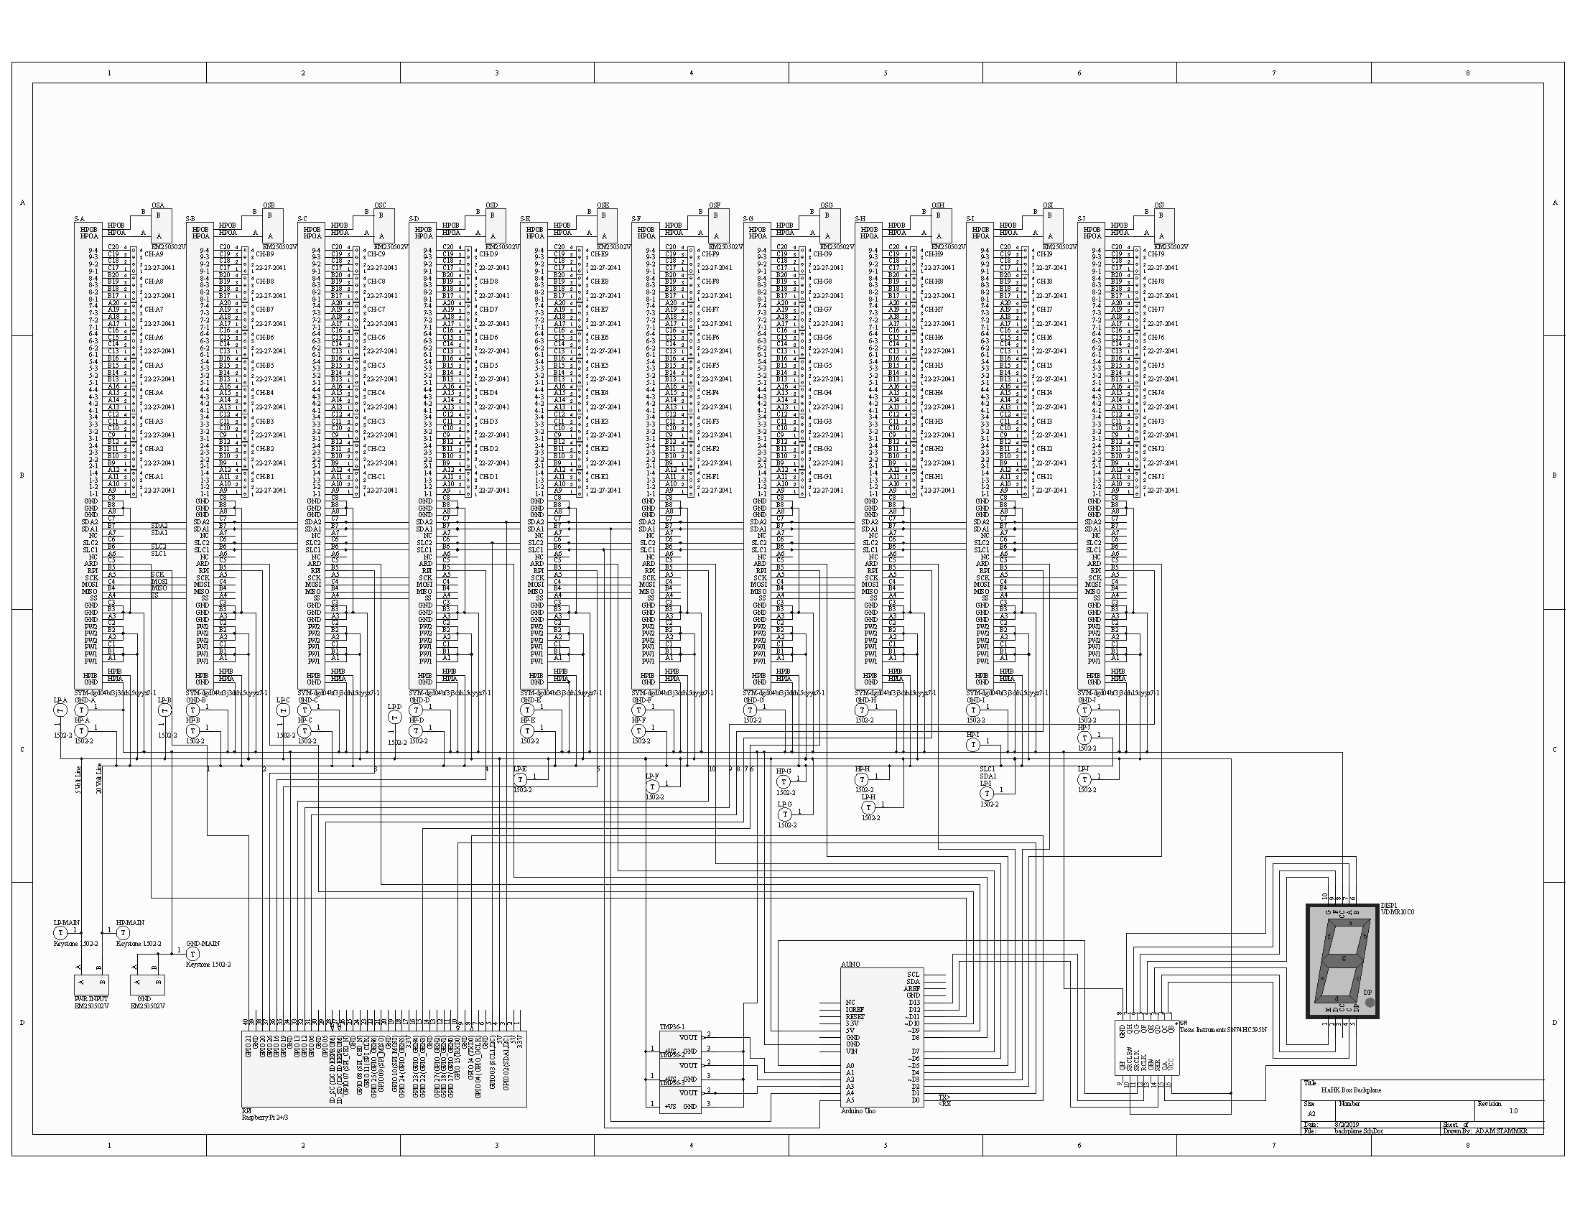
Sockets, Power, SPI, HP Signal I/O, 9 4-pin signal I/Os per card, Arduino Controller (with I2C), On board Temperature Sensors, 7-segment digit display, 5Volt and 20Volt Power, Raspberry Pi (with I2C), Interrupts from Arduino and Pi
Backplane

Slide 11
Finish Technical Guide
Summarize completed work
Guide future designers and end users
Finish Backplane PCB Layout
Build and Test Everything
Program Controllers
Design/Build Cards
Next Steps

