Slide 1
Hardware.Astronomy Housekeeping Box (H.aCKBox) Chassis
As Worked On By Adam Stammer

Slide 2
Project Goal
To design and build an open source, modular Eurocard system to be used as control equipment with the ZEUS2 while keeping costs down
My Goals
Design Prototyping Card to aid in development
Design Eurocard Backplane to connect and control modular cards
Choose Case and Power Supplies
Program Controller as foundation for card interaction
Context

Slide 3
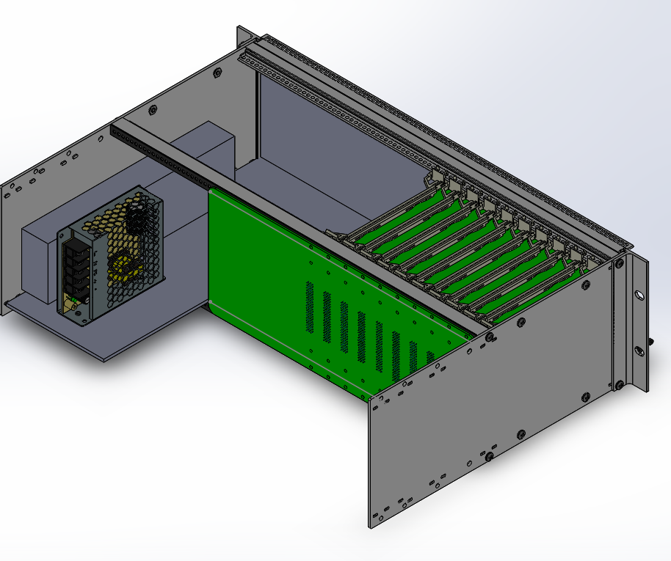
Chassis Render

Slide 4
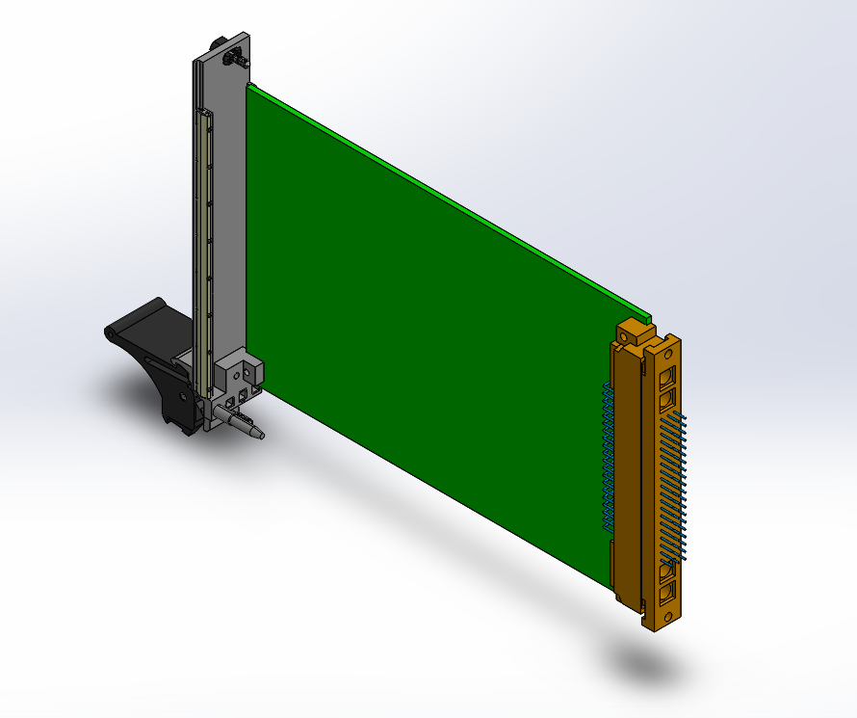
Card Render

Slide 5
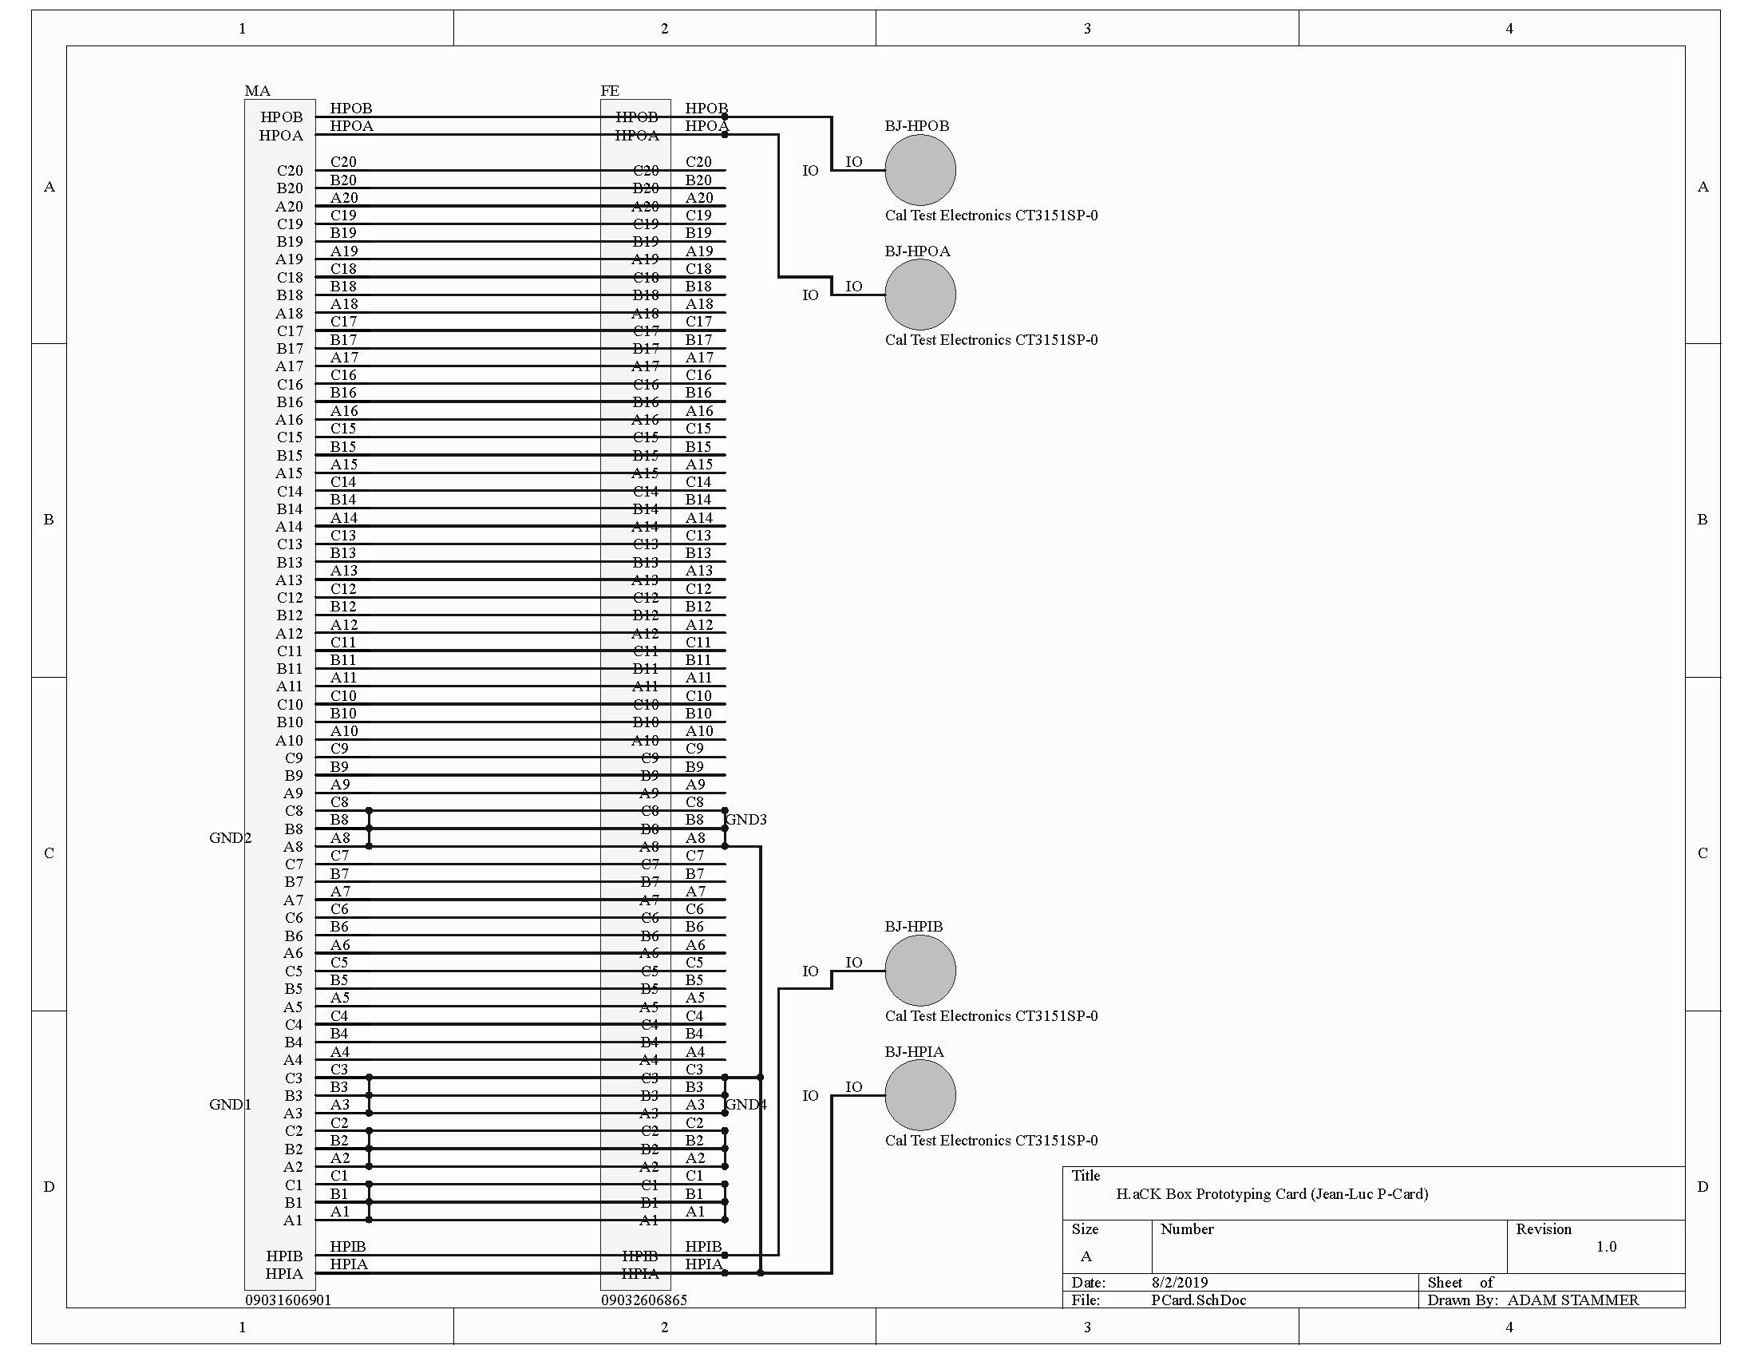
Male Socket, Female Socket, Breadboard, High Power Banana Jacks, Double Length For Easy Access
Prototyping Card (P-Card)

Slide 6
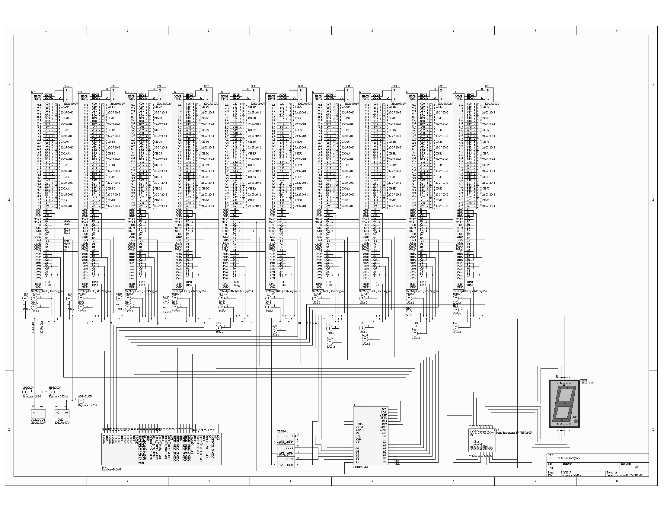
Sockets, Power, SPI, HP Signal I/O, 9 4-pin signal I/Os per card, Arduino Controller (with I2C), On board Temperature Sensors, 7-segment digit display, 5Volt and 20Volt Power, Raspberry Pi (with I2C), Interrupts from Arduino and Pi
Backplane

Slide 7
Finish Technical Guide
Summarize completed work
Guide future designers and end users
Finish Backplane PCB Layout
Build and Test Everything
Program Controllers
Design/Build Cards
Next Steps

