Slide 1
Hardware.Astronomy Housekeeping Box (H.aCKBox) Chassis
As Worked On By Adam Stammer

Slide 2
Context
Project Goal
To design and build an open source, modular Eurocard system to be used as control equipment with the ZEUS2 while keeping costs down
My Goals
Design Prototyping Card to aid in development
Design Eurocard Backplane to connect and control modular cards
Choose Case and Power Supplies
Program Controller as foundation for card interaction

Slide 3
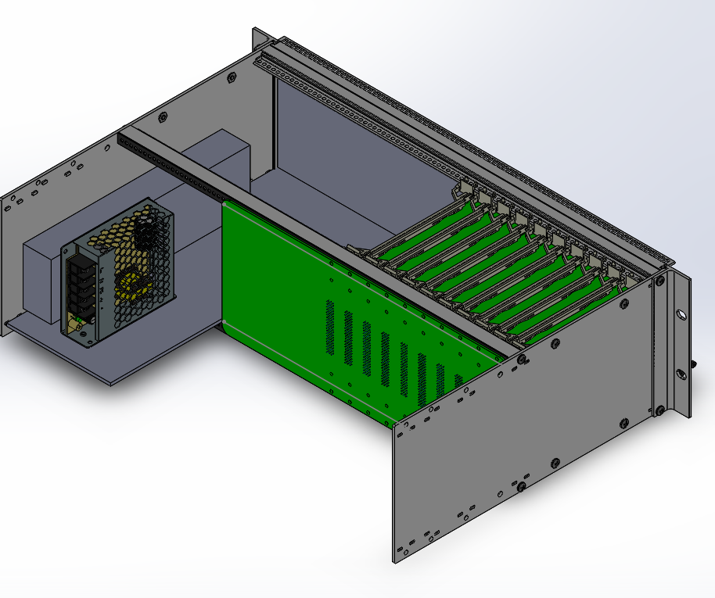
Chassis Render

Slide 4
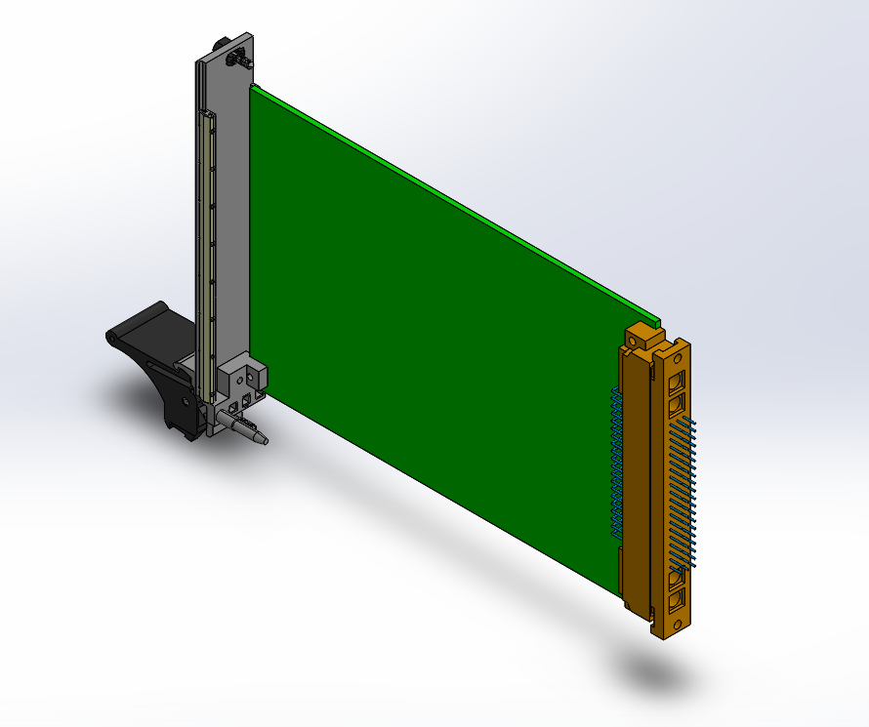
Card Render

Slide 5
Prototyping Card (P-Card)
Male Socket, Female Socket, Breadboard, High Power Banana Jacks, Double Length For Easy Access

Slide 6
Backplane
Sockets, Power, SPI, HP Signal I/O, 9 4-pin signal I/Os per card, Arduino Controller (with I2C), On board Temperature Sensors, 7-segment digit display, 5Volt and 20Volt Power, Raspberry Pi (with I2C), Interrupts from Arduino and Pi

Slide 7
Next Steps
Finish Technical Guide
Summarize completed work
Guide future designers and end users
Finish Backplane PCB Layout
Build and Test Everything
Program Controllers
Design/Build Cards

