Slide 1


HARDWARE.astronomy
Housekeeping Operating System
(H.aHk OS)
Adam Stammer
Under the Direction of Dr. Carl Ferkinhoff

Slide 2
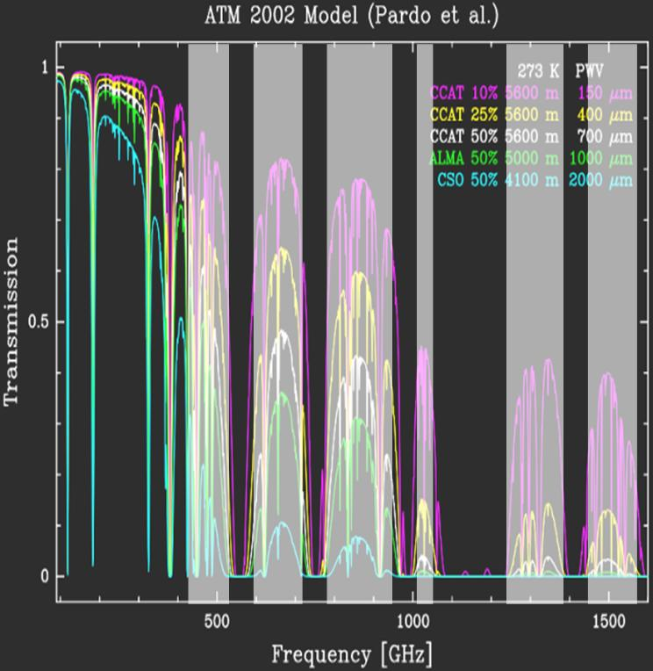
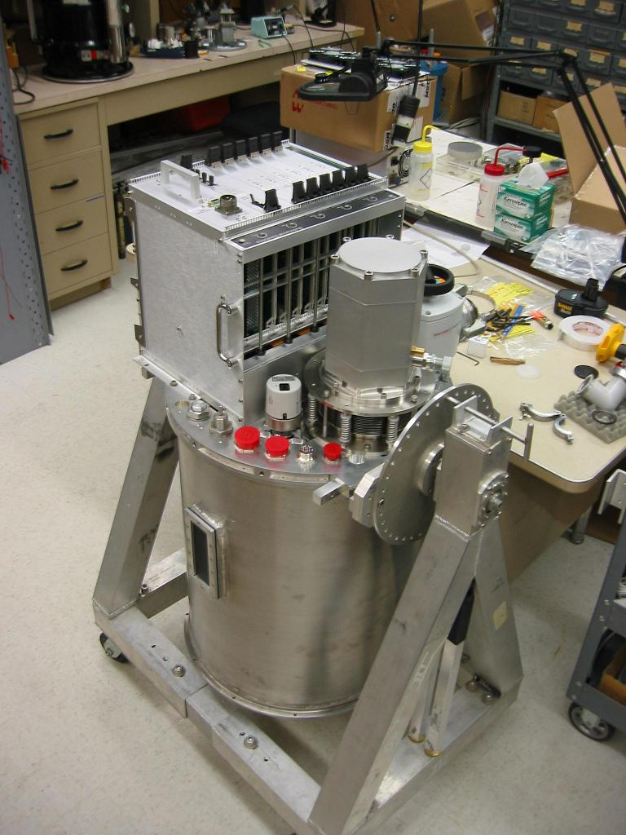
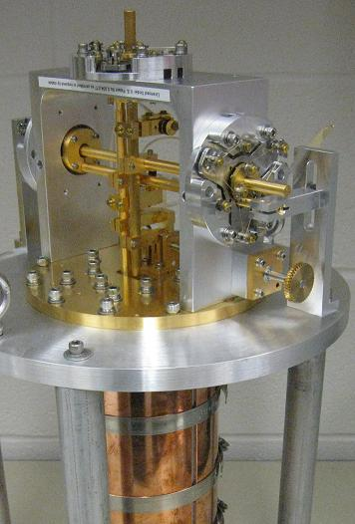
ZEUS2
Grating Spectrometer
Light Interference Proportional to Thermal Energy
Pulse-Tube Cyrocooler

Slide 3
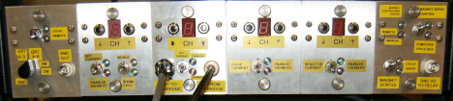
Motivations
Obsolete Internal Chips
Multiplexer Readout Rate Limit
Dependent On PC

Slide 4
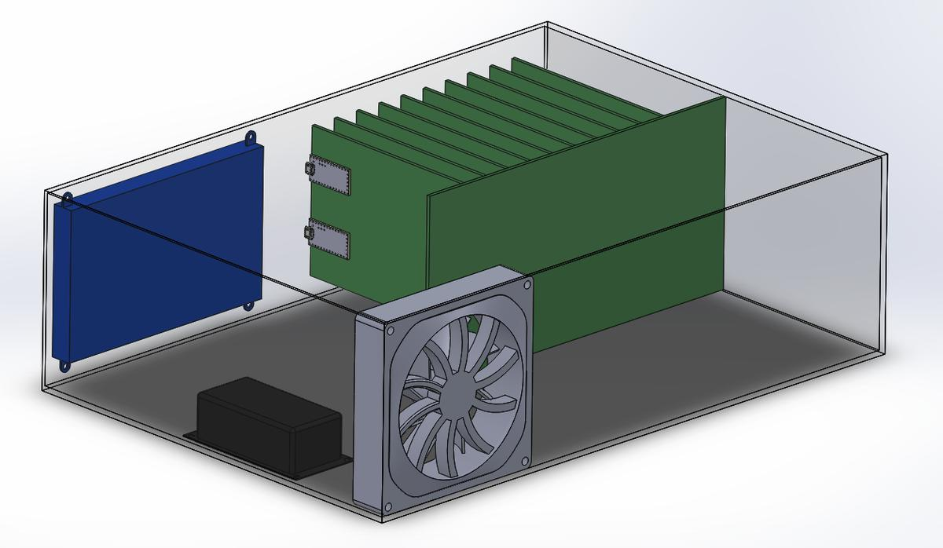
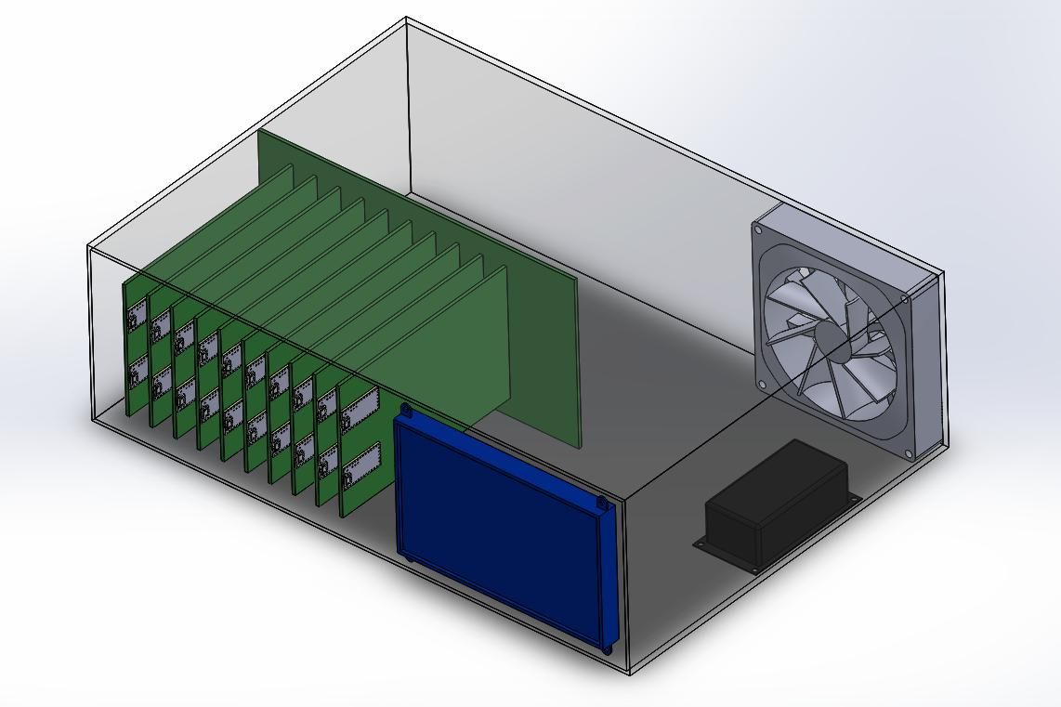
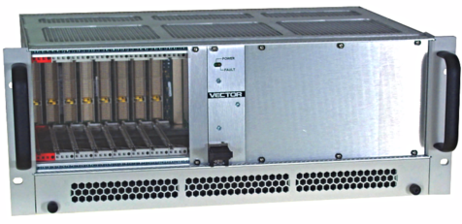
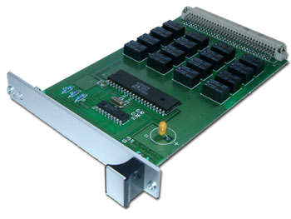
Draft Render and Similar Products
Touch Screen
Backplane & Daughtercards
Cooling Fan
Power Supply

Slide 5

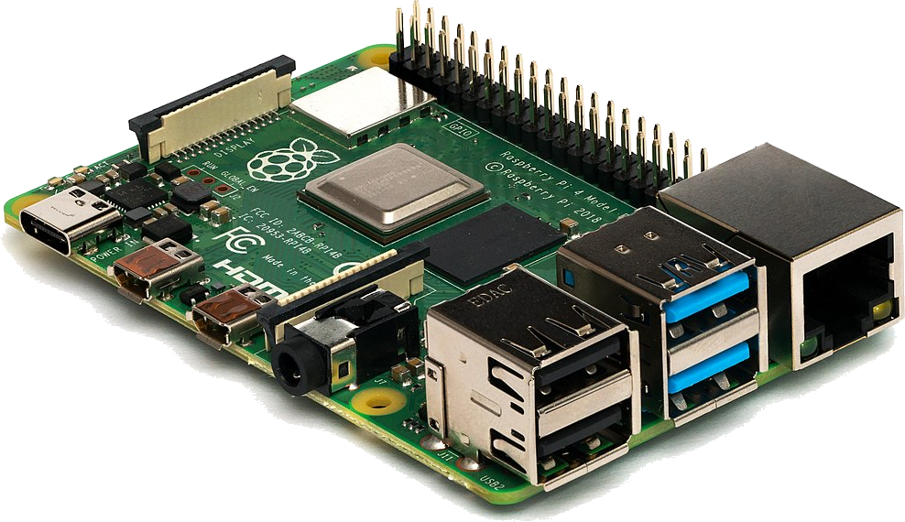

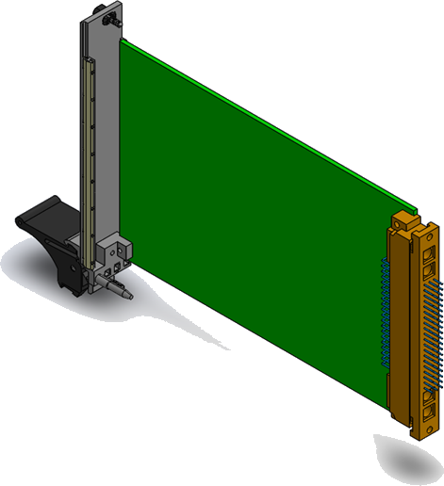

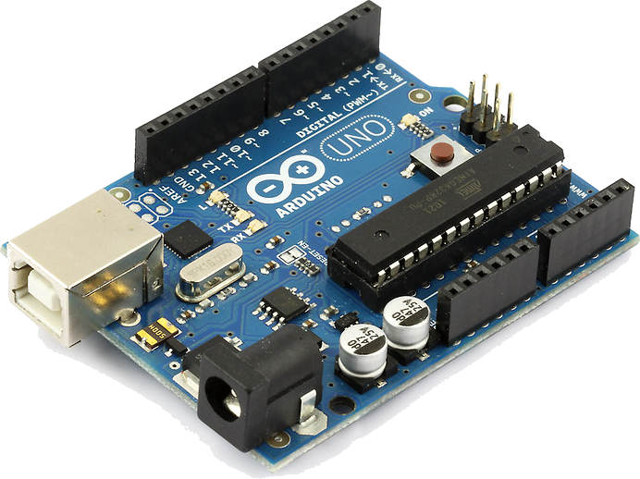
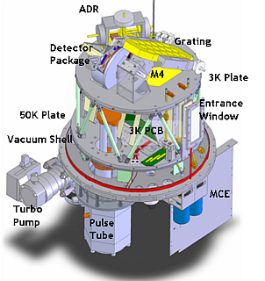

Touchscreen
Raspberry Pi
Communication Example
-200°C
Cooler Controller
ZEUS2
Arduino
Temperature Sensor

Slide 6
General:
Facilitate Communication Between Modular Cards
Monitor Motherboard Temperature
Log Data
Manage Touch Screen
Control Debug Display
ZEUS2:
Read Temperatures From ZEUS2
Control and Power Pulse-Tube Cryogenic Cooler
OS Goals

Slide 7
I2C (x2)
Parallel SPI (x5)
6 On-board Temperature Sensors
Touchscreen
USB Ports
10 Card Slots
9 4-pin IO per Card Slot
Arduino, Raspberry Pi
At Least One Processor per Card
2 Interrupts per Card
Hardware Features

Slide 8
Subsystems
Board Environmentals
Measure Temp.
Power-down if unsafe
Request Logging
Card Process
Specific To Each Card
Parallel Comm.
Card Communication
Card Polling
Interrupt Routines
Message
Processing/Forwarding
Card Detection
Debug Display
Cycle Error Display
Data Logging
Receive/Acknowledge
Requests
Log Data To USB
Touchscreen Display
Display Card Info
User-Card Interaction
Request Logging
IO Processing
Poll Inputs
Update Outputs

Slide 9
Subsystem Distribution
Raspberry Pi
Touchscreen Display
Debug Display
Data Logging
Arduino
Board Environmentals
Card Communication
Cards
Card Process
Card Communication
IO Processing

Slide 10
I2C → Arduino Master, Card Slaves
  Polling/Acknowledgments Required
Round Robin
Simple
Risks over delayed messages
Interrupt Signaling
No Overhead
Increased Complexity
Requires Hardware Support
Round Robin With Interrupts
Maintains Simplicity
Decreases the risk of late messages
Card/Board
Comm.
Scheduling

Slide 11
Rule #1: “An interrupt routine must not call any RTOS function that might block the caller”
If ISR is blocked, Parent process will also be blocked
Often stops hardware from processing additional interrupts
Rule #2: “An interrupt routine may not call any RTOS function that might cause the RTOS to switch tasks unless the RTOS knows that the interrupt routine, and not a task, is executing”
Any event that ends the waiting of another process risks that processing taking control (i.e. releasing a semaphore, writing to shared queue, etc.)
Interrupt (Service) Routine Rules

Slide 12
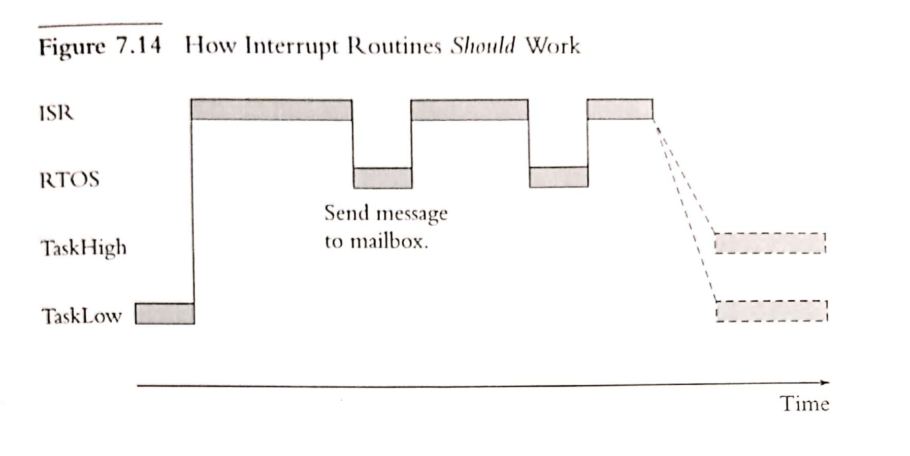
Interrupt (Service) Routine Rules

Slide 13
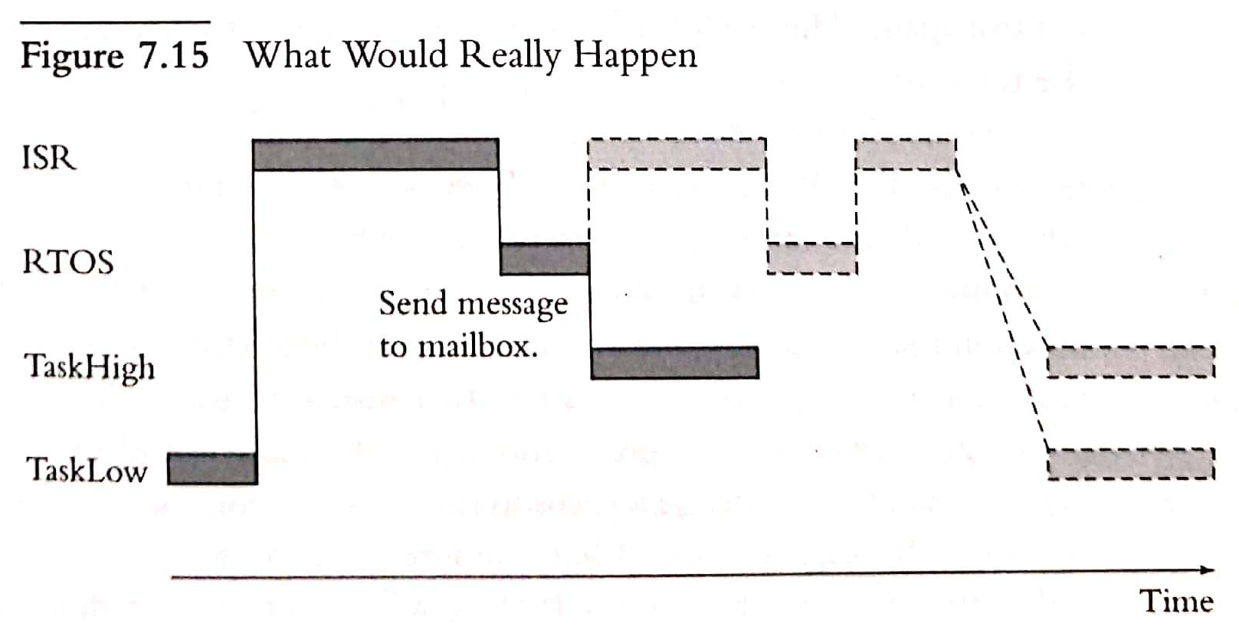
Subsystem Distribution

Slide 14
Interrupt Implementation
“Hard” Interrupt
“Soft” Interrupt
Process Control Block is stored for later
Interrupt Routine is processed
Process Control Block is restored
Requires Hardware Support
    within Arduino
Has Library Support
I2C Interruption can be tricky to
    recover from
Interrupt Lines Are Polled Frequently
    Increasing Overhead
Active Interrupt Lines Signal A High
    Priority Message To Be Read
No Process Control Block Storage
    Necessary
Very Simple to Recover From
No Direct Hardware Support In
    Arduino
Requires
Hardware
Connection
Between
Cards &
Arduino

Slide 15
  Check Card A For Message
  If No Message Queued, go to step 2f
  If Message is Queued, Read Message
    Send Message Acknowledgment to Card A
    Read Message Block From Card A
    Repeat Until Full Message Is Read
  Acknowledge Full Message Received
      From Card A
  Process Message
  Repeat With Next Card Until All Cards Have Been Polled
If an interrupt is triggered at any point, the ISR will process the given message and return to interruption point
Comm.
Polling
Sequence
(“Hard”)

Slide 16
  Check Card A For Message
  If No Message Queued, go to step 2f
  If Message is Queued, Read Message
    Send Message Acknowledgment to Card A
    Read Message Block From Card A
    Repeat Until Full Message Is Read
  Acknowledge Full Message Received
      From Card A
  Process Message
  Query Each Interrupt Line (OVERHEAD)
    If Interrupt Line is true, do steps 1a-1e processing the source of the interrupt
    Return here afterwards
  Repeat With Next Card Until All Cards Have Been Polled
Comm.
Polling
Sequence
(“Soft”)

Slide 17
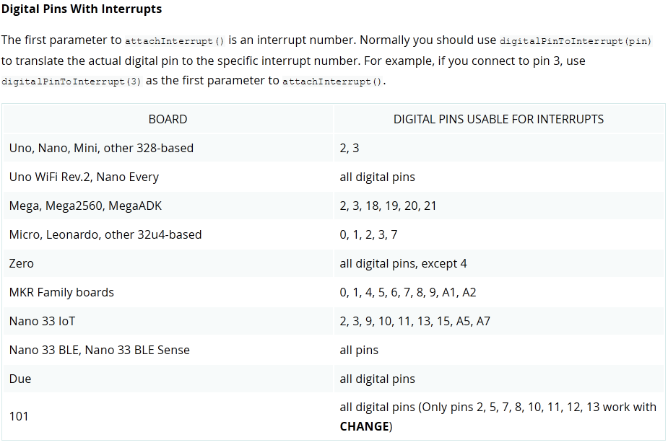
Subsystem Distribution

Slide 18
Multiplicity Is Hardware Based
There are multiple processes, but each one has its own processor
No inherently shared memory
  Any Shared Data Must Be Communicated Across The Motherboard
  Very High Overhead
Share Memory Not Required On Motherboard
ZEUS2 Implementation
No Shared Data Required
All Data Can Only Be “Reported” – Single Source
Card Specific If Necessary – SPI Strongly Recommended
Shared
Memory

Slide 19
Strengths
Simple
Modular
Versatile Scalability
Weaknesses
I2C Bottleneck Potential
Unpredictable Cards
Very Difficult to Debug
Potential Avalanche Crashing
Analysis

Slide 20
https://github.com/AdamStammerWSU/h.aHKbox
http://hosting.astro.cornell.edu/~spifiweb/zeus2/index.html
An Embedded Software Primer by David E. Simon
Dr. Carl Ferkinhoff
Sources

Slide 21
Questions?

