Slide 1
Using a SPARQL endpoint
Steve Baskauf 2017-03-20

Slide 2
apulianscene:Adornment
a skos:Concept
skos:prefLabel “ADORNMENT"@en
skos:broader
apulianscene:AdornmentEros
a skos:Concept
skos:prefLabel "ADORNMENT (EROS)"@en
skos:broader
_:bnode2
apulianscene:AdornmentDionysiac
a crm:E38_Image
dcterms:subject
a skos:Concept
skos:prefLabel "ADORNMENT (DIONYSIAC)"@en

Slide 3
Things we would like to enable a "machine" to do with Linked Data
Acquire data from other sources, possibly by following links.
Merge those data with our data
"Learn" things that weren't apparent before the data were merged.
Expose our data in a way that would allow others to use it.
The first three items are what we do with a Web browser and our brains via documents and the World Wide Web. In this group, we want to figure out how to do the same thing automatically with software.

Slide 4
ex:Lingyansi
rdfs:label "灵岩寺"@zh-Hans;
dcterms:temporal _:2 ;
a geo:SpatialThing.
_:2 rdf:value "Tang Dynasty to Ching Dynasty"@en;
a dcterms:PeriodOfTime.
text document (serialized as RDF/Turtle)
loading process
http://example.org/Lingyansi
"Tang to Qing"@en
a geo:SpatialThing
rdfs:label
rdf:value
"灵岩寺"@zh-Hans
dcterms:temporal
_:edbde6f9-62f0-4922-a1f3-e4bfa379303d
a dcterms:PeriodOfTime
triple store (graph database)

Slide 5
Query:
SELECT ?place WHERE {
?place a geo:SpatialThing.
}
Response:
?place http://example.org/Lingyansi
GUI query interface (SPARQL)
querying process
"API"
"endpoint"
triple store (graph database)
http://example.org/Lingyansi
"Tang to Qing"@en
a geo:SpatialThing
rdfs:label
rdf:value
"灵岩寺"@zh-Hans
dcterms:temporal
_:edbde6f9-62f0-4922-a1f3-e4bfa379303d
a dcterms:PeriodOfTime
Application (Callimachus/Blazegraph)

Slide 6


HTTP protocol Hypertext Transfer Protocol (HTTP), used to carry out an interaction across the Internet. mediated by. Retrieving information using HTTP GET is called "dereferencing a URI". (People also say "resolving" a URI.)
HTTP GET http://dbpedia.org/resource/Bonobo
Accept: text/html
asking for a web page
Image from Clipart Panda
Client software
(a.k.a. the "machine")
In this case, the client is a web browser. It displays the returned body as a web page.
Image from Clipart Kid
HTTP Status: 200 OK
Body:
<?xml version="1.0" encoding="UTF-8" ?><!DOCTYPE html PUBLIC "-//W3C//DTD XHTML+RDFa 1.0//EN" "http://www.w3.org/MarkUp/DTD/xhtml-rdfa-1.dtd"><html xmlns="http://www.w3.org/1999/xhtml" xmlns:dbpprop="http://dbpedia.org/property/"
…
Web server

Slide 7
How can we see what's going on when a client interacts with a server?
A user-friendly option is client called Postman, a Chrome extension (google "postman plugin"). Another is Advanced REST client (PC only)
Postman carries out the entire dialog without interaction, Advanced REST client carries out each step one at a time.
HTTP GET http://dbpedia.org/resource/Bonobo
Accept: text/html or text/turtle
HTTP GET http://rdf.library.vanderbilt.edu/sparql?query=SELECT+%3Fplace+WHERE+%7B%0D%0A++++%3Fplace+a+geo%3ASpatialThing.%0D%0A+++++%7D%0D%0A
Accept: application/sparql-results+xml

Slide 8
querying process (via HTTP)
Remote client
GET http://rdf.library.vanderbilt.edu/sparql?query=SELECT+%3Fplace+WHERE+%7B%0D%0A++++%3Fplace+a+geo%3ASpatialThing.%0D%0A+++++%7D%0D%0A
ACCEPT: application/sparql-results+xml
<?xml version='1.0' encoding='UTF-8'?>
<sparql xmlns='http://www.w3.org/2005/sparql-results#'>
<head>
<variable name='place'/>
</head>
<results>
<result>
<binding name='place'>
<uri>http://lod.vanderbilt.edu/historyart/site/Anchansi</uri>
</binding>
</result>
…
Image from Clipart Panda
"API"
"endpoint"
triple store (graph database)
http://rdf.library.vanderbilt.edu/sparql
http://example.org/Lingyansi
"Tang to Qing"@en
a geo:SpatialThing
rdfs:label
rdf:value
"灵岩寺"@zh-Hans
dcterms:temporal
_:edbde6f9-62f0-4922-a1f3-e4bfa379303d
a dcterms:PeriodOfTime
Server application (Callimachus/Blazegraph)

Slide 9
Graph for Veronica's vase data
vase
side A
side B
a scene
a scene
possibly
another scene

Slide 10
http://lod.vanderbilt.edu/vase/08-6q
a dcterms:PhysicalResource
crm:P59_has_section
_:bnode1
a crm:E46_Section_Definition
geo:location
Controlled vocabulary for scene description
_:bnode2
a crm:E38_Image
dcterms:subject

Slide 11
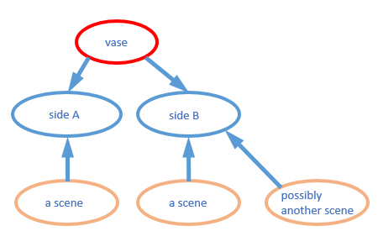
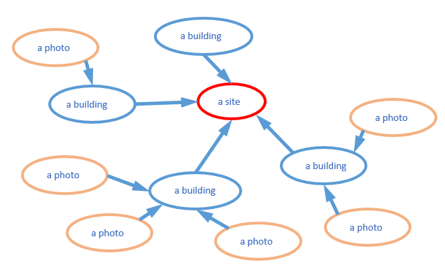
http://lod.vanderbilt.edu/apulian
http://lod.vanderbilt.edu/temple
Named graphs in the graph database (triple store)

